Slide 1
Guidelines and Best Practices for Micro-, Small and Medium Enterprises in Delivering Energy-Efficient Products and in Providing Renewable Energy Equipment - Armenia
Key findings and recommendations
Suren Shatvoryan

Slide 2
Objectives of the Study
UNDA - UNECE project “Global Initiative towards post-Covid-19 resurgence of the MSME sector.”
UNECE is developing Guidelines and Best Practices for MSMEs in delivering energy efficient products and in providing renewable energy equipment - “Clean Energy MSMEs” - after the COVID-19 crisis.
The overall goal: to strengthen the capacity and resilience of MSMEs to mitigate the economic and social impact of the global Covid-19 crisis

Slide 3
Objectives of the Study
Analysis of the business environment and challenges for MSME during the Covid-19 outbreak
Measures to restore business confidence of MSMEs
Best practices and recommendations for MSMEs in delivering energy efficient products and in providing renewable energy equipment
Recommendations to the Government of Armenia on creating an enabling environment for MSMEs to promote an economic recovery consistent with sustainable development goals

Slide 4
General impact of COVID-19 crisis
Gross Domestic Product (GDP) by years 2020-2021
 | January - September 2020 relative to January-September 2019, % | January - September 2021 relative to January-September 2020, %
Economic activity index | 93.4 | 104.4
Industry | 101.0 | 100.7
Agriculture | 100.5 | 98.5
Construction | 84.3 | 106.4
Trade turnover | 88.6 | 106.4
Services (without trade) | 88.3 | 105.4

Slide 5
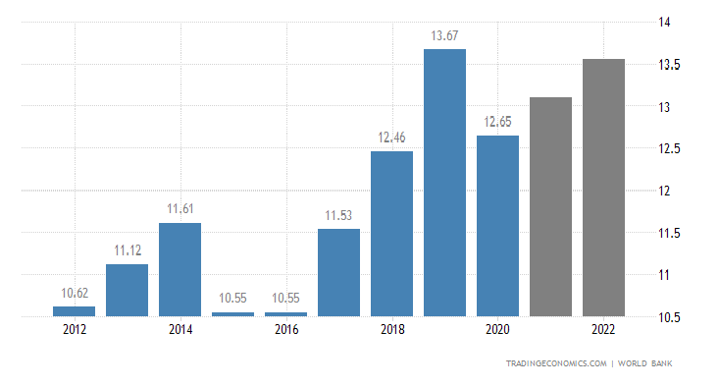
General impact of COVID-19 crisis
Gross Domestic Product (GDP) by years 2010-2021

Slide 6
Objectives of the Study
The effects of the global economic slowdown are reflected on the Armenian exports and tourism:
Brandy -18.8 %
Iron smelting -28.4 %
Diamond stone -53.1 %
Tobacco -9.6 %
Jewelry -52.4 %
Tourism -63.0 %

Slide 7
General impact of COVID-19 crisis on the Economy
General impact of COVID-19 crisis

Slide 8
General impact of COVID-19 crisis on the Economy
MSME labor turnover in 2017 – 2020 (employees)
MSME Labor Turnover in absolute figures and growth percentage, 2017 – 2020
Year | Total | Micro | Small | Medium | %
2020 | 232955 | 90917 | 72002 | 70036 | - 6.1
2019 | 248069 | 95929 | 79808 | 72332 | 16.5
2018 | 212963 | 82586 | 69328 | 61049 | 26.6
2017 | 168187 | 61000 | 57261 | 49926 | 21.0
General impact of COVID-19 crisis

Slide 9
Electricity Consumption in 2020 compared to 2019 increased in industry by 6.2 %; transport by 6.6 %; households by 5.9 %; agriculture 217.1 %; decreased in services and other sectors by 10.4 %. Electricity Generation in 2020 compared to 2019 by autonomous and utility-scale Solar PV increased from 1.9 % in 2019 to 2.7 % in 2020 Generation by autonomous Solar PV increased by 2.4 times
Energy Sector
General impact of COVID-19 crisis

Slide 10
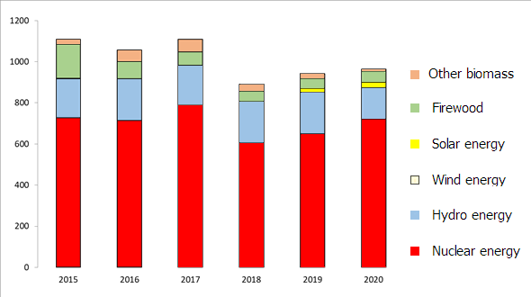
Energy Sector
Electricity Generation by source types
General impact of COVID-19 crisis

Slide 11
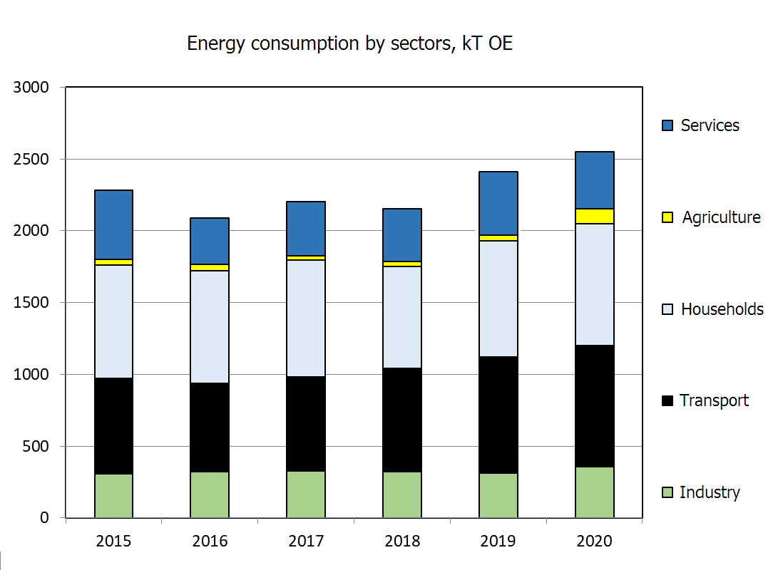
Energy Sector
General impact of COVID-19 crisis

Slide 12
Energy Sector
National Energy Efficiency Targets
Sector | Final Energy Consumption [ktoe]
 | 2019* | 2030
Industry | 313 | 443
Transport | 807 | 1,305
Household | 813 | 1,260
Service | 451 | 523
Agriculture | 29.8 | 189
Non energy use | 46.2 | 114
Total | 2,460 | 3,834
^{*)} The data are used from the Ministry of Territorial Administration and Infrastructure. Energy Balance of RA 2019: www.mtad.am/en/mtad04.02.04/
General impact of COVID-19 crisis

Slide 13
MSME Definition in Armenia
 | Number of employees | Revenue from the previous year’s activity | or the assets’ book value as of the previous year-end
SUPER SMALL (“MICRO”) | 0 - 9 | < 100 million AMD | < 100 million AMD
SMALL | 10 – 49 | < 500 million AMD | < 500 million AMD
MEDIUM | 50 - 249 | < 1.5 billion AMD | < 1.0 billion AMD
MSMEs in Armenian economy

Slide 14
The share of MSMEs in Armenian Economy
MSMEs accounted for 99 % of active enterprises, with micro enterprises representing the largest segment (49.9 % of total MSMEs)
MSMEs accounted for
66 % of total employment
62 % of total turnover and
60 % of total value added generated by the enterprise sector in 2019
MSMEs in Armenian economy

Slide 15
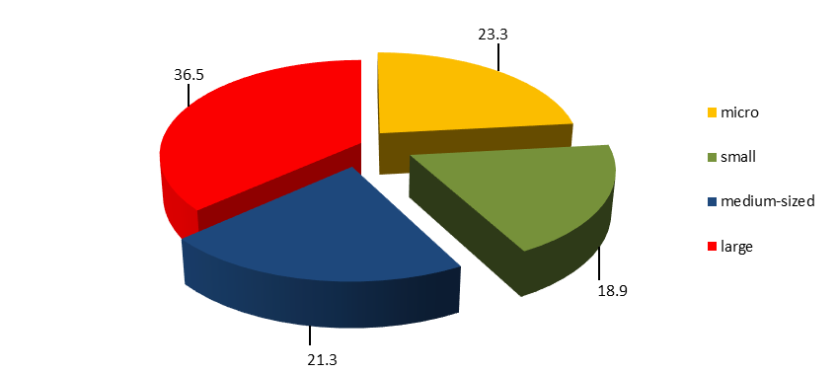
Structure of gross value added by size of economic entities, 2020, %
MSMEs in Armenian economy

Slide 16
MSME Turnover
MSMEs in Armenian economy

Slide 17
MSME Turnover
MSMEs in Armenian economy

Slide 18
Government Support Strategy
Comprehensive Measures to Counter Coronavirus Effects
March 26, 2020
Announced and implemented 24 measures to neutralize the economic consequences of Coronavirus: Decision No: 354-L on the “Approval of Comprehensive Measures Plan to Counter Coronavirus Effects”
Government Anti-Crisis Strategy

Slide 19
Government Support Strategy
Comprehensive Measures Plan to Counter Coronavirus Impact
Tax payment relief and customs duties; Subsidized loans - co-financing of interest rates on bank loans;
Refinancing and subsidized loans to cover running expenses; One-time grants and lump-sum allowances for employees and sole proprietors engaged in highly affected sectors of manufacturing, accommodation and catering; transportation and storage; tourism services, other customer services;
Subsidies as family allowance for utility expenses for February, 2020; tuition fee for graduate, postgraduate (clinical residency) students of the 2019-2020 academic year; allowance in amount of one month minimum wage in the specified MSME business (hospitality, tourism, entertainment and leisure, pre-school education, culture, music, sports, dance; rental cars etc.).
Government Anti-Crisis Strategy

Slide 20
Government Support Strategy
Comprehensive Measures Plan to Counter Coronavirus Effects
The entrepreneurship-focused programs pursue providing access to financial resources, to stimulate the businesses activities of MSMEs, to ensure the advanced development of high-tech businesses, to promote the implementation of competitive programs and entrepreneurial ideas to create a business from scratch.
Support for competitive business ideas, (19th measure) the entrepreneurial ideas to start a business from scratch; Promotion of innovative business in the form of interest-free loans (75 %) with a maturity of 8 years and 25 % as grants.
The measures 5, 18, 21 specifically target effective job support for resident industrial companies. The salaries and taxes payment (1st measure);
Loans for purchase or import raw materials; devices and equipment;
The 3rd measure is to pay salaries of the staff; state or community taxes, duties; purchase and import of raw materials; utility payments (electricity, water, heating, communication) for a maximum of three months; rents) to support MSMEs.
Government Anti-Crisis Strategy

Slide 21
Monetary and fiscal policies in response to COVID-19
Tax Relief - June 16, 2020
Corporate advance tax payment relief provides for an exemption from advance payments for the second quarter of 2020. Further, from the third quarter of 2020 the advance payment amount applies automatically, either 20 % of the corporate tax for the previous year or 2% of revenue from the results of the previous quarter
The tax penalty for late payment for each day of delay has been reduced to 0.04 % instead 0.075 %, and is also effective retroactively
The taxpayer's property liabilities amount of unfulfilled tax has been set at AMD 1.5 million instead of AMD 500,000
The minimum period of amortization of fixed assets from 1 July to 31 December 2020 has been set at the discretion of the taxpayer, but not less than one year
Government Anti-Crisis Strategy

Slide 22
Monetary and fiscal policies in response to COVID-19
Central Bank actions
The refinancing rate reduced to 4.25 %
The deadlines for submitting reports of financial institutions to the Central Bank extended
Contractual terms for borrowers particularly affected by COVID-19 renegotiated
Banks have been instructed not to confiscate from those borrowers through whose accounts assistance was provided to individuals within the framework of the Government support measures and other social assistance; take steps to avoid commissions from social assistance
Government Anti-Crisis Strategy

Slide 23
Government Support Measures
Enterprise support
Subsidized loans - co-financing of interest rates on bank loans taken out by the enterprises; refinancing and subsidized loans to cover running expenses
Subsidized loans for MSMEs employing 2-50 persons - one-time grant to the beneficiaries
Support for high-tech companies (17th measure)- Competitive one-time grant awarded through a tender procedure
Support for employees and sole proprietors - Lump-sum allowances for employees and sole proprietors in highly affected sectors (except retail for food, tobacco, drugs, or alcohol)
One-time Grants for MSMEs with 2-100 employees – which retain the income fund during February 1 to April 30, 2020. Some sectoral limitations apply
Government Anti-Crisis Strategy

Slide 24
Government Support Measures
Access to Finance
Armenian National Interests Fund (Հայաստանի Պետական Հետաքրքրությունների Ֆոնդ) is a state-owned enterprise aimed at supporting investments and partnering investment projects in industry, energy, agriculture, tourism, healthcare, high tech
ANIF invested about 4 million USD in the EU-Armenia SME Fund to provide equity finance to MSMEs to support business expansion
Dutch entrepreneurial development bank FMO investment of about 7 USD
The committed capital of the Fund reached the target of USD 50 million
Government Anti-Crisis Strategy

Slide 25
Government Support Measures
Access to Finance
EBRD, IFC, ADB, KfW, USAID, EU (EAP), UNDP, Green Economy Financing Facility (GEFF), Green Climate Fund (GCF), Climate Investment Funds (CIF) are key international partners in funding under various climate change, technical assistance, other regional and bilateral development programs
Government Anti-Crisis Strategy

Slide 26
Government Support Measures
Access to Finance
On February 20, 2020 Armenia’s government endorsed financial agreements with the EU totaling €65 million to create tools for the implementation of the Comprehensive and Enhanced Partnership Agreement and the “Financing Agreement between the Government of the Republic of Armenia and the European Commission for Energy Efficiency and the Environment” to support energy efficiency and environmental initiatives in Armenia.
The measures are envisaged to increase energy efficiency in existing buildings (e.g. multi-residential and low-income households), provide technical support for achieving the required energy efficiency standards.
Government Anti-Crisis Strategy

Slide 27
Government Support Measures
Access to Finance
EBRD - the leading institutional investor in Armenia
Invested more than €1.51 billion in 189 projects in the country’s financial, corporate, infrastructure and energy sectors, with 88 % of those investments in the private sector
Key strategic priorities in Armenia include strengthening the capacity of MSMEs through direct and indirect financing; full range of advisory services for MSMEs
Support for the implementation of innovative climate technologies. regional development and inclusivity (e.g. Women in Business), targeted lending framework to invest in energy efficiency, green technologies in private sector in upgrading technologies to EU standards
Government Anti-Crisis Strategy

Slide 28
Government Support Measures
Access to Finance
Ameriabank - On 20 January 2022 signed loan agreement with the EBRD in total US$ 25 million from which up to USD 4 million under the GCF GEFF Regional Framework in Armenia with 75% out of EBRD resources and 25% - Green Climate Fund; up to US$ 10 million for on-lending under the “Women in Business (WiB) Programme in the Eastern Partnership countries”; a senior loan of up to USD 5 million under the SME Competitiveness Programme in Eastern Partnership ('EaP SMEC').
Under the EU4Business initiative, Ameriabank received US$ 5 million credit line to finance at least 70% of individual loans to investment in green technologies in line with the EBRD's Green Economy Transition (GET) approach. Borrowers are eligible to receive technical advice and incentive grants in the amount of EUR 523,000
Government Anti-Crisis Strategy

Slide 29
Government Support Measures
Access to Finance
EBRD
June, 2020 A 20 million USD loan agreement to ACBA-CREDIT AGRICOLE BANK to finance MSMEs affected by the coronavirus in Armenia.
The financial resources of the MSMEs affected by the Covid-19 pandemic will be provided both in AMD and USD
Government Anti-Crisis Strategy

Slide 30
Government Support Measures
Access to Finance
EBRD - EaP SMEC – SME Competitiveness Programme in Eastern Partnership countries
Established by the EBRD in cooperation with the EU to help finance investments in MSMEs to support sustainable investments in technologies, meeting best standards in the field of product quality, occupational health and safety, environmental protection, and promoting the use of green technologies, enhancing MSMEs' competitiveness
At least 70 % of all financed sub-loans are expected to be compliant with EBRD Green Economy Transition (GET) approach. Eligible sub-borrowers will receive technical assistance and grant support in the form of investment incentives upon the completion of their investment projects
Government Anti-Crisis Strategy

Slide 31
Government Support Measures
Access to Finance
EBRD - EaP SMEC – SME Competitiveness Programme in Eastern Partnership countries through Partner Financial Institutions
USD 5 million senior loan to InecoBank
EUR 5 million to Armeconombank
USD 4 million to ArmSwissBank
USD 5 million to ACBA bank
USD 6 million equivalent in AMD to Converse Bank
Government Anti-Crisis Strategy

Slide 32
Government Support Measures
Access to Finance
Asian Development Bank (ADB)
In the framework of ADB’s 2019–2023 strategic objectives, ADB supports renewable energy development aiming at maximum utilization of the available solar and wind potential, covering also “measures to make the internal energy market competitive and efficient to attract investments in greenfield power generation”
ADB supports MSMEs in delivering energy efficient products and supplying renewable energy equipment. Thanks to the implementation of the Country Partnership Strategy, it is expected to increase generating capacity from renewable energy sources (wind, solar energy) to 205.1 MW by 2024. (baseline 2018: 10.9 MW).
Government Anti-Crisis Strategy

Slide 33
Government Support Measures
Access to Finance
GCF GEFF Regional – GEFF Armenia
Green Climate Fund – Green Economy Financing Facility funds for on-lending to private sector sub-borrowers for investments into climate change mitigation and adaptation technologies and services in line with GCF GEFF Policy Statement
USD 4 million to ArmSwissBank
USD 5 million to ACBA Bank
USD 6 million to InecoBank
Government Anti-Crisis Strategy

Slide 34
Government Support Measures
Access to Finance
IFC – International Finance Corporation, member of the World Bank Group
Armenia has been cooperating with IFC for decades, in development programs, financing MSMEs, to promote accelerated market penetration of renewable energy, energy efficiency, and climate resilient technologies including solar PV, solar thermal, geothermal heat pumps and biogas technologies
$15 million loan to Evocabank
$15 million loan to Inecobank
focused on digital banking, to provide working capital and trade-related loans to MSMEs, particularly those operating in critical economic sectors, including health care, food production, packaging, e-commerce, and logistics
Government Anti-Crisis Strategy

Slide 35
Government Support Measures
Access to Finance
FMO risk sharing facility (Netherlands)
US$ 9.33 million to Ararat bank to support Covid-19 affected MSMEs
A MSME business loan portfolio of displaced people from conflicted areas currently living in Armenia to support their income generating business activities and to increase Araratbank’s risk appetite and incentivize to finance the underserved and marginalized communities in Armenia
Government Anti-Crisis Strategy

Slide 36
MSMEs in RE and EE market
Methodology
With the objective to evaluate the business environment of the MSMEs operating in the renewable energy and energy efficiency market, the information from various sources, such as official statistics, research results from various local and international organizations and experts, as well as the results of the survey have been collected and analyzed.
ANALYSIS OF THE BUSINESS ENVIRONMENT

Slide 37
MSMEs in RE and EE market
Survey
About 60 companies were offered to take part in the survey, from which only 24 qualified responses were received, which were taken as the basis for establishing links between the consequences of the crisis and various aspects of MSME activity
Following the health safety rules, e-mail communication was used to conduct the survey. Some respondents were interviewed by telephone in addition
The answers were processed, analyzed and results made usable to summarizing, conclusions and recommendations
ANALYSIS OF THE BUSINESS ENVIRONMENT

Slide 38
MSMEs in RE and EE market
Profile of Respondents
The pool of 24 represents about 20% of the MSMEs registered their activities in the fields of EE and RE. The 24 respondents collectively account for about 40% of sales in the booming solar PV and solar thermal technology market.
The respondents represent the most active market players who were interested in honestly communicating their concerns and needs regarding the situation caused by the COVID-19 pandemic. Thus, we assume that the information collected from the responses of the surveyed group is trustworthy and relevant, and therefore good for analysis and some generalizations and conclusions about the situation in this research focus field among MSMEs
ANALYSIS OF THE BUSINESS ENVIRONMENT

Slide 39
MSMEs in RE and EE market
Profile of Respondents
From the survey pooling table of 60 MSMEs 24 qualified responses were received. The respondents activity cover solar PV and solar thermal facilities design, construction, installation, manufacturing, service; whole sale and retail supply, manufacturing of thermal and hydro insulation materials and energy efficiency equipment; energy efficient construction and renovation materials and goods; supply and importation of equipment and devices for biogas stations, heat pumps, electric cars; residential and industrial energy efficient HVAC systems, passive solar and nZEB equipment and materials; manufacturing and supply of energy efficient doors and windows; urban and residential energy efficient lighting
ANALYSIS OF THE BUSINESS ENVIRONMENT

Slide 40
MSMEs in RE and EE market
Survey
The survey questionnaire is split into four sections.
Section I (questions 1 to 6) identifies the size of the company, links of the sickness rate to the company financial turnover before and after (during) the Covid-19 outbreak; coverage of the respondents by the Government job support programs
Section II (questions 7 to 18) seeks to explore the response of corporate strategy to the impact of COVID-19 on business
Section III (questions 19 to 28) identifies the business survival rate among respondents faced with severe anti-epidemic restrictions
Section IV (questions 19 to 28) seeks to reflect the degree of satisfaction of respondents with the government's anti-crisis policy and their views on how to further combat the impact of the pandemic on business
ANALYSIS OF THE BUSINESS ENVIRONMENT

Slide 41
MSMEs in RE and EE market
Number of employees
before Feb. 2020 and after to pres.
Response rate: 100 %
The total number of employees after February 2020 increased by 120% (from 241 to 529) so it can be concluded that the Covid-19 epidemic in Armenia has not led to a dramatic shortage of labor in MSMEs in the RE and EE market
ANALYSIS OF THE BUSINESS ENVIRONMENT

Slide 42
MSMEs in RE and EE market
Number of employees
before Feb. 2020 and after to present
Only 12 % of respondents have reduces the employee number
ANALYSIS OF THE BUSINESS ENVIRONMENT

Slide 43
MSMEs in RE and EE market
Annual turnover dynamics
(before and after Feb. 2020)
Response rate: 75 %
The average growth in turnover amounted to 91 %
A negative dynamics of annual turnover reported 17 % of respondents (4 out of 24). The decline on average -28 %
The 18 respondents who reported growth had an average increase of 293 %
55 % of respondents had turnover increased by an average of 183 % in comparison with the previous year
ANALYSIS OF THE BUSINESS ENVIRONMENT

Slide 44
MSMEs in RE and EE market
Employees on sick leave due to COVID-19
(before and after Feb. 2020)
Response rate: 100 %
The ratio of the number of employees on sick leave due to Covid-19 to the total number of employees (25 out of 241) before and (65 out of 529) after February 2020 is 10.37 % and 12.38 %, respectively
After February 2020 the relative increase in sick leave is 2 % (to the total number of employees)
ANALYSIS OF THE BUSINESS ENVIRONMENT

Slide 45
MSMEs in RE and EE market
Number of days on sick leave due to health problems
(before and after Feb. 2020 to present)
Response rate: 100 %
Number of days on sick leave due to health problems after February 2020 (1167) increased by 256 %.
ANALYSIS OF THE BUSINESS ENVIRONMENT

Slide 46
MSMEs in RE and EE market
Total number of monthly compensations paid to the employees under government support programs for mitigation of the COVID-19 impact
Response rate: 100 %
62.5 % of the respondents by various reasons did not receive financial compensations
ANALYSIS OF THE BUSINESS ENVIRONMENT

Slide 47
MSMEs in RE and EE market
The number of employees vaccinated against Covid-19
Response rate: 100 %
303 out of 529 employees in 24 respondents are received at least the first shot of a vaccine which is 57 % at the time of receiving the last completed questionnaire.
A higher vaccination rate is factor in a lower number of sick leaves
The vaccination rate is higher in the respondent MSMEs than in the country in general
ANALYSIS OF THE BUSINESS ENVIRONMENT

Slide 48
MSMEs in RE and EE market
The number of employees vaccinated against Covid-19
A higher vaccination rate resulted in a lower number of sick leaves. However, since the vaccination itself very often results in the employee sick leave, this should not be taken as a linear factor, albeit for a shorter period of time
ANALYSIS OF THE BUSINESS ENVIRONMENT

Slide 49
MSMEs in RE and EE market
MSME human resources and corporate strategy responses under the impact of COVID-19
ANALYSIS OF THE BUSINESS ENVIRONMENT

Slide 50
MSMEs in RE and EE market
MSME human resources and corporate strategy responses under the impact of COVID-19
ANALYSIS OF THE BUSINESS ENVIRONMENT

Slide 51
MSMEs in RE and EE market
The business survival rate in respondents faced with severe anti-epidemic restrictions
Sales increased or remained unchanged for 62 % of respondents, while decrease reported 38 %
The competitiveness increased or remained unchanged for the 79% of the respondents, while decrease reported for 21 %.
While the production process has changed significantly for 21% of respondents, 79% of respondents say it has changed or not changed at all.
No suspension of payment of wages was reported; only 8% reported a wage cut.
The property unchanged or has increased in 88% (21 out of 24) of respondents; 8% (2 out of 24) reported a decrease; 4 % of respondents completely lost their property (1 out of 24)
ANALYSIS OF THE BUSINESS ENVIRONMENT

Slide 52
MSMEs in RE and EE market
The business survival rate in respondents faced with severe anti-epidemic restrictions
Liabilities to banks are unchanged for 50 % of the respondents; increased for the other 50 % (12)
Financial assistance/subsidies from the Government programs received only 50 %, of which 4 respondents rated the assistance useful, and 9 - partially useful
Nobody halted sales in the country. sales declined significantly for 50 %, for the other 50 % it increased or remained unchanged
Exports increased or remained unchanged for 63% (15 out of 24); suspension reported 33% (8 out of 24); 1 reported a significant decrease
Imports increased or remained unchanged for 58% (14 out of 24); for 10 – significantly reduced
ANALYSIS OF THE BUSINESS ENVIRONMENT

Slide 53
MSMEs in RE and EE market
What would you recommend the government to help businesses?
Response rate: 71 %
Fiscal policy
Subsidize loans for businesses to reduce the interest rate to 0% - 3%; deferred payment of the principal debt
Tax breaks, tax holidays, tax deferrals
Reduce leasing rates
Deferral of payment of VAT and customs duties for one year when importing goods related to RES and EE
Establish consumer benefit programs (incentives) to encourage greater use of renewable energy
ANALYSIS OF THE BUSINESS ENVIRONMENT

Slide 54
MSMEs in RE and EE market
What would you recommend the government to help businesses?
Response rate: 71 %
Legislation
Fill the existing gap in national legislation to halt the activities of unlicensed organizations
Improve the law on public procurement which currently does not meet the interests of business
ANALYSIS OF THE BUSINESS ENVIRONMENT

Slide 55
MSMEs in RE and EE market
What subsidy/assistance would you like to receive in addition to what the government offers?
Response rate: 67 %
Fiscal policy
Apply zero rates for income tax on energy-saving projects
Provide soft loans to encourage the use of alternative energy
Deferral customs duty payments on import, and/or postpone VAT payment
Tax benefits for those organizations that promote the reduction of greenhouse gases
More flexible banking products will be welcomed
Interest-free loans for importing equipment and materials for RE and EE production
ANALYSIS OF THE BUSINESS ENVIRONMENT

Slide 56
MSMEs in RE and EE market
What subsidy/assistance would you like to receive in addition to what government offers?
Response rate: 67 %
Legislation
For environmentally friendly technology implementation, establish open joint-stock companies with public-private participation
Subsidize installation of PV and solar thermal technologies for the population of non-gasified areas under targeted community benefit programs
ANALYSIS OF THE BUSINESS ENVIRONMENT

Slide 57
MSMEs in RE and EE market
How long will it take for your business to recover to its pre-Covid-19 state?
Response rate: 100 %
50 % (17 + 29 + 4 %) think that their business will return to pre-Covid-19 status in 1 or 2 years which is seen as an optimistic scenario
1 respondent thinks that it will take longer – 2 to 3 years
42 % found it difficult to answer – the most realistic respondents
 | Don't have a certain idea | Already restored | 1 year | 2 years | 1-2 years | 2-3 years
 | 42 % | 4 % | 17 % | 29 % | 4 % | 4 %
Responses | 10 | 1 | 4 | 7 | 1 | 1
ANALYSIS OF THE BUSINESS ENVIRONMENT

Slide 58
MSMEs in RE and EE market
Do you plan to change your business activity field?
Response rate: 100 %
One answer for all respondents: "No"
ANALYSIS OF THE BUSINESS ENVIRONMENT

Slide 59
MSMEs in RE and EE market
Are you going to establish backup resources (financial or physical)?
Response rate: 92 %
Backup resources (financial or physical) have been established by 4.5 % of the respondents and 82% are going to establish
 | Yes | Can’t say | Already created | Yes, once it becomes possible
% | 81.8 % | 9.1 % | 4.5 % | 4.5 %
Responses | 18 | 2 | 1 | 1
ANALYSIS OF THE BUSINESS ENVIRONMENT

Slide 60
MSMEs in RE and EE market
The types of subsidies used, their pros and cons
Response rate: 100 %
16 out of 24 (67 %) respondents did not take advantage of the subsidies
What Respondents think about the government assistance programs
Negative 5 and only one positive
The negative answers mention (a) too high interest rate of loans; (b) mandatory collateral; (c) slow clearance procedure; (d) various limitations (eligibility issues due to limitations); (e) the subsidy it too small
ANALYSIS OF THE BUSINESS ENVIRONMENT

Slide 61
MSMEs in RE and EE market
MAIN FINDINGS FROM THE SURVEY AND INTERVIEWS CONDUCTED AMONG THE MSMES
Human resources
In general for the MSMEs in delivering energy-efficient products and in providing renewable energy equipment employment has increased by 120 % which should be seen as a positive trend
Annual turnover trend
For the summary of turnover for all respondents, the average growth was 91 % during the Covid-19 outbreak which should be seen as a positive trend
ANALYSIS OF THE BUSINESS ENVIRONMENT

Slide 62
MSMEs in RE and EE market
MAIN FINDINGS FROM THE SURVEY AND INTERVIEWS CONDUCTED AMONG THE MSMES
Trends in sick leave due to COVID-19
The share of sick leaves relative to the total number of employees before (25 out of 241) and after February 2020 (65 out of 529) is 10.37 % and 12.38 % correspondingly
At first glance, this increase in sick leaves does not seem significant, however, the impact on industry performance should be taken as the benchmark (see Productivity).
ANALYSIS OF THE BUSINESS ENVIRONMENT

Slide 63
MSMEs in RE and EE market
MAIN FINDINGS FROM THE SURVEY AND INTERVIEWS CONDUCTED AMONG THE MSMES
Number of days on sick leave for health reasons
Absolute number of days on sick leave due to health reasons before February 2020 (328) and after February 2020 to the present (1167) increased by 256 %
ANALYSIS OF THE BUSINESS ENVIRONMENT

Slide 64
MSMEs in RE and EE market
MAIN FINDINGS FROM THE SURVEY AND INTERVIEWS CONDUCTED AMONG THE MSMES
Compensations paid under Government support programs to the employees for mitigation of the COVID-19 impact
Low coverage of 37.5 % of respondents received financial compensations (mix) paid to employees may be due to unawareness of the employees about the state support programs; support conditions (eligibility) not met; complications associated with application to the support programs; Lack of interest due to the small amount of financial assistance, etc.
ANALYSIS OF THE BUSINESS ENVIRONMENT

Slide 65
MSMEs in RE and EE market
MAIN FINDINGS FROM THE SURVEY AND INTERVIEWS CONDUCTED AMONG THE MSMES
Covid-19 vaccination rate
At the time of conducting the survey, the vaccination rate of respondents was much higher than the national average
In fact only three companies had the staff entirely vaccinated. The other 21 companies have only 56 % of vaccinated employees. For the total number of the respondents the average rate of vaccination was 65 %
ANALYSIS OF THE BUSINESS ENVIRONMENT

Slide 66
MSMEs in RE and EE market
MAIN FINDINGS FROM THE SURVEY AND INTERVIEWS CONDUCTED AMONG THE MSMES
Staff layoffs due to financial situation
12 % of respondents had lay-offs caused by Covid-19 pandemic financial situation. This is significantly lower rate than in other industries
ANALYSIS OF THE BUSINESS ENVIRONMENT

Slide 67
MSMEs in RE and EE market
MAIN FINDINGS FROM THE SURVEY AND INTERVIEWS CONDUCTED AMONG THE MSMES
Staff layoffs due to financial situation
12 % of respondents had lay-offs caused by Covid-19 pandemic financial situation. This is significantly lower rate than in other industries
Cases of quitting work due to health issues caused by Covid-19
17 % of respondents had employees who quit their job due to health problems caused by Covid-19
Compensations from the company and Employees on unpaid leave
58 % of respondents paid compensation from the company due to Covid-19, and no respondents had employees on unpaid leave
ANALYSIS OF THE BUSINESS ENVIRONMENT

Slide 68
MSMEs in RE and EE market
MAIN FINDINGS FROM THE SURVEY AND INTERVIEWS CONDUCTED AMONG THE MSMES
Increasing the company staff in the near future
It is remarkable fact that 19 out of 24 respondents are intended to increase the company staff in the near future. This indicates that companies are preparing for the growth of the RES and EE market in the country
ANALYSIS OF THE BUSINESS ENVIRONMENT

Slide 69
MSMEs in RE and EE market
MAIN FINDINGS FROM THE SURVEY AND INTERVIEWS CONDUCTED AMONG THE MSMES
Productivity, turnover and labor resources of the MSMEs RE and EE field before and after February 2020
ANALYSIS OF THE BUSINESS ENVIRONMENT

Slide 70
MSMEs in RE and EE market
MAIN FINDINGS FROM THE SURVEY AND INTERVIEWS CONDUCTED AMONG THE MSMES
Remote work
For MSMEs supplying EE products and RE equipment, the remote work allows a rather limited range of tasks, and therefore cannot be considered an effective solution to combat the impact of Covid-19 on the regular operation of enterprises
Due to possible slow adaptation to new working conditions and organizational difficulties, despite some reduction in overhead costs, remote work should be seen as a factor leading to a decrease in labor productivity
ANALYSIS OF THE BUSINESS ENVIRONMENT

Slide 71
MSMEs in RE and EE market
MAIN FINDINGS FROM THE SURVEY AND INTERVIEWS CONDUCTED AMONG THE MSMES
Special considerations for MSMEs owned and/or operated by women
Armenia has been adopted the "Women's Entrepreneurship Strategy in Armenia“ in 2013. However, there are no gender-disaggregated statistics conducted for MSMEs. According to the "Armenia. Country Gender Assessment Report” women represent about 30 % of owners of Micro-Enterprises
Some studies state that “Men are harder hit by the crisis than women in Armenia,” while the others claim the opposite: "female-led SMEs were seven percentage points more likely to close compared to male-led SMEs with some regional variations".
To alleviate challenges faced by women entrepreneurs, several financing programs have been introduced to the Armenian market, including those to be implemented as part of the MSME support measures to combat the impact of Covid-19 in Armenia
ANALYSIS OF THE BUSINESS ENVIRONMENT

Slide 72
MSMEs in RE and EE market
MAIN FINDINGS FROM THE SURVEY AND INTERVIEWS CONDUCTED AMONG THE MSMES
Special considerations for MSMEs owned and/or operated by women
Eastern Partnership Countries – Women in Business Programme (WiB) loan of up to US$ 2 million in local currency got Converse Bank for women-led MSMEs. The technical cooperation (TC) support is organized at the level of the Regional WiB TC Programme for Eastern Partnership countries and funded by SIDA – Swedish International Development Cooperation Agency (EUR 2.2 million)
Ameriabank will receive US$ 10 million under the Women in Business (WiB) programme
ADB and Armeconombank have signed a $15 million loan to support MSMEs with a specific focus on women-owned and operated businesses and areas outside the capital city of Yerevan, in dealing with the impact of the COVID-19 outbreak
ANALYSIS OF THE BUSINESS ENVIRONMENT

Slide 73
MSMEs in RE and EE market
Solar PV 4 MW plant in Aragatsotn Marz
Funded by EU-Armenia SME Fund managed by Amber Capital Armenia
Solis LLC (number of employees 1 – 10) will build and operate a 4 MW PV. The engineering and construction contract for the project in a competitive tender process awarded to a small enterprise Ecoville LLC (number of employees 1 - 10)
The facility will generate 7.5 GWh of clean energy per year, resulting in 3,200 tons of avoided CO2 emissions annually. Around 50 jobs in construction and operation
The funding amount has not been disclosed
BEST PRACTICES IN RESPONSE TO THE COVID-19 CRISIS AND POST-CRISIS RECOVERY

Slide 74
MSMEs in RE and EE market
Green refrigeration to save energy and water
Tamara Fruit (number of employees 50 – 249) is one of Armenia’s largest companies producing a wide range of natural juices, compotes, nectars, jams and the first in Armenia to produce deep-frozen fruit and vegetables, as well as organic food. In addition to domestic sales, the company’s products are exported to Russia, the USA, the UK, EU, Israel and UAE.
The company replaced old ammonia-based system with a modern, Freon gas-based refrigerator. The company received technical assessment from GEFF team at no charge. The investment of US$ 39,300 for a new refrigeration machine enables to save US$ 6,070 annually, - 84 MWh of electricity and 1,895 m3/year of water. CO2 savings - 37 tons per year.
The project funded by the Green Climate Fund (GCF) and the Climate Investment Funds
The project is nominated for the Energy Globe Awards 2022
BEST PRACTICES IN RESPONSE TO THE COVID-19 CRISIS AND POST-CRISIS RECOVERY

Slide 75
MSMEs in RE and EE market
Energy-efficient bottling equipment for wine producer
Kataro LLC (number of employees 10 – 49) is a winemaker of the Ararat region, annually produces and exports approximately 60,000 bottles of wine overseas. In order to expand its production, the winemaker invested in energy-efficient bottling equipment from Italy. The new unit will save in energy consumption 41 %.
The project was made accessible owing to the efforts of the PFI through GEFF (supported by the Green Climate Fund (GCF), in combination with the Program on “State assistance of leasing for financial lending of agri-food equipment in the Republic of Armenia”.
Total investment US$ 162,000, payback - 15 years. Yearly energy saving - 12 MWh. CO2 saving - 3 tons per year.
The project is nominated for the Energy Globe Awards 2022
BEST PRACTICES IN RESPONSE TO THE COVID-19 CRISIS AND POST-CRISIS RECOVERY

Slide 76
MSMEs in RE and EE market
А ground-based PV plant for gas station
Karen Ev Rafik LLC (number of employees 1 – 10), gas station operator invested in a ground-based PV plant in Artashat. It is an efficient combination of new customized technical solutions for existing business operations. The investment lead to a reduction in dependence on energy supply from external suppliers, as well as a significant reduction in energy and operating costs. The environmental friendliness of the investment also enhances the status of the company.
Reduction of CO2 - 381 t/year
BEST PRACTICES IN RESPONSE TO THE COVID-19 CRISIS AND POST-CRISIS RECOVERY

Slide 77
MSMEs in RE and EE market
A rooftop PV plant for clothing company
A clothing company Artik PHK LLC (number of employees 10 – 49, has a 70 % of women employees) is based in Shirak region which has abundant solar energy resources. The company has invested in a rooftop Solar PV installation to reduce its energy dependence on external sources and take an important step towards achieving sustainability.
The project financed by GEFF – GCF, implemented quickly and the investment is efficient in all aspects as it has zero emissions, requires minimal maintenance, helps to save the environment and slow down global warming.
BEST PRACTICES IN RESPONSE TO THE COVID-19 CRISIS AND POST-CRISIS RECOVERY

Slide 78
MSMEs in RE and EE market
Solar Village pilot project for a border settlement
The project initiated by Free Energy LLC (number of employees 10 – 49) and Armenian Relief and Development Association (ARDA) for the border community of Chin-chin in Tavush region. it is planned to provide the community of Chin-chin with 150 roof-top solar thermal and solar PV installations for residential, public and administrative buildings, and also street lighting and drinking water supply. In addition to all the positive aspects of energy conservation and preserving of forests from illegal logging, the project will create an opportunity for the development of the tourism industry, as the Tavush region is known for its charming forest-rich nature and ancient historical monuments and spectacular sites. The initiators seek for approval of the Government in order to further contact the EU and international donors to co-finance the project.
BEST PRACTICES IN RESPONSE TO THE COVID-19 CRISIS AND POST-CRISIS RECOVERY

Slide 79
MSMEs in RE and EE market
The Armenian government has launched 25 support measures to counter the COVID-19 with more than 200.0 billion AMD. Access to external funding has also been maintained. Armenia has received multimillion-dollar targeted programs to combat the impact of Covid-19 on MSME operations
In general, the Government policy mitigated the crisis state of the economy, as evidenced by the growth of credit investments of the banking system by 6.3 % in January-September 2020
However, the lending and subsidy conditions not fully correspond to the potential beneficiaries. As the main aspects the respondents stressed (a) too high interest rate on loans; (b) mandatory collateral; (c) slow clearance procedure; (d) eligibility limitations; (e) too small subsidy size. One of the likely reasons for this, perhaps, is the lack of eligible financial resources
FINDINGS – CONCLUSIONS - RECOMMENDATIONS

Slide 80
MSMEs in RE and EE market
Extend the availability and efficiency of the financial resources by introducing new adjusted rules and regulations for commercial banks, including business protection through a credit guarantee mechanism, tax incentives
Develop and operate an effective credit risk management system
Introduce credit investment insurance, provision of state guarantees for loan repayment (co-financing) for MSMEs in delivering EE products and in providing RE equipment
Encourage and subsidize investments in EE and RE products and services that will result in energy and cost savings in the long term
FINDINGS – CONCLUSIONS - RECOMMENDATIONS

Slide 81
MSMEs in RE and EE market
Lending on preferential terms to individuals and legal entities that have been loyal clients for 3-5 years
Establish close cooperation between banks and companies; participate in companies' capital, develop and implement of joint investment projects; provide technical consultancy services, etc.
Ensure employment by promoting remote work of RA citizens
FINDINGS – CONCLUSIONS - RECOMMENDATIONS

Slide 82
MSMEs in RE and EE market
Develop special programs dedicated to the MSMEs operating in the RE and EE market to provide access to grants, low interest loans and loan guarantees; information and markets; opportunities to address common problems with jointly developed strategies
The government should ensure that MSMEs and individual entrepreneurs are consulted and involved in government decision-making processes regarding the policy response to the pandemic and the development of recovery plans
FINDINGS – CONCLUSIONS - RECOMMENDATIONS

Slide 83
MSMEs in RE and EE market
Establish efficient two-way communication to monitor and evaluate the needs of businesses and to guiding MSMEs through available measures and solutions to overcome the influence of the pandemic
Increase the visibility and accessibility of the state support programs and services, international donors, private initiatives to address the specific challenges
FINDINGS – CONCLUSIONS - RECOMMENDATIONS

Slide 84
MSMEs in RE and EE market
Provide clear guidance to companies on how to access various financial instruments, who to contact with questions, who are the national authorities involved in the disbursement of funds, what is the role of commercial banks and what are their obligations, etc.
Expand the eligibility criteria for the government financial support to equally reach those who have lost their jobs and those on unpaid leave; should expand the eligibility criteria to cover self-employed; bring more clarity to the issue
Ensure policy support in simplifying access of MSME to effective digital systems while safeguarding accountability and effectiveness of use.
FINDINGS – CONCLUSIONS - RECOMMENDATIONS

Slide 85
MSMEs in RE and EE market
The government should review public procurement procedures and encourage the purchase of EE and RES products from local suppliers/producers
The government should help the green economy by financial support to MSMEs with grants, low-interest and interest-free loans
Financial assistance should be integrated with training, mentoring and networking support to ensure the most effective use of such assistance
FINDINGS – CONCLUSIONS - RECOMMENDATIONS

Slide 86
MSMEs in RE and EE market
The government should ensure the inclusivity of the support measures to reach vulnerable segments of SMEs, such as border and women entrepreneurs
The government should facilitate repurposing processes to run their course, supporting second-chance entrepreneurship and ensuring a just transition
The government should reconsider policy towards self-employed entrepreneurs and take action to improve the resilience of SMEs, start-ups, and scalable enterprises
FINDINGS – CONCLUSIONS - RECOMMENDATIONS

Slide 87
MSMEs in RE and EE market
Improving the competitiveness of MSMEs providing EE and RE products and services for their post-pandemic recovery
Strengthening the institutional framework for innovation and investment activities
FINDINGS – CONCLUSIONS - RECOMMENDATIONS

Slide 88
MSMEs in RE and EE market
Recommendations to MSMEs working in RE and EE field. Guidelines for MSME
Proactively use the opportunities for financing and technical assistance provided by local and international support programs
Increase visibility of the products and services for the clients and investors through social media, online-based platforms and databases
Launch online sales and marketing tools, explore the possibility of creating as many online services and operations as possible
FINDINGS – CONCLUSIONS - RECOMMENDATIONS

Slide 89
MSMEs in RE and EE market
Recommendations to MSMEs working in RE and EE field. Guidelines for MSMEs
Increase the variety of services and service packages, develop new products, add social components in the list of services; explore new markets
Master new knowledge-based technologies, know-how, methods, equipment
Develop and introduce proactive business strategies, short and medium-term growth goals
Develop corporate social policy, Support flexible working approaches for female employees; encourage and support work from home
FINDINGS – CONCLUSIONS - RECOMMENDATIONS

Slide 90
MSMEs in RE and EE market
Recommendations to MSMEs working in RE and EE field. Guidelines for MSMEs
Take part in online training programs, promote capacity building
Strengthen research and development (R&D) portfolio
Introduce corporate governance principles; Ensure transparency of companies' activities
Explore opportunities for new supply partners
Create your own financial and material security funds
FINDINGS – CONCLUSIONS - RECOMMENDATIONS

Slide 91
The End

