Slide 1
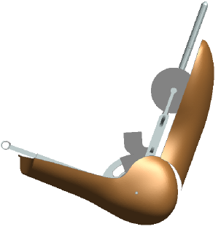
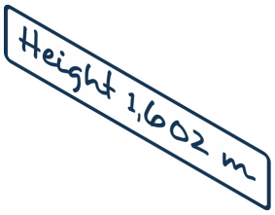
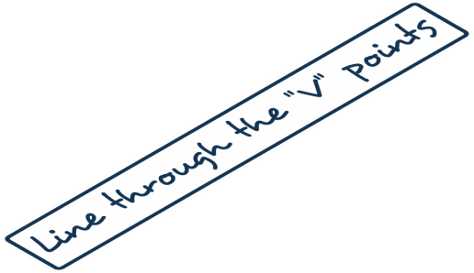
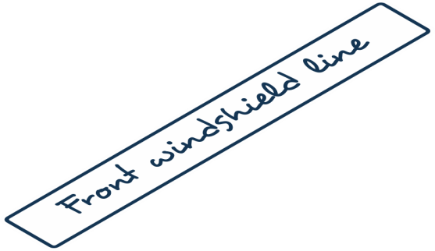
Submitted by the expert from Spain | Informal document GRSG-123-25 (123rd GRSG, 28 March – 1 April 2022 Agenda item 4 (f))

Slide 2
