Slide 1
Informal document GRVA-12-14/Rev.1
12th GRVA, 24-28 January 2022
Agenda item 5(c)
Submitted by the expert from CITA
12th GRVA
Access to in-vehicle data
Presentation of the informal document GRVA-12-11
January 24th to 28th, 2022
Eduard Fernández, Executive Director

Slide 2
Who is CITA?
We are the world-wide association of authorities and authorized members active in the field of vehicle compliance
We make roads safer and cleaner.
Every day. Everywhere. Impartially. Responsibly.

Slide 3
Who we are? What we do?
Ministries and agencies members of CITA
General Directorate of Road Transport Services | ALBANIA |  | Ministry of Infrastructure | KOSOVO
ATTT - Agence Technique des Transports Terrestres | TUNISIA |  | NALTEC - Japan National Agency for Automobile and Land Transport Technology | JAPAN
Bundesministerium für Klimaschutz, Umwelt, Energie, Mobilität, Innovation und Technologie” (BMK) | AUSTRIA |  | Norwegian Public Roads Administration | NORWAY
Consejo de Seguridad Vial | COSTA RICA |  | NZTA | NEW ZEALAND
Driver & Vehicle Agency | UNITED KINGDOM |  | RAR | ROMANIA
DVSA | UNITED KINGDOM |  | RDW | NETHERLANDS
Transport Administration | ESTONIA |  | RSA | IRELAND
Ministry for Innovation and Technology | HUNGARY |  | RTA - Licencing Agency Dubai | UNITED ARAB EMIRATES
ITS | POLAND |  | SWEDAC | SWEDEN
Ministry of Land, Infrastructure, Transport | JAPAN |  | TRAFICOM | FINLAND
KOTSA | KOREA |  | UTAC | FRANCE
Ministero delle Infrastrutture e dei Trasporti | ITALY |  | VIETNAM REGISTER | VIETNAM

Slide 4
Concepts
Follows up of document GRVA-11-15
Spotlights the sovereign case to access in-vehicle data
Vehicle fitness will be more critical than ever
Technological-legislative hurry
Impartiality

Slide 5
Key principles for access
Fair
Non discriminatory
Reasonable
Cybersecure
Neutral
Trustworthy
Impartial
Useful for
sovereign tasks

Slide 6
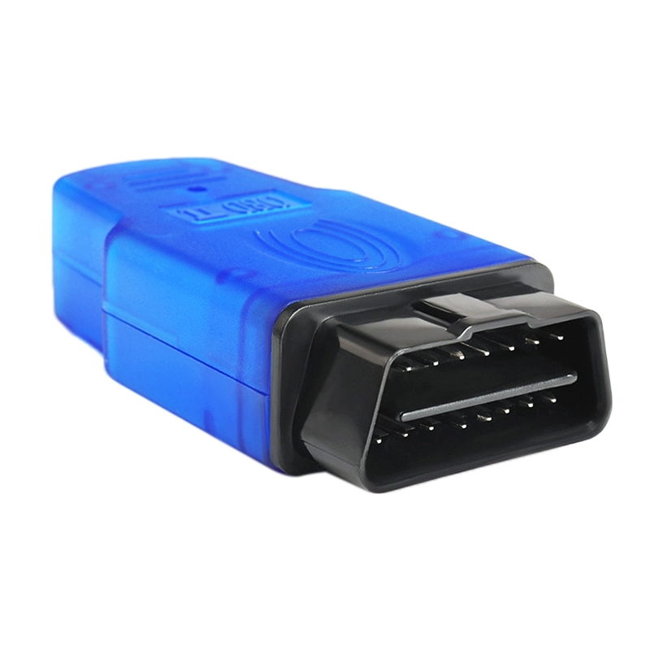
Models
Dongle solution

Slide 7
Models
Extended Vehicle Concept / ADAXO
ADAXO: Automotive Data Access – Extended and Open
Based on the ISO standardized Extended Vehicle concept
Open to other server platforms (NEVADA approach)
Possibility of installing 3rd party software in the vehicle fulfilling UNECE Reg 155 and 156

Slide 8
Models
Secure On-board Telematics Platform (S-OTP)
Protection Profile addressing life-cycle performance and maintenance of vehicles regarding Cybersecurity as methodology
Neutral access and authorization concept for data
Modification of software and hardware components needed

Slide 9
Models
Man in the middle
The MNO – Mobile Network Operator becomes the “Man in the middle”
MNO transfers to the Data Trustee (DT) the data sent from the vehicle to its manufactures
For sovereign use cases
The DT safely stores data and provide access to designated stakeholders
Consumers may decide which stakeholders will receive their data

Slide 10
Models
Trust Centre
Independent governance model with separation of duties
Access management handled by independent trust centers
Data trustees collect and/or process data from vehicles

Slide 11
Way forward
Possibilities for the GRVA:
Using UN Regulations, Rules and GTRs to ease the access to vehicle data
Data to be collected
Transmission of data
Authenticity and no-repudiation
Encryption requirements
…
Recommendations

Slide 12
Way forward
Setting up and ad-hoc group to assess the existing models^{(*)}
(*) The document contains a proposal of Template for the assessment

Slide 13
Thank You for your attention!
www.citainsp.org
Rue du Commerce 123 - 1000 Brussels, Belgium
+32 (0)2 469 06 70
secretariat@citainsp.org

