Slide 1
OICA comments on UN GTR No. 21
GRPE 85th meeting
11.-14. January 2022
Submitted by the expert of OICA Informal document GRPE-85-35
85th GRPE, 11.-14. Jan 2022 agenda item 9.(a)

Slide 2
Feedback on HEV System power Determination
Background:
GTR 21 Determination of Electrified Vehicle Power (DEVP) was published on 18. January 2021 in the global registry
Initial purpose for the GTR development was the need from GTR15 for provisions on downscaling and cycle classification for HEV
In GRPE 77 In June 2018 was decided to develop a standalone GTR instead of an annex to GTR15
In noise regulation, UN-R51, 3rd series of amendments, we see already references to GTR21:
2.8.3. For hybrid electric vehicles (HEV) [where at least one electric machine contributes to propulsion], or pure electric vehicles that have more than one propulsion energy converter
The maximum engine power is the "vehicle system power rating" according to the arithmetic sum of parallel propulsive engines on the vehicle or GTR 21, paragraph 6.9.1.(b) “sustained vehicle system power”.

Slide 3
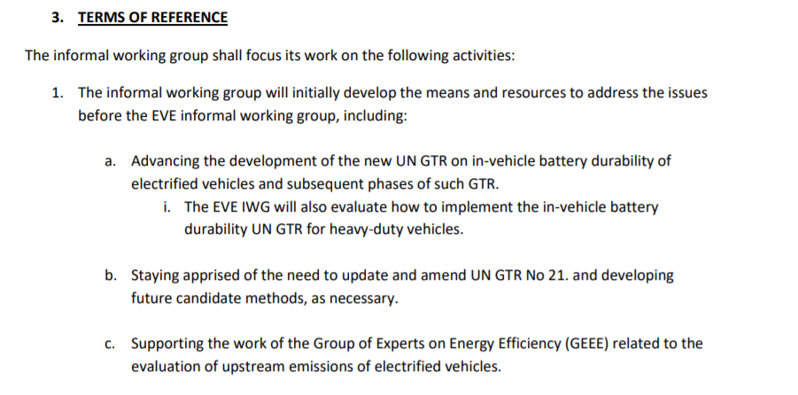
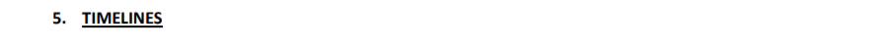
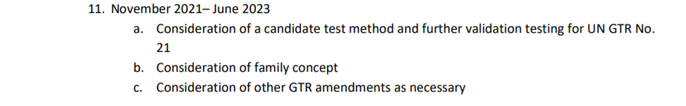
New Terms of References of the EVE-IWG:
The Battery Durability GTR for LD vehicles was adopted.
It is time to revisit GTR 21 now, since it could be used for Type approval soon
OICA sees some limitations in the GTR21 that should be resolved soon according to the timeline

Slide 4
Validation testing
EVE-31-04e.xlsx
EVE-31-04e Vehicle test matrix
The test matrix should be revisited in order to check if all architectures are covered
Some architetures are tested with only one (sometimes outdated) vehicle
We have to discuss if more tests are neccessary and what needs to be validated.
If we agree to carry out more tests, we need commitment from the stakeholders to support the validation program

Slide 5
GTR amendments and clarifications
It was stated already from manufacturers in the past, that very powerful vehicles could be too demanding for the chassis dynos
This could not be verified with the low to mid powered vehicles from the validation program. Only a small number of vehicles will be affected but the test procedure has to cover all configurations.
OICA wants to raise awareness on this issue:
6.8.6. Power test:
The maximum accelerator pedal command shall be given by either the pedal position or by vehicle communication network for a duration of at least 10 s.
The maximum accelerator command shall be given as rapidly as possible. If necessary in order to elicit maximum power delivery, it is permissible to vary the accelerator pedal command as recommended by the manufacturer prior to the maximum accelerator pedal command (for example, ask the manufacturer if it is necessary to achieve a kickdown state).
If the gearbox has driver-selectable gears, the gear shall be selected as recommended by the manufacturer for a typical driver to achieve maximum power. Gear shifting by means of special modes or actions that are not available to a typical driver are not permitted.
Our experience is that, when delivering the maximum power in the above mentioned conditions, it may happen that this power exceeds the specifications of the dyno used for the test (even for the best dyno currently on the market in terms of performance).
Therefore, the current test procedure seems not applicable for high power hybrid vehicles.
OICA is discussing a proposal for an amendment of the test procedure that could solve this issue.
The proposal will be presented in the next EVE-IWG meeting for discussion.

Slide 6
GTR amendments and clarifications
Other open issues should be identified and discussed quickly
The development of a possible candidate test method is mentioned in the ToR
We have to discuss if this is a priority and really needed
A family concept would be required if GTR 21 will be used for type approval

