Slide 1
EC study to review the appropriateness of crash pulses used in current EU legislation
Informal document GRSP-70-23
70th GRSP, 6-10 Dec. 2021, agenda item 24(a)
Directorate-General for Internal Market, Industry, Entrepreneurship and SMEs
GROW I.2 Mobility Unit
Peter Broertjes
GRSP 10 December 2021

Slide 2
Objectives of the research
Review crash pulses in current legislation and assess their appropriateness
Identify potential amendments to regulations and assess the potential benefits as well as any (unintended) consequences
Study carried out by TRL (2021 Edwards et al)
  https://data.europa.eu/doi/10.2873/58935

Slide 3
Background – evolution of regulations
Car stiffness
Euro NCAP consumer rating assessment
1980
1990
2000
2010
2020
Component assessment only
Component and full vehicle system assessment
Late 70s / early 80s:
R11 (door latches): 30-36g for > 30ms
R14 (anchorages): No crash pulse option
R44 (CRS): corridor max 20-28g,
duration 100-120ms
80s / early 90s
R16 (seatbelts): corridor
max 26-32g, duration
60-80ms
R17 (seats): seat inertia strength, >20g for >30ms
R21(Interiors): No crash pulse requirements
R67(LPG): No crash pulse req
Circa 2000
Intro:
Frontal (R94) and side (R95) impact Regulations
R110 (CNG): >20g for whole veh approval
Updated:
R14 (SB anchorages): Added crash pulse option, corr max 26-32g, duration 60-80ms
R17 (Seats): Added protect luggage displacement, corr max 20-28g, duration 100-120ms
R21 (Interiors): Added cp option to define head impact zone, corr max 26-32g, duration 60-80ms
R67 (LPG): Added > 20g for whole veh approval
Circa 2007 Intro:
R126(Partitions): corr max 20-28g, duration 100-120ms
Circa 2013
Updated:
R100 (REESS) corrid. max 20-28g, duration 100-120ms
Circa 2015 Intro:
R134(Hydrogen): : corr max 20-28g, duration 100-120ms
Circa 2017 Intro:
R144: corr max 65-77g, duration 38-60ms

Slide 4
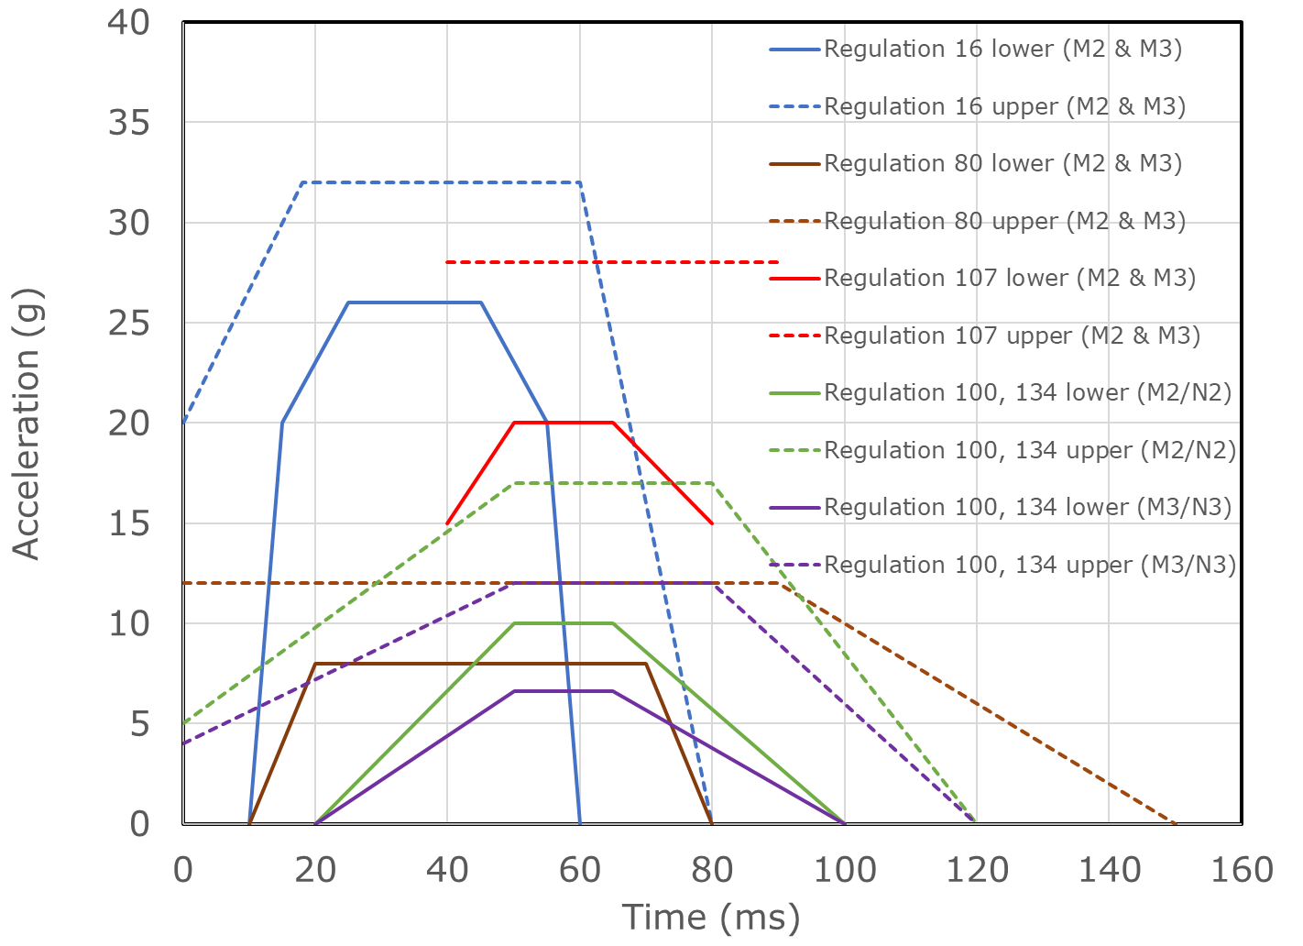
Regulatory crash pulses as they exist (frontal)
Frontal: M1 & N1
Frontal: M2/N2 & M3/N3
R144
Note: Regulations 67 & 110 pulse magnitude > 20g
Note: Regulations 67 & 110 pulse magnitude: M2/N2 > 10g; M3/N3 > 6.6g

Slide 5
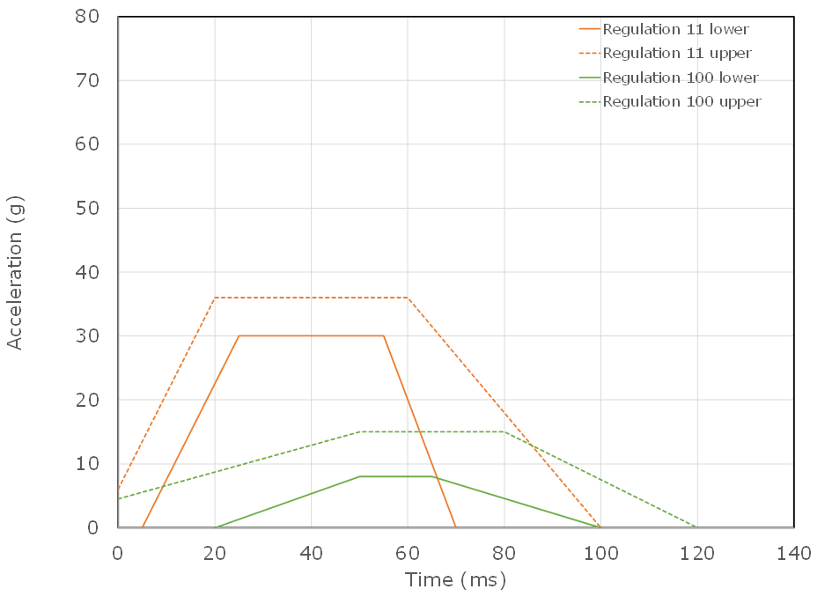
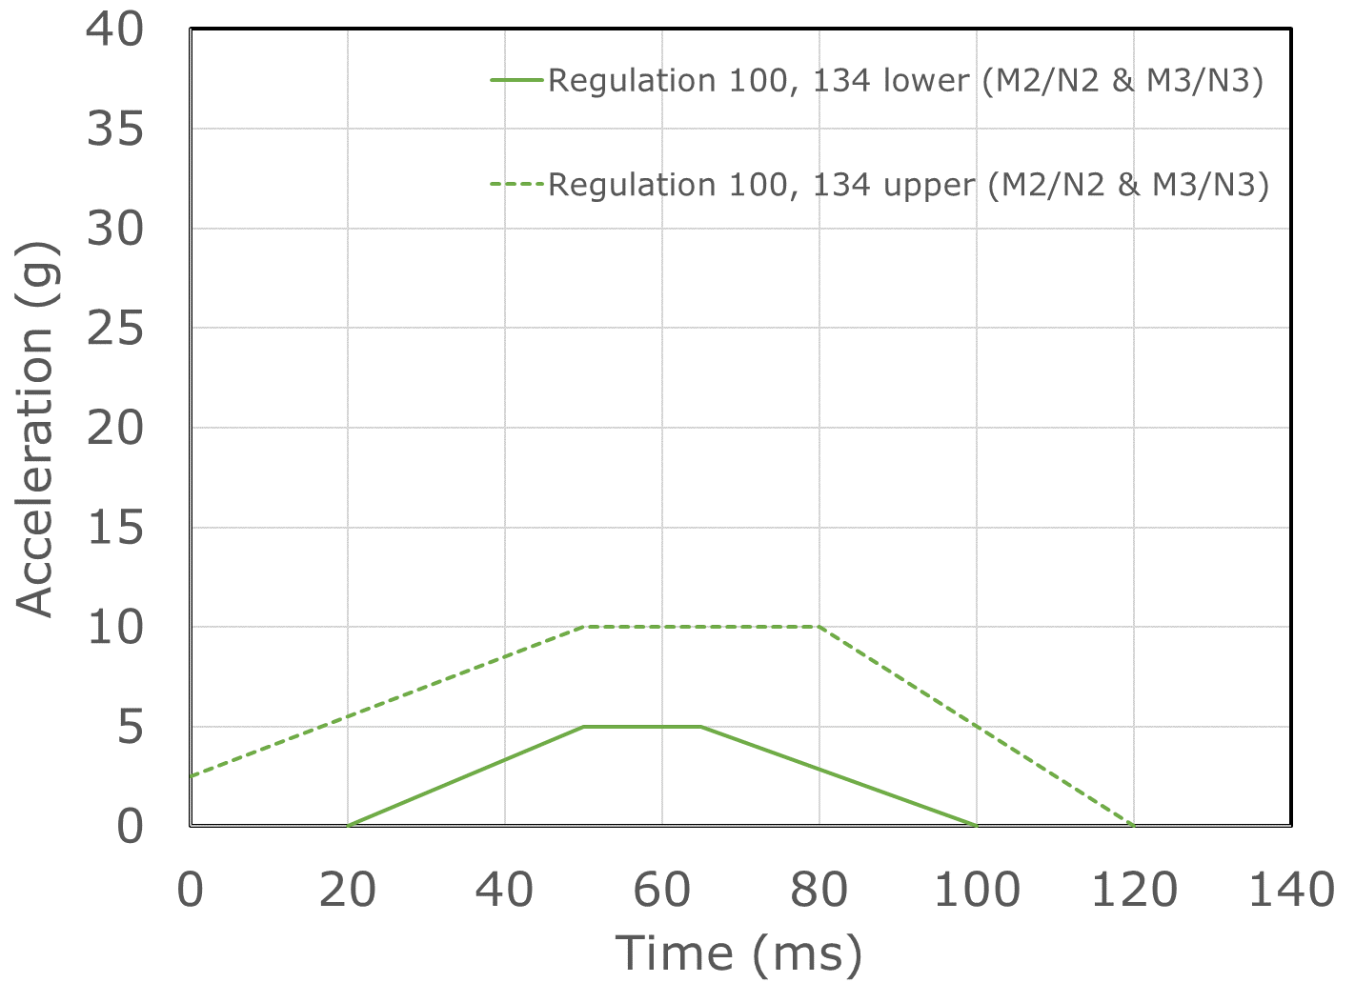
Regulatory crash pulses as they exist (side)
Side: M1 & N1
Side: M2/N2 & M3/N3
Note: Regulations 67 & 110 pulse magnitude > 8g
Note: Regulations 67 & 110 pulse magnitude > 5g

Slide 6
Comparison M3 frontal impact (example 1)
Limited data shows R100 and R80 corridors reasonably representative in terms of pulse magnitude but duration is much shorter than rigid barrier test
US coach (circa MY 2000) Frontal FWRB at 50 km/h
Simulation US city bus vs MPV both at 50 km/h

Slide 7
Comparison M2 frontal impact (example 2)
Limited data shows R100 corridor not representative of current M2 buses (large van types)
and that R16 corridor fits better
Mini-bus (circa MY 2000) FWRB at 50 km/h
Mini-bus (MY 2020) FWRB at 56 km/h

Slide 8
Comparison M1/N1 frontal impact (example 3)
Shows R129 corridor not representative of current vehicles – average is higher and individual peaks significantly higher; focus on 50 km/h data because equivalent to R137
FWRB 50 km/h
FWRB 56 km/h

Slide 9
Conclusions
Refer to Table 18 of the study (pages 139 to 147) with the summary of potential updates by regulation
  https://data.europa.eu/doi/10.2873/58935
Downstream alignment necessary in some cases, for example
  If R129 pulse is increased, the R145 ISOFIX pull force is no longer representative as it is expected to then exceed 8 kN
  The R80 equivalency between dynamic and static tests need to be reviewed as forces should also become higher
Limited real-world issues found in literature and accident data
Lack of concrete cost-effectiveness data (at this stage)

Slide 10
Discussion in GRSP
Consideration by delegates and Contacting Parties if any action based on this research needs to be prioritized
  The European Commission has an obligation to evaluate vehicle safety by July 2027 (Article 14 of General Safety Regulation (EU) 2019/2144) and will take this research into account at that time
Recommendations from GRSP to GRSG
  Notably for UN Regulation No 67 (LPG) and 110 (CNG) as covered by this research, to ensure consistency with
  UN Regulation No 134 / GTR No 13 (hydrogen safety)

Slide 11
Thank you
Images:
European Commission and TRL
For further information:
Directorate-General for Internal Market, Industry, Entrepreneurship and SMEs
Mobility Unit
DG GROW – Unit I.2
+32 229-94933
peter.broertjes@ec.europa.eu

