Slide 1
Submitted by the expert from Republic of Korea on behalf of IWG-DPPS
Informal document GRSP-70-19
70th GRSP, 6-10 Dec. 2021, agenda item 2(b)
Status of Informal Working Group
on Deployable Pedestrian Protection Systems
(IWG-DPPS)
Chair: Jin Seop PARK, Republic of Korea(KATRI)
Secretary: Irina Dausse, OICA(Renault)

Slide 2
Overview
Objective To develop the amendment of GTR No.9 & UN R127 w.r.t. Deployable Pedestrian Protection Systems (DPPS)
Activities - IWG: MAR., 2018 ~ NOV., 2022(extended mandate)
Meetings - 12th Meeting (29 ~ 30 JUN., 2021 / Online) - 13th Meeting (14 ~ 15 SEP., 2021 / Online) - 14th Meeting (16 ~ 17 NOV., 2021 / Online) - Subgroup online meetings
* Due to the Covid19 pandemic, the progress is slow
2p

Slide 3
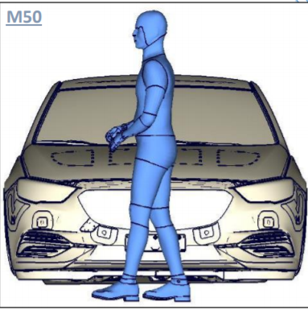
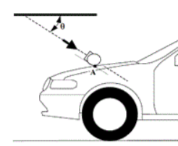
Summary of the amendment discussion
Must meet the regulation criteria
Static test in undeployed position
@LT x 0.9
Verification
of detection
(TRT/ST Measurement, Activation)
Headform Test
(physical)
Static test in undeployed position
@ 9.7 m/s
Static test in deployed position
@ 9.7 m/s
Prerequisites
- System info
- HIT
options
- Simulation
Physical testing
Generic Method
Dynamic test
@ 9.7 m/s
* HIT = Head Impact Time
LT = Lower Threshold (of speed)
3p

Slide 4
Decision
IWG-DPPS Decision Phase 1 will include numerical simulation for HIT and a marker in the preamble for generic approach to be developed in the next phase
Issue Japan proposal adds a sentence about an equivalent method (physical or alternative numerical simulation) to the numerical simulation to be agreed by CPs
4p

Slide 5
Administrative Issue 1
Opinion 1 The physical or alternative numerical simulation must be clarified for GTR and UN Regulation. Therefore, the proposal without detailed procedure cannot be included in Phase 1.
Opinion 2 The equivalency of methods must be agreed by CPs. The proposal is sufficient and can be included in Phase 1.
Request for discussion on this issue in GRSP level
5p

Slide 6
Administrative Issue 2
How to deal with the remaining left topics of DPPS?
Opinion 1. IWG-DPPS Phase 2 - Generic approach for HIT - Other remaining topics for DPPS test procedure
Opinion 2. IWG Phase 3 of GTR No.9 - all DPPS related remaining topics - Head test impact area (GTR 9 amendment 3) - Adjustable Ride Height Suspension System - Extension of head test area
Request for discussion on this issue in GRSP level
6p

Slide 7
Plan
Next Meeting - 1~2 February, 2022 (t.b.d.) - Online meeting
More subgroup meetings (t.b.d.)
timeline
GTR9 drafting
Formal
GRSP
May 2022
WP29
Nov 2022
7p

Slide 8
Thank you for your attention
8p

