Slide 1
Modification of R16/R129 Support Leg Volume
Informal document GRSP-70-18
70th GRSP, 6-10 Dec. 2021, agenda item 11
Submitted by the experts from CLEPA
70th session of GRSP, 06 – 10th December 2021

Slide 2
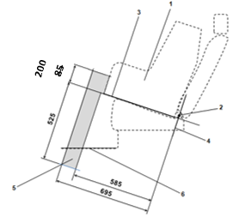
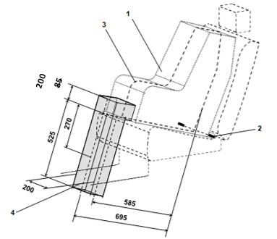
Proposal
CLEPA propose to increase the height of the support leg volume to improve compatibility between support leg volume and ISO/R2 & ISO/F2X volumes
This change would require R129 & R16 to be updated with this modification (GRSP/2021/25 & GRSP/2021/26)
This change is important for large rearward facing ECRS designs
This change will not reduce the support leg compatibility with vehicles
200
200

Slide 3
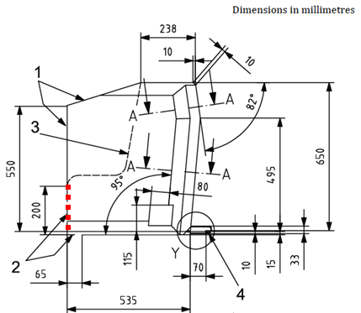
Justification (1/6)
UN Regulation No. 16 defines the envelope dimensions of ISO/R2 & ISO/F2X CRF envelopes
Dashed line 2) represents the area where a support leg or similar may protrude. For the ISO/F2X envelope, this is indicated with a height of 200 mm (red dotted line)
The proposal is to increase the support leg volume height to match this 200 mm dimension

Slide 4
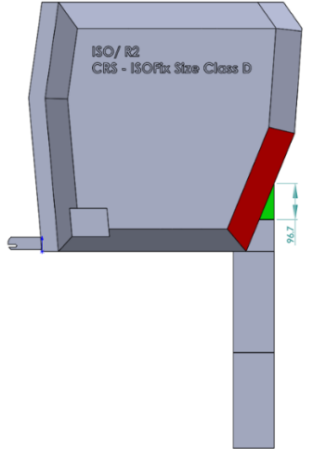
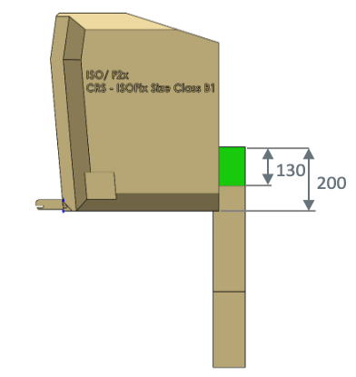
Justification (2/6)
Increasing the height of the support leg volume would create a better match with both i-size ISO volumes
Particularly useful for large rearward facing CRS designs with support legs
Will increase design space for support leg & misuse mechanisms & electronics for user misuse warnings
Environmental benefits - improved load paths leads to a reduction in materials
Potential to reduce CRS weight, improving handling for consumers
ISO/R2
200
115
ISO/F2X
200
115

Slide 5
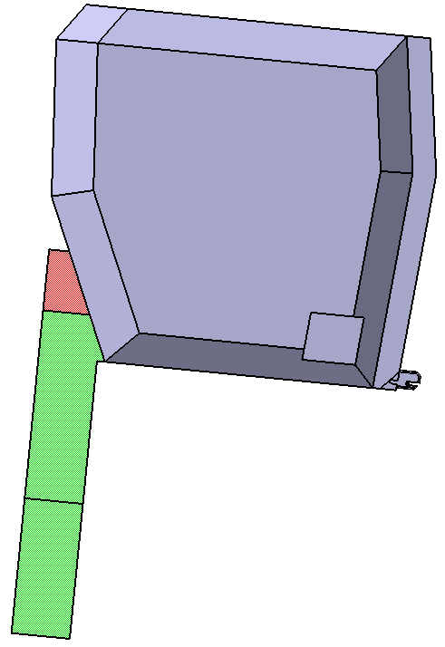
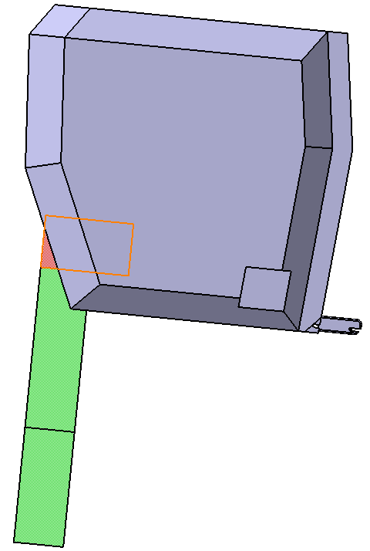
Justification (3/6)
The additional support leg volume already overlaps with the ISO/R2 volume and therefore little or no extra space is required (depending on ISOFIX position)
ISOFIX anchors at 20mm
ISOFIX anchors at 70mm

Slide 6
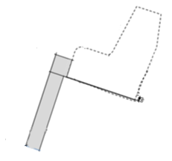
Justification (4/6)
The additional space required by extending the support leg volume is available in vehicles that can already fit the support leg volume
This additional support leg volume unused in the vehicle (100 vehicles)
If contact between the child seats and vehicle seat occurs, it is at the top of the seat, not where the additional support leg volume would be
200

Slide 7
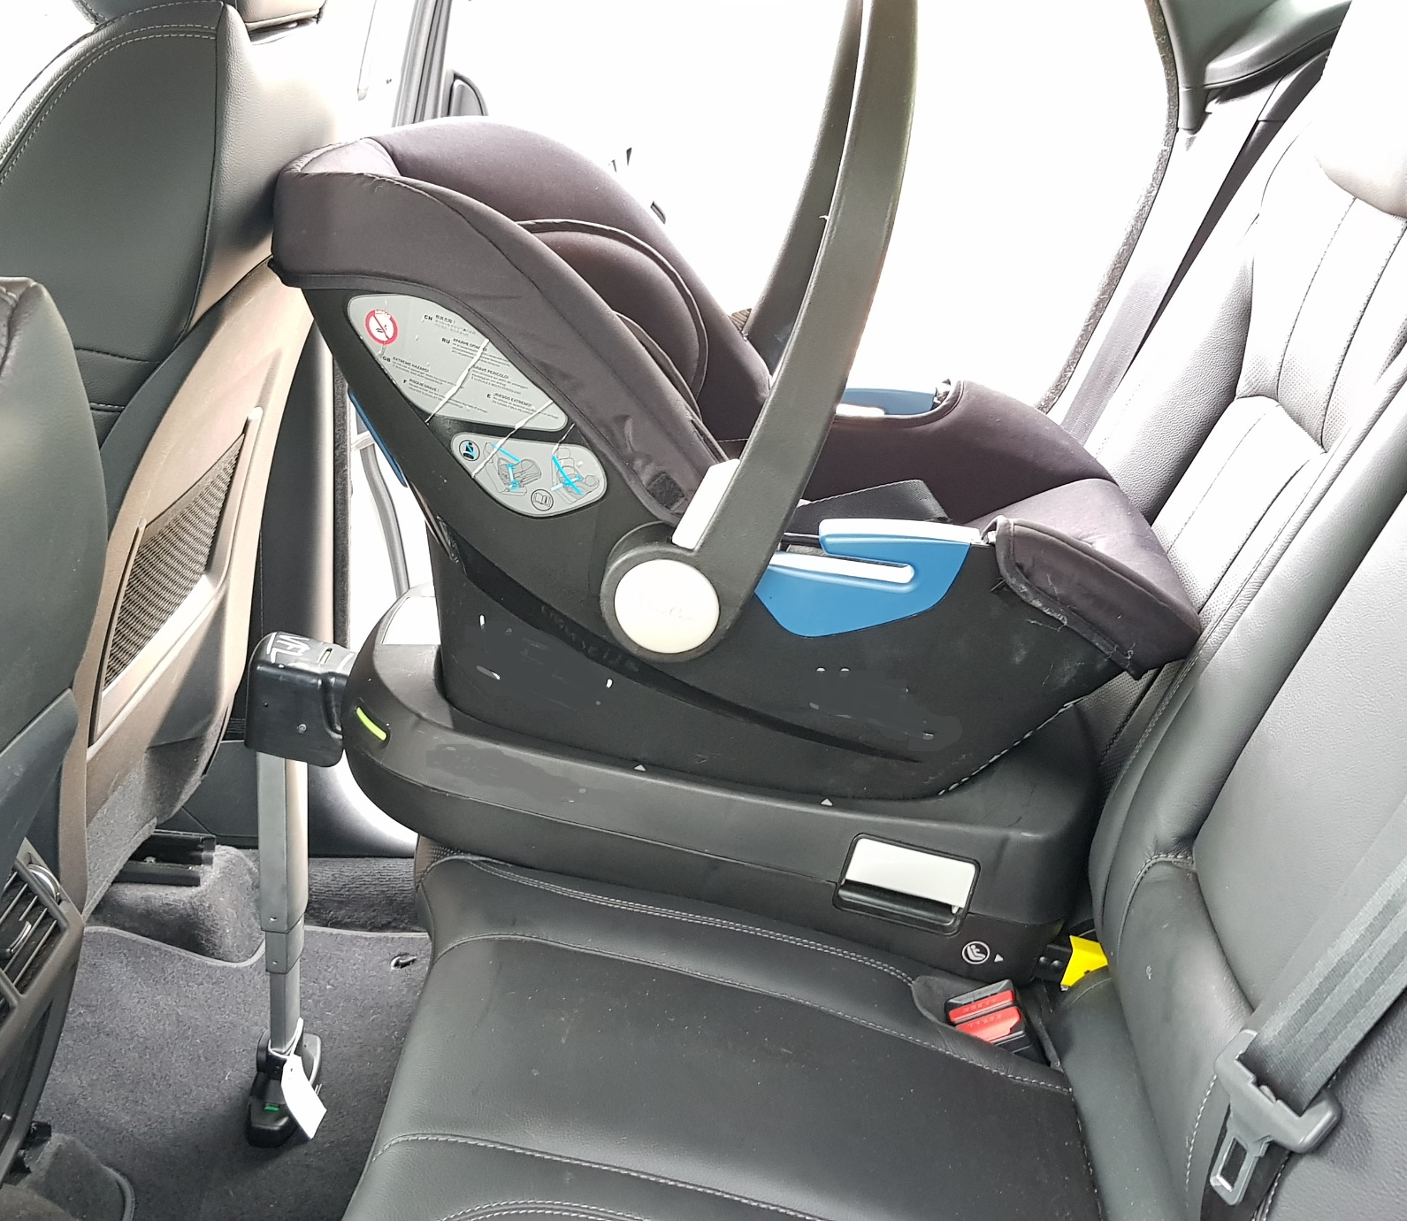
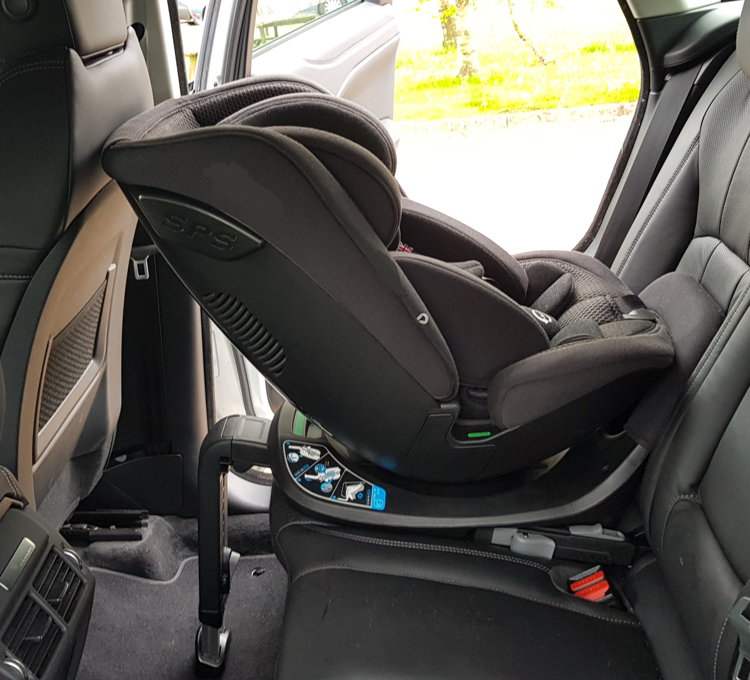
Justification (5/6)
Additional support leg volume unused in the vehicle
Vehicle contact between child seats and vehicle seat occur at the top of the seat
Examples (Small Off-Road)
Infant Carrier
Large RF

Slide 8
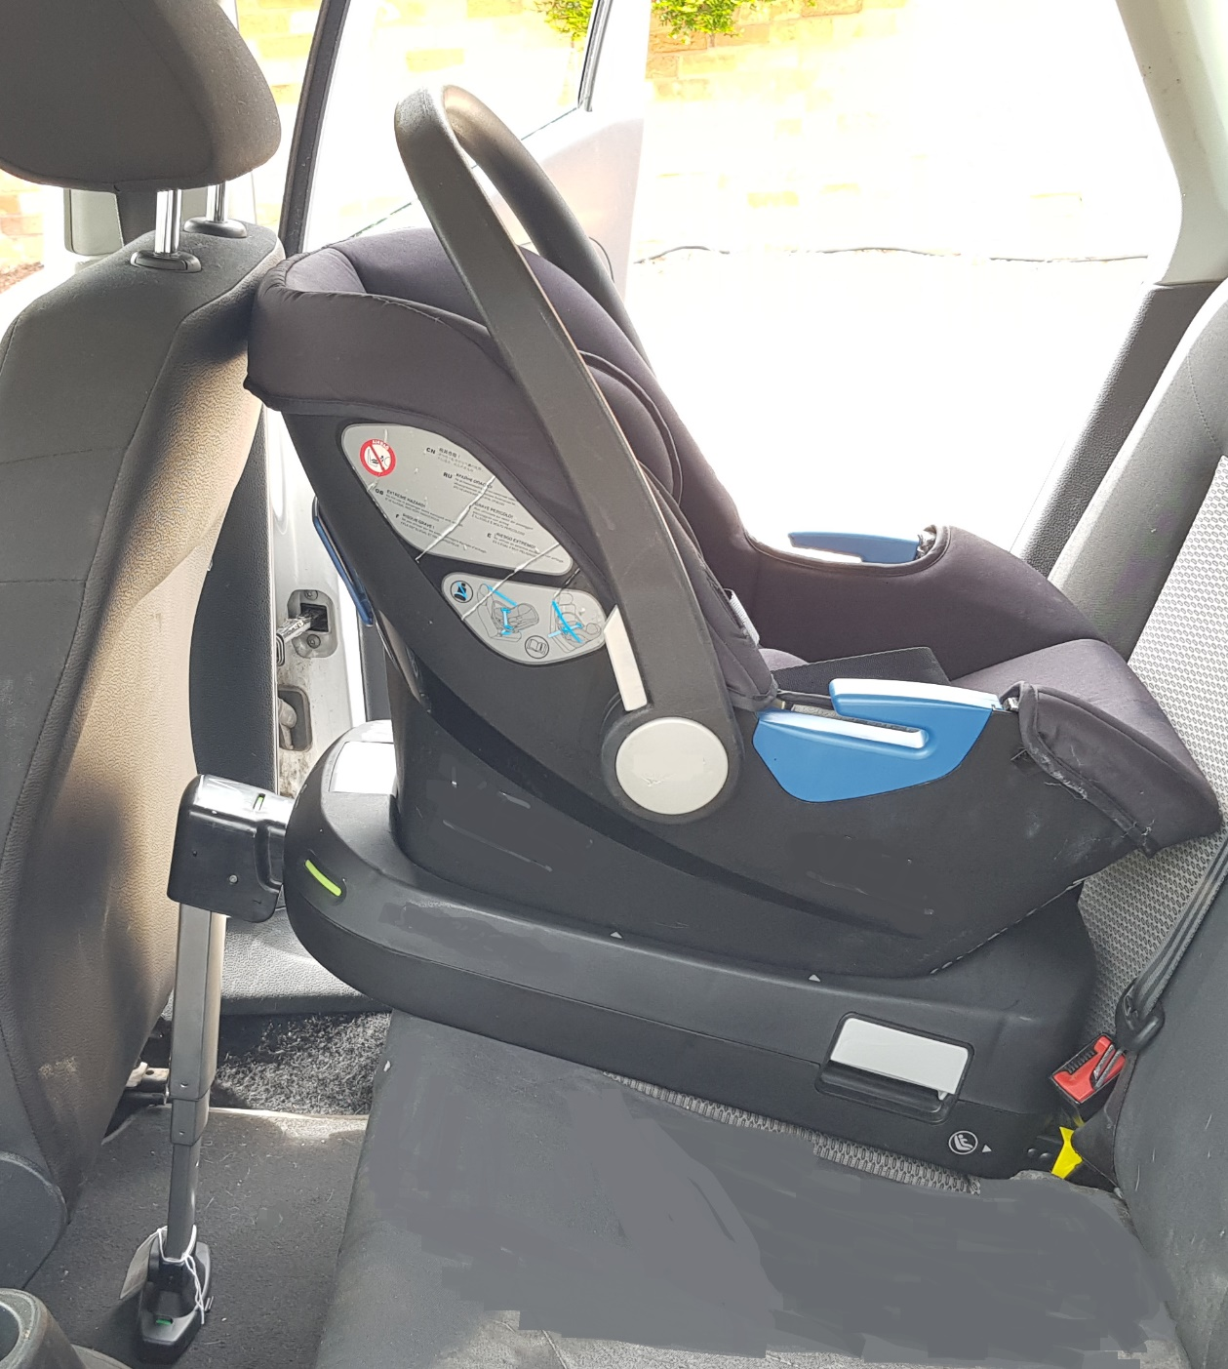
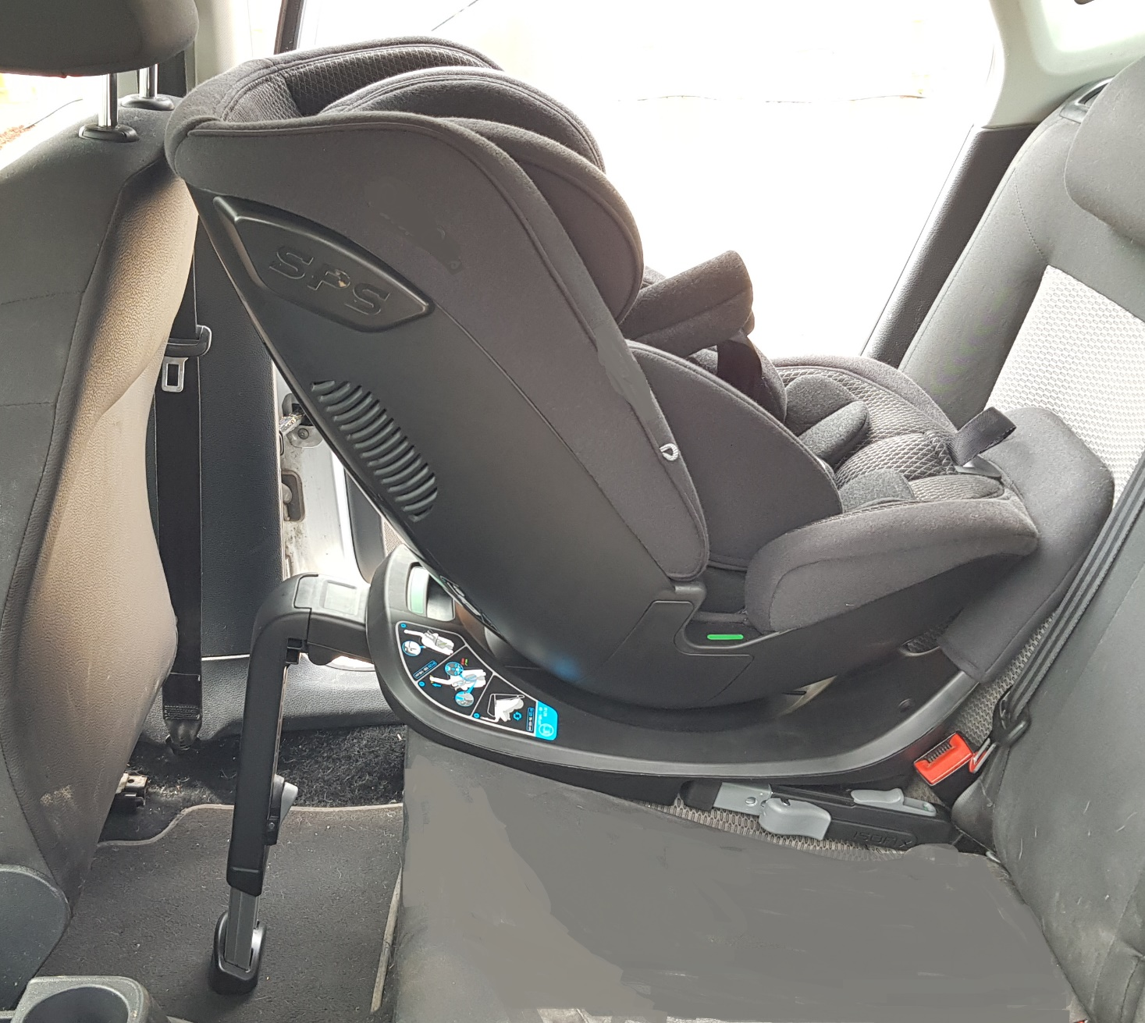
Justification (6/6)
Additional support leg volume unused in the vehicle
Vehicle contact between child seats and vehicle seat occur at the top of the seat
Examples (Supermini)
Infant Carrier
Large RF

Slide 9
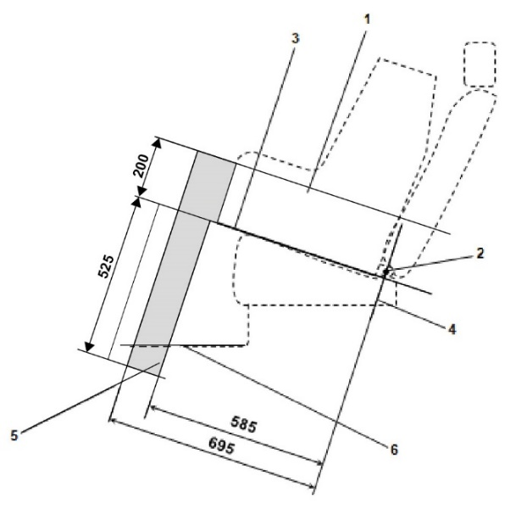
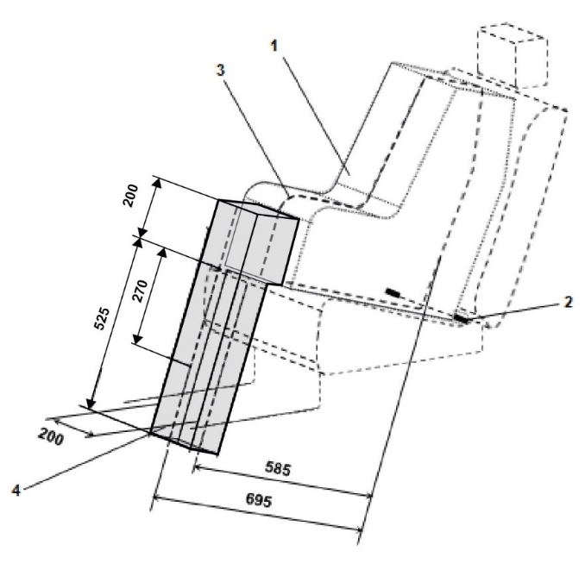
CONCLUSION
Increasing the height of the support leg volume would improve compatibility between support leg volume and ISO/R2 & ISO/F2X volumes
Will increase design space for support leg & misuse mechanisms & electronics for user misuse warnings
Environmental benefits - improved load paths leads to a reduction in materials
This change is important for large rearward facing ECRS designs
This change will not reduce the support leg compatibility with vehicles

