Slide 1
Submitted by the expert from Republic of Korea
Informal document GRSP-70-15
70th GRSP, 6-10 Dec. 2021,
agenda item 20)
Crash Safety of Autonomous Vehicles Based on a Survey Result

Slide 2
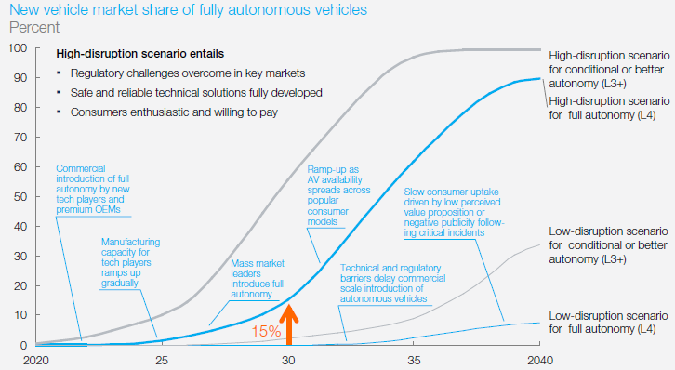
Background - Autonomous vehicles never collide?
Malfunctions - Autonomous Driving System (HW/SW) failures - Hacking, etc.
Market penetration - 90% (Level 4) in 2040 (w/positive scenario) - AVs and Non-AVs on a road for tens of years
Passive safety demand - Customer’s expectation
Source: Mckinsey (2016) Autonomous revolution – perspective towards 2030
* AV: Autonomous Vehicle, Non-AV: Non Autonomous Vehicle
2p

Slide 3
Public Survey of Autonomous Vehicle Crash Safety
Overview
Objective - investigation of customers’ cognition w.r.t. autonomous vehicles passive safety
Subject - driver’s license holders aged 20 and above
Sample - 1,000 persons
Period - Sep. 14., 2021 - Sep. 29., 2021
Confidence level - 95% ± 3.10%
Funded by “Development of safety assessment technology of driving and collision response for level 4 automated vehicle” (Ministry of Land, Infrastructure and Transport of Republic of Korea) - Period: 2021.04.01.~2027.12.31. - Budget: 19.8 Billion KRW - Coordinator: Jo, Kwang-sang (@KATRI)
3p

Slide 4
Public Survey of Autonomous Vehicle Crash Safety
Result
Crash Safety Performance Level (fully autonomous vehicles - SAE Level 5)
Unit: %
4p

Slide 5
Research on Autonomous Vehicle Crash Safety
Result
Willingness to purchase fully autonomous vehicles (when they are released to the market)
Reasons not to purchase
Unit: %
5p

Slide 6
Research on Autonomous Vehicle Crash Safety
Result
Time to purchase fully autonomous vehicles
Unit: %
6p

Slide 7
Research on Autonomous Vehicle Crash Safety
Result
Occupant protection devices/technologies preference
Unit: %
7p

Slide 8
Opinion
Autonomous vehicles can be involved in crashes - Malfunction or hacking may occur - Mixture of AVs and Non-AVs on a road
Autonomous Vehicles will provide more flexibility of seating layouts and postures → new passive safety test methods are necessary
Crash safety performance of autonomous vehicles should be required to be equivalent to or more advanced than the current level, considering the traffic situation and market expectation and so on
8p

Slide 9
Thank you for your attention
9p

