Slide 1
Requirement for updating GTR15 Amendment 6 Annex 13 (Low Temperature Test Procedure)
Submitted by the expert of OICA Informal document GRPE-85-22 85th GRPE, 11.-14. Jan 2022 agenda item 3.(b)
GRPE-85-21

Slide 2
Points to be amended
Correction of wrong references
PEV vehicle selection
PEV value calculation (e.g. clarification on K_{UBE} application)
Adding breaks for PEV test procedure
Clarification when complete PEV test procedure required and when just three cycles or no test at all is sufficient
Further clarifications and amendments (see word document)
More to come…

Slide 3
New points
Discussion on solutions for temperature set point verification (22°C setting for thermal comfort system)
Discussion on consideration for user initiated preconditioning (with potential impacts on other parts as e.g. test report etc.)
More to come…

Slide 4
Example 1: PEV vehicle selection
Main body, paragraph 5.14.2.
Low Temperature Family for PEVs:
Type of traction REESS (cell, coolant)
BMS
Pre-Heating
Interior heating system
REESS insulation
Annex 13, paragraph 2.6.2.3.3.1. (UBE ratio)
At least one vehicle which is expected to produce the lowest UBE ratio defined in paragraph 4.4.2.1.3. of sub-annex 1 shall be selected from all vehicle high (VH) of the interpolation families in a low temperature family for PEVs . In order for vehicles to be considered to belong to the same low temperature family for PEVs, the variation in battery capacity shall not exceed 55 per cent of the vehicle with the tested configuration within the family.
The measured values of a tested vehicle may be extended without further testing to all family members which fulfil the family criteria defined in paragraph 5.14.2. of this UN GTR.
Comment ACEA:
The measured values of a tested vehicle may be extended without further testing to all family members which fulfil the family criteria defined in paragraph 5.14.2. of this UN GTR.
→ Proposal to add this sentence
Annex 13, paragraph 2.6.2.3.3.2. (PER ratio, EC ratio)
At least one vehicle shall be selected from the PEV low temperature family which is expected to produce the lowest ratio (i.e. combination of heater efficiency and cabin volume) for the PER ratio defined in paragraph 4.4.2.1.1. and which is expected to produce the highest EC ratio defined in paragraph 4.3.4.2.1. of sub-annex 1 shall be selected and tested with vehicle L or vehicle H road load and dyno settings adjusted as described in paragraph 2.4. of this annex. from vehicle high (VH) or vehicle low (VL) of the interpolation families.
The measured values of a tested vehicle may be extended without further testing to all family members which fulfil the family criteria defined in paragraph 5.14.2. of this UN GTR.
If vehicles within the family include other features which may have a non-negligible influence on the PER and/or EC ratio, these features shall also be identified and considered in the selection of the test vehicle.
If the responsible authority determines that the selected vehicle does not fully represent the low temperature family, an alternative and/or additional vehicle from other vehicle high (VH) and/or vehicle low (VL) of the interpolation families shall be selected and tested.
Comment ACEA:
Heating system has no impact at Type 1 Test but is a family criterion of PEV low temp family (further explanation, slide x)
→ Proposal to modified as suggested by ACEA
Comment ACEA:
Why is this required? The first part already requires to test the worst case ratio and therefore all features already need to be considered there, otherwise manufacturer would not be compliant with the first part of the paragraph.
→ Proposal to delete this sentence

Slide 5
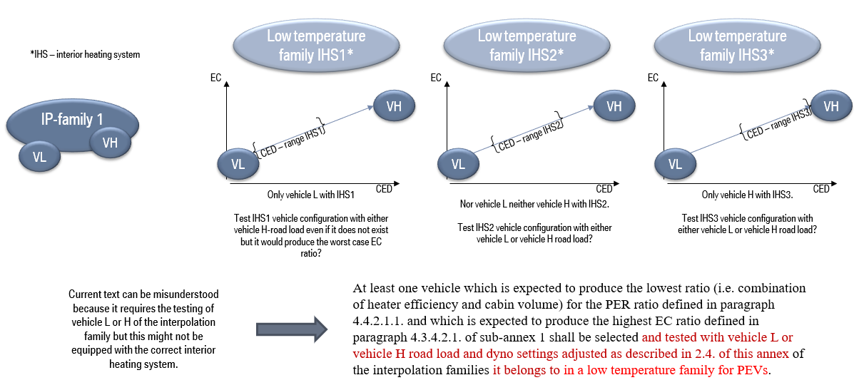
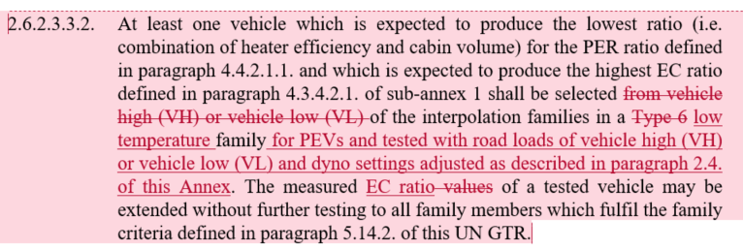
Example 2: PEV vehicle selection

Slide 6


Example 2: K_{UBE} application (1/2)
Paragraph 4.4.2.1.
PER and PER ratio
PER@Type6
=
$\frac{\text{UBE}\text{@}\text{Type}\text{6} }{\text{EC}\text{DC}\text{,}\text{WLTC}\text{@}\text{Type}\text{6 }}$
PER ratio (K_{PER,WLTC})
In case several ratios available, the lowest shall be selected
Measurements:
EC_{DC,WLTC@Type6}
UBE@Type6
PER_ind@Type6:
PER_{WLTC,ind@Type6} = K_{PER,WLTC} * PER_{WLTC,ind@Type1}
Paragraph 4.4.2.1.3.
UBE ratio (K_{UBE})
At option of manufacturer, ratio may be decreased
Different nominal REESS capacity in same family:
EC_{DC,WLTC@Type6}
UBE_{@Type6} = K_{UBE} * UBE_{@Type1}
EC_ind@Type6:
EC_{WLTC,ind@Type6} = K_{EC,WLTC} * EC_{WLTC,ind@Type1}
Paragraph 4.3.4.2.
EC and EC ratio
Inputs:
PER_{WLTC@Type6} = K_{PER,WLTC} * PER_{WLTC@Type1}
E_{AC@Type6}
EC_{WLTC@Type6}
=
$\frac{\text{E}\text{A}\text{C}\text{@}\text{Type}\text{6}}{\text{PER}\text{WLTC}\text{@}\text{Type}\text{6}}$
EC ratio (K_{EC,WLTC})
In case several ratios available, the highest shall be selected

Slide 7
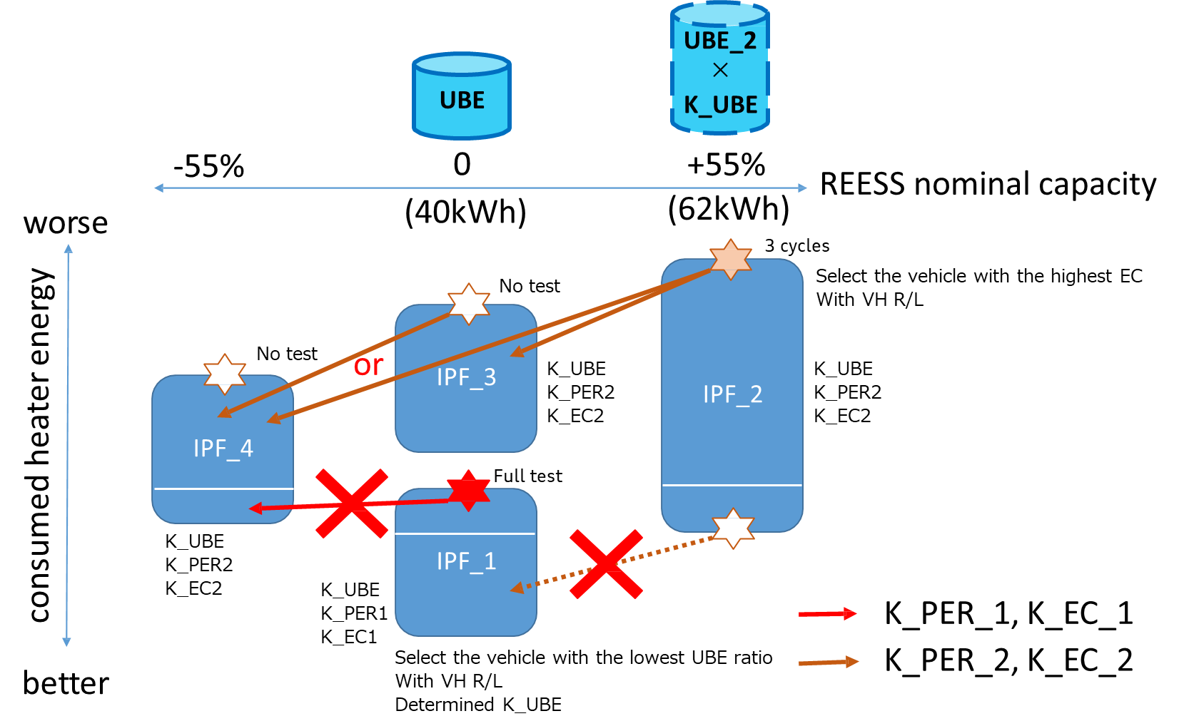
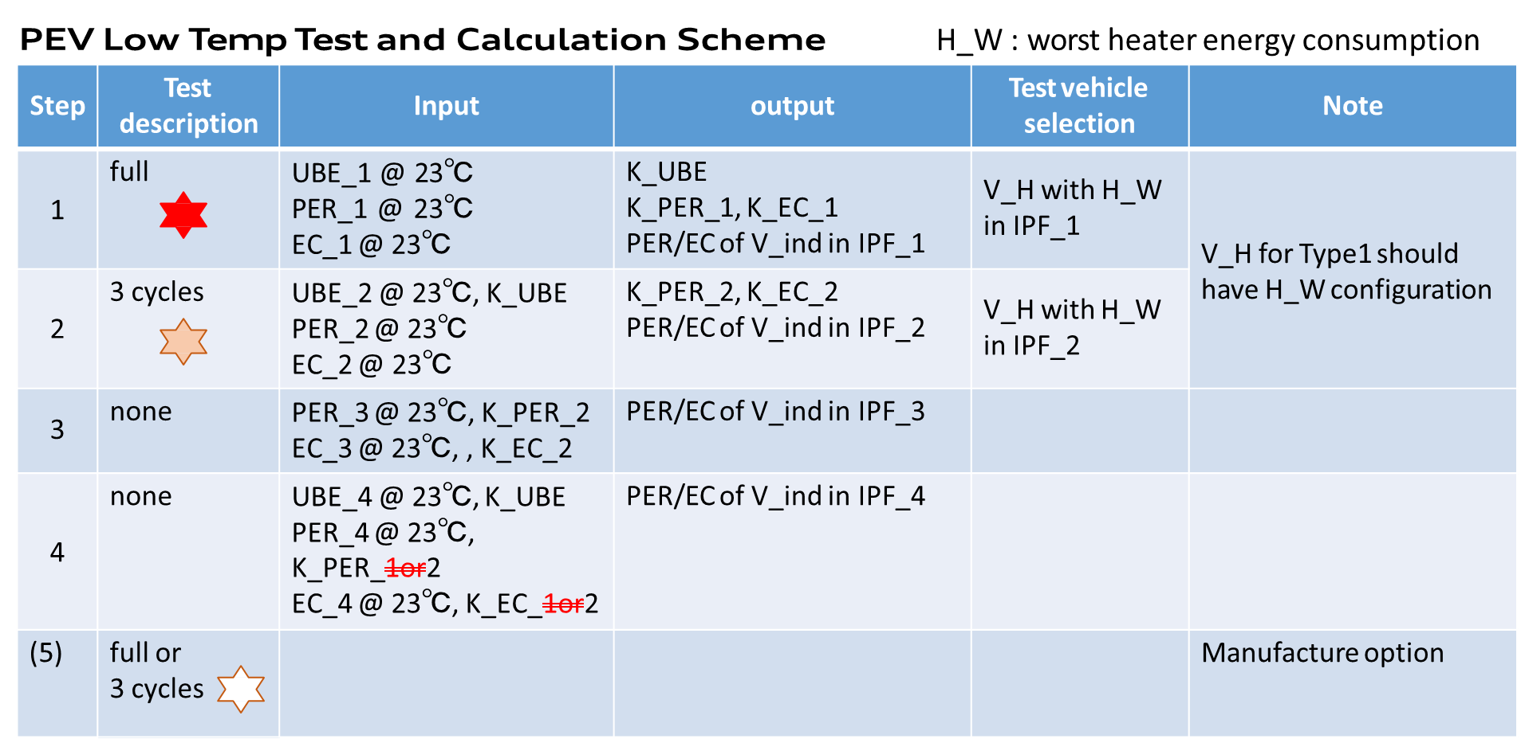
Example 2: K_{UBE} application (2/2)
Image of PEV Low Temp Test and Calculation

Slide 8
Conclusion
GTR 15 Amendment 6 Annex 13 need to be updated
Discussions cannot just happened in GRPE
Suggestion: installation of an Adhoc group to discuss topics

