Slide 1
Energy audits procedure of buildings and multicriteria analysis

Slide 2
Table of contents
Introduction
Energy Audit
Preparation
Visit
Measurements
Analysis
Measures

Slide 3
Introduction
An energy audit is an essential tool of energy management.
Energy audit is an investigation and detailed analysis of the energy (and water) entering and leaving a building, and is carried out to pinpoint the areas where there is potential for energy efficiency measures and savings.
The main aim of the energy audit is to identify actions that will lead to savings in energy and costs.
Other aims:
Reduction in carbon emissions
Improved environmental conditions for the occupants of the building
The development of a system for recording energy use
The development of monitoring and targeting schemes
Notes:
Energy Efficiency means reducing energy and water consumption but keeping or improving the working conditions, quality of service or production process.
Reducing the energy and water consumption costs leads to decreasing of the product / service price and thus becoming more competitive on the market.

Slide 4
Energy audit
DEFINITIONS
Energy audit is:
“A systematic, documented verification process of objectively obtaining and evaluating energy audit evidence, in conformance with energy audit criteria and follow by communication of result to the client”.
“The verification, monitoring and analysis of the use of energy and submission of technical report containing recommendations for improving energy efficiency with cost benefit analysis and an action plan to reduce specific energy consumption”.

Slide 5
Introduction
The energy entering the building comes from a number of sources (oil, coal, gas, electricity, etc.) and “free” sources, such as solar radiation and people, which supply light and heat. All this energy is eventually converted to heat and leaves the building via a number of routes:
Transmission through the building envelope,
Flue losses
Infiltration and ventilation losses, etc.
The energy is used to power: heating equipment, lighting, cooling equipment, fans, pumps, cooking appliances, refrigerators, appliances (computers, printers, etc.), larger items of machinery, lifts and escalators, etc.

Slide 6
Energy audit
Benchmarking – preliminary cost analysis, comparison with similar energy efficiency solutions and/or industries, etc.
Preliminary audit (walk-through) – available data mostly used for a simple analysis of energy use and performance of the technical systems. Does not require measurements and detailed data collection. It is not time consuming and results are rather generic and include simple economic calculations.
Detailed audit (diagnostic audit) – detailed data and information on all technical systems is required. Detailed measurements and data inventory is needed for each system (pumps, fans, compressors, etc.). The economic calculations should cover at least NPV, IRR, LCC, etc. The result is list of clearly defined measures that the client should implement in order to improve the energy efficiency of the building.
Investment-grade audit – includes also complete technical and economic analysis at the investment level.

Slide 7
Energy audit
 | Models of scan | Models of analyzes
Smaller objects | basic, "walk-through" audit | selective audit |  | Selected by auditor
Larger objects | preliminary audit | targeted audit |  | Selected by owner representative
 |  | for specif. systems | detailed
 | Appropriate for buildings, etc. | Appropriate for industrial processes

Slide 8
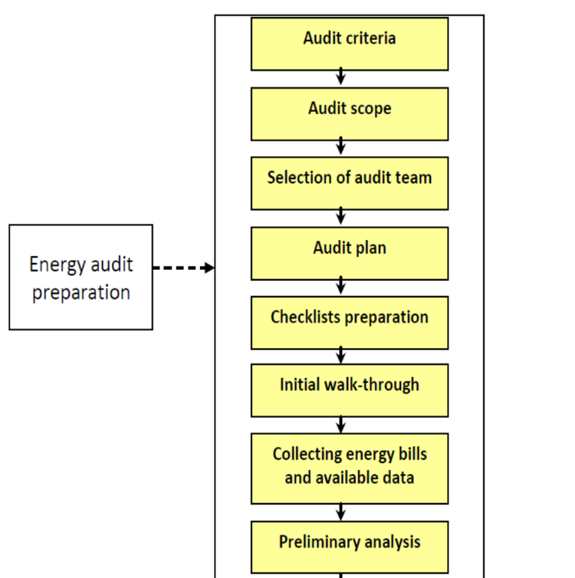
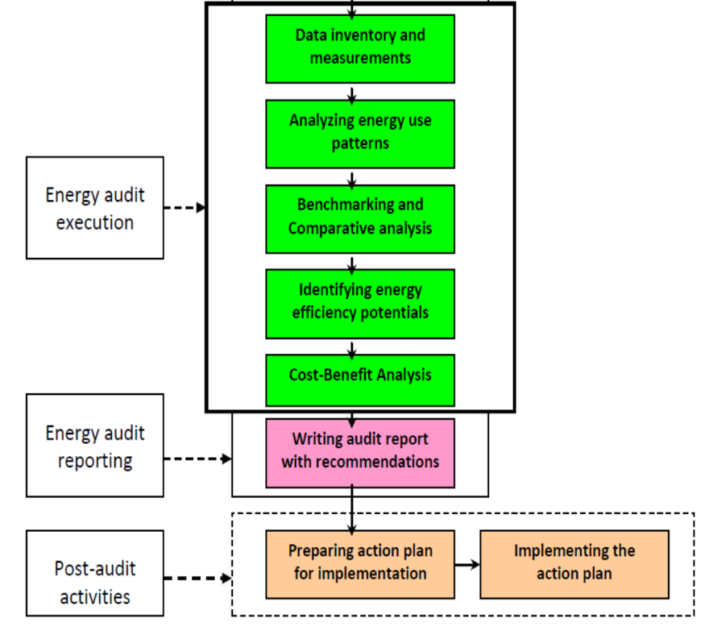
Energy audit

Slide 9
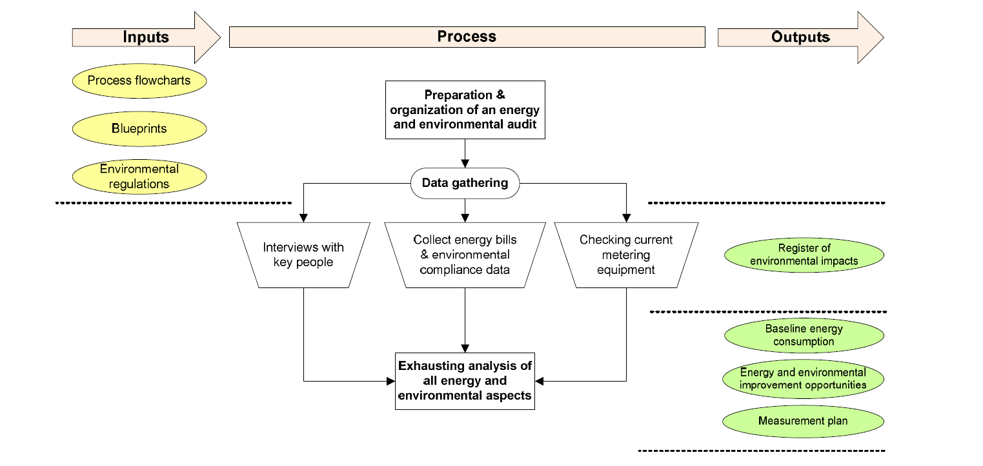
Energy audit

Slide 10
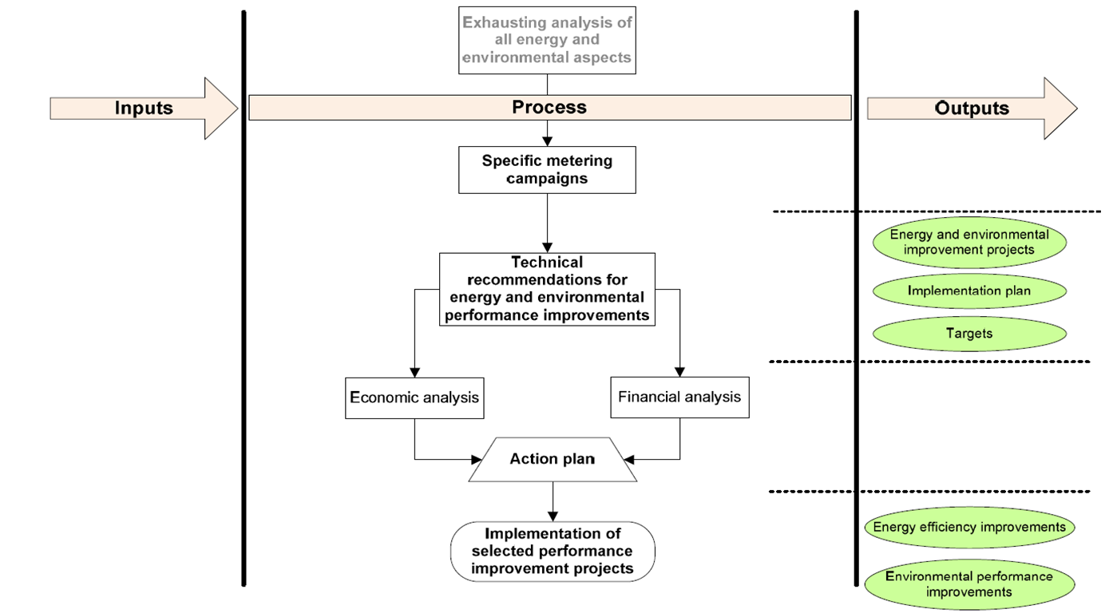
Energy audit

Slide 11
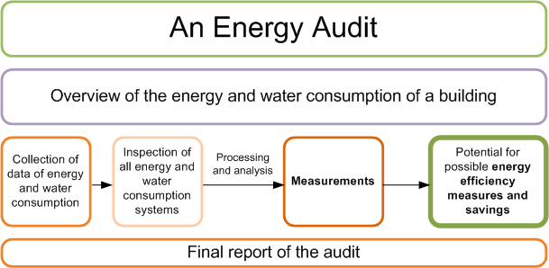
Energy audit

Slide 12
Energy audit
An energy audit consists of 8 main steps that can be performed in the office of the auditor in the field.
DESK JOB
FIELD JOB
⁰
Information collection
Analysis of the productive process
²
¹
Analysis of the energy input*
³
Technology and services analysis
⁵
Performance of the Energy Accounting
⁴
Measurement and data collection
⁶
Analysis and development of suggested energy saving measures
COMUNICATION
WORK PROGRAMME
⁷
Energy Audit report
NOTE: *The information is requested prior to the visit in order to resolve any doubt or further information on it

Slide 13
Energy audit
The energy audit process may be divided into a number of phases:
Pre-survey information and data collection
The building survey
Analysis of the data collected
Formulation of energy-saving solutions
Reporting of results

Slide 14
Pre-survey data collection
Introductory meeting with the administration and head of maintenance services
Initial questionnaire
Data collection
Meeting with the head office of the institution
Basic information required:
The contact person
The basic building characteristics
Gather all the plans from the contractor and the maintenance personnel

Slide 15
Pre-survey data collection
Important to collect as much information as possible about the building
Utility bills provide useful information on the amount of energy (and water) purchased and tariffs paid
Readings from any sub-meters should be used if available (if these are not available then this might be potential area for improvement)
Regular readings taken manually (also a potential EE measure)
Bills will show maximum demand charges (load-shifting potential)
Bills going back number of years (at least 3) will enable long-term trends in energy usage
The most recent energy/water bill is needed as well

Slide 16
Pre-survey data collection
Any plans, elevations or technical data on the building should be obtained (useful information od dimensions, construction materials, possibly U-values, and important information on the building services plan (type, size and control strategy)
The collected information may include:
Electricity/gas/oil/solid fuel/water utility bills
Plans/elevations/design of the building (incl. building services systems)
Location of the building (climate)
Information on the controls and building management system (BMS)
Information on the structure of the building (U-values, materials, etc.)
Information on the building’s purpose, hors of work and operation

Slide 17
Walk-through survey
Walk-through survey will provide much additional information which cannot be obtained from the plans
There are often changes made (extensions, new ventilation plant, additional insulation, etc.)
The condition of the building should also be noted (e.g., cleanliness of light fittings, etc.)
Interviews with building managers, engineers, caretakers and others can provide useful anecdotal evidence and better understanding of the operation of the building
Sometimes is good (with the employer’s permission) to interview the building users or issue questionnaires.
Notes:
Dirty lighting fittings may result in 20% more energy being required

Slide 18
Walk-through survey
Conditions in the building may be measured as well, various hand-held devices are available nowadays: for temperature, humidity, lighting level, CO₂ level, etc. (provide only indication of the conditions prevailing at the time of the survey)
Spot reading can be useful in identifying potential problems (problems with temperature control, etc.)
Other control issues may also be identified:
Do users have manual override for heating controls?
Are there open windows immediately above working radiators?
Can the user adjust light levels?
Where are the light switches?
Are computers switched off at night?
Is there manual control of ventilation?
Are fans switched on at night for night cooling?

Slide 19
Walk-through survey – building envelope
Surfaces and sizes, orientation and building characteristics (roof, floors, windows, walls, etc.)
The working schedule of the building
Number of employees, number of workers
The heated and cooled area and/or volume
The referent climatic data

Slide 20
Walk-through survey – heating system
Detailed inspection of the boiled rooms is essential
The characteristics of the heating system, the boiler, the distribution system and the medium, the heating elements (radiators, etc.)
Working schedule, power and efficiency, regulation, etc.
Standard of maintenance (maintenance plans)
Hydraulic balance of the system
Connection to other systems (DHW or steam)
Any specific problems such as broken valves, leaks, missing lagging and other defects should be noted

Slide 21
Walk-through survey – domestic hot water
Collect all the technical characteristics of the domestic hot water (DHW) system including distribution system and the medium
Technical data such as power and efficiency
Working schedule and regulation
Standard of maintenance (maintenance plans)
Connection to other systems (connection to heating system, connection to alternative heating systems, etc.)

Slide 22
Walk-through survey – cooling, ventilation and air conditioning system
Listing all the technical characteristics of all three systems, the distribution part and the medium, the cooling/ventilation elements such as convectors, fans, etc.
Technical data such as power and efficiency
Working schedule and regulation
Standard of maintenance (maintenance plans)
Split systems
Connection to other systems such as cooling, refrigeration, etc.

Slide 23
Walk-through survey – electricity (other)
Indoor and outdoor lighting system
Important to collect number of lamps, power and operating hours
List of all the other usual and specific equipment such as IT equipment, various kitchen appliance, washers, etc. (power and operating hours)
Overall efficiency and regulation
Standard of maintenance (maintenance plans)

Slide 24
Walk-through survey – renewable energy
Installed power and energy production
How are the renewable energy systems connected to building technical systems
What is the purpose of such renewable energy source
Analysis of distribution system
Overall efficiency and regulation
Standard of maintenance (maintenance plans)

Slide 25
Walk-through survey – water supply
Is there a pressure control system
Number and type of water sources and end-user appliances
Is there an alternative water source(s)?
Is there any water leakages when no one is using it?

Slide 26
Analysis of the data collected
The form and extent of the analysis depends on the number of factors:
The depth of the audit
The nature of the building
The degree to which the energy consumption data can be disaggregated into end-uses
The needs of the client
For complex buildings it is worth to model the performance using proprietary software for simple steady-state heat loss calculations or detailed hourly simulations of HVAC performance
If there is accurate input data available then it is possible to simulate the effect on energy consumption by changing for example building envelope insulation, improving boiler efficiencies, etc.

Slide 27
Analysis of the data collected
The results of analysis should include at lease:
Analysis of all the energy and water bills and definition of referent energy/water consumption
Model the energy and cost balance
Model the balance for each type of energy and water consumer
Compare the calculated energy demand with the referent consumption
Measured or estimated energy consumption should be compared with that of other buildings having the same function
Comparisons are normally based on kWh/y/m²

Slide 28
Analysis of the data collected - metering
Easy to measure:
Temperature and humidity
Surface and sizes of building envelope (laser distance meter)
Lux measurement (lux meter)
Not so easy to measure
Thermal camera (thermography)
Water pressure and consumption (ultrasound)
Ventilation losses, air penetration (blower door test)
Boiler efficiency measurement (direct and indirect, waste gasses, etc.)
Electricity data (active and reactive power, energy, power factor, etc.)

Slide 29
Formulation of energy-savings solutions
The analysis of the data collected should result in the identification of where energy use is high and where there is waste.
Such “waste” can be reduced by implementation of no-cost solutions (changes to occupant behaviour, low-tech solution such as adding blinds to the windows) to highly engineered and costly measures (installation of combined heat and power system, etc.).
After the suitable means of energy reduction are identified, the estimated savings should be calculated and their cost effectiveness should be assessed.

Slide 30
Formulation of energy-savings solutions
The energy efficiency measures should be calculated according to the referent energy consumption (real consumption from energy and water bills)
The energy efficiency measures are technically, ecologically and economically evaluated
The energy efficiency measures should be transparently calculated and presented
The energy efficiency measures should be calculated in accordance with local norms and laws

Slide 31
Reporting
The report can be made to the client outlinging:
The present state of the building
An analysis of current energy use
Identification of areas of waste and where energy can be saved
Details of the kinds of intervention which will reduce energy use
Details of the savings possible
The cost-effectiveness of the methods recommended
Measures can be listed in order of preference (lowest cost, shortest payback, highest net present value (NPV), etc.
List of best options should be presented to management in the form of an energy audit report.

Slide 32
Reporting
The energy audit report should include:
Description of building – dimensions, materials, location, orientation, purpose. Hours used.
Description of heating/cooling/lighting system, air-handling units, boilers, fittings, controls
Thermal comfort – state whether conditions are acceptable
Energy consumption – bills, estimates. If not available, state what you would need to do to find out – what measurements to make.
Comments on specific points about the operation of the buildings. Does everything work as it should, is it well maintained, and so on?
List of where you think energy is being wasted, where and how savings could be made
Calculations based on 6 to show the cost-effectiveness (or otherwise) of measures
Specific recommendations

Slide 33
Q&As
Thank you for your attention!
Matija Vajdić

