Slide 1
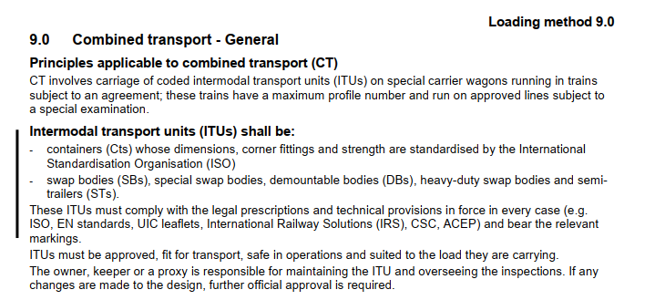
Loading Guidelines Volume 2 Chpt. 9.0
Combined Transport - General
Chapter 9 of Volume 2 describes the general requirements for transport of Container, Swap Bodies, Semitrailer or other ILU on railway wagons in combined transport
14.09.2021

Slide 2
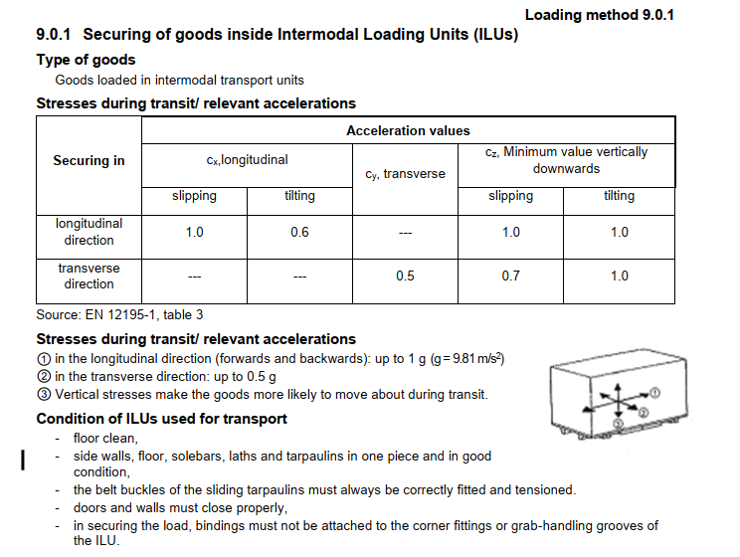
Chapter 9.0.1 securing of goods inside ILUs
Basis for the stresses affect inside the unit acc. to EN12195-1 table 3
14.09.2021

Slide 3
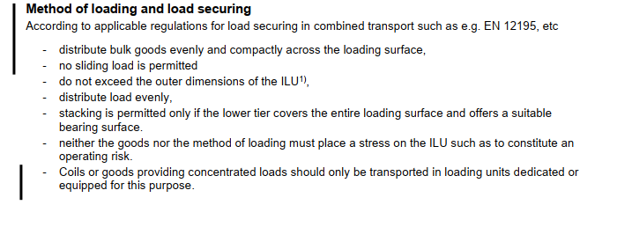
Chapter 9.0.1 securing of goods inside ILUs
Method of loading and load securing refer to applicable standard
EN12195, etc
We had a discussion in our group to add CTU Guideline as regulation as well
14.09.2021

Slide 4
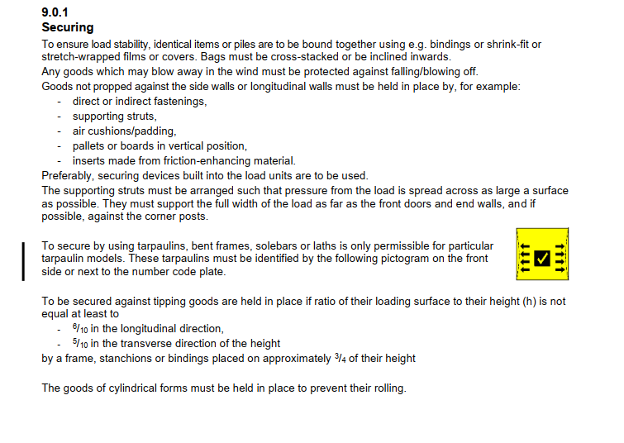
Chapter 9.0.1 securing of goods inside ILUs
Securing – load stability
14.09.2021

