Slide 1
Status Report of the Informal Working Group on Validation Methods for Automated Driving (VMAD)
Informal document GRVA-11-37
11th GRVA, 27 Sept.-1 Oct. 2021
Agenda item 4(b)
Submitted by the IWG on VMAD
United Nations Economic Commission for Europe (UNECE) Working Party on Automated/Autonomous and Connected Vehicles (GRVA)
27 September-1 October 2021 WebEx

Slide 2
Purpose
To provide a status update on the work of the Validation Methods for Automated Driving (VMAD) Informal Working Group (IWG). Specifically the following:
Deliverables
Work accomplished on 2nd iteration of NATM
VMAD IWG and its Subgroups’ working schedule
Collaboration between FRAV and VMAD

Slide 3
VMAD Deliverables to the World Forum for Harmonization of Vehicle Regulations (WP.29)
Based on the Framework document, VMAD has the following deliverables to WP.29:
Deliverables | Status
１．Second iteration of NATM addressing the “outstanding issues” identified by VMAD and the evaluation of NATM for the motorway use-case | November 2021 (information) / March 2022 (endorsement)
２．WP29 guidelines for NATM including outcome of “outstanding issues” and translation of FRAV requirements | March 2022 (information)

Slide 4
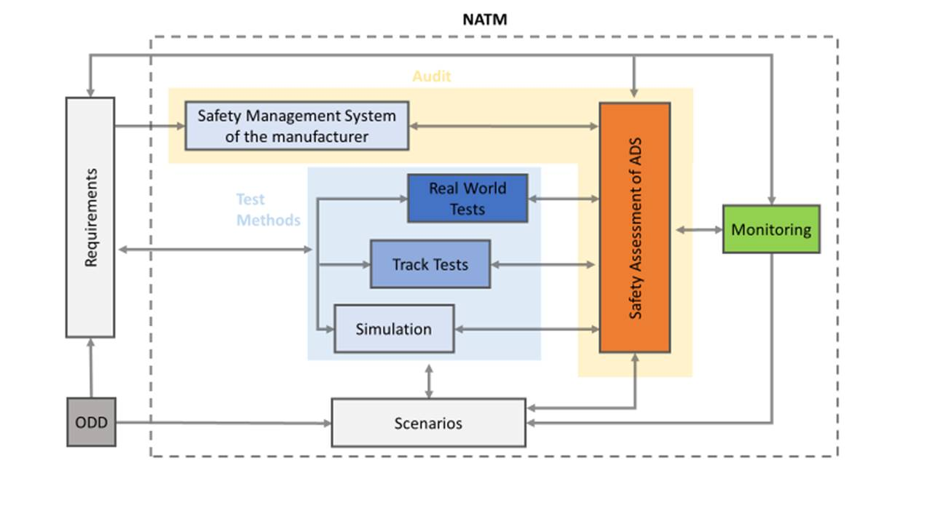
NATM Master Document
Section 9
Section 8
Section 10
Section 7
Section 12
Section 6
Section 5
4

Slide 5
Work accomplished by Sub Group 1 (Scenarios)
SG1 has continued discussions on draft 2nd iteration Ch.5 and Annex 2 of NATM MD.
Various proposals have been submitted and are bundled as a draft amendment (e.g. language regarding developing a scenario template, etc.)
There are several unresolved issues and SG1 is going to discuss and finalize the texts for Master Document amendment at the next SG1 session (to be held October 4).
Introduced a new objective in Ch. 5 & Annex 2 to provide examples of scenarios with lower abstraction level.
FRAV and VMAD agreed to select a few concrete test cases to work on collaboratively.

Slide 6
Work accomplished by Sub Group 2 (Simulation/Virtual Testing)
Introduced new section in NATM:
Credibility assessment for using virtual toolchains in ADS validation.
Ongoing discussions to refine, including how to address issues such experience and expertise.
Proposed 3 new annexes:
Annex I - Virtual Testing Toolchain Example
Annex II – Correlation methodologies
Annex III – Validation examples
SG2 will review comments on proposed documents and revise NATM as required.

Slide 7
Work accomplished by Sub Group 3 (Audit and In-use Monitoring)
Safety by design: Draft requirements under development.
Safety Management System (SMS): Draft requirements
Conditions of validity of the SMS still to be refined.
Final text for requirements still to be formally endorsed by SG3 then VMAD.

Slide 8
Work accomplished by Sub Group 3 (Audit and In-use Monitoring)
Goal/Metrics necessary for in-service monitoring still under discussion.
Proposed data elements to be monitored and reported under discussion.
Investigate reporting mechanism and reporting criteria as well as data accessibility (at macro level only at this stage) still under discussion.
Big differences between motorway applications and other applications.
Guidance from FRAV in the overall safety level to be achieved on the motorway could be useful.
Next meeting scheduled for 12 October, 2021.

Slide 9
Work accomplished by Sub Group 4 (Track Test and Real-world Test)
Developed inventory of TT / RWT best practices/procedures and technical resources/tools (for NATM).
Developed possible approach for a test matrix
Further work to be done:
Design/elaboration of the test matrix
Development of test methodology (method and tools to be used) and test protocols with pass / fail criteria for TT and RWT based on FRAV input
Development of specific test protocols
Try out/validation

Slide 10
Collaboration between FRAV and VMAD
FRAV and VMAD co-chairs continue to meet regularly to facilitate the accomplishment of their respective deliverables.
FRAV and VMAD co-chairs extended the joint meeting to SG leaders and FRAV Workstream leaders.
FRAV and VMAD agreed to select a few test cases to work on collaboratively to develop a better synchronization between our two groups.
Co-chairs will continue to update the GRVA members on progress.
SG1 and SG4 have already started together with FRAV.

Slide 11
VMAD IWG and its Subgroups’ working schedule
September 29: VMAD members are asked to send written comments to the proposed revisions of the Master Document by Sept. 29
October 27: VMAD21 is held to review and finalize the draft second iteration
October 29: the draft second iteration is submitted to GRVA Secretary
November 9-10: VMAD22 is held to consider WP29 guidelines for NATM
February 7, 2022: the draft second iteration is tabled at GRVA as formal doc.
March 8-11: the draft is tabled at WP29 as informal doc. for endorsement
June 21-24: the draft is tabled at WP29 as formal doc. for endorsement

Slide 12
Summary
Substantial work has been accomplished on 2nd iteration of NATM.
Draft second iteration of the NATM Master Document will be submitted to the next GRVA.
FRAV and VMAD agreed to select a few concrete test cases to work on collaboratively to develop a better synchronization between the two groups.

Slide 13
Thank you!

