Slide 1
The transport of live aquatic animals using oxygen Geoff Leach Director The Dangerous Goods Office Ltd
Notes:
Version: 2021-01
Date: 01/01/2021
RESOURCES NEEDED:
Laptop and backup
Projector
IATA DGR
ICAO TI (optional)
AN(DG)Rs (optional)
Flip Chart
Chemical oxygen generator (if not travelling by air)
Examples of batteries, cells and equipment

Slide 2
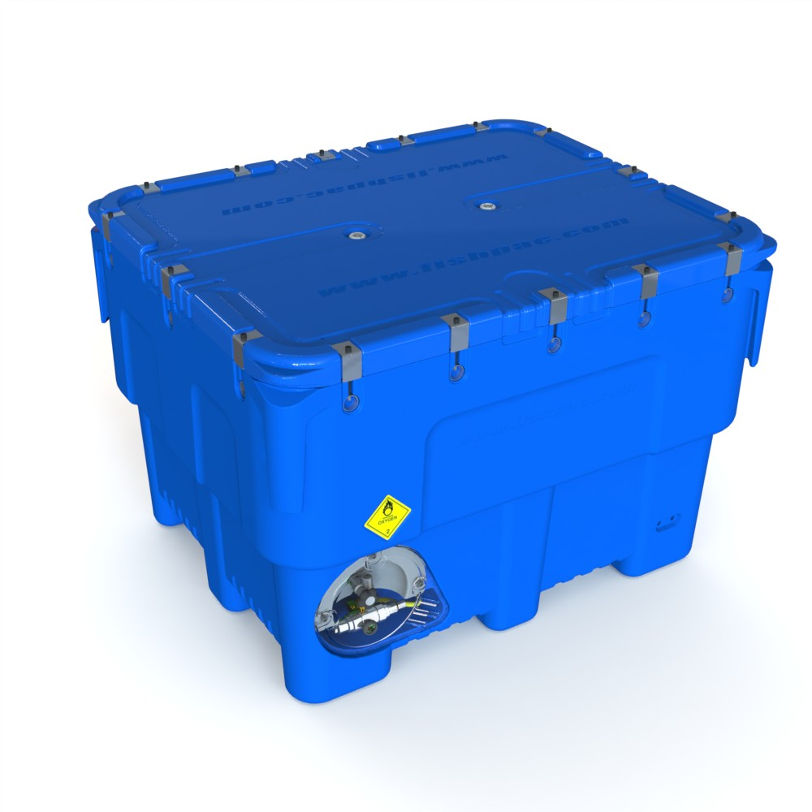
An example….
Payload of 400kg +
Weight up to 1250kg
Cylinder placed in dedicated holder at the bottom of bin
Maximum top opening for packing and filling
Double gore vents in lid

Slide 3
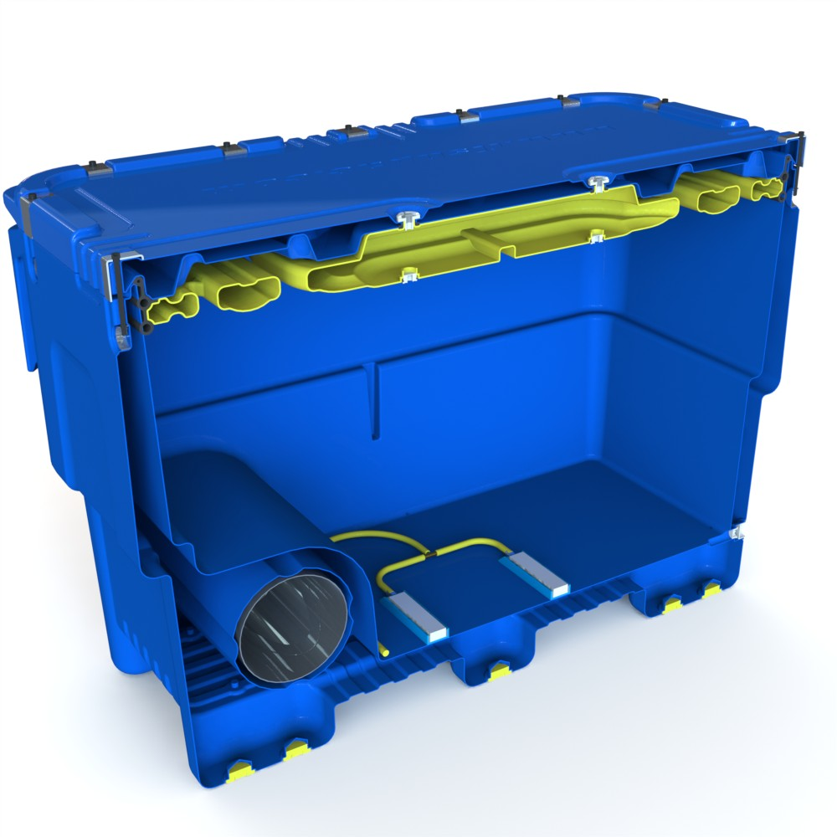
Cut away showing Oxygen bottle retainer and internal foaming
Cross sectional cut away

Slide 4
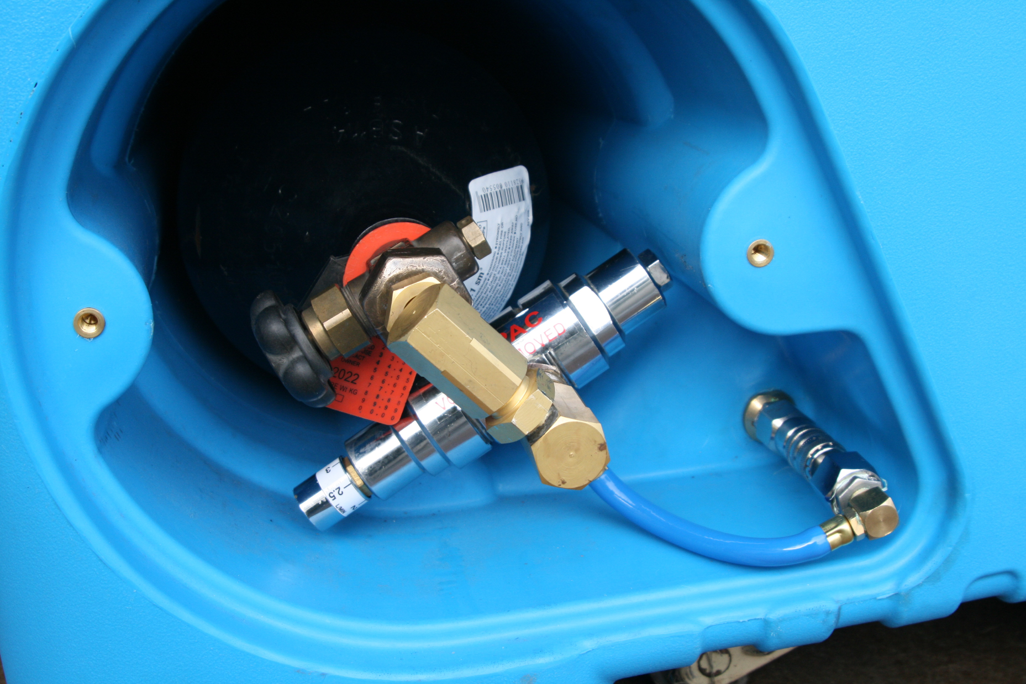
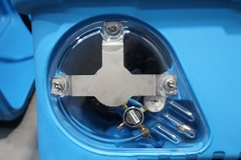
Oxygen bottle retained in housing
Protective steel plate

Slide 5
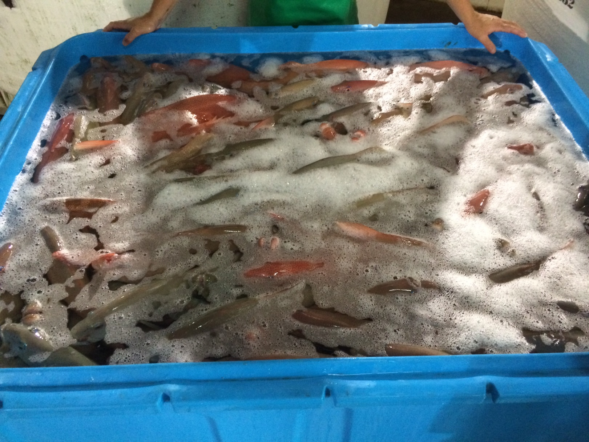

Slide 6
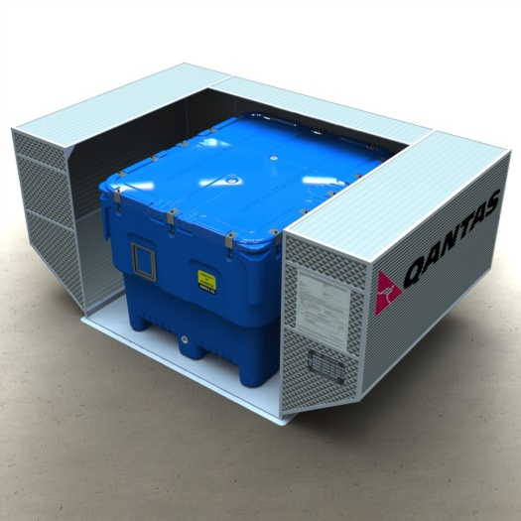
350,000+ movements by air

