Slide 1
Electric Vehicles and the Environment (EVE IWG)
Submitted by the EVE informal working group
Informal document GRPE-83-29
83rd GRPE, 1~4 June 2021
Agenda item 9(b)
Report to GRPE 83rd Session

Slide 2
EVE Mandate Items
In-vehicle battery durability
EVE IWG has made significant progress on the GTR over the last year.
However, significant issues remain and prevent the IWG from moving the GTR forward during this GRPE
An option for a 1-year extension was provided under the last mandate.
The IWG is now targeting consideration of the GTR by GRPE in November 2021.
Hybrid power determination
New GTR on determination of power in electrified vehicles was accepted by WP. 29 in November 2020 as GTR No. 21
The EVE IWG will continue to consider the need for additions and revisions
For example, addition of family concept and candidate method
Method of stating energy consumption
EVE coordinating with Group of Experts on Energy Efficiency (GEEE)

Slide 3
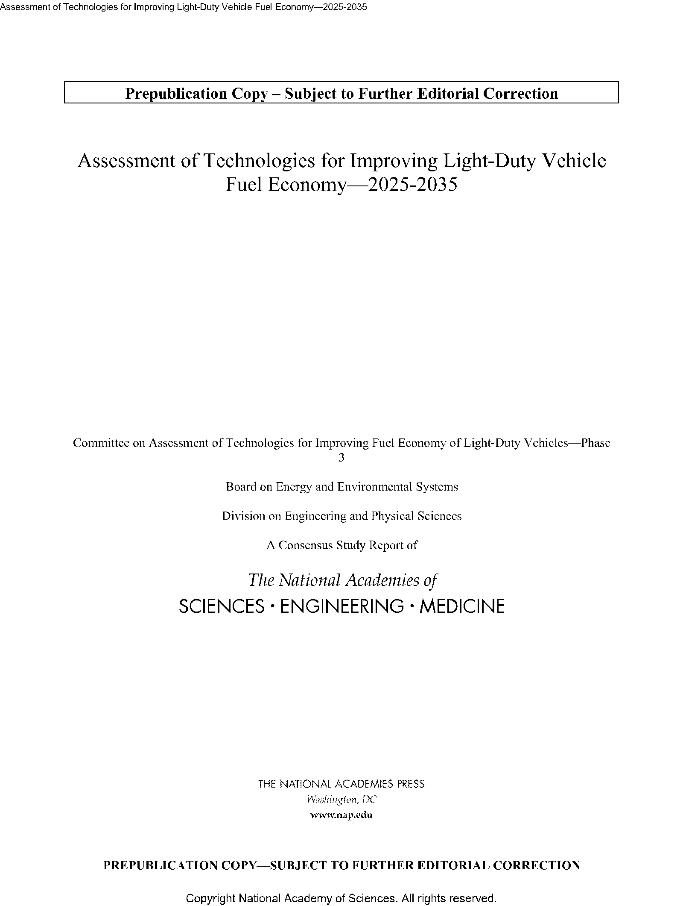
Electrified Vehicle Durability Importance
California Air Resources Board (CARB) recently presented “Assurance Measures”, which included electrified vehicle durability requirements, during a public workshop on their Advanced Clean Car (ACC) II program.
https://ww2.arb.ca.gov/events/public-workshop-advanced-clean-cars-ii
New Battery Regulation proposal in EU recognizes the importance of performance criteria for batteries and mentions work of EVE IWG
https://ec.europa.eu/commission/presscorner/detail/en/ip_20_2312
In US National Academy of Science’s recent report: “Assessment of Technologies for Improving Light-Duty Vehicle Fuel Economy—2025-2035” concluded that
“Battery degradation is important to cost and consumer acceptance, but real-life degradation is not well understood.”
https://www.nationalacademies.org/our-work/assessment-of-technologies-for-improving-fuel-economy-of-light-duty-vehicles-phase-3

Slide 4
Status of In-Vehicle Battery Durability
Document has been submitted for this GRPE: ECE/TRANS/WP.29/GRPE/2021/18
Originally submitted for consideration by this GRPE
Significant issues remain open or have just recently been closed:
Part A and B Family Definitions
Part A Statistics
Part A and B Flags
UBE Definition
V2X Provision
Considerable new text has been drafted and it is appropriate that stakeholders have more time for review.

Slide 5
Part A and B Family Definitions
As previously described, the Durability GTR contains provisions for family definitions.
These families are divided into two parts:
Part A Family, for verification of the state of health monitor
Part B Family, for verification of the minimum performance requirements
Issue: Lack of consensus regarding the exact criteria for Part A and Part B family membership
Attempt to identify the vehicle and system parameters which are important for the Part A and Part B requirements.
Balanced with manufacturer burden for testing and monitoring.
Status: GTR text recently updated to reflect current consensus. (Reference GTR Section 6.1)

Slide 6
Part A Statistics
As previously described, the Durability GTR contains provisions for in-service conformity.
Part A requirements specifically address the performance of the state of health monitor.
Issue: Testing and developing confidence in the capability of SOH monitor requires prescriptive statistics. Several alternatives were considered.
Status: GTR text recently updated to reflect current consensus. (Reference GTR Section 6.3)

Slide 7
Part A and B Flags
GTR has provisions for the status of the vehicle to be included in Part A and Part B verification
Part A flag is meant to show that vehicle and/or operating conditions are not appropriate for the monitor to reflect the correct SOH value.
Part A flags may be cleared through the inducement of a monitor routine.
Part B flag is meant to identify vehicles that have been operated in such a way as make the monitoring of the performance requirements inappropriate.
Intent was to have a limited use of Part B flags with most vehicle operation considered “normal”.
Issue: Criteria for setting of Part A and Part B flags and their exact role in Part A and Part B is not decided.
Status: Issue open. (Reference GTR Section 6 and Annex 2)

Slide 8
Usable Battery Energy (UBE) Definition
In Phase 1 of GTR, MPR is based on UBE retention (range retention to be considered in Phase 2)
Issue: Depending on the applicable regional test procedure, UBE may be determined differently and may not be a formally declared value
GTR needs more detail on how to determine “certified” UBE and measured UBE in all scenarios, and other issues such as SOC correction for OVC-HEV and rounding
IWG considering proposals but more discussion needed
Status: Issue open. (Reference GTR Annex 3)

Slide 9
V2x Provision
V2x is the ability for the vehicle to supply energy from the in-vehicle battery to a load not related to propulsion.
For example: powering your home in the event of a power loss
GTR should not discourage V2x operation
Issue: Usage of the battery for this purpose is not reflected in the distance traveled when the MPR is being evaluated in Part B.
Status: EVE is considering several alternatives including exclusion of vehicles with significant V2x operation or a means of compensating for V2x energy transfer.

Slide 10
Original proposed mandate timeline
(i) March 2020: Approval of mandate from AC.3
(ii) January 2020 – June 2020: EVE IWG formulates new drafting group, and begins drafting GTR with elements agreed upon by EVE IWG
(iii) June 2020: EVE IWG provides update to GRPE outlining details of draft outline of GTR
(iv) June 2020 – December 2020: EVE begins validation testing of relevant aspects of the proposed procedure, assesses results and makes changes to GTR
(v) January 2021: EVE IWG submits first draft proposal for the GTR as an informal document to January 2021 session of GRPE for further discussion and recommendation.
(vi) January 2021- March 2021
a. EVE revises draft proposal based on recommendations from GRPE
b. Transmission of the draft GTR as an informal document twelve weeks before the June 2021 session of GRPE;
c. Endorsement of the draft GTR based on an informal document by GRPE.
(vii) June 2021: EVE presents the final GTR to GRPE
(viii) November 2021: establishment of the GTR by AC.3 in the Global Registry.
(ix) January 2021-January 2024: EVE IWG continues information gathering on possible modifications to the GTR and develops amendments to the GTR for consideration by WP.29 and AC.3, as deemed appropriate.

Slide 11
Next Steps for Electrified In-Vehicle Battery Durability
(a) January 2020: IWG on EVE presents timeline and framework for mandate request in GRPE.
(b) June 2020: Request for authorization submitted to AC.3; ✓
(c) January 2020 – June 2020: IWG on EVE formulates drafting group and begins drafting UN GTR with elements agreed upon ✓
(d) June 2020: IWG on EVE provides an update to the June 2020 meeting of GRPE with the detailed elements and proposed timelines to be pursued; ✓
(e) June 2020 – December 2020: IWG on EVE begins validation testing of relevant aspects of the proposed procedure, assesses test results and makes further UN GTR changes as necessary (No validation necessary for phase 1, more time being spent on drafting and framework)
(f) January 2021: IWG on EVE presents to GRPE
(i) A status update of the first UN GTR validation results; ECE/TRANS/WP.29/AC.3/57 5 (Not needed)
(ii) First draft UN GTR proposal, both as informal documents for the January 2021 session of GRPE for further discussion and recommendation
(g) January 2021 – March 2021:
(i) IWG on EVE revises draft proposal based on discussions and recommendations from GRPE and;
(ii) Submits the draft UN GTR for transmission as a formal document for the June 2021 GRPE session (The aim was to achieve this, but several open issues remain in discussion and need to be resolved to ensure a robust and accepted GTR)
(h) (Proposal) November 2021: IWG on EVE presents Final UN GTR to GRPE for endorsement at the additional GRPE session held in November 2021.
(i) November 2021: establishment of the UN GTR by AC.3 in the Global Registry.
(j) November 2021-January 2024: IWG on EVE continues information gathering on possible modifications to the UN GTR and develops amendments to the UN GTR for consideration by WP.29 and AC.3, as deemed appropriate.
✓

Slide 12
Requirements to meet adjusted schedule
The original schedule was ambitious
EVE IWG has increased cadence of meetings
The draft GTR is available for review and comment
The EVE IWG requires some additional time to address remaining issues.
Final document will be submitted in September to support an additional GRPE session in November 2021.

Slide 13
Method of Stating Energy Consumption
EVE held, together with the Group of Expert on Energy Efficiency (GEEE) of the Energy division of UNECE and its task force on Energy Digitalization, a joint workshop on “Real-Time Upstream Emissions of Electric Vehicles During Recharge”
More info about the workshop available here: https://unece.org/sustainable-energy/events/online-workshop-real-time-upstream-emissions-electric-vehicles-during
The objective of the workshop was to:
Engage GEEE and EVE to look closely at this (and other) opportunities to work together on a concrete topic linked to the EVE mandate
Assess the feasibility of an accurate determination of the electricity mix and its related carbon content in real time during EV recharge, exploring both grid, recharging stations and vehicles dimensions

Slide 14
GEEE/EVE Workshop Results
Smart grids, intelligent charging management systems and connected vehicles make the quantification of real-time recharging emissions technically feasible today
Broad agreement among speakers that vehicle and energy supply sides need to work together to deliver on a potential measurement procedure, if deemed appropriate and useful
Third-party data users (app developers, data aggregators) called for more transparent and harmonized data streams, from both electricity providers and connected vehicle features, while ensuring data privacy and security
GEEE and EVE still need further considerations to decide on a way forward towards concrete collaboration

Slide 15
Other EVE IWG items and updates
UN GTR No. 21 – Determination of system power of electrified vehicles
The EVE IWG previously indicated that a candidate method and family concept may be considered in the future for this GTR.
The EVE IWG will continue to assess and provide updates
EVE IWG Terms of Reference
A draft copy of the updated terms of reference has been added to the EVE IWG wiki page as document EVE-49-05e.

Slide 16
EVE Meetings
Regular meetings concurrent with GRPE each January and June
EVE IWG has conducted regular online meetings since September 2020 to diligently work within the in-vehicle battery durability GTR timelines
24-26 March 2020– WebEx
7-8 September 2020 - WebEx
7-8 October 2020 – WebEx
9-10 and 30 November 2020 – WebEx
1 and 15-16 December 2020 – WebEx
8 January 2021 – WebEx
3-4, and 26 February 2021 – WebEx
25-26 March 2021 – WebEx
23 and 26 April 2021 – WebEx
12, 18 and 26 of May 2021 - WebEx

Slide 17
Proposed Meetings for EVE IWG
Meetings will remain virtual through the summer and early fall.
Meetings planned for mid-June, early July and early September
Dates to be announced

Slide 18
Thank you!
Michael Olechiw
EVE Chair
olechiw.michael@epa.gov

