Slide 1
Transmitted by the Chair and Secretary of VIAQ
Informal document GRPE-83-23
83nd GRPE, 1-4 June 2021
Agenda item 12
Status Report of the
VIAQ (Vehicle Interior Air Quality)
Informal Working Group
Geneva, June 1-4, 2021
Chair: Andrey KOZLOV, Russian Federation
Co-Chair: Jongsoon LIM, The Republic of Korea
Secretary: Andreas WEHRMEIER, BMW

Slide 2
ToR for the Third Stage
Terms of reference and rules of procedure for the IWG on Vehicle Interior Air Quality
Background. The group considered the inclusion in the scope of interior air pollutants from outside sources as a possible extension of the mandate at third stage. As an extension of the existing Mutual Resolution on VIAQ, this will take into account not only interior air emissions generated from interior materials and exhaust gases from the vehicle entering into the cabin but also outside air pollution sources. The list of outside air pollutions could include CO, NO, NO2, SO2, O3 volatile organic compounds (VOC), aldehydes, aromatic and aliphatic hydrocarbons, particulate number (PN) and mass (PM) and microbiological substances, e.g. allergens, fungi, bacteria and viruses. As an extension of the existing Mutual Resolution on VIAQ, this will take into account not only interior air quality but also the air cleaning efficiency of the vehicle air handling & treatment system.
Objective. This proposal expands on the issues of the vehicle interior air quality, addressing outside air pollutants entering into the vehicle cabin and the interior air cleaning efficiency, to develop a test procedure in a recommendation by including Part 4 in the Mutual Resolution No. 3.
Scope and work items. Outside air pollutants entering into the vehicle cabin and their cleaning efficiencies
(a) Collect the information and research data on relevant air pollutants and similar issues, and understand the current regulatory requirements with respect to vehicle interior air quality in different markets.
(b) Review, assess and develop new test procedures suitable for the measurement methods of air pollutants entering into the vehicle cabin and their cleaning efficiencies (including test modes, sample collection methods and analysis methods, etc.)
(c) Discuss the potential of air pollutants in the vehicle interior air with toxicologists.
(d) Develop a draft for test procedures in a recommendation.
Informal document GRPE-81-09
Notes:
2

Slide 3
VIAQ IWG Meetings since the last GRPE session
22nd VIAQ IWG Meeting
• Webex, 27th April 2021
Half a day
Notes:
3

Slide 4
Timeline
WP.29
197
GRPE
81
82
83
84
85
86
87
88
89
90
91
VIAQ
20
21
22
23
24
25
26
27
28
29
30
31
32
33
34
35
36
37
38
2020 | 2021 | 2022 | 2023 | 2024 | 2025
PM Draft +Gas Draft Final Draft
Data collection
Analysis of existing test procedures
Tests by VIAQ IWG members
Developing of harmonized test procedure
Stage 3. Phase 1
Stage 3. Phase 2
Notes:
4

Slide 5
The objective and tasks for the Phase 1
Objective:
globally: development of a harmonized (at the UN level) methodology for assessing the effectiveness of air cleaning in the cabin of a complete vehicle
1 phase of work: development of a methodology for the concentration of particles measuring in the passenger compartment of a car in real driving conditions and assessment of the effectiveness of the cabin air cleaning systems regarding particles
Tasks:
Development of the draft of the test procedure
Carrying out field experiments on various vehicles in various driving conditions with various settings / configurations of the interior ventilation system
Analysis of the obtained data (with the development of the method of post-processing of the data), their submission for consideration in the VIAQ group
Development of a methodology for measuring the concentration of particles in the passenger compartment under real driving conditions
Analysis of the data obtained with an assessment of the effectiveness of the cabin air cleaning system
Development of a methodology for assessing the effectiveness of a cabin air cleaning system for a car regarding to particles in real driving conditions
Presentation of the methodology and results of experimental studies on the VIAQ group
Notes:
5

Slide 6
Comparative analysis of different VIAQ test methodologies
The purpose of this analysis is to compare different vehicle interior air test approaches to develop PM measurement test method.
The items
Vehicle Category
Criteria for excluding a vehicle from tests
Test Vehicle age/millage
Meteorological Conditions
Test Conditions
Sampling Points/Sampling Lines
Background air pollution level
Cabin air filter age
PM and gas components to be Measured
Measurement Methods
Test equipment requirements
Gas Analysers Calibration
Test Modes
HVAC Modes
Test Procedure
Test Protocol
Notes:
6

Slide 7
Literature Review
Index | Publication reference
CEN | CEN/WS 103 Real drive test method for collecting vehicle interior air quality data // Doc. CEN/WS 103 N. 23, 2021 Pham, L., Molden, N., Boyle, S., Johnson, K., & Jung, H. (2019). Development of a Standard Testing Method for Vehicle Cabin Air Quality Index. SAE International Journal of Commercial Vehicles, 12(2). http://dx.doi.org/10.4271/02-12-02-0012
CabinAir | Cha Y. Dynamic and stationary measurement of in-vehicle PM2.5 and the filtration. VIAQ-21-07
Wei | Wei, D., Nielsen, F., Ekberg, L., Löfvendahl, A., Bernander, M., Dalenbäck, J-O. PM2.5 and ultrafine particles in passenger car cabins in Sweden and northern China—the influence of filter age and pre-ionization. Environ Sci Pollut Res 27, 30815–30830 (2020). https://doi.org/10.1007/s11356-020-09214-0
Abi-Esber | Abi-Esber L, El-FadelM (2013) Indoor to outdoor air quality associations with self-pollution implications inside passenger car cabins. Atmos Environ 81:450–463. https://doi.org/10.1016/j.atmosenv.2013.09.040
Zhu | Zhu Y, Eiguren-Fernandez A, Hinds WC, Miguel AH (2007) In-cabin commuter exposure to ultrafine particles on Los Angeles freeways. Environ Sci Technol 41:2138–2145. https://doi.org/10.1021/Es0618797
Notes:
7

Slide 8
Literature Review
Both AF, Westerdahl D, Fruin S, Haryanto B, Marshall JD (2013) Exposure to carbon monoxide, fine particle mass, and ultrafine particle number in Jakarta, Indonesia: effect of commute mode. SciTotal Environ 443:965–972. https://doi.org/10.1016/j.scitotenv.2012.10.082
Jain S (2017) Exposure to in-vehicle respirable particulate matter in passenger vehicles under different ventilation conditions and seasons. Sustain Environ Res 27:87–94. https://doi.org/10.1016/j.serj.2016.08.006
Jung HS, Grady ML, Victoroff T, Miller AL. Simultaneously reducing CO2 and particulate exposures via fractional recirculation of vehicle cabin air. Atmos Environ. 2017 Jul;160:77-88. https://doi.org/10.1016/j.atmosenv.2017.04.014
Huang J, Deng F, Wu S, Guo X (2012) Comparisons of personal exposure to PM2.5 and CO by different commuting modes in Beijing, China. Sci Total Environ 425:52–59. https://doi.org/10.1016/j.scitotenv.2012.03.007
Kaur S, NieuwenhuijsenM, Colvile R (2005) Personal exposure of street canyon intersection users to PM2.5, ultrafine particle counts and carbon monoxide in Central London, UK. Atmos Environ 39: 3629–3641. https://doi.org/10.1016/j.atmosenv.2005.02.046
Knibbs LD, de Dear RJ, Morawska L, Mengersen KL (2009) On-road ultrafine particle concentration in the M5 East road tunnel, Sydney, Australia. Atmos Environ 43:3510–3519. https://doi.org/10.1016/j.atmosenv.2009.04.029
Knibbs LD, De Dear RJ, Morawska L (2010) Effect of cabin ventilation rate on ultrafine particle exposure inside automobiles. Environ SciTechnol 44:3546–3551. https://doi.org/10.1021/es9038209
Qiu Z, Song J, Xu X, Luo Y, Zhao R, Zhou W, Xiang B, Hao Y (2017) Commuter exposure to particulate matter for different transportation modes in Xi’an, China. Atmos Pollut Res 8:940–948. https://doi.org/10.1016/j.apr.2017.03.005
Tartakovsky L, Baibikov N, Czerwinski J, Gutman M, Kasper M, Popescu D, Veinblat M, Zvirin Y (2013) In-vehicle particle air pollution and its mitigation. Atmos Environ 64:320–328 https://doi.org/10.1016/j.atmosenv.2012.10.003
Notes:
8

Slide 9
Analysis conclusions
The analytical review of published papers describing VIAQ research showed a wide range of approaches, measured substances and particle dimensions, different test modes and conditions, different HVAC settings etc. Most works are research or pilot study.
Only some publications contain of relatively detailed description of test methodology and test conditions and they were analysed in this document.
Most comprehensive test methodology description is in the document CEN/WS 103 N. 23.
Our informal working group could use this information for developing our own harmonized methodology taking into account researchers experience worldwide.
Most important criterions for our methodology will be: to find worse case scenario; to minimize cost and test time; to ensure accuracy and repeatability of tests in different laboratories; to harmonize test conditions and test procedure worldwide.
Notes:
9

Slide 10
Information discussed last meeting
Company | Presenter Name | Document Title | Document No.
VolvoCars | Dixin Wei | PM 2.5 and UFP in Sweden and Northern China – The influence of filter age and pre-ionization | VIAQ-22-04
CabinAir | Yingying Cha | Vehicle filtration performance for testing at different locations where the dominant particle size is different | VIAQ-22-05
AIR | Nick Molden | Update on method validation. Results of further testing | VIAQ-22-06
NAMI | Andrey Kozlov | Comparative analysis of different VIAQ test methodologies Working items feedback form | VIAQ-22-07 VIAQ-22-08
Cambustion | Mark Peckham | Passenger car cabin air vent [NO] measurements with a fast response CLD | VIAQ-22-09
Stellantis | Juliette Quartararo | Methodology for PM measurements in real driving conditions | VIAQ-22-10
Renault | Didier Moigneu | Air treatment for vehicle interior air quality | VIAQ-22-11

Slide 11
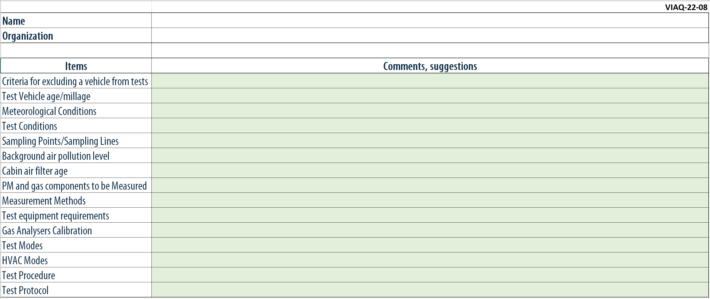
Feedback form
Notes:
11

Slide 12
Next VIAQ IWG Meetings
23st VIAQ IWG Meeting (TBD)
• Brussels, Belgium, November, 2021
or Paris, France, November, 2021
Two days
24st VIAQ IWG Meeting (TBD)
• Geneva, Switzerland, January, 2022
• Half a day
Notes:
12

