Slide 1

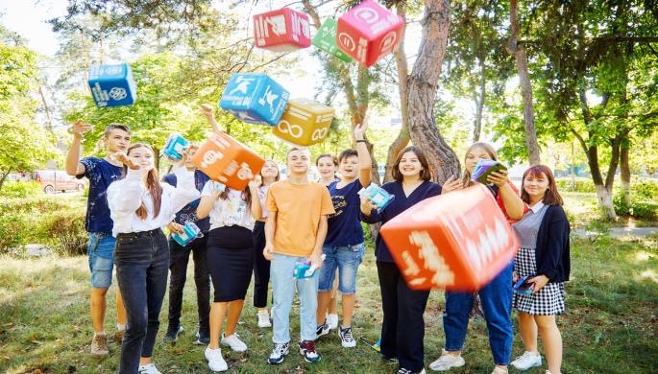
Mechanisms and Tools related to ESD
at the frame of the SGP Innovation Youth Program
Maryna Diachenko, Coordinator of the Partnership Network
"Education for Sustainable Development in Ukraine"
16th meeting of UNECE Steering Committee on ESD, May, 10-11, 2021

Slide 2
At 1.8 billion, more adolescents and young people (aged 10-24) than at any other time in history. They form the majority of the world’s population.
Three conditions need to be in place:
Young people have the capacities to effectively participate in community efforts towards environmental conservation/ sustainable livelihood creation;
Solid and inclusive partnerships and spaces to foster youth engagement and networking;
Gender equality and young women’s empowerment
It is also important to note SGP is undertaking a first step to address coverage of beneficiaries:
  Number of Youth;
  Number of youth organizations engaged with as part of SGP intervention

Slide 3

YOUTH AND CLIMATE CHANGE
For the past 5 years, SGP with UNFCCC and other partners have been jointly supporting Global Youth Video Competition on Climate Change for 5 years, starting from COP21 in Paris.
UNFCCC, SGP, and other partners are developing a broader partnership initiative aiming to connect and support local, national and global youth climate actions and bridge the gap between local activities and global processes to achieve greater scale and impact.
The United Nations, in preparation for the 2019 Climate Summit of the Secretary-General has stressed that youth participation and leadership is key for the success of the summit. Several UN agencies, including UNDP and UNFCCC are working on the joint Youth Engagement Strategy aiming to increase ambition and accelerate climate action.
The United Nations, in preparation for the 2019 Climate Summit of the Secretary-General has stressed that youth participation and leadership is key for the success of the summit. Several UN agencies, including UNDP and UNFCCC are working on the joint Youth Engagement Strategy aiming to increase ambition and accelerate climate action.

Slide 4
Notes:
MAIN ELEMENTS TO IMPLEMENT THE SGP YOUTH APPROACH
Provides for both "mainstreaming" and "special investments in direct public inclusion”
KEY COMPONENTS LEVEL OF INTERVENTION
Grant making Project
Capacity building Project Country World
Knowledge generation Country World
Partnership development Country World
SGP COMMITMENT: Gender mainstreaming to address cross-cutting issues in a specific area of public inclusion
Addressing the issue of "young women and girls" in the framework of SGP youth work

Slide 5
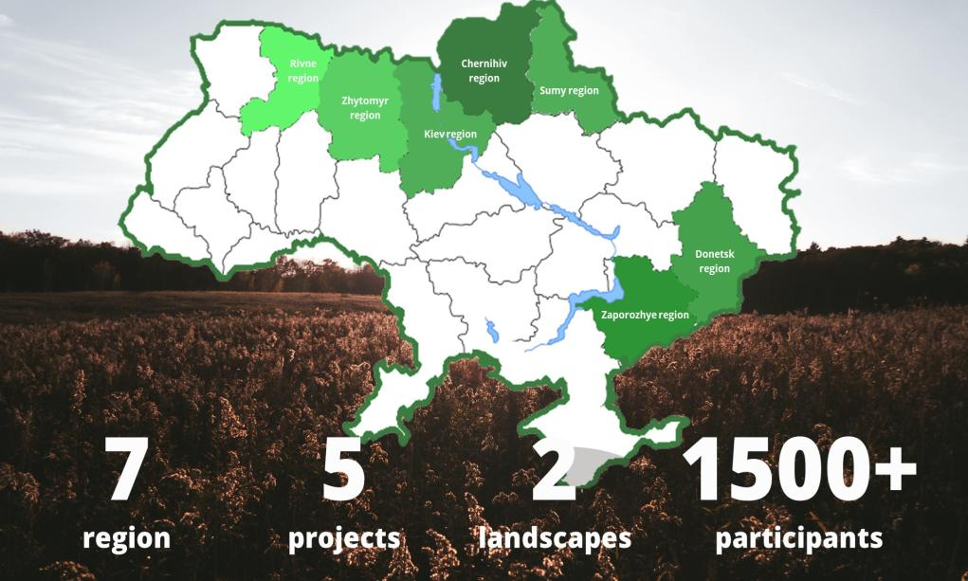

Slide 6



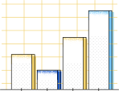
KEY ELEMENTS OF GEF SGP YOUTH
APPROACH
Grant making
Capacity building
Consolidation of knowledge
Partnership development

Slide 7

Develop awareness, skills and competencies of young people to lead climate action
The GEF SGP youth group has been established and operating on a permanent basis consisting of more than 15 youth leaders from various regions of Ukraine, in particular representatives of rural youth and internally displaced persons
The main objectives of the youth group are capacity-building in the preparation and implementation of local strategies and action plans for sustainable community development, education for sustainable development, exchange of experience, and scaling up results at the national and international levels;
Setup of 3 youth centres in 3 regions;
Support 9 youth initiatives on sustainable development, education for sustainable development in 6 regions (Rivne, Zhytomyr, Chernihiv, Sumy, Zaporizhia and Donetsk);
Capacity building, setup and legalization of 4 youth associations, support in the policy making and development of activities (online platforms, communication policy, positioning, attracting resources, scaling, expanding opportunities to influence local, national and international policies)

Slide 8
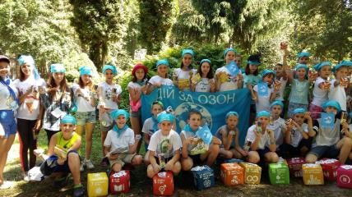
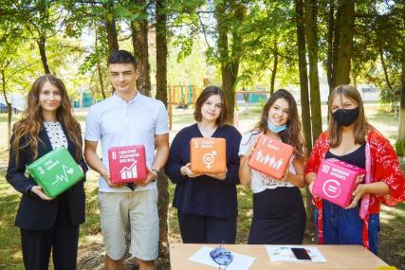
KNOWLEDGE SHARING AND OUTREACH
Outreach activities and capacity building (12 events, 6 workshops, 5 seminars, 3 national forums, 2 international events, 1 knowledge fair, 1 study visit);
Setup and development of networks and partnerships (5 networks, more than 26 partnerships);
Dissemination of results in mass and social media, on-line-platform;
Creation Youth movement "Community Compost Local - Youth Action!»;
Youth Environmental Knowledge Fair, All-Ukrainian Youth Forum "Children for environment – The future We Want” (June 2021);
GEF SGP knowledge advisory platform (Education for Sustainable Development Network, Green Zhytomyrshchyna, Ecoacademy).

Slide 9
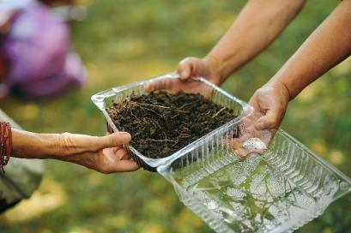
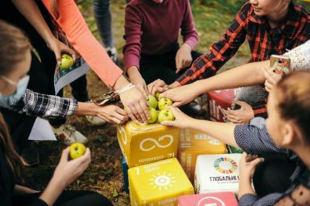
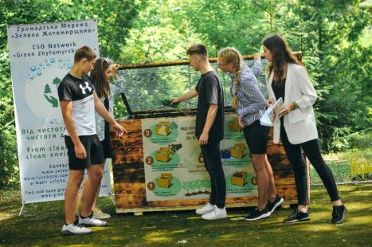
Youth movement "Community Compost Local - Youth Action!»

Slide 10

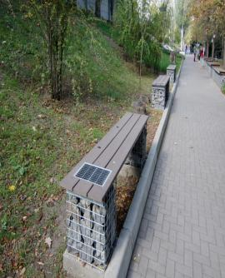
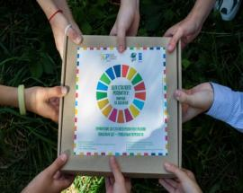
“Green jobs” for young generation
Renewable and energy efficiency technologies for productive use that results in youth employment and/or supporting youth entrepreneurship.
Youth-led initiatives that implements nature-based solutions to climate change, leading to income generation and improved livelihoods.
Cooperation with the Khortytsia National Academy (Zaporizhia region):
a youth center established; leisure sites using solar energy.
10 environmentally friendly jobs for young people created.
a laboratory and demonstration locations have been created for the implementation of garden therapy as an environmental area of social and physical rehabilitation, in particular for young people.
the concept of environmental socialization of people with disabilities and practical ecological social work developed.
the results were presented in 2 scientific articles, in the framework of 5 international scientific conferences.

Slide 11
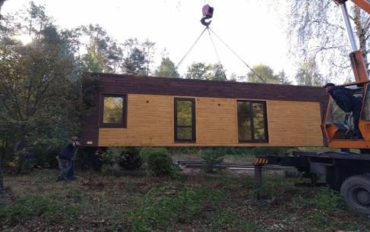
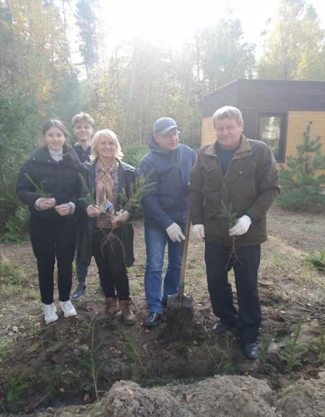
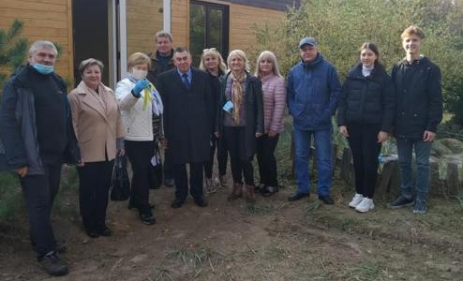
Setup of youth climate centers (Chernihiv, cooperation with Chernihiv lyceum for gifted rural youth, Chernihiv Teacher's University, local authorities, Department of Education, Department of Environment, forestries)

Slide 12
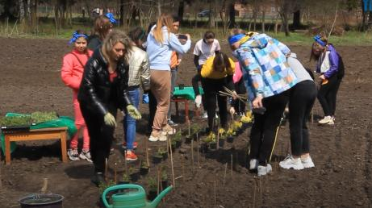
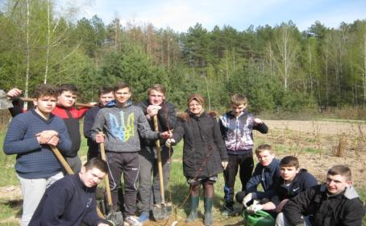
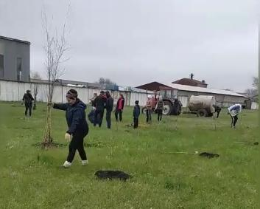
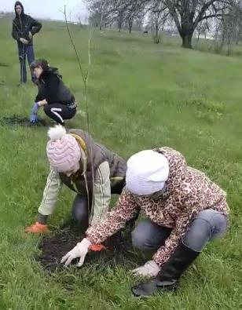
Competition of youth environmental initiatives, leadership, development of local communities based on the principles of sustainability, adaptive measures to prevent climate change (9 projects from 6 regions supported)

Slide 13
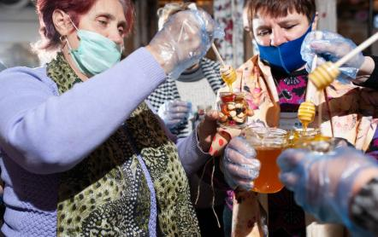
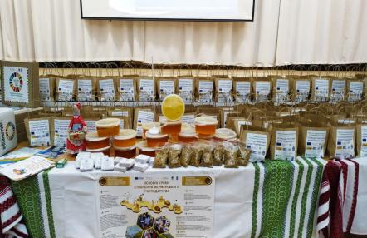
SCHOOL OF SOCIAL LEADERSHIP
(supported by Heinrich Boell Foundation, Taras Shevchenko Kyiv National University)
2 projects of the School of Social Leadership implemented;
capacity building of rural youth to practice leadership, development of opportunities, the best agroecological practices, in particular the cultivation of medicinal plants, preparation of herb collections, vitamin and medicinal teas, at school sites in cooperation with educational institutions for children with special needs, more than 120 youth representatives covered (Zhytomyr region);
expanding opportunities to support particularly vulnerable youth representatives from among internally displaced persons, children with special needs, in creating self-assistance groups, sets to support immune system using beekeeping products, more than 200 children supported, capabilities of more than 40 teachers built (Donetsk region)
testing of practical aspects in the implementation of the concept and green recovery policy during the global coronavirus pandemic

Slide 14
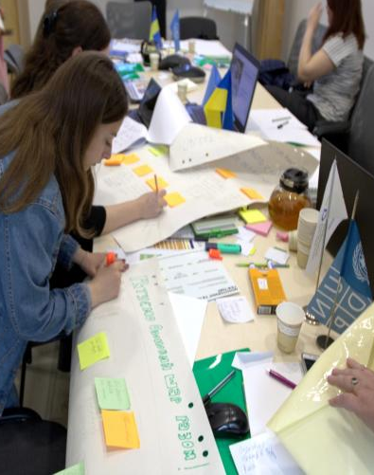
CSO-GOVERNMENT-PRIVATE SECTOR DIALOGUE PLATFORMS: OBJECTIVES AND SCOPE
Contribute to SGP overall focal area and strategic initiative objectives, engage private sector:
Building on existing participatory processes employed by SGP;
Building on GEF consultative platforms;
Facilitating CSO participation in ongoing national dialogues and legislative processes;
Supporting sustained multi-stakeholder national processes;
Contribution to global processes and their “localization”.

Slide 15
CSO-GOVERNMENT-PRIVATE SECTOR DIALOGUE PLATFORMS: OBJECTIVES AND SCOPE
Participation in an online panel on Youth Climate Action, presented by the UNDP's NDC Support Programme and the Global Youth Program in collaboration with the Environmental Management Dialogue Group and Sparkblue/SDGi teams (July, August 2020).
Participation in the meeting of the UN Working Group on Climate Change (July 2020) Workplans, involvement of institutions in youth initiatives and events, coordination of activities with the Ministry of Youth and Sports discussed.
A series of DIGITAL BRIDGE 2.0 online training sessions (September 2020).
Eastern partners youth conference 'Youth for Environment‘ for EU support.
School of Social Leadership supported by Heinrich Boell Foundation Kyiv Office Ukraine.
Exchange of experience in implementing environmental policies and education for sustainable development supported by the Bavarian Enviromental Protection iAgency.

Slide 16
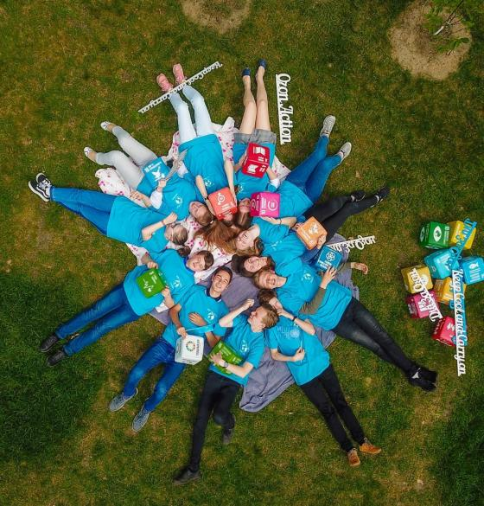
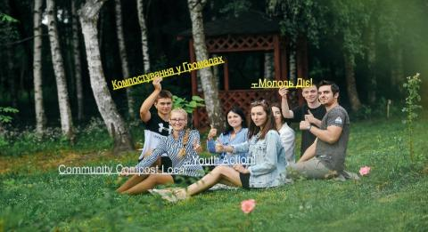
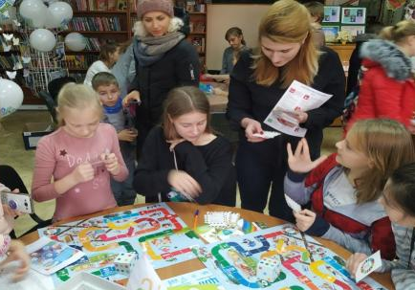
Implementation of ESD principles, interactive tools, environmental games, flash mobs, promotions, knowledge fair, All-Ukrainian Youth Forum "Children for environment – The future We Want”

Slide 17
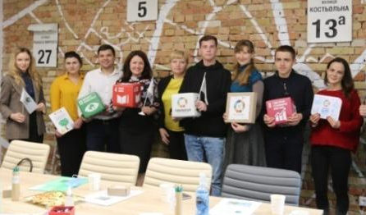
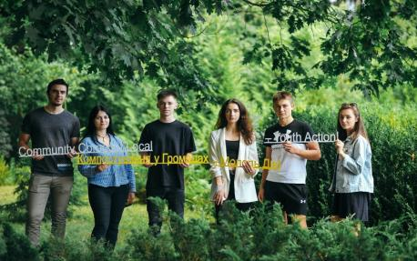
KNOWLEDGE SHARING AND OUTREACH
Promote the participation of CSOs in ongoing national dialogues and legislative processes
Support sustainable national processes and multi-stakeholder activities (National Waste Management Forum, All-Ukrainian Ecoforum);
Exchange of experience in global processes and their "localization" (UNECE Youth Working Group "Education for Sustainable Development", EU Eastern Conference "Youth for Environment", cooperation with the Bavarian Environmental Protection Agency).

Slide 18





Thank you for attention!
http://www.sgpinfo.org.ua
http://ecoacademy.org.ua
http://www.zelena.org.ua
http://www.wcu.org.ua
http://ecoosvita.org.ua
https://www.facebook.com/ecoosvita.org.ua
osvita_development@ukr.net

