Slide 1
UN Task Team on Scanner Data
Tanya Flower
Chair of the UN Task Team on Scanner Data
Group of Experts on Consumer Price Indices (online), June 2021

Slide 2
UN Committee of Experts on Big Data and Data Science for Official Statistics
Previously the Global Working Group on Big Data for Official Statistics
Created in March 2014 under the UN Statistical Commission
Mandated to give direction to the use of Big Data for Official Statistics

Slide 3
Objectives of UN Task Teams
Draft methodological guidance (handbooks/notes)
Develop method/code library supporting guidance
Develop training material

Slide 4
UN Task Team on Scanner Data
Increase the use of new data sources (web scraped and scanner data) in consumer price statistics…
Task Team homepage

Slide 5
Task Team membership
Workstream 1 | Workstream 2 | Workstream 3
Tanya Flower (ONS (UK)) | Ingolf Böttcher (Statistics Austria) | Thomas Hjorth Jacobsen (Statistics Denmark)
Brendan Williams (BLS) | Serge Goussev (Statistics Canada) | Oskar Eugster (Swiss Federal Statistical Office)
Michael Scholz (University of Graz) | Kjersti Nyborg Hov (Statistics Norway) | Kristiina Nieminen (Statistics Finland)
Cem BAŞ (TurkStat) | Liam Greenhough (ONS (UK)) | Federico Polidoro (Istat)
Lincoln Teixeira da Silva (IBGE) | Florin Barb (CBS (Netherlands)) | Wichanun Niwatjinda (Thailand (TEID))
Vladimir Gonçalves Miranda (IBGE) | Karola Henn (Destatis) | Catherine Smyth (ABS)
Rafael Posse (NISG (Mexico)) | Ken van Loon (Statistics Belgium) | Matt Stansfield (Stats NZ)
Ragnhild Nygaard (Statistics Norway) |  | Dave Lum (Stats NZ)
Matthias Bieg (Destatis) |  | Daniel Melser (Monash University, Australia)
Clément Yélou (Statistics Canada) |  | Wan Ahmad Ridhuan Wan Jaafar (Malaysia)
Antonio Chessa (CBS (Netherlands)) |  | Noradilah Adnan (Malaysia)
Claude Lamboray (Eurostat) |  | Wa Ode Zuhayeni Madjida (Indonesia)
Jacek Białek (Statistics Poland)

Slide 6
Workstream 1: Guidance on using ADS for consumer price indices
Produce an e-handbook (wiki) on using alternative data sources (ADS) to produce consumer price statistics
Make code available for NSIs to test out different methods that can be applied to ADS to produce consumer price indices

Slide 7
Workstream 2: Classification
Draft new guidance on potential methods available for classifying scanner data to produce data ready for price index compilation – via e-handbook
Initial methods/code available to share with NSIs

Slide 8
Workstream 3: Training
Production of new training content for trusted learning (targeted at different entry levels)
Delivery of new training course on using alternative data sources for consumer prices

Slide 9
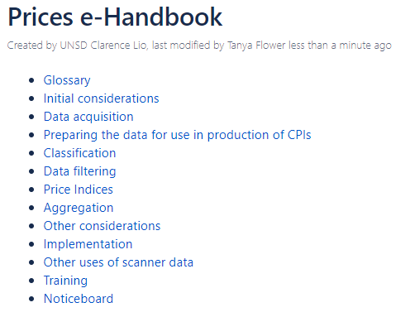
E-handbook (wiki)
Aim is to have a “living” document that will be updated over time to include the latest research/ international best practice, linking to existing material such as the CPI Manual
Currently working through the initial content, with the aim to have something ready for wider feedback towards the end of September 2021

Slide 10
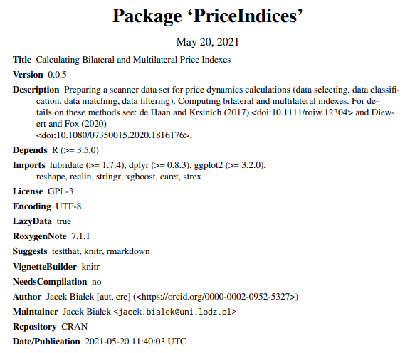
PriceIndices R index package
Includes functionality to:
Prepare a scanner data set for price dynamics calculations (data selecting, data classification, data matching, data filtering)
Compute bilateral and multilateral indexes
Link to: CRAN repository

Slide 11
Things to look out for
We are aiming to publish the e-handbook and initial training content towards the end of September 2021
We are organising a joint workshop between Eurostat and the UN Task Team towards the end of 2021

Slide 12
How can you get involved?
We’re always on the look out for new members!
Please contact any of the steering group members:
Tanya Flower (Chair and Workstream 1 lead) tanya.flower@ons.gov.uk
Ingolf Böttcher (Workstream 2 lead) Ingolf.Boettcher@statistik.gv.at
Thomas Hjorth Jacobsen (Workstream 3 lead) tsj@dst.dk
Ivo Havinga (UN Secretariat) havinga@un.org
Benson Sim (UN Secretariat) simb@un.org
If you have any specific questions on the PriceIndices R package, please contact Jacek Białek jacek.bialek@uni.lodz.pl

Slide 13
Thanks for listening! Any questions?

