Slide 1
Quality Adjustments of telecommunication services
Alexandra Schindlar and Manuel Koller
Directorate macro economics
Vienna
6 May 2021

Slide 2
Introduction
In former times tariff method, each time-distance combination was own weighted elementary aggregate only one monopolist
Upcoming of mobile telephony and service providers for fixed telephony Actual usage method combined with consumer profiles weights for providers
Changes in importance of quality dimensions (speed instead of included minutes, GB), more bundles, problems with user profiles test of application of hedonic method

Slide 3
Telecommunication status quo
Actual usage method combined with consumer profiles
Get volume data from providers per tariff package; shows that older tariff packages are more representative than new ones (contract binding, …)
Currently used method creates problems when the price determining characteristics are changing but profiles react to slowly
More bundles, joint credit (eg. 100 minutes for calls within country and within EU), total packages

Slide 4
Data
Webpage that summarizes all packages available on the market at a certain point in time; Little bit less than 200 packages per month (contract and prepaid)
Consumers can insert their profile and get feedback about most suitable – in terms of lowest costs – tariff package(s)
Data are scraped since 12/2018 – prices (basic fee + additional costs, package descriptions in terms of included volume and other describing variables (contract, costs, network)
Page intention is not long-term comparison

Slide 5
Webscraping of telecom data
Tarife.at – a comparison portal listing most/all relevant offers for the Austrian market
Provider 1
Provider 2
. . .
Provider n
Comparison portal
Comparison portal collects tariff information from various providers
Webscraping using R
Package rvest
Crontab for scheduling
Once per week
Prices and details

Slide 6
Webscraping of telecom data (1)
Name of the package | Characteristics | Value | Header
Provider A Tariff package 1 | Basic fee | 30€ | contract detail
Provider A Tariff package 1 | Included GB | 7 | Included volume
Provider A Tariff package 1 | Minute AT-AT | 0€ | Prices
Provider A Tariff package 1 | SIM-Only | No | Contract detail
Provider B Tariff package 2 | Basic fee | 0€ | Contract detail
Provider B Tariff package 2 | Included GB | 0 | Included volume
Provider B Tariff package 2 | Minute AT-AT | 0,2€ | Prices
Provider B Tariff package 2 | SIM-Only | Yes | Contract detail
Provider B Tariff package 2 | Text | Prepaid | General
… | … | … | …

Slide 7
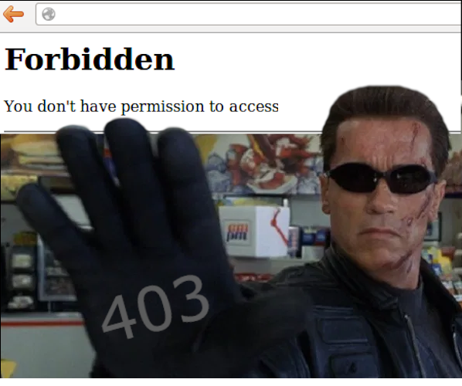
Webscraping of telecom data (2)
Problems and hassles which may arise
Page updates
Changes in design
Change of variable names
new variables (e.g. 5G)
Delay of sitemap update
Access problems/denials
IP-Block
Captchas
403
Forbidden!

Slide 8
Matched and unmatched packages
 | 2018 | 2019
Month | 12 | 01 | 02 | 03 | 04 | 05 | 06 | 07 | 08 | 09 | 10 | 11 | 12
Match before and after | 112 | 108 | 98 | 100 | 101 | 104 | 116 | 105 | 97 | 101 | 109 | 96 | 95
Last month | 2 | 4 | 12 | 7 | 13 | 3 | 4 | 12 | 9 |  |  | 13 | 1
First month |  | 2 | 9 | 14 | 6 | 16 | 1 | 1 | 4 | 8 |  |  | 18
Only one month |  |  |  |  |  |  | 1 | 1 | 1
 |  | 2020
Match before and after |  | 81 | 73 | 89 | 94 | 100 | 94 | 98 | 92 | 97 | 72 | 72 | 107
Last month |  | 29 | 9 | 10 |  | 3 | 6 | 1 | 11 | 3 | 29
First month |  | 1 | 26 | 5 | 9 |  | 5 | 5 | 8 | 4 |  | 35
Only one month |  |  | 1

Slide 9
Methods
Index of average prices (all packages)
Matched model
Bridged overlap
Time product dummy hedonic model
Hedonic repricing model (reduced data set, replacing disappearing packages with new ones, similarity plus QA)
Time dummy method (full period and adjacent time period)

Slide 10
Included variables – single effect
Variable | R² | R² adj | # dummies | Sign
Minutes within AT | 0,524 | 0,523 | 6 | 4
Minutes EU | 0,068 | 0,065 | 6 | 6
GB in Austria | 0,651 | 0,649 | 10 | 10
GB in EU | 0,692 | 0,690 | 9 | 9
Download in mbit | 0,138 | 0,135 | 6 | 6
Network operator | 0,257 | 0,257 | 2 | 2
Binding period | 0,367 | 0,366 | 3 | 3
Voice over LTE | 0,238 | 0,237 | 2 | 2
5G | 0,081 | 0,081 | 2 | 2
Age border | 0,004 | 0,003 | 2
Full model (dummies) | 0,9015 | 0,8995 | 22 | all

Slide 11
Results – implicit methods

Slide 12
Results – explicit methods without weights

Slide 13
Results – hedonic with provider weights

Slide 14
Results - Overview
 | AP | MM | MM BO | TDPD | Repricing | HTD
Reaction to unlimited packages | Up | No | No | No | No
New providers/ renaming |  | X | X | X | X
New contents/ same name |  | X | X | X | Yes | Yes
End of sales tariffs | Yes | X | X | X | yes | Yes
Start of sales tariffs |  |  |  |  | yes | Yes
Corrects for included service between packages | No | Yes | Yes | Yes | yes | Yes
Corrects for included service within packages | No | No | No | No | Yes | Yes
Uses all data | Yes | No | No | NO | Yes | Yes

Slide 15
Integration into HICP calculation
Development of an automatic computation/ production system
Annual Service fee was included which is currently the main driver for price changes (increases)
Using information about package distribution – combining old and new tariff packages

Slide 16
Tariffs offered vs tariffs used
When did you get your last mobile phone contract and …
… how long do you keep it?
Offers change quite frequently
Problem!
Tariffs actually used don’t!
An index based on new offers only is ahead of the actual market

Slide 17
Introducing a lag for offers (1 year example)
2020
Jan
Feb
Mar
…
Dec
T1_Jan_20
T1_Feb_20
T1_Jan_laged_20
T1_Mar_20
T1_Jan_20_laged
T1_Feb_20_laged
T1_Dec_20
T1_Jan_laged_20
T1_Feb_20_laged
T1_Mar_20_laged
. . .
T1_Nov_20_laged
T1 no longer offered
2021
Jan
Feb
Mar
…
Dec
T1_Jan_21
T1_Jan_20_laged
T1_Feb_20_laged
T1_Mar_20_laged
. . .
T1_Nov_20_laged
T1_Dec_20_laged
T1_Feb_21
T1_Feb_20_laged
T1_Mar_20_laged
. . .
T1_Dec_20_laged
T1_Jan_21_laged
T1_Mar_20_laged
T1_Apr_20_laged
. . .
T1_Jan_21_laged
T1_Feb_21_laged
T1_Dez_20_laged
T1_Jan_21_laged

Slide 18
Outlook
Telecommunication is still a (fast) changing market with product innovations/ changes combined with price changes
Hedonics seem feasible and the results plausible
Webscraping proved to enlarge the sample of observed tariff packages and providers
Application for prepaid mobile telephony

Slide 19
Please address queries to:
Alexandra Schindlar
Contact information:
Guglgasse 13, 1110 Vienna
phone: +43 (1) 71128-8067
Alexandra.schindlar@statistik.gv.at
Improvement of QA methods in the HICP Telecommunication product group

