Slide 1
A framework for new index number methods
Alex Rose
Methodologist
Economics Hub
ONS
Notes:
Before we get into the framework, I will give an overview of the transformation plans for inclusion of ADS in our Consumer Price Statistics.

Slide 2
Timelines for ADS implementation

Slide 3








Priority item categories
Groceries
CPIH weight: 11.4%
Used Cars
CPIH weight: 1.4%
Chart Items
CPIH weight: <1%
Clothing
CPIH weight: 4.1%
Air Fares
CPIH weight: <1%
Rail Fares
CPIH weight: <1%
Tech Goods
CPIH weight: <1%
Package Holidays
CPIH weight: 3.4%

Slide 4
Why change index method?

Slide 5
Alternative Data Sources
Census Basket
Increased Collection Frequency
More Detailed
Characteristics
Expenditure Information
UPC | Product Name | Size | Price (£) | Date
001 | Kingsmill White Loaf | 800g | 0.79 | 14/10/2020
002 | Warburtons White Loaf | 800g | 1.35 | 14/10/2020
003 | Hovis White Loaf | 800g | 1.10 | 14/10/2020
… | … | … | … | …
147 | Burgen Soya & Linseed | 800g | 1.25 | 14/10/2020
Quantity Sold
45
22
30
…
6
Notes:
Alternative data sources provide many benefits compared with our current sources, including improved product coverage and high frequency of collection.
Scanner data can also provide additional information such as expenditure per item, while web-scraped data contain a rich source of product information that is useful for things like accurate classification and determining quality.
Scanner data also have the potential to allow us to provide greater regional coverage of prices and expenditure such as, for example, regional inflation measures.

Slide 6
But traditional index methods…
Perform poorly or break down due to the dynamic nature of ADS
Fail to utilise the additional information
Notes:
because of this NSI are starting to use Multilateral methods for compiling indices using ADS.

Slide 7
How to choose a new method?

Slide 8
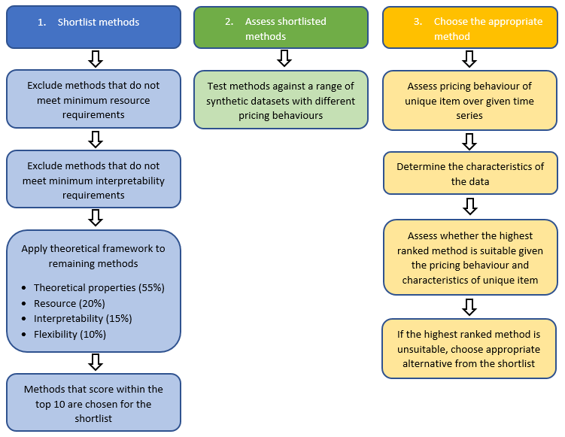
Process for choosing an index method
Rank | Method
1 | Quality adjusted Geary Khamis (QU-GK) using a Fixed Base Monthly Expanding window (FMBE)
2 | GEKS-Törnqvist using a Movement Splice
3 | GEKS-Fisher using a Movement Splice
4 | GEKS-Jevons using a Movement Splice
5 | GEKS-Törnqvist using a Geometric Mean Splice
6 | GEKS-Fisher using a Geometric Mean Splice
7 | GEKS-Törnqvist using a Window Splice
8 | GEKS-Fisher using a Window Splice
9 | GEKS-Jevons using a Geometric Mean Splice
10 | GEKS-Jevons using a Window Splice
Notes:
Our index framework:
Stage 1: Methods are first shortlisted to top 10 based on scoring against theoretical framework of pre-determined criteria (details in the next few slides).
A large number of methods is undesirable as it is both impractical to implement and complex to explain. While a large number of methods is undesirable, a single method may also not be suitable for all data sources and categories of spending.
Stage 2: Then methods are assessed against synthetic datasets covering different pricing behaviours (such as obsolescence, high variability) to work out which methods behave well under which scenarios
Stage 3: Then we assess behaviours of different markets (e.g. groceries, clothing) to see whether our top ranked method works well, if not move onto second…

Slide 9
Framework Criteria
Theoretical properties
Resource
Interpretability
Flexibility
Cohesion
Notes:
These are the criteria that we came up with as being important to our choice of index method. We discussed the importance of these criteria with our technical panel and our consumer prices stakeholders and through this were able to apply weights to reflect their relative importance.
Each method was assessed against each criterion using a pass/fail system of sub-criteria questions to produce the criterion score; the weighted criterion scores are then added together to get each method’s final score. The final score is used to rank the methods and produce the ONS shortlist of appropriate index methods for consumer prices.

Slide 10

Framework Criteria
55% of total weight, split across three key areas:
  Axiomatic approach
  Transitivity
  Characteristicity
Notes:
Given that ONS are primarily concerned with producing accurate and reliable statistics, the theoretical properties criterion was given the highest weight, 55%, and can be broken down into three key areas:
i. the axiomatic/test approach (30%)
ii. transitivity (15%),
iii. characteristicity (10%)
The axiomatic approach is an established set of tests to measure a method’s suitability from a theoretical stand point.
There are two other approaches that are often considered when theoretical properties are discussed, the stochastic approach and the economic approach.
The economic approach was given a zero weight within this framework owing to the fact that we do not currently consider a Cost of Living Index (COLI) our primary target .
The stochastic approach was considered but also given zero weight based on criticisms of the approach which highlighted that the variance assumptions made in the stochastic models are not consistent with the observed behaviour of prices.
Transitive indices are free of chain drift, that is they are directly equivalent to the direct index calculated between the start and end periods. In the static-universe, a lack of transitivity is not overly important since chaining is not required. However, transitivity is an important consideration in a dynamic-universe context, where high frequency chaining can account for dynamic prices and high churn but also results in significant chain drift.
Characteristicity requires the binary comparisons between periods to be reflected in the index.
We feel that the influence of price movements from distant periods should be kept to a minimum. For example; any multilateral method using a window of nine quarters would have data from over two years previous feeding into its index calculation. The resulting index should be more characteristic of the price movements that occurred within that month, and less characteristic of price movements observed two years ago.

Slide 11

Framework Criteria
20% Weight
Are the processing requirements manageable?
Notes:
The resources criteria aims to answer the question “does this method enable more effective use of human and information resources?”.
In terms of computing requirements and processing power needed, bilateral methods will be less intensive than multilateral methods as they require less periods of data to compute the statistical output.
Also methods that use expenditure data (weighted methods) and/or product characteristics (hedonic methods), will also place higher burden on information resources due to the increase of variables used in the computation of the index.

Slide 12

Framework Criteria
15% Weight
Do users understand the method?
Can price movements be easily interpreted?
Notes:
It is vital for all statistical agencies to be transparent with the statistics they produce, and justify the chosen methods used in published statistics.
There are two aspects to the interpretability criterion; firstly, how easily understood the methods are for users to understand and; secondly, whether the price movements that each index produces are easy to interpret, particularly the products/categories of greatest influence and why.

Slide 13

Framework Criteria
10% Weight
Purpose
Data Sources
Items
Notes:
The flexibility criterion assesses how methods can be used for a range of purposes, data sources and types of items.

Slide 14

Framework Criteria
Unweighted – secondary filter
Across items, categories and data sources
With NSI and statistical institutes
Notes:
The cohesion criterion is twofold;
internal cohesion across different areas of the basket, and different data sources and;
external cohesion with other NSI to aid comparison between countries.
The decision was made, given user feedback, that the cohesion criteria should be used as a secondary filter, to separate equal scoring methods, rather than to contribute to a method score. This is because a method should be chosen for its qualities, not simply because others are using the method. Ideally, should other NSI prioritise similar criteria as ONS, they would reach the same chosen methods for their indices.

Slide 15
Next steps
External review of framework by Kevin Fox, Martin O’Connell and Peter Levell
Update framework based on review recommendations
Further research into extension methods and impact of window length
Continued testing on real world data

Slide 16
Take home messages
Multilateral indices more suitable than bilateral methods
QU-GK & GEKS approaches are suitable
Weighting important
Extension method choice has impact
Notes:
Multilateral methods offer increased product coverage, ability to weight at the product level and makes better use of the product information gathered in dynamic data sets.
The QU-GK, GEKS-T and GEKS-F adequately represent each of the features tested and rarely diverged by more than a single percentage point in our isolated feature analysis.
The difference between our weighted and unweighted methods was more significant. This highlights the importance of using information on, or approximates of, sales values at the product level for web-scraped and scanner data and that this research is arguably more valuable than the choice between weighted index number methods and extension methods themselves.
We did see greater differences between the extension methods when used on a longer periodicity of data when using real world data; a finding that has also been observed by other National Statistical Institutes (NSIs). We will continue to investigate.

Slide 17
Testing our shortlist
Notes:
To assess the potential suitability of our shortlisted methods in the production of consumer price indices, we produced a range of synthetic datasets demonstrating isolated pricing behaviours to stress-test each method’s performance.

Slide 18
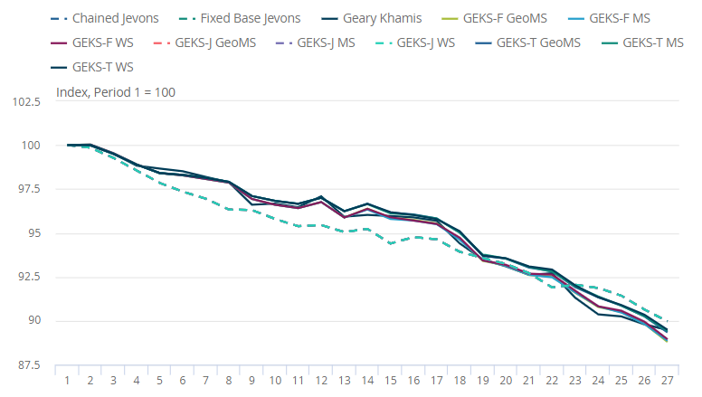
Base Synthetic Data
Notes:
We can see here, and throughout the analysis, that the difference between the weighted and unweighted indices is greater, on average, than the difference observed within the weighted methods, highlighting that the presence of weighting information at the product level is arguably more important than the choice of weighted index number method itself.

Slide 19
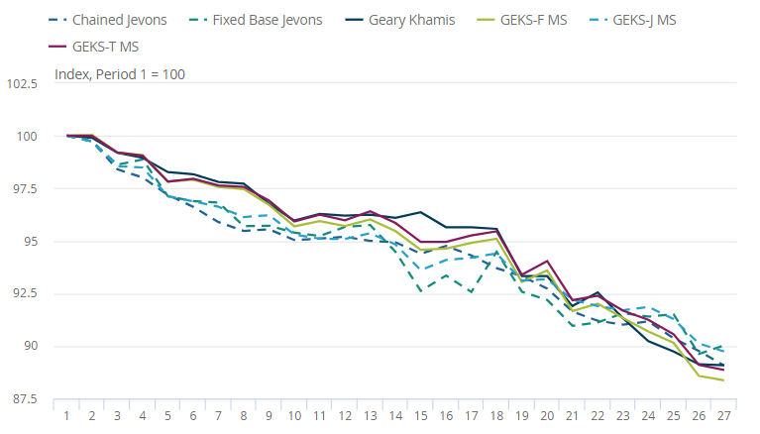
High Attrition Rate
Notes:
One feature that is prominent in web-scraped and scanner data is a high number of products entering and leaving the market driven, for example, by episodes of fast-fashion (particularly in clothing markets) or rapidly advancing technology (for technology products such as PCs, laptops, tablets and smartphones). This feature highlights the reason multilateral methods outperformed their bilateral counter parts.
The graph shows that all methods fall in a similar way to the fall that we observed in the base data, although the variation between the different index number methods is now greater. To assess the performance of each method, we compared the sum of the absolute differences between the index values based on the simple base data and the index values produced using the dataset with high churn added.

Slide 20
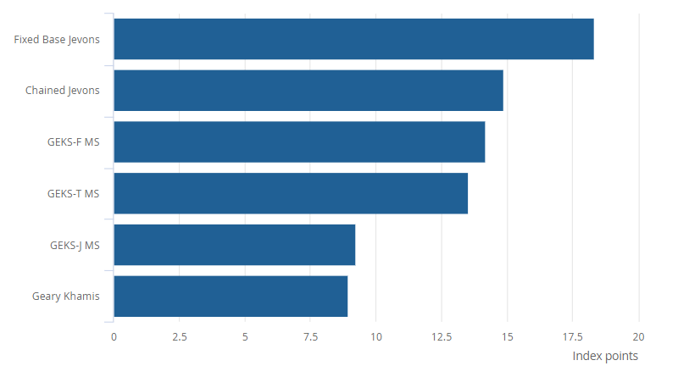
High Attrition Rate
Notes:
For our dataset, when churn is high the fixed-base Jevons and chained Jevons vary further from their base indices than the multilateral methods.
The fixed-base Jevons method will use an ever-decreasing proportion of the available data each month of a year, so it becomes less representative of the item than the chained and multilateral methods over time.
Furthermore, chained bilateral methods typically suffer from chain drift so, over time, we would expect them to become increasingly different from the baseline dataset.
Given the properties of the methods, we would therefore expect the sum of absolute differences to increase for the fixed-base and chained Jevons compared to the multilateral methods over time.

Slide 21
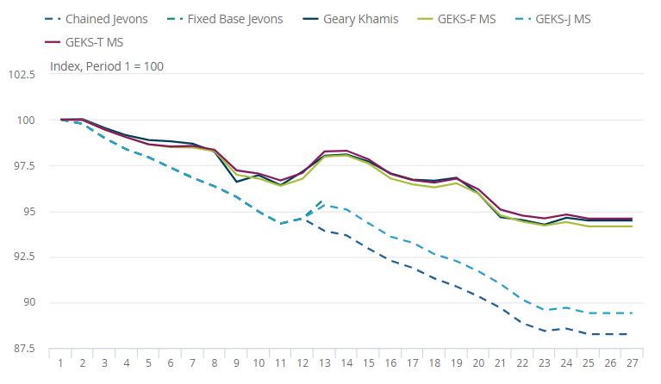
Product Obsolescence
Notes:
Obsolescence occurs when a product ceases to be functionally competitive with other products. This may occur when a retailer stops producing or marketing a product because the product becomes undesirable to the consumer. High-tech products such as smartphones often display this feature, as when new models are released the older models will often be withdrawn from the market.
The problem of using a fixed-base bilateral method is highlighted here, as after period 13 there are no longer any matching products in the set of the current and base periods; therefore, no more index values can be produced, and the time series ends.
The unweighted methods result in indices significantly lower than the weighted methods in this scenario. This is unsurprising as they do not use the expenditure information, instead giving each product in the basket equal importance. The weighted methods identify that, in this obsolescence dataset, products with increased popularity do not reduce in price as quickly as the products that are leaving the market, again showing the importance of having sales information, or approximates of sales values, at the product level.

Slide 22
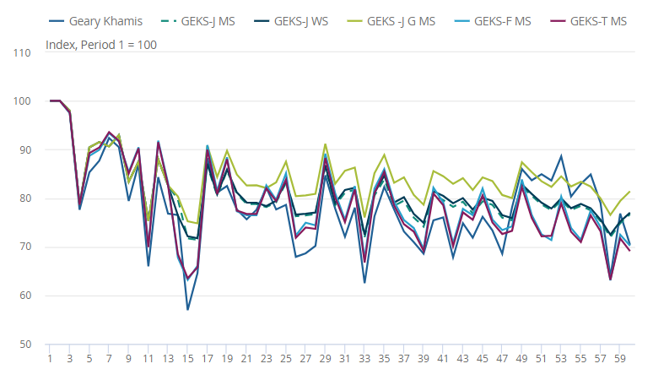
Real World Data –
Soft Drinks
Notes:
While our stress-testing of the methods isolated features to understand how our index number methods would respond, we are aware that a number of these features could be simultaneously present in a real-world dataset.
Two main observations can be made from these items case studies:
First, differences between each method’s indices are more substantial in practice than we observed when stress-testing the methods - this is likely impacted by a longer period of data as well as seeing many features occurring simultaneously rather than in isolation. We see that the different extension methods cause the indices to differ more significantly in the latter period of the time series, a result that replicates the findings of other National Statistical Institutes’ (NSIs’) studies.
Secondly, there is an apparent upward bias from the GEKS-J methods in comparison to the weighted methods; this is likely because consumers substitute towards products that are on sale and this is not accounted for when using unweighted methods. This again highlights that having information on sales values, or approximates thereof, is arguably more important than the choice between weighted index number methods themselves.

