Slide 1
Scanner data to compile CPIs Data, Aggregation structure and the Window Linking issue
Videoconference, 2,3,4,5,9, 10 June 2021
Group of Experts on Consumer Price Indices
2021, June, 2
Alessandro Brunetti (Istat), Stefania Fatello (Istat), Tiziana Laureti (University of Tuscia), Federico Polidoro (Istat)

Slide 2
Outline
Scanner data to estimate Italian inflation: the state of play
The case study for the experimental application of multilateral methods
Four aggregation levels to compile multilateral indices by adopting different formulas
Analysis of the results
Conclusive remarks and perspectives

Slide 3
Scanner data to estimate Italian inflation: the state of play
Since 2018, Istat has been using scanner data of grocery products (excluding fresh food) to compile CPIs.
At present, scanner data feed the calculation of 82 sub-indices (“aggregate of products”) belonging to six COICOP Divisions (01, 02, 05, 06, 09, 12)
Probabilistic sampling of outlets selected from the Italian territory stratified by provinces (107) and retail trade channels (5)
Scanner data for 4,003 outlets (472 hypermarkets, 1,452 supermarkets, 560 discounts, 1,023 outlets with surface between 100 and 400 s.m. and 496 specialist drug). These outlets belong to the main 21 RTCs and cover the entire national territory (agreement with RTCs, and Nielsen cooperation)
Concerning the selection of the sample of items, a dynamic approach has been adopted. Each month a sample of GTINs is selected within each outlet and ECR4 market (representative of elementary aggregates)
A set of filters have been implemented to select the matched sample each month comparing the current month with the preceding month

Slide 4
Scanner data to estimate Italian inflation: the state of play
Scanner data on a weekly basis at GTIN/outlet level
More than 18 million price quotes are collected each week to estimate inflation. For each barcode (GTIN), prices are calculated taking into account turnover and quantities (weekly price=weekly turnover/weekly quantities). Monthly prices are calculated as the arithmetic mean of weekly prices weighted with quantities
In January 2021, the sample includes more than 11 million references (GTIN/outlet) thereof about 30 million elementary weekly prices enter the indices compilation
Scanner data indices of ECR market are calculated at outlet level as unweighted Jevons index (geometric mean) of GTINs elementary indices. The ECR market indices are then linked to the base period (December of the previous year)
Provincial indices of ECR market are calculated as the weighted arithmetic means by using sampling weights of outlets and turnover by retail trade channel
Finally, provincial indices of product aggregates are calculated as the weighted arithmetic mean of ECR markets using turnover shares (referred to one year before) for the weights

Slide 5
The case study for the experimental application of multilateral methods
Experimental Multilateral Indices (MIs) compiled using data from December 2018 to April 2021, province of Rome
2 Product Aggregates (10dgts of the National classification): «whole fresh milk», that includes 3 Elementary aggregates (ECR ‘markets’, EAs), and «dish detergents» that includes 8 Elementary aggregates.
Alternative options concerning the compilation of MIs for each Product Aggregate passing through:
GTINs aggregation by type of outlets (Supermarkets, Hypermarkets, Discounts, Small Supermarkets and - for non-food products - Specialists Drug), within each EA;
GTINs aggregation by type of outlets, without considering EAs (that is, within the Product Aggregate).
Alternative options concerning the compilation of MIs of each Product Aggregate disregarding the outlet type, passing through:
GTINs aggregation within each EA;
GTINs aggregation, without considering EAs.

Slide 6
Four aggregation levels to compile multilateral indices by adopting different formulas
Aggregation over EAs and outlet types: Laspeyres
Alternative 1: MIs for each EA and outlet type.
References
(GTIN x outlet)
Average price of GTIN over all the outlets of the same type
Alternative II: MIs for each outlet type.
Aggregation over outlet types: Laspeyres
$${\overline{p}}_{m}^{h}\left(i\right)=\frac{F_{m}^{h}(i)}{Q_{m}^{h}(i)}=\frac{\sum_{jεh}{f_{m}^{j}(i)∙σ_{j}}}{\sum_{jεh}{q_{m}^{j}(i)∙σ_{j}}}=\sum_{jεh}{\frac{q_{m}^{j}(i)∙σ_{j}}{\sum_{jεh}{q_{m}^{j}(i)∙σ_{j}}}∙p_{m}^{j}(i)}$$
where:
$F_{m}^{h}(i)$ is the sales turnover of item i in the outlets of type h in period m;
$Q_{m}^{h}(i)$ is the quantity of item i sold by the outlets of type h in the same period;
j is the generic outlet of type h and $σ_{j}$ is its sample weight;
$f_{m}^{j}\left(i\right)=q_{m}^{j}\left(i\right)∙p_{m}^{j}\left(i\right)$ is the turnover of sales of item i in outlet j, in period m.

Slide 7
Four aggregation levels to compile multilateral indices by adopting different formulas
Alternative III: MIs for each EA.
Aggregation over Eas: Laspeyres
References
(GTIN x outlet)
Average price of GTIN over all outlets
Alternative IV: MIs for the Product Aggregate
$${\overline{p}}_{m}\left(i\right)=\frac{F_{m}\left(i\right)}{Q_{m}\left(i\right)}=\sum_{∀j}{\frac{q_{m}^{j}\left(i\right)∙σ_{j}}{\sum_{∀j}{q_{m}^{j}\left(i\right)∙σ_{j}}}∙p_{m}^{j}\left(i\right)}$$

Slide 8
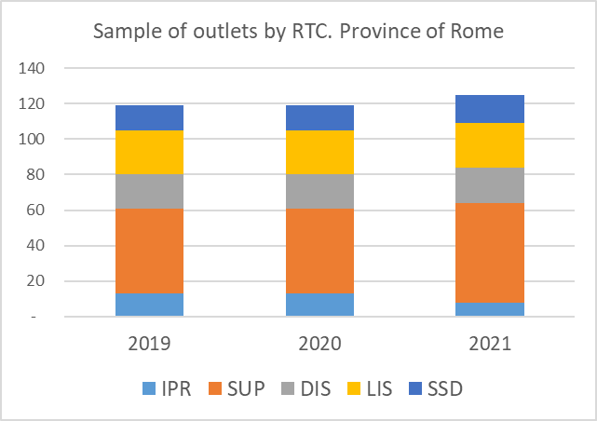
Four aggregation levels to compile multilateral indices by adopting different formulas
Data set description: Sample size (outlets and GTINs)
GTIN x Outlet

Slide 9
Four aggregation levels to compile multilateral indices by adopting different formulas
Multilateral GEKS-Törnqvist and Weighted Time Product Dummy have been calculated over 25 months rolling time windows, by adopting different splicing options (linked on published indices):
Half splicing:
Window splicing;
Movement splicing;
Mean splicing;
The following pages show the results obtained by adopting the Half Splicing

Slide 10
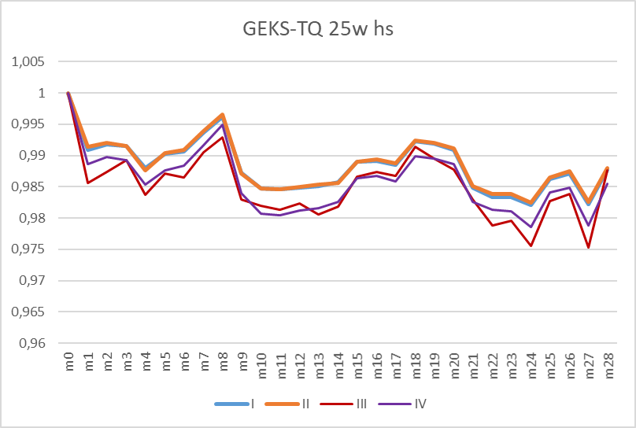
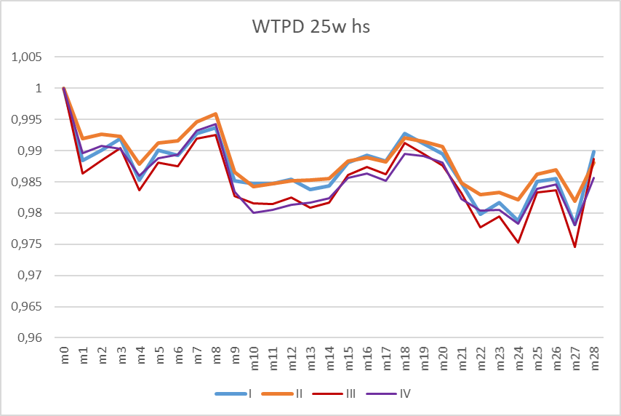
Analysis of the results
Whole fresh milk
Indices seem to be more influenced by the alternative options concerning the outlet dimension and to a small extent by the options on the «market» dimension.

Slide 11
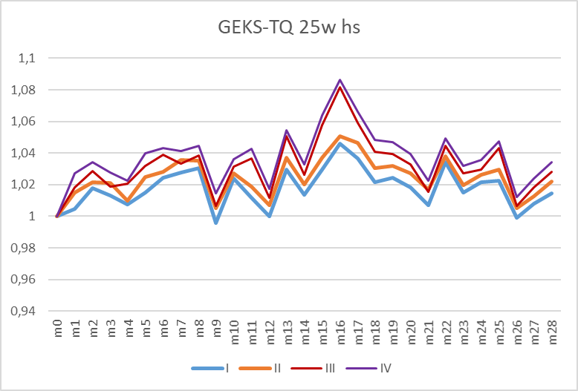
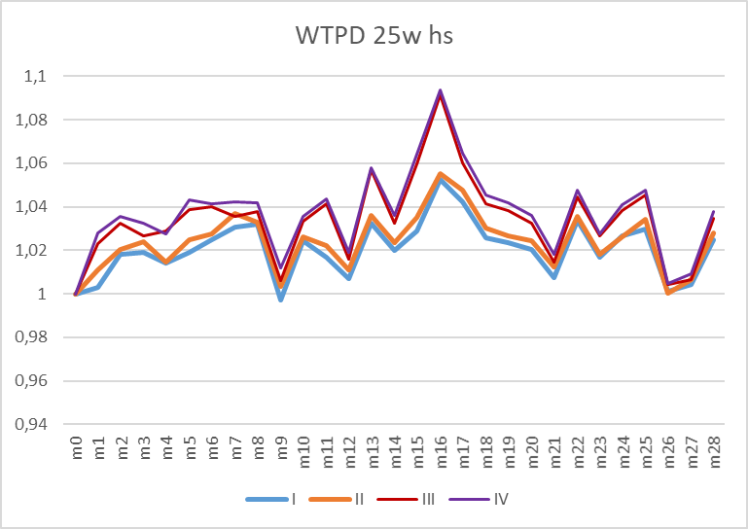
Analysis of the results
Dish detergents
As before, the choice of aggregating (or not) GTINs over outlet types seems to be more relevant. However, in the case of dish detergents, the alternative options on «market» dimension have some more visible effects.

Slide 12
Analysis of the results
Whole fresh milk
In this case, GEKS-TQ and WTPD indices remain very close to each other (some relatively wider dicrepancies can be observed for indices of the first simulations)

Slide 13
Analysis of the results
Dish detergents
Concerning dish detergents, GEKS-TQ and WTPD indices slightly differ
This reflects the differences in the dinamic of the universe of items in the two product aggregates

Slide 14
Analysis of the results
GTINs matching ratio in periods (m ; n) (m ; n = 0, 1, … , 28)
Whole fresh milk (all outlets)
Dish detergents (all outlets)

Slide 15
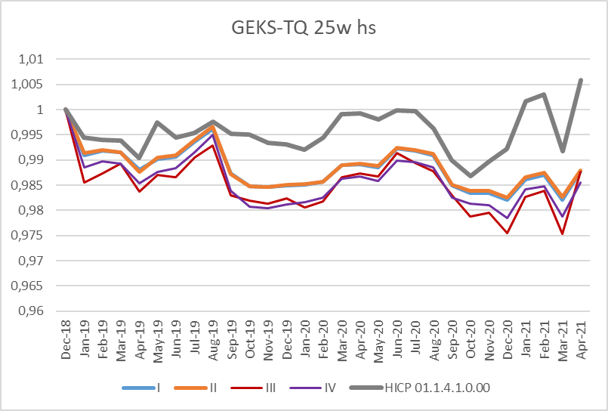
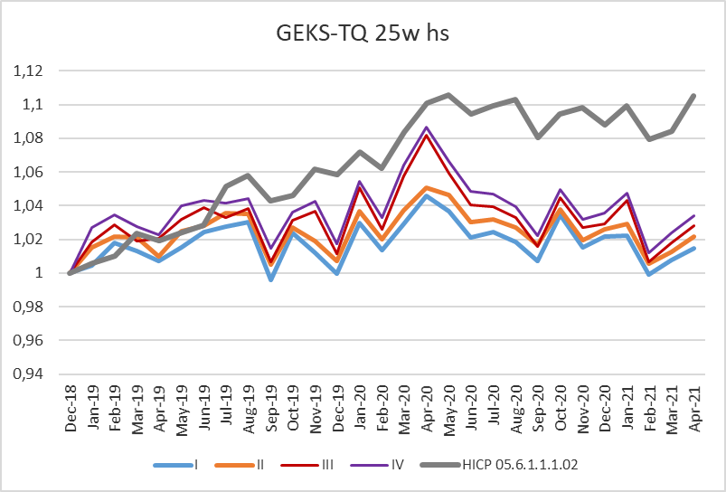
Analysis of the results
Simulated and official indices of «whole fresh milk» and «dish detergents»
Official and simulated indices show a similar evolution from Dec-20 onward. But there is a wide level shift (linking old and «new» series may be problematic)

Slide 16
Analysis of the results
Differences between indices calculated with different splicing methods are quite small in the case of whole fresh milk but not negligible in the case of dish detergents.

Slide 17
Conclusive remarks and perspectives
Aggregation issue
The analysis suggests that the outlet-type dimension has a stronger influence than “markets” dimension when applying MIs;
The simulations taking into account the market dimension have some more visible effects, especially when items are more heterogeneous;
How to introduce new «marketplaces» in the basket? Is it better compiling indices at more aggregate level?
Multilateral formulas
GEKS-TQ and WTPD produce very similar results whenever the GTINs matching is high; the choice of the formula is more relevant when the time heterogeneity of the assortments in the Products Aggregate is high;
Other formulas to be explored (Geary-Khamis, Weighted GEKS);

Slide 18
Conclusive remarks and perspectives
Splicing methods
Splicing methods seem to produce different results when prices exhibit a higher time variability;
Perspectives
2022 deepening tests and experimentations;
2023 introduction of MIs in Italian CPI/HICP?

Slide 19
Thank you
ALESSANDRO BRUNETTI | albrunet@istat.it
STEFANIA FATELLO | fatello@istat.it
TIZIANA LAURETI | laureti@unitus.it
FEDERICO POLIDORO | polidoro@istat.it

