Slide 1
Informal document GRVA-10-34
10th GRVA, 25-28 May 2021
Provisional Agenda item 4(d)
Update from the Special Interest Group on UN Regulation 157

Slide 2
Meetings of the group
Five meetings held so far:
#1 on 15th January 2021
#2 on 16th February 2021
#3 on 18th & 19th March 2021
#4 on 15th & 16th April 2021
#5 on 10th & 11th May 2021
Three more scheduled:
#6 on 10th & 11th June 2021
#7 on 8th & 9th July 2021
#8 on 13th & 17th September 2021
Meeting documents can be found here

Slide 3
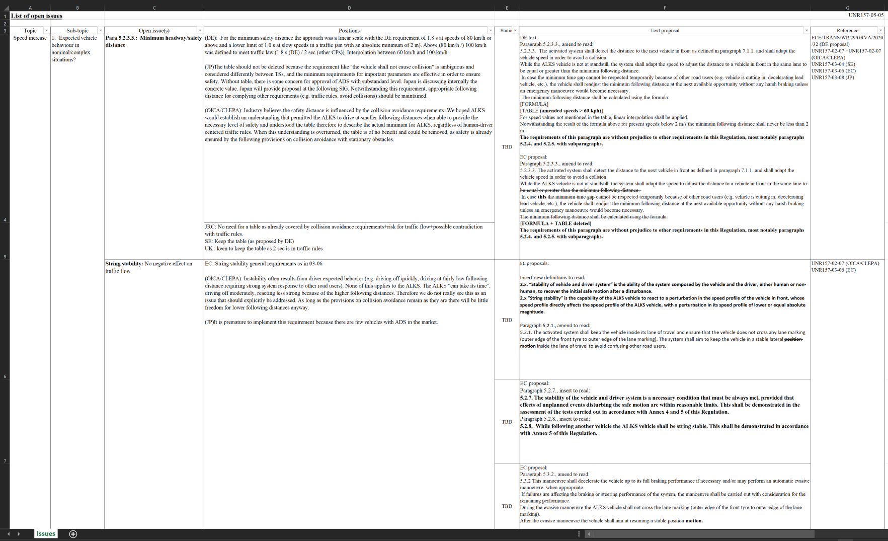
Items addressed by SIG on UN R157
Higher Speeds
Lane Change
Introduction of HDV
Clarifications
Open Points list: UNR157-05-05.xlsx

Slide 4
Higher Speeds
Parameters for safety distance
Based on deceleration or national traffic rules (i.e. 2 second rule)?
Detection Range
Is there a need to specify or shall it be based on braking performance?
String stability
Do we need to specify such requirement?
Change to the driver model
Suggestion to create a unified model (see UNR157-05-12)
Evasive lane change/MRM lane change
Are these required for higher speeds?
Pedestrian & wrong way driver scenario

Slide 5
Lane Change
Definition of different lane changes
Potential definitions of lane change (see UNR157-05-10)
Parameters to be used for the lane changes
Is ACSF-C sufficient or is RMF relevant?
Triggering conditions for lane changes
Audit/test requirements for lane changes

Slide 6
Higher Speeds & Lane Change
Changes to the HMI and driver monitoring requirements
DSSAD event data for higher speeds and lane change
Improvements to information document and introducing interpretation document
To ensure all necessary information is provided for assessment and the Regulation is applied in a consistent way (see UNR157-04-09)
Working drafts:
Higher speeds: UNR157-05-06
Lane changes: UNR157-05-07
Final proposals expected for September GRVA

Slide 7
Introduction of HDV
Changes to GRVA/2021/03
Modification minimum following distance
Collision avoidance for cutting in vehicle remains the same
Reference to compliance with national traffic rules for sensing requirements
Equivalent for retrievability of data
Demonstration of sensing strategies for trailer length (TBC)
Consolidated proposal for adoption:
GRVA-10-26

Slide 8
Clarifications to UN R157
Response to emergency vehicles
Agreed that emergency and enforcement vehicle should be responded to by the ALKS
Either through transition demand or manoeuvring in compliance with national traffic rules
Detectable collisions
Provision understood to be safety strategy to bring vehicle to a stop in case system has failed as a result of collision
Does not preclude vehicle from being brought to a stop or issuing a transition demand in the event of any collision as required by national traffic rules
Proposal on clarifications for adoption: GRVA-10-25
No progress on continuation of assistance after ALKS deactivated (GRVA/2021/02)

Slide 9
Thank you for your attention.

