Slide 1
Report of the TF on ADAS to the 10th GRVA Session
TF on ADAS Co-Chairs
Informal document GRVA-10-14
10th GRVA session, 25-28 May 2021
Provisional agenda item 6 (a)

Slide 2
Background
GRVA adopted at its 9th session in February 2021 the terms of reference for the Task Force on Advanced Driver Assistance Systems (ADAS).
The Task Force (TF) focuses on Advanced Driver Assistance Systems (ADAS), and shall address the simplification of UN Regulation No. 79 and if needed, develop a new ADAS UN Regulation with a focus on ADAS systems up to of level 2 (as defined in ECE/TRANS/WP.29/1140).
Meetings to Date
4 online meetings in February, March, April and May 2021
80+ participants at each meeting
A number of side meetings between TF meetings

Slide 3
Two Parallel Workstreams of the TF
Development of the provisions for the new ADAS use cases
Analysis of ADAS use cases and associated requirements
Development of the definitions, classification and scope of regulatory activities
Development of the high-level regulatory items for ADAS
New UN Regulation on (longitudinal + lateral control)
Working on the pending proposals for UN R 79
Finding open issues hindering to adopt the proposals
Proposals on how to resolve open issues
Drafting the amended proposals to UN R 79
Discussions are going on…

Slide 4
Outcome on the pending proposals for UN R 79
Document | System | Objective of the proposal | Status
GRVA-09-43 WP.29/2021/82 | RMF | Introduce provisions for the approval of RMF as the systems are already on the market. | Proposal from ADAS TF supplementing WP.29/2021/82 ready for GRVA adoption.
GRVA-09-37 | ACSF B1 | Clarify expected support behaviour in absence of lane markings. | Progress made but not finalized. Updated proposal submitted by OICA-CLEPA to GRVA.
GRVA/2021/07 | ACSF B1 | Avoid lane departure or excessive braking when maintaining the max. lateral acceleration 3 m/s². | No progress. Some CP supports. Other CP oppose. To be discussed again in GRVA for final decision.
GRVA/2021/09 | ACSF C | Introduce a tolerance of 10% to the critical distance. | Put on hold. Discussion to be continued in the TF +industry workshops.
GRVA/2021/10 | ACSF C | Extend allowed time to start a LCM to 7 s (or more). | No progress. Some CP supports. Other CP oppose. Industry expected to submit a revised proposal to GRVA-10 final decision
GRVA/2021/12 | RCP | Introduce alternative HMI for RCP. | Progress made but not finalized. Industry may submit a revised proposal to GRVA for final decision.
GRVA-07-24 | ESF | Adapt existing ESF provisions to permit low-speed maneuvering assist. | Discussion just starting in the TF. Industry may submit a revised proposal to GRVA-10.
GRVA/2021/11 | ACSF C or HCV | Adapt ACSF C to enable the function on HCVs to address the truck-trailer combination in lane change provisions. | Discussion just starting in the TF.

Slide 5
Development of the provisions for the new ADAS use cases
New ADAS use cases
Regulatory frameworks & scope
High-level regulatory items
New UN Regulation

Slide 6
Development of the provisions for the new ADAS use cases
High-level regulatory items
Audit & Assessment (CEL, NATM)
  ADAS functionality
    General
    DDT
    Operating scenarios
    System boundaries (ODD)
    System states, modes, transitions and actions
  System interaction with the driver
  Hazard analysis related to system application
Functional requirements
  General
  Driver engagement detection
  Dynamic behavior
  Function-specific requirements
  Overriding
  HMI
    System activation and deactivation
    Status indication (System monitoring)
    System-initiated driving maneuvers
    DDT fallback by the system

Slide 7
What to be covered in a new UN Regulation?
To address ADAS in general with a focus on systems combining longitudinal and lateral support on a sustained basis:
  To provide a safety net (minimum requirements) for any ADAS especially the ones currently not regulated today.
  To consider combinations of ADAS.
To introduce a generic approach to the ADAS performance/assessment:
  More generic performance requirements applying to any (combination of) ADAS whereas UN R 79 is focused on steering systems only. Strong emphasis on driver involvement and HMI.
  More generic compliance assessment method compared to those in UN R 79 (where specific tests are developed for each use case).
  Aligned with discussions in FRAV/VMAD on generic requirements/ assessment for ADS.
GRVA noted the large number of proposals aiming to amend UN R79 and tasked this group to find a solution. A new regulatory approach that ensures more use cases or function variations are addressed is an appropriate approach to resolve this issue
Without prejudice to possible more detailed requirements on some ADAS in other regulations such as the ones currently covered in UN R 79 (similar to what exists e.g. for braking with UN R 13-H and AEBS Reg)
ADAS already covered by the other UN Regulations will not fall in the scope of the new UN Regulation.
The TF on ADAS agreed starting development a new UN Regulation on this basis

Slide 8
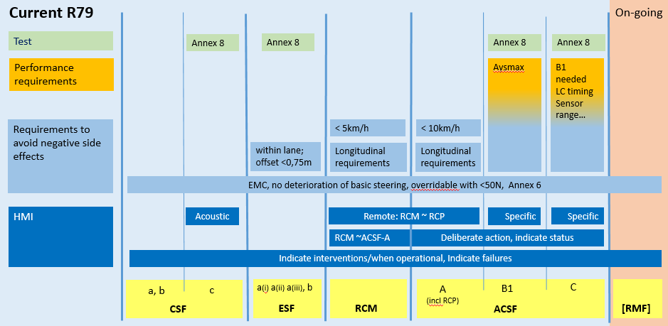
Annex: Scope of R79 vs future ADAS Regulation (doc ADAS-01-06)
ADAS regulation may only cover ADAS with both “lateral and longitudinal control”
The scope proposals here are addressing the main R79 limitations:
Longitudinal control does not fit in R79
A number of Use Cases are restricted / prohibited by R79 (i.e. definitions and ADAS scope in R79 are not general enough)
UN R79
ADAS Reg.
UN R79
ADAS Reg.
“Missing use cases” and “adjustments needed” could probably be handled under the current approach (i.e. be kept in R79)
ADAS regulation may as well cover continuous lateral control (which would then address more of the restricted / prohibited UCs by R79)

