Slide 1
Informal document GRSP-69-25
(69th GRSP, 17-21 May 2021,
agenda item12)
Submitted by the expert from Japan
Test Data of Q1.5 Dummy’s Neck Injury Measures
in R129 Frontal Test
JASIC
MLIT / NTSEL

Slide 2
Background
GRSP is considering introducing neck injury criteria for the Q dummy to R129.
In the 68th GRSP, Spain reported that the contact of the chin and chest influences neck injury of the dummy.
We conducted R129 frontal impact tests four times using the Q1.5 dummy and four types of R129 approved CRSs, and examined the effect of contact between the chin and chest on the dummy’s neck injury.

Slide 3
Test Conditions
Test No. | Dummy | CRS | Attachment method | Direction
Test 1 | Q1.5 | CRS A | ISO FIX | Front facing
Test 2 | Q1.5 | CRS B | ISO FIX | Front facing
Test 3 | Q1.5 | CRS C | ISO FIX | Front facing
Test 4 | Q1.5 | CRS D | ISO FIX | Front facing

Slide 4
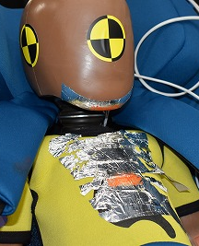
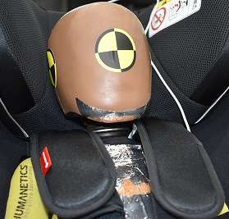
Test Results
CRS A
CRS B
Contact between chin and chest
CRS C
CRS D
Contact between the chin and chest was confirmed in all tests.

Slide 5
Injury Data
 | Test 1 CRS A | Test 2 CRS B | Test 3 CRS C | Test 4 CRS D
Neck upper tension force (N) | 1718 | 1242 | 1428 | 1539
Neck upper moment (Nm) | 20.7 | 15.5 | 15.4 | 16.2
Chest 3ms maximum acceleration (G) | 34.5 | 31.8 | 33.3 | 36.3
Chest deflection (mm) | 24 | 14 | 17 | 14
Neck upper tension forces were between 1242 and 1718 in the four tests.
Neck upper moments were between 15.5 and 20.7 Nm in the four tests.

Slide 6
Comparison of Neck Fz and Head Load Calculated from Acceleration (az)
CRS A
CRS B
CRS C
CRS D
These graphs compare the neck upper Fz and the multiple (head mass × head acceleration z). After contact between the chin and chest, Fz became larger than the multiple because of the input force from the chest to the head, however, the maximum neck tension force increased in only one case.

Slide 7
Neck Upper Tension Force
Contact timing between chin and chest (85–87ms)
In one CRS, the maximum neck upper tension force became much larger after contact than before contact.

Slide 8
Conclusions
We conducted the R129 frontal impact tests four times using the Q1.5 dummy and four types of CRSs approved by R129.
Contact between the chin and chest was confirmed in all tests.
Neck upper tension forces were between 1242 and 1718 N in the four tests.
In one CRS, the maximum neck upper tension force became much larger after contact than before contact. So, in some cases the contact between chin and chest is not influenced by the maximum neck tension force.

