Slide 1
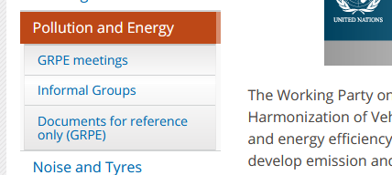
Working Party on Pollution and Energy (GRPE) General information
Note by the secretariat
Informal document GRPE-83-05
83rd GRPE, 1-4 June 2021
Agenda item 1
Participants/Address list
Based on registrations to the session, a provisional list of participants has been prepared; It will be crossed checked with the persons connected.
At the end of the session, we will circulate the list of participants by email.
Next session
The next (84th) session will be held on 11-14 January 2022 (tbc)
Proper session starting on Wednesday 12 January, 2.30 pm (if physical meeting)
The deadline for the submission of official working documents is 19 October 2021
New UNECE website
Some improvements implemented

Slide 2
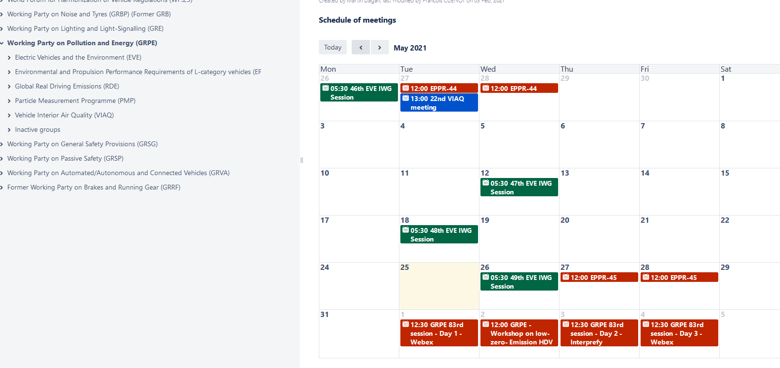
Improvements to the Wiki https://wiki.unece.org/pages/viewpage.action?pageId=917779
Schedule of meetings on main GRPE wiki

Slide 3
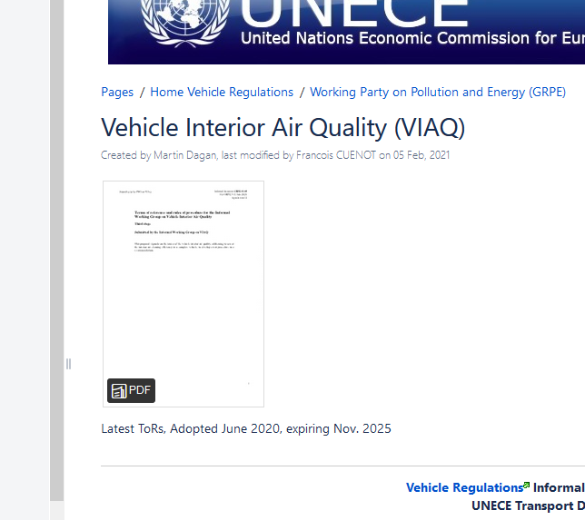
Improvements to the Wiki https://wiki.unece.org/pages/viewpage.action?pageId=917779
Latest ToRs on each IWGs main page
PDF of the ToR
Adoption date
Expiry date
All info to be maintained and updated by IWG secretaries

Slide 4
Proceedings
Following the meeting, the list of decisions will be circulated to delegations and their permanent missions in Geneva for final confirmation by the established silence procedure.
Survey about virtual meeting experience sent to GRs and WP.29 participants (results are in WP.29-182-22)
Document submission and copyrights
1.Make sure that any submission to the secretariat does not represent a copyright breach.
2.Please allow the secretariat to modify, translate and post the document on the UN websites

