Slide 1
ENVIRONMENT
UNECE Strategy for Education for Sustainable Development
National Workshop
«Learning for Sustainability in Higher Vocational Education and Training
in the Republic of Azerbaijan»
Baku, 21-22 April 2021

Slide 2
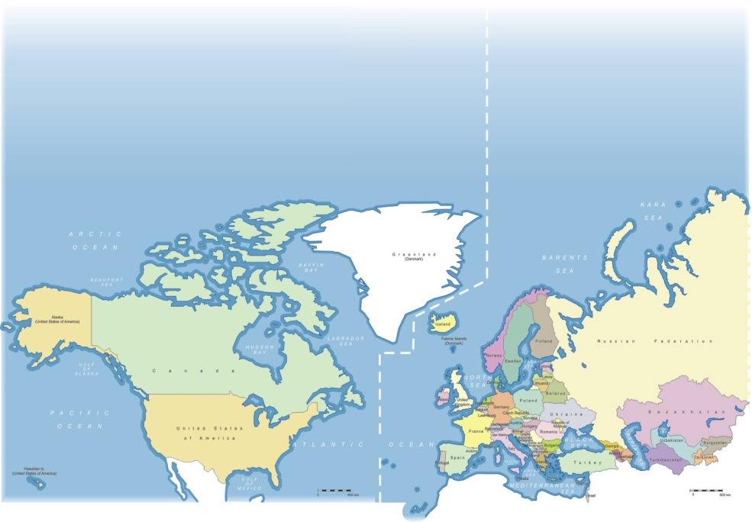
United Nations Economic Commission for Europe (UNECE)
ENVIRONMENT
56 member States
Promotes pan-European economic integration
Implementation of joint SD initiatives
from 1947
Notes:
• United Nations Economic Commission for Europe, est. 1947
• 56 countries – Europe, Central Asia, North America (2017)
– Executive Committee
• Sectoral Committees
– Committee on Environmental Policy
– Inland Transport Committee
– Conference of European Statisticians
– Committee on Sustainable Energy
– Steering Committee on Trade Capacity and Standards
– Committee on Forests and the Forest Industry
– Committee on Housing and Land Management
– Committee on Innovation, Competitiveness and Public-Private
Partnerships (CICPPP)

Slide 3
UNECE Strategy for ESD:
History & Context (1)
ENVIRONMENT
Global level:
UN World Summit on Sustainable Development (Johannesburg Summit) & UN GA resolution 57/254 (Dec 2002)
UN Decade for ESD (2005-2014)
Rio+20 UN Conference on Sustainable Development (2012) & UNESCO General Conference in 2013
UNESCO Global Action Programme (GAP) for ESD (2015-2019)
The 40th session of UNESCO General Conference (November 2019)
Education for Sustainable Development: Towards achieving the SDGs (ESD for 2030) framework - the UNESCO programme on ESD for the next decade, to be launched at
UNESCO World Conference on Education for Sustainable Development (Berlin, 17-19 May 2021)

Slide 4
UNECE Strategy for ESD: History & Context (2)
ENVIRONMENT
Regional level:
UNECE HL Meeting of Environment & Education Ministries in Vilnius in 2005 (1st HLM)
UNECE Strategy for ESD as a regional pillar of UN Decade for ESD (2005-2015) & Vilnius Framework for the implementation
UNECE HL Meeting of Education & Environment Ministries in Batumi in 2016 (2nd HLM)
UNECE Strategy for ESD aligned with the UNESCO Global Action Programme for ESD (2015-2019) & new Framework for the future implementation of the UNECE Strategy for ESD (with priority areas for the first phase 2016-2019)
Notes:
The Vilnius framework defined the practical arrangements for the implementation of the Strategy for the first decade.
The “Batumi” framework was aligned with the Global Action Programme on ESD coordinated by the United Nations Educational, Scientific and Cultural Organization (UNESCO).

Slide 5
What is the UNECE Strategy for ESD?
ENVIRONMENT
Regional implementation pillar of the global process at UN level guided by UNESCO
Practical tool to incorporate ESD into all forms of education in the national context
Governed by the inter-governmental Steering Committee on ESD
A Strategy that provides guidance on how to develop and incorporate ESD in all forms of education and that can be adapted to national contexts.
Notes:
UNECE Strategy for Education for Sustainable Development
One of the specific sustainable development initiatives supported by the UNECE is Education for Sustainable Development, in brief ESD.
The Education and Environment Ministries of the UNECE region have adopted the UNECE Strategy for ESD in 2005 at their high level Ministerial meeting in Vilnius.
The UNECE Strategy for ESD was the regional implementation pillar of the United Nations Decade on ESD, which run from 2004-until the end of 2014.
The Strategy is a practical tool to incorporate ESD into all forms of education, which means to introduce core themes related to sustainable development, into teaching and learning, but it means also to support participatory teaching and learning methods that motivate learners to change their behaviour and take action for sustainable development.
The implementation of the Strategy is governed by the Steering Committee on ESD, which includes representatives of both, Education and Environment Departments as well as other major stakeholders.
---------------------------------
OR:
The Strategy is a practical tool to introduce ESD into all education systems. It was adopted by 55 member States of the ECE region at the Highl Level Meeting of Education and Environment Ministries in Vilnius in 2005.
Its main objective is to support member States in incorporating key themes of Sustainable Development in all education systems.
- The Strategy is the regional implementation pillar of the UN Decade on ESD and is implemented in close cooperation with UNESCO.
The implementation of the Strategy is a continuous, long-term process, with three major implementation phases:
The first phase which started in 2005 and run until 2007 focused on taking stock, that is it was identified what countries were already doing that fits within the framework of the Strategy. Moreover initial activities were launched and action priorities were identified.
In the second phase, which terminated in 2010, focus was put on starting to integrate ESD into policy frameworks, learning programmes and curricula. Moreover the progress achieved was reviewed and national action plans and strategies finalised as well as revised if necessary.
After the closure of phase II, the first mandatory national implementation reporting was carried out. 36 countries participated in the reporting process, among them 3 countries from Central Asia. Many of you might remember the last ECE sub-regional workshop for Central Asia, which focused on facilitating the national reporting process. The the national implementation reports showed that the majority of countries had accomplished or were close to finalizing and putting in place policy, regulatory and operational frameworks that supported ESD.
In 2010, the Strategy entered its 3rd implementation phase and the focus shifted from the policy level to practical implementation.

Slide 6
Main objectives of the UNECE Strategy for ESD
ENVIRONMENT
Six objectives:
Ensure that policy, regulatory and operational frameworks support ESD
Promote SD through formal, non-formal and informal learning
Equip educators with the competence to include SD in their teaching
Ensure that adequate tools and materials for ESD are accessible
Promote research on and development of ESD, and
Strengthen cooperation on ESD at all levels within the ECE region

Slide 7
Priority action areas of the current implementation
Framework (2016-2019)
ENVIRONMENT
Priority areas (3 vertical and 3 horizontal):
ESD school plans in every school by 2019
Promoting ESD in teacher education and in the training of all educators
Strengthening TVET in support of SD and the transition to a green economy
ESD integration in int. and nat. policies and other processes;
Linking ESD in formal, informal and non-formal education
Important role of networks, incl. of civil society, academia and science, NGOs, business and enterprises, in implementing ESD
Notes:
Advancing three “vertical” priority action areas (subparas. (a)–(c) below), which focus on what should be done, and three “horizontal” priority action areas (subparas. (d)– (f) below), which focus on how it should be done:
1. Encouraging whole-institution approaches by establishing education for sustainable development school plans, or embedding education for sustainable development in existing school plans, for every school by 2019
2. Promoting the extension of education for sustainable development in teacher education and in the training of all educators
3. Strengthening technical and vocational education and training in support of sustainable development and the transition to a green economy
4. Strengthening integration of education for sustainable development in both international and national education and sustainable development policies and other relevant processes
5. Linking education for sustainable development in formal, informal and non-formal education
6. Acknowledging the important role of networks, including those of civil society, academia and science, non-governmental organizations, business and enterprises, in implementing ESD

Slide 8
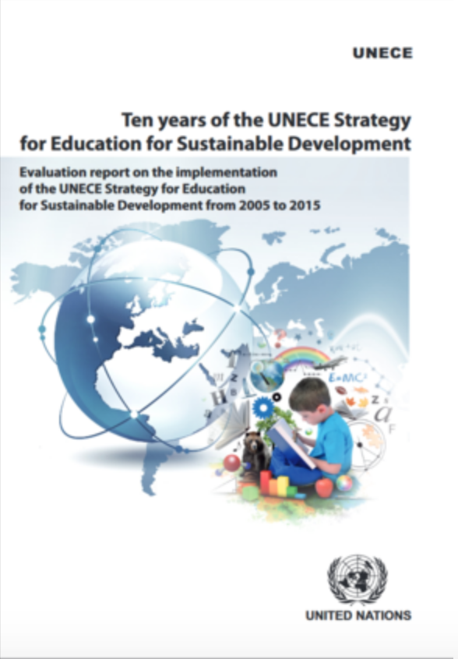
Progress Report: 10 years of UNECE Strategy
for ESD
ENVIRONMENT
Publication on progress achieved during 2005-2015
Challenges encountered

Slide 9
UNECE Strategy for ESD today
ENVIRONMENT
2019: preliminary results of the 4th implementation phase reported at the 14th meeting of Steering Committee (2-3 May 2019, Geneva)
2020: Fourth evaluation report of the UNECE Strategy for Education for Sustainable Development (16th meeting of the Steering Committee, 10-11 May 2021)
2015: окончание третьего этапа осуществления Стратегии
2022: Third High level meeting of Education & Environment Ministries in the framework of the 9th Ministerial Conference «Environment for Europe» (5-7 October 2022, Nicosia, Republic of Cyprus).
Framework for the implementation of the next phase (Concept Note soon finalised)
Ministerial Declaration

Slide 10
Main activities carried out by Steering Committee
ENVIRONMENT
Monitoring the implementation of the Strategy
Sharing of experiences on regional level (annual Steering Committee meeting, good practice collection)
Jointly addressing bottlenecks in implementation, e.g. through the work of Expert Groups (on educator competences, indicators, strategic planning or any other expert groups created under the umbrella of the Steering Committee)
Building capacity through national and sub-regional workshops

Slide 11
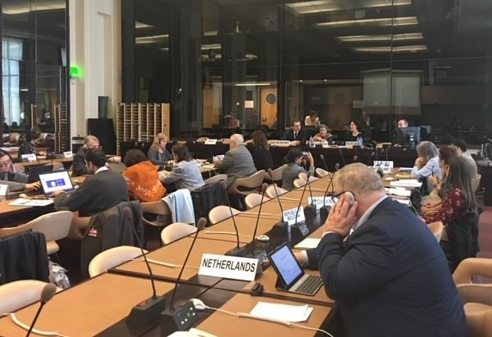
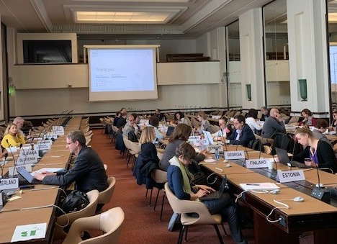

Slide 12
UNECE Steering Committee Expert Groups
ENVIRONMENT
Expert groups
On ESD indicators (2005-2008)
On ESD Competences (2009-2011)
«Electronic» Expert groups on priority action areas (2012)
On introducing ESD in schools plans
On introducing ESD in teacher training programmes
On reorienting TVET in support of SD in member States
Most recent:
AHG on Strategic Planning (2018 - present)
AHG on Indicators (2019 – present)
AHG on Youth (2019)
Notes:
Expert group on Indicators (8 meetings)
The Group of Experts was established upon the decision of the HL Meeting of Education and Environment Ministries in Vilnius in 2005 with the purpose of developing indicators for assessing the effectiveness of the Strategy’s implementation.
The set of indicators became a basis for the Format for reporting (http://www.unece.org/fileadmin/DAM/env/documents/2009/ECE/CEP/AC.13/ece.cep.ac.13.2009.10.e.pdf).
Expert Group on competences in ESD (5 meetings)
The Expert Group on Competences was established by the Steering Committee at its fourth meeting of 2009 with the purpose to prepare general recommendations for policymakers, as well as a certain number of core competencies in ESD for educators.
Outcome document “Learning for the Future: Competences in Education for Sustainable Development” (ECE / CEP / AC.13 / 2011/6). (ECE / CEP / AC.13 / 2011/6). Contains the necessary measures to support the implementation of competences in ESD in order to provide policy makers with the means to integrate ESD into relevant policy documents.
“Electronic” Expert Working Groups on Priority Action Areas (2012)
In 2012, at the 7th Steering Committee meeting on ESD, small working groups were established for each of the priority action areas to provide greater clarity on underlying concepts, as well as opportunities and potential challenges that member States might face in working towards these specific goals.
Recommendations were developed as a result of the work of these 3 working groups.
The results of the activities of these 3 working groups and their recommendations were presented to the Committee, in particular, in information documents
1. http://www.unece.org/fileadmin/DAM/env/Information_document_4_school_planning_02.pdf
2. http://www.unece.org/fileadmin/DAM/env/esd/9thMeetSC/Documents/Information_doc_3_teacher_education.pdf
3. http://www.unece.org/fileadmin/DAM/env/esd/9thMeetSC/Documents/4_TVET-final.pdf
Most recent:
AHG on Strategic Planning (2018 - present) – 2 meetings (plus online meetings)
AHG on Indicators (2019 – present): 3 meetings
AHG on Youth (2019): 1 meeting plus online

Slide 13
Results of work of ECE Expert Group on Competences in ESD (online materials)
ENVIRONMENT
Educator Competences for ESD and policy recommendations on promoting ESD Competences
Workshop Toolkit: Training materials on the Educator Competences
Notes:
ECE Expert Group on Competences in ESD defined core competences and recommendations for policy makers in 2011 (Published and available online )
Moreover, following the request from the Steering Committee, the Expert Group has developed in 2012 a standard workshop concept in order to facilitate the adaptation and promotion of the Competences in the sub-regions of the ECE.

Slide 14
Capacity building workshops
ENVIRONMENT
Series of national workshops in Middle Asia (2011-2013)
Sub-regional workshop in Slovenia (2011) and Middle Asia (2012)
On implementing 3rd priority area on “reorienting TVET to support SD and green economies”
2015: Cholpon-Ata, Kyrgyzstan
2016: Minsk, Belarus
2018: Yerevan, Armenia
2019: Tbilisi, Georgia
Notes:
At the Sixth Steering Committee meeting in 2011, the Committee decided that “Promoting educator competences should be a central aspect in Phase III.
Subregional workshops could be used as a means to specify and adapt educator competences, as developed by the Expert Group on Competences, to regional needs.”
Hence overall objective was to organize and implement workshops on the localization of educator competences in the sub-regions (1 workshop in each of the sub-regions), targeting different governmental institutions as well as NGOs:
A Eastern Europe;
B Northern Europe/ North America;
C Southern Europe (& West Asia); (Host: Slovenia)
D Western Europe; and (Host: Netherlands)
E Central Asia/ Caucasus.

Slide 15
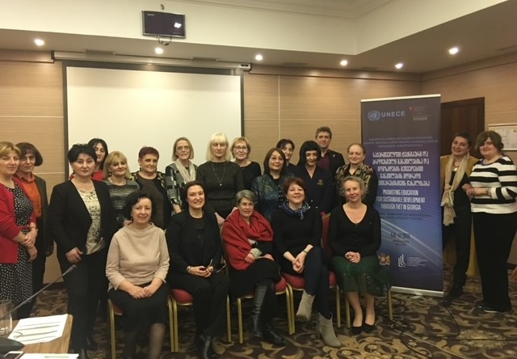
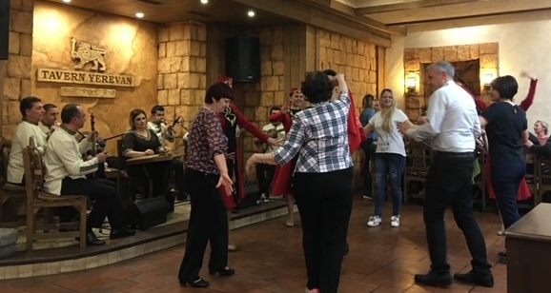
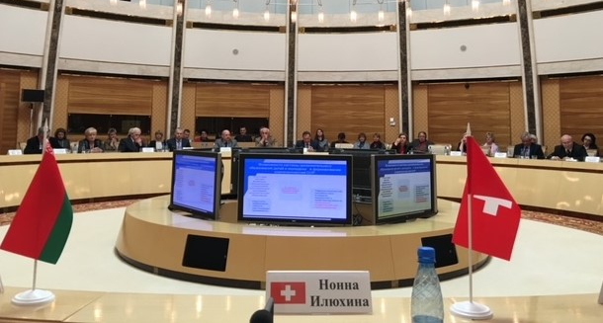
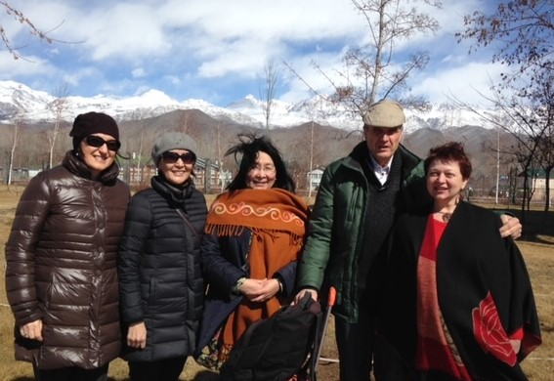

Slide 16
2021, April 21-22
National workshop in Baku
ENVIRONMENT
Building the capacity of the Republic of Azerbaijan for implementing the 3rd priority area of the UNECE Strategy for ESD:
«Strengthening technical and vocational education and training in support of sustainable development and the transition to a green economy»
How?
Which assistance needed?
(recommendations to be developed)

Slide 17
ENVIRONMENT
Thank you !
UNECE Strategy for ESD Secretariat:
Nona ILIUKHINA
nona.iliukhina@un.org
Tel.:+41 (0)22 917 8891
https://unece.org/environment-policy/education-sustainable-development
Baku, 21-22 April 2021

