Slide 1
Satellite (extended) Accounts in Norway
Ann Lisbet Brathaug

Slide 2
The different satellite accounts…..
System of Health Accounts
  established in 2005 and with time series back to 1997
Satellite Accounts for Education and Training
  established in 2018 – starting with data from 2015
Satellite Accounts for Non-profit institutions
  established in 2010 and with 2006 as the starting year
Unpaid household work
  Compiled every 10 years, covering 1970, 1980, 1990, 2000 and 2010
Satellite Accounts for tourism
  established 1997 and with time series back to 1988
System of economic and environmental accounts
  Established in 2002. The Division for National Accounts compile the link between the economic data, energy use and emission (to air), and present the growth in energy and emission intensity (e.g. emissions per produced unit and/or produced value added by industry)

Slide 3
System of Health Accounts (SHA)
Tri-axial system, defining
  Consumption of health care services by health care functions (HF)
  Providers of health care services by industry (HP)
  Financing of health care (sources of funding)
In Norway, the SHA is closely linked to the SUT-system – mapping of NA-products directly to HF etc
The system is efficient to run (and give positive feedbacks to the NA)
Establishing of the SHA – financed by the Ministry of Health

Slide 4
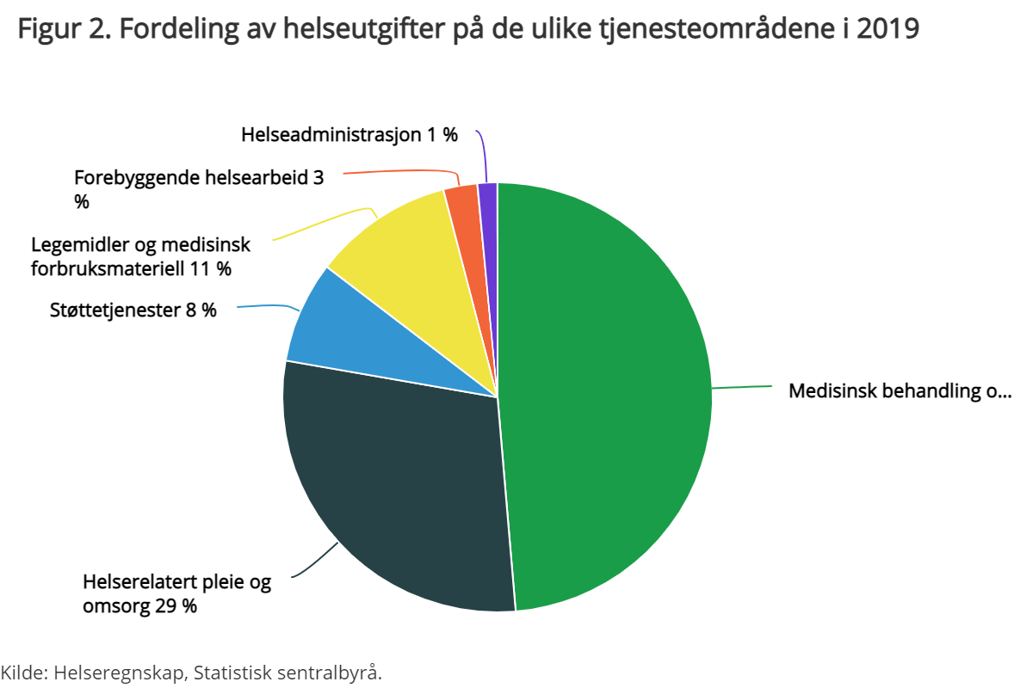
Why is the health accounts interesting?
Health Expenditure. Key Figures
 | 2015 | 2016 | 2017 | 2018 | 2019* | 2020*
Current health expenditure | 315207 | 328134 | 339948 | 356241 | 375453 | 386690
Current health expenditure per capita | 60735 | 62667 | 64421 | 67065 | 70206 | 71883
Health expenditure in constant 2015 prices | 315207 | 320329 | 323113 | 325524 | 331290 | 332402
Current expenditure on health at constant NOK in 2015. Percentage change in volume from the previous year | 3,4 | 1,6 | 0,9 | 0,7 | 1,8 | 0,3
Expenditure on health at constant NOK in 2015 per capita. Percentage change in volume from the previous year | 2,3 | 0,7 | 0,1 | 0,1 | 1,1 | -0,3
Share of health expenditure financed by public sources. Per cent | 85,5 | 85,4 | 85,1 | 85,7 | 85,8 | 86,0
Share of health expenditure financed by private sources. Per cent | 14,5 | 14,6 | 14,9 | 14,3 | 14,2 | 14,0
Public share of health spending in per cent of general government total expenditure | 17,9 | 17,8 | 17,7 | 17,9 | 17,8 | 17,0
Current health expenditure. Per cent of GDP | 10,1 | 10,6 | 10,3 | 10,0 | 10,5 | 11,3
Current health expenditure. Per cent of GDP Mainland Norway | 12,1 | 12,2 | 12,2 | 12,1 | 12,2 | 12,7

Slide 6
Satellite account for Education and Training
Expenditure on education and training (purpose) by provider - by purchaser and by financing sector
Can be supplemented with non-monetary data; population, enrolled students, teachers, employed persons ++++
Extends the production boundaries of SNA by estimating in-house training (do not change GDP)
Starting point for estimating Human Capital from the expenditure side

Slide 7
Some highlights from our satellite
Education expenditure. Key indicators ¹
 | 2016 | 2017 | 2018 | Change last year
Key variables
Current education expenditure. NOK million | 197779 | 204696 | 213183 | 8487
Capital formation in education. NOK million | 36165 | 37377 | 42442 | 5065
Current education expenditure per capita | 37772 | 38790 | 40133 | 1343
Current education expenditure. Per cent of GDP | 6,4 | 6,2 | 6,0 | -0,2
Current education expenditure. Per cent of GDP Mainland Norway | 7,3 | 7,3 | 7,3 | 0,0
Share of total expenditure (percentage)
Primary education | 39,2 | 39,5 | 39,7 | 0,2
Secondary education | 18,1 | 17,9 | 17,6 | -0,3
Higher education | 23,2 | 23,1 | 23,6 | 0,5
Adult education | 4,0 | 4,1 | 4,1 | 0,0
Other education | 4,1 | 4,1 | 4,1 | 0,0
In-house training | 10,7 | 10,4 | 10,0 | -0,4
Associated goods and services | 0,8 | 0,8 | 0,8 | 0,1
¹Current education expenditure does not include capital formation.
Source: Statistics Norway
Expenditure on education per pupil / student. NOK million
 | 2016 | 2017 | 2018 | Per cent change from last year
Expenditure on education per pupil, primary school | 123309 | 127871 | 133108 | 4,1
Expenditure on education per pupil, secondary school | 177880 | 184127 | 188159 | 2,2
Expenditure on education per student, higher education | 168080 | 170402 | 180948 | 6,2
Source: Statistics Norway

Slide 8
Education expenditure, by type of education and producer
 | Education expenditure (NOK million)
 | 2018
 | Sum all sectors | Central govern-ment | Central government | Local govern-ment | Market producers in education industry | Non-profit instit. serving house-holds | Other market producers | Rest of the world
All functions of education | 213183 | 51536 | 51536 | 118667 | 11193 | 9619 | 20467 | 1703
Primary education | 84703 | 929 | 929 | 80004 | - | 3771 | - | -
Secondary education | 37519 | 780 | 780 | 29314 | 531 | 3832 | 3062 | 0
Higher education | 50364 | 43170 | 43170 | 619 | 2661 | 1301 | 910 | 1703
Adult education | 8730 | - | - | 8730 | - | - | - | -
Other education | 8716 | - | - | - | 8001 | 715 | - | -
In-house training of enterprises | 21342 | 6657 | 6657 | - | - | - | 14685 | -
Associated goods and services | 1810 | - | - | - | - | - | 1810 | -
Research and Development in education | 20420 | 19827 | 19827 | 110 | 113 | 370 | - | -
Capial formation of education provider (Excl. R&D) | - | - | - | - | - | - | - | -
Education expenditure, by type of education and user
 | Education expenditure (NOK million)
 | 2018
 | Sum all sectors | Central government | Central govern-ment | Local government | Households | Non-profit institutions serving households | Rest of the world | Intermediate consumptionmarket producers
All functions of education | 213185 | 49577 | 49577 | 118484 | 14846 | 8341 | 1068 | 20869
Primary education | 84705 | 929 | 929 | 79784 | 450 | 3542 | - | -
Secondary education | 37519 | 780 | 780 | 29073 | 1559 | 3045 | - | 3062
Higher education | 50364 | 40676 | 40676 | 619 | 4248 | 1259 | 1068 | 2494
Adult education | 8730 | - | - | 8730 | - | - | - | -
Other education | 8716 | 535 | 535 | 279 | 6779 | 495 | - | 628
In-house training of enterprises | 21342 | 6657 | 6657 | - | - | - | - | 14685
Associated goods and services | 1810 | - | - | - | 1810 | - | - | -
Research and Development in education | 19180 | 18704 | 18704 | - | - | 370 | - | 106
Memo: Capial formation of education provider (Excl. R&D) | 24922 | 5384 | 5384 | 18363 | - | 968 | - | 207

Slide 9
Satellite Accounts for non-profit institutions
Establishing of the accounts was proposed in a white paper from the Ministry of Culture the Parliament (“Voluntariness for everybody”) in 2007
Strong pressure from professional industrial and voluntary organisations
Need for more insight into non-profit institutions as
  their activities cover a wide area and
  through service production and voluntary efforts they contribute to fulfilling important objectives of wellbeing

Slide 10
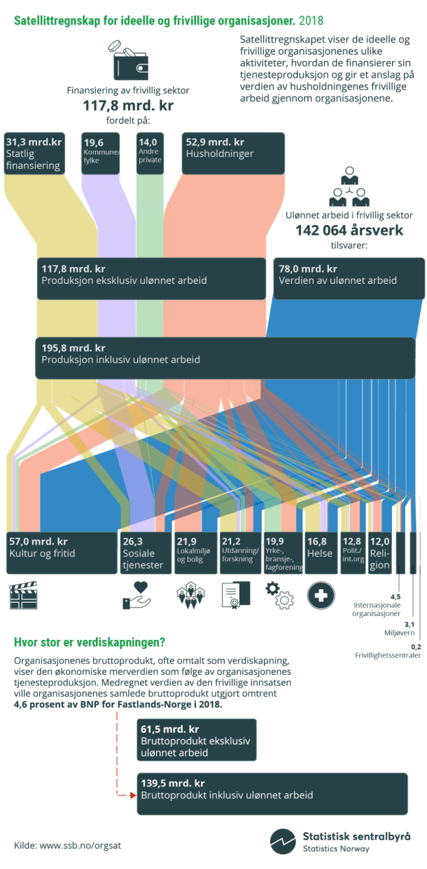
Highlights form the satellite accounts for NPI
Key results - Non-profit institutions (excluded voluntary work)
 | 2016 | 2017 | 2018
Output. NOK million | 110874 | 115443 | 117844
Value added. NOK million | 56974 | 60588 | 61526
Full-time equivalent persons (paid employees) | 90893 | 91561 | 89161
Value added as share of GDP. Per cent | 1,8 | 1,8 | 1,7
Value added as share of GDP Mainland Norway. Per cent | 2,1 | 2,2 | 2,1
Full-time equivalent persons (paid employees) as share of total full-time equivalent persons in Norway. Percentage | 3,9 | 3,9 | 3,7
Sources of income for non-profit institutions
Central government’s share of total funding. Percentage | 27,4 | 28,1 | 26,6
Local/municipal governments’ share of total funding. Per cent | 16 | 15,8 | 16,7
Households’ share of total funding. Per cent | 43,8 | 43,8 | 44,9
Other sources of funding. Share of total funding. Per cent | 12,8 | 12,4 | 11,9
Source: Statistics Norway

Slide 11
Characteristics when including voluntary work
Included voluntary work value added more than doubles
Very high inclusion of voluntary work in culture and recreation (includes sports)
  9 volunteer man year behind each employee (man year)

Slide 12
Conclusion
The extended accounts (satellites) should be consistent with the core national accounts, but with possibilities to go beyond
Give insight in areas which are too aggregated in NA to be analysed properly
There are a lot of possibilities to combine the extended accounts with relevant non-monetary data
For the future, aim to distribute also by “type” of households

Slide 13
Thanks!

