Slide 1
Communication TT Alignment to Statistical Standards
UNECE: Meeting of the Group of Experts on National Accounts
May 17, 2021
Charles Sessede – African Development Bank

Slide 2
Outline
Overview of Activities of the CMTT - Compliance Workstream
Overview of Alignment Framework
Communication of Assessments to Users
Uses of Alignment Framework
To note, these are provisional results reflecting a snapshot of where we are, the work is rapidly evolving

Slide 3
What does it mean to “comply” with a statistical standard?
About 62 per cent of economies currently report that they compile national accounts according to the 2008 SNA. What does this mean? This statistic does not tell us the degree to which the key concepts/methods of the 2008 SNA are implemented across these economies.
IMF Staff Estimates

Slide 4
CMTT - Compliance Workstream: Activities
Develop a framework to measure alignment to the statistical frameworks
Framework
Propose a framework that countries can use to gauge their alignment to international statistical standards
Communication
Propose guidance on how this information can be communicated to users and stakeholders
Uses
Communicate uses of the framework to NSOs. Main uses include: improve cross country data comparisons; help to prioritize resources, planning and development; and signal to users the impact of future updates / revisions.

Slide 5
The Alignment Assessment Framework

Slide 6
What Exactly is a Statistical Standard?
Given that a statistical standard contains many concepts, methods, accounting rules, classifications and accounts/tables – there is a need to prioritize the list.
The CMTT proposes that the alignment framework be developed around the following components of the international statistical standards.
Concepts
Production
Income
Methods
Chain linking
Double Deflation
Accounting Rules
Classifications
Assets
:
Seasonal Adjustment
Accrual
Consolidation
Industry
Product
Netting
:
:
Expenditure
:
Accounts
Production A/c
Generation of Income A/c
Financial A/c
:

Slide 7
What Exactly is a Statistical Standard?
Given that macroeconomics statistics are mainly used to analyze the structure and evolution of the economy.
The proposed framework focuses on features of the statistical standards that impact the levels of economic activity and growth rates.
Concepts
Production
e.g. Domestic territory
Methods
Deflation
e.g. Use of appropriate price indices
Accounting Rules
:
Valuation
:
:
e.g. Valuation of CFC

Slide 8
Alignment Framework: Concepts
Concepts are the foundation of a statistical standard. They reflect the articulation of a macroeconomic idea, activity, interaction, state, notion. Concepts determine what gets measured.
Consider the concept of production in the 2008 SNA. Production in the SNA ultimately determines the size of a given economy.
Other key concepts include income, assets, capital formation, expenditure, consumption, etc.
Concepts - Production
Observed market output
Non-observed market output
Non-market output
Output for own final use
Imputed services
Illegal output

Slide 9
Alignment Framework: Accounting Rules
Accounting rules reflect the guidelines that compilers should follow when recording transactions and other economic flows.
Accounting rules determine how activities get recorded.
For example, a key accounting rule in the 2008 SNA is that transactions are recorded “on an accrual basis throughout.”
The statistical standards have numerous accounting rules related to the time of recording, valuation, consolidations, netting, re-routing, etc.
Accounting Rules - Valuation
Market output is valued at basic price
Output for own use is valued at equivalent market prices
If levied, sales and excise taxes are included in the valuation of intermediate consumption
Corrections are made when transfer prices are detected
Consumption of fixed capital is valued at current replacement cost.
If applicable, the deductible part of the value added taxes is excluded from the valuation of final uses

Slide 10
Alignment Framework: Methods
Methods are closely associated with accounting rules and concepts. They can be interpreted as the way in which an accounting rule is implemented or how a concept is measured.
The statistical standards list several recommended methods related to valuation, calculation of volumes etc. that should be included in the framework.
Methods
Sub-annual series are seasonally adjusted
Output and intermediate consumption are deflated by appropriate price indexes
Volume indexes are chained-weighted

Slide 11
Alignment Framework: Classifications
Classifications determine the level of detail that is presented to users.
As an example, the concept of production determines what gets measured. At the limit, this could result in publication of a single number.
A single estimate of production would not be very useful and lead to questions from users seeking more granularity.
Classifications facilitate a consistent presentation of detailed or granular information to users and a standard approach to aggregating the information.
Classifications: Sectors
Institutional Sectors
Households
Non-profit institutions serving households
General Government
Non-financial corporations
Financial corporations

Slide 12
Alignment Framework: Accounts/Tables
Accounts/Tables outline how information is presented to users.
Most statistical standards have identified a set of accounts / tables that are considered minimum requirements.
Since these are well-defined and widely used, the CMTT proposes that these tables be incorporated into the alignment framework.
Countries will be asked to indicate whether they publish the accounts and the associated granularity, instead of the level of alignment.
Minimum Required Data Set | Timeliness | Granularity | ...
Annual value added and GDP at current and constant prices by industry
Annual expenditures of GDP at current and constant prices
Annual sequence of accounts for the total economy (until net lending)
Annual rest of the world accounts (until net lending)
Annual non-financial corporation sector accounts (until net lending)

Slide 13
Communicating Assessment Results

Slide 14
Alignment Framework: Communicating the information
While some consideration was given to the development of a “scoring” system or a methodology to communicate country assessments to users, a dashboard approach is preferred and recommended.
“Scoring” a country’s alignment to a statistical framework may create a disincentive to use the framework and misuse of the results.
Any aggregate score would require some form of weighting mechanism which would introduce a high degree of subjectivity (e.g. weighting alignment to concepts relative to accounting rules, methods, classifications, etc.).
A dashboard could be a more widely accepted public communication tool.

Slide 15
Alignment Framework: Communicating the Information
The starting point for the dashboard is the alignment framework.
Most of the items in the framework can be structured to solicit a “yes” or “no” response. However, this does not provide the granularity users need to properly interpret the results.
For each item in framework, the compiling organization would indicate if they:
Fully align with the guidelines – between 75-100 per cent of the guidance is implemented.
Partially align with the guidelines – between 25-75 per cent of the guidance is implemented.
Do not align with the guidelines – between 0-25 per cent of the guidance is implemented.
Not Applicable – these may relate to issues of non-materiality or no user requirements where the guidance is not implemented.

Slide 16
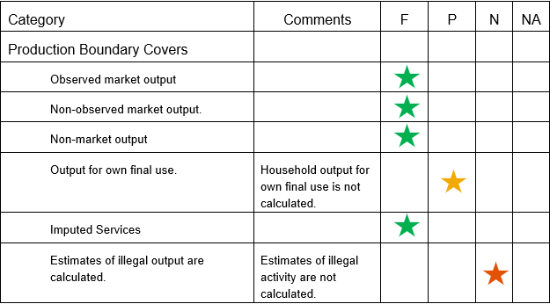
Alignment Framework: Communicating the Information
Using the notion of “per cent aligned” does introduce some subjectivity into the exercise.
This was done because it is difficult to define (and impossible to measure) what would constitute being 100 per cent aligned to a concept, accounting rule, method, etc.
It is proposed that country compilers use their knowledge of their processes and an assessment of economic activity in their country to make this determination.

Slide 17
Uses of Alignment Framework

Slide 18
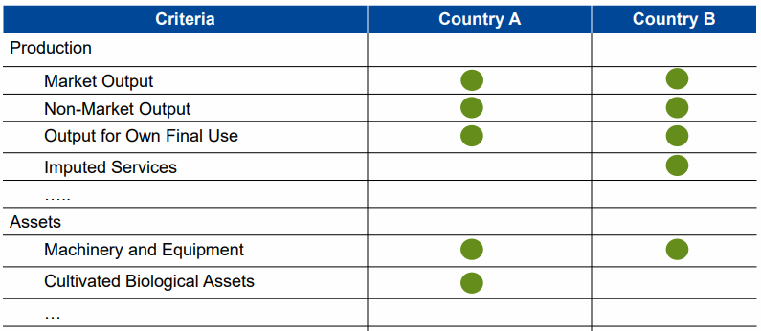
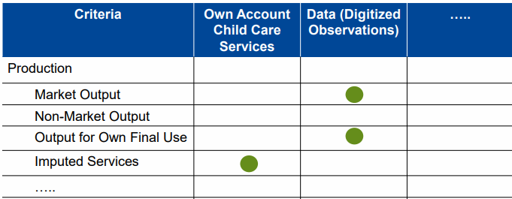
Alignment Framework: Possible Uses
Cross-country comparisons
Having a standard alignment framework allows for more accurate and economically meaningful cross-country comparisons.
Helps to inform planning, resource allocation, identifying improvements, prioritization and developments to improve quality and comparability.
Communicate future updates
Communicate with users about the impact of the proposed changes to the SNA or the impact of other improvements.
Cross-country comparisons
Potential future revisions

