Slide 1
ESD in TVET Georgia
Manana Ratiani, PhD
Deputy Director
National Center for Teacher Professional Development
Focal Point on ESD
Associate Professor,
Ilia State University

Slide 2
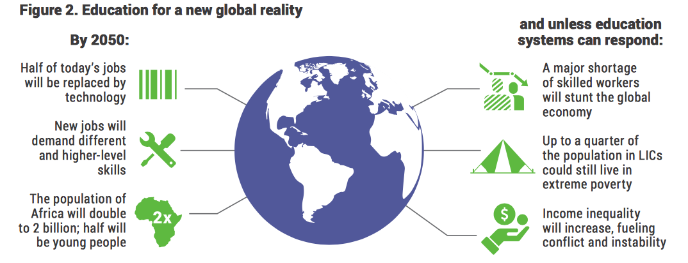
The Global Crisis
By 2030 more than half a generation of young people will not have the skills needed for the changing global job market
This is more than 800 million out of 1,6 billion children and young people globally
Digital divide widen the gap and inequality in access of quality education

Slide 3

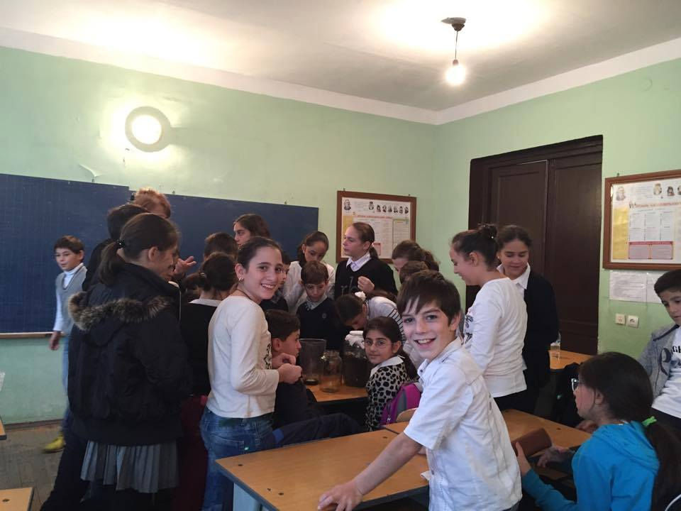
Government Programme
The long-term strategy and interventions:
developing the lifelong learning system;
ensuring equality, accessibility and inclusion within the educational system;
improving quality of education and science and upgrading result-oriented quality management and support systems;
ensuring autonomy and institutional development of educational institutions;
developing human resources at all levels within the systems of education and science;
enhancing community involvement and social partnership;
improving the education and science management system and upgrading the funding mechanisms thereof;

Slide 4

Educational Programmes
-Benchmarks, which defines competences of educational programmes with regard to specific directions or field/specialization considering appropriate levels of education is based on the National Qualifications Framework and European Qualifications Framework. Sector Benchmarks in Education was approved in 2018, ESD is underlined as an essential competence for future teachers. Starting from 2018 newly accredited programs will consist courses on SD, GCED, ESD.
“Teacher knows the goals and principles of sustainable development; Recognizes the principles of sustainable development in a person’s development; Teacher is socially and environmentally responsible and could apply SD, GCED, ESD related activities into everyday work, to integrate in the subject goals”

Slide 5
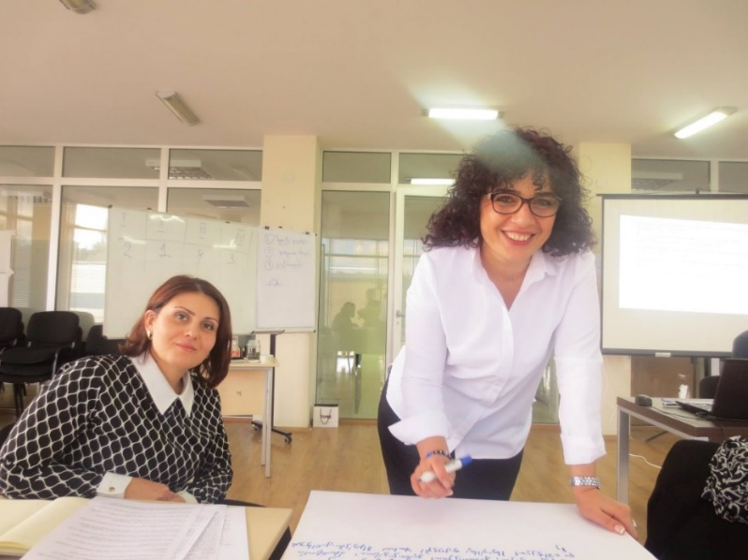
Unified Strategy for Education and Science for 2017-2021
Education is one of the fundamental rights of a human being and a vital condition for sustainable development of the country. Therefore, ensuring quality and affordable education and science system is one of the main priorities of the Government of Georgia and is declared to be the cornerstone of country’s development.
Georgia has made significant progress in reforming the education system aimed at transforming the post-Soviet education system and creating a new system that would be in line with rapidly changing world demands and be competitive internationally. There are still many challenges to the quality of education and training services and equal access, among them - the link of the education with the labour market, promotion of the development of science and research.
Vocational education in the modern world is no longer considered as a sphere developing narrow professional knowledge and skills, but as a life-long learning, self-realization, social welfare, employment and self-employment support system. The strategy reflects the social and economic priorities and objectives of the government of Georgia, whose implementation according to a particular action plan shall facilitate sustainable development of human resources, development of the capabilities and potential, opportunities for the employment. New programs are made not only on the development of professional skills (study of a craft, profession) but also basic (literacy, numeracy, etc.) and key skills (entrepreneurship, communication in foreign language, digital competences).

Slide 6
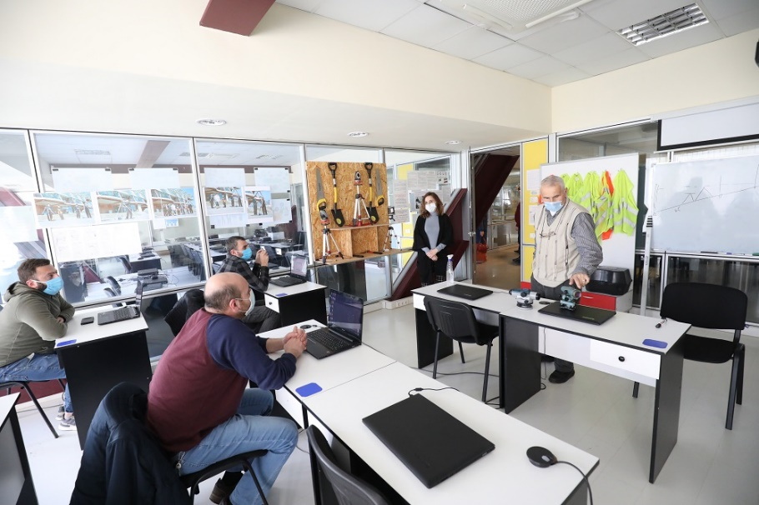
Unified Strategy for Education and Science for 2017-2021
Purpose of VE is to increase the number of students in support of socio-economic development of the country and ensure their competitiveness by developing professional and general skills.
Strategic objective 1. Compliance of the vocational education with the requirements of the labour market and internationalization of the system
Strategic objective 2: Ensure access to vocational education based on the principle of lifelong learning
Strategic objective 3: Popularization of professional education and increase of attractiveness;

Slide 7
Vocational Education system governance is ensured based on publicity and transparency:
Georgian Government – implements public policy; defines the sector strategy; approves the rules and regulations defined by Law; establishes advisory board.
Ministry of Education and Science – implements public policy. Approves regulations referring to program implementation, student enrollment, teachers’ professional development.
Vocational education institution/college – legal entity, providing vocational education and short cycle programs, vocational training and retraining programs.
LEPL Education Management Information System (EMIS)– represents the entity responsible for efficient operation of vocational education electronic management system.
LEPL National Center for Education Quality Enhancement (NCEQE) – represents the entity under the Ministry being responsible for quality assurance procedures at vocational education system.
LEPL Teachers’ Professional Development Center (TPDC) - represents the entity responsible for development of programs to support TVET teachers and quality of education.
LEPL Education and Science Infrastructure Development Agency (ESIDA) – represents the entity responsible for rehabilitation, construction and provision of inventory and technology.
LEPL National Assessment and Examination Center - represents the entity responsible for organizing examination for enrolling the students on TVET programs as well as on short cycle programs.
Skills Agency

Slide 8
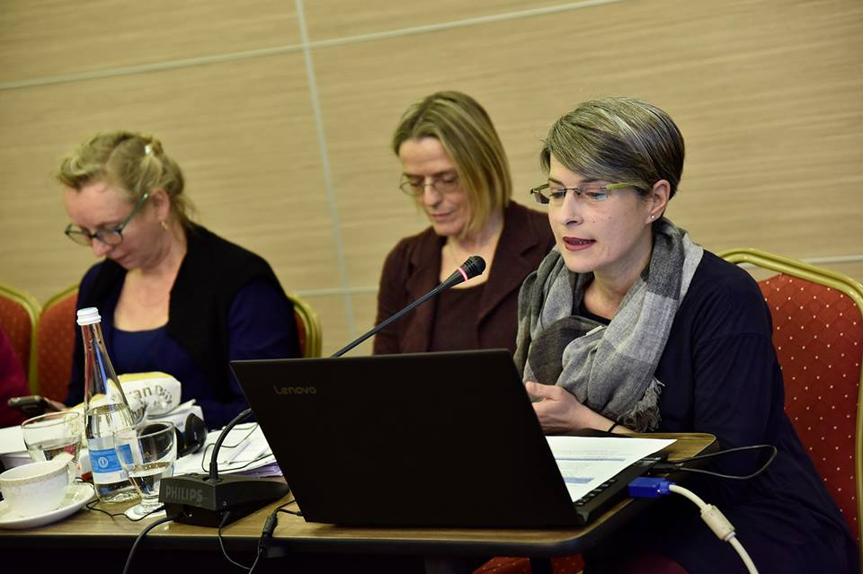
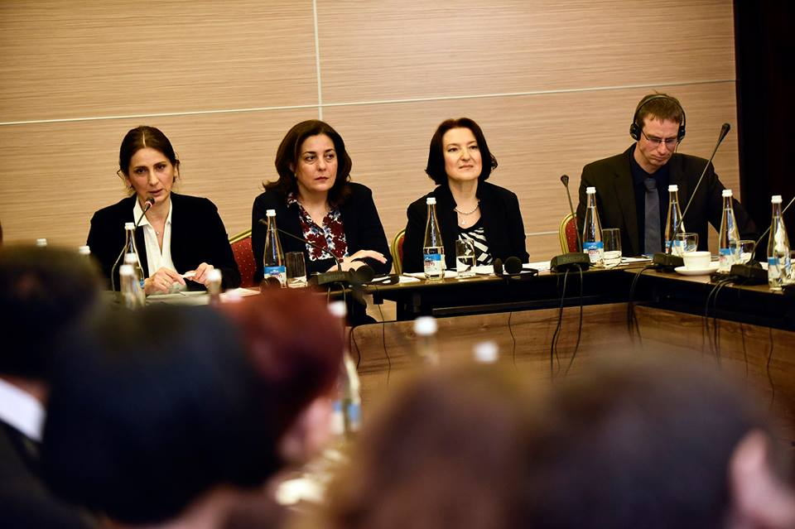
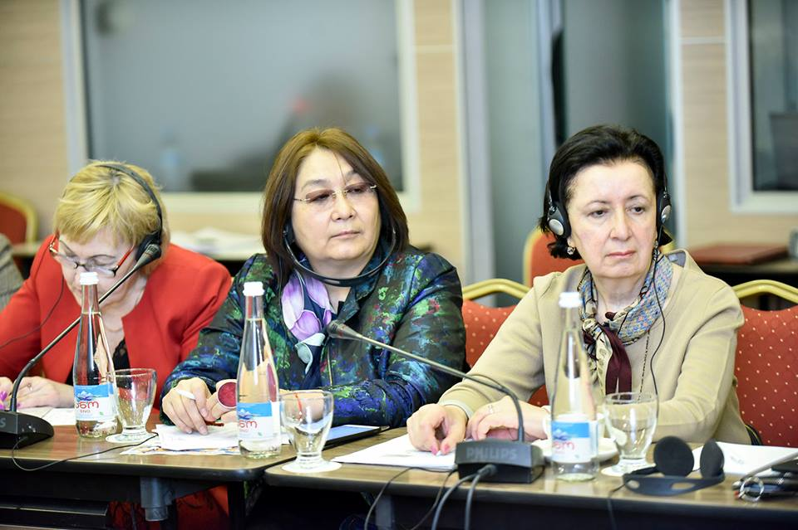
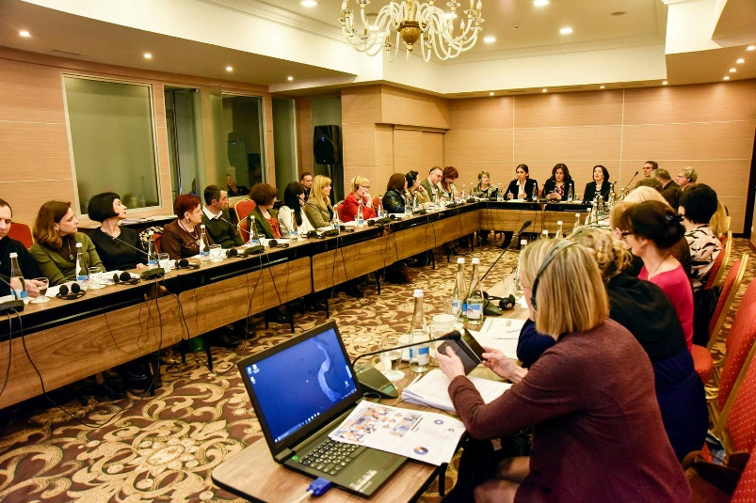
The National Workshop on implementing the UNECE Strategy for ESD:
“Promoting Education for Sustainable Development through TVET in Georgia”
The workshop was was organized by TPDC with the support of UNECE Secretariat and Educational Cooperation Strategy of the Swiss State Secretariat for Education, Research and Innovation.
Participants of the workshop:
Experts from Switzerland, the United Kingdom, the Netherlands, Cyprus, Kyrgyzstan, Armenia, Belarus
Teachers of vocational education system, representatives of ministries, business community of Georgia, international organizations.
The workshop was focused on the following main objectives:
Providing an understanding of the content of ESD and SDGs in relevance to vocational education, especially for priority areas for Georgia
Analyzing of the existing policy and priorities on national level in relevance with ESD and SDGs and possibilities to extent it.
Determining the ways of embedding ESD principles into vocational education system, educational standards and programs.

Slide 9
The National Workshop on implementing the UNECE Strategy for ESD:
“Promoting Education for Sustainable Development through TVET in Georgia”
The questionnaire was electronically distributed to the participants. The responses served to set agenda. The expectations of the workshop participants were high
On the first day International participants shared their visions, strategy directions, researches and best practices of integration of ESD
National strategy, law on VET were discussed as well as programs that focuses on 8 transversal competences to be developed through the teaching and learning;
Participants made recommendations on Standards and Code of Ethics of Teacher to ensure the ESD and SD principles are embedded. The revision of the frameworks is ongoing;
One session was dedicated how to develop educational programs using sustainability compass to ensure all three dimensions of SD are addressed in a holistic way;
Field visit was organized for the international experts to the college “Spectri”
Recommendations were developed at the end of the workshop

Slide 10
Recommendations from the participants
The goals of sustainable development should be more integrated into the level of curriculum;
Educational resources should be available in the establishment of education for sustainable development;
Education Competences for sustainable development must be reflected in standard;
Encouraging awareness on sustainable development principles; Collect the best practices and share them;
Attract international opportunities for cooperation in sustainable development.
Ensure that at the institutional level are applied the following: Interactive methods, project based learning, modeling, group works, holistic approach – teachers are attending relevant trainings;
Principles of sustainable development should become everyday practice on institutional level.
Equip students with 21st century skills, with social and environmental responsibility, together with a profession.

Slide 11
Professional Standards for Vocational Education Teacher
Structure of the professional standard
A professional standard consists of two parts.
The first part of the professional standard defines the main functions and responsibilities, as well as reflects the competencies, knowledge and skills, the implementation / possession of which is necessary for all types of vocational education teachers. This section provides the main functions and responsibilities for each type of vocational education teacher and the criteria for their fulfillment (Annexes №1 and №2) and describes the knowledge and understanding required by the main function-duties required of all types of vocational education teachers (Appendix № 3). The second part provides additional functions of the vocational education teacher and the criteria for their performance (Appendix № 4).
“VET teacher knows the principles of sustainable development and resource-saving technologies in their field, the principles of caring and responsible use of the natural environment”

Slide 12
Education e-House
Project aims and objectives
To provide high quality education through equal access to school based continuous professional development services;
To provide targeted support of all types and specificity in respect with both formal and non-formal education.
To create a unified platform for “Education e-House”
To provide varied services supporting continuous professional development and prepare/offer respective resources
To encourage establishment of cooperation-based school culture and school/professional networks/ communities
To identify and share best practices

Slide 13
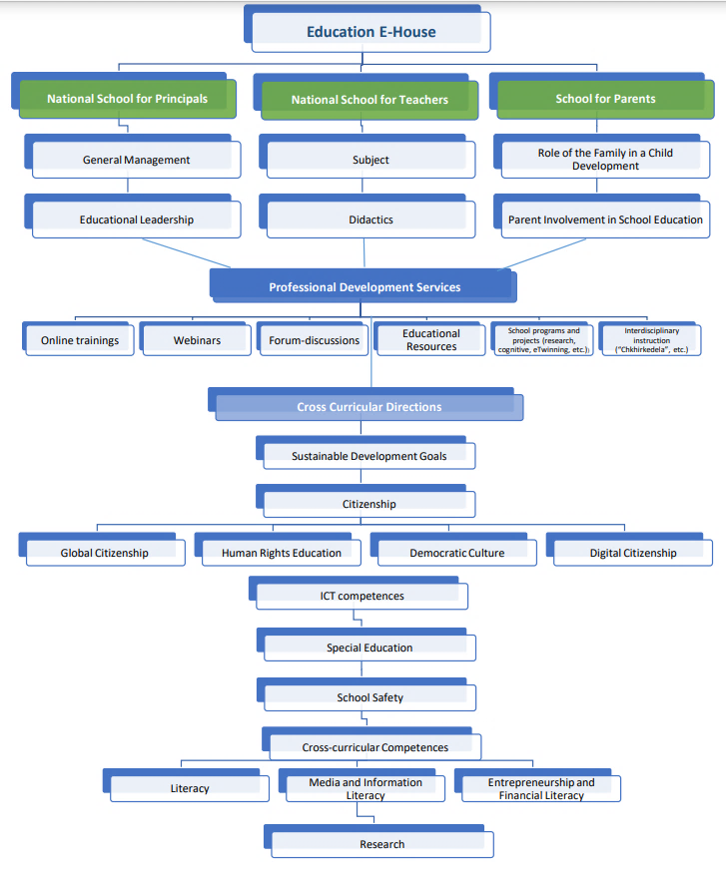

Slide 14

Comments, Questions?

