Slide 1
Advanced axles in trailers
Informal Document GRSG-121-34
((121st GRSG April 12-16 2021 Agenda item 14)
New technologies to reduce CO2 emissions for vehicle combinations
UNECE, 121st GRSG, April 2021

Slide 2
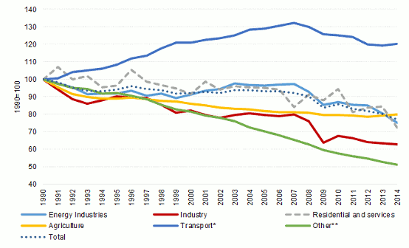
Advanced axles in trailers Road transport sector and Climate protection
As part of the European Green Deal, the Commission proposed in September 2020 to raise the 2030 greenhouse gas emission (GHGE) reduction target, including emissions and removals, to at least 55% compared to 1990
Europe – GHGE development based on 1990-level
GHGE in Europeans transport sector increased in the last decades due to growing transport capacities
Transport represents almost a quarter of Europe’s GHGE whereof Heavy-duty vehicles – trucks and buses – are responsible for about 5% of total EU emissions
Source: https://ec.europa.eu/clima/policies/transport_en

Slide 3
Advanced axles in trailers Road transport sector and Climate protection
Europe
European Green Deal – Total emission reduction targets -90% for the whole traffic sector in 2050
(EU) 2019/1242 – CO2 Reduction targets for N2/N3 vehicles -15% in 2025 and -30% in 2030 compared to 2019/2020
Procedure for a CO2 certification of trailers is under development and shall be finalised until end of 2021
Currently defined parameters to reduce CO2 emissions at the trailer are:
Weight
Rolling resistance
Air drag
Improvements are limited due to restricted masses & dimensions and intended use of the trailer → high pressure to invest in advanced technologies beyond these parameters

Slide 4
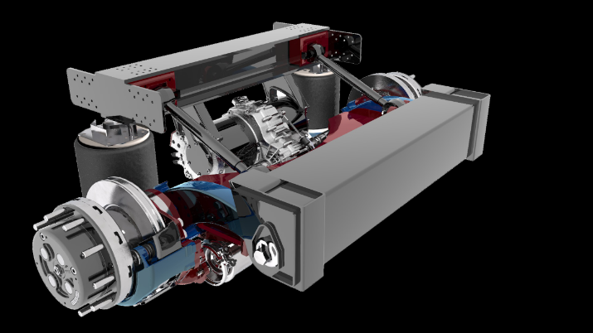
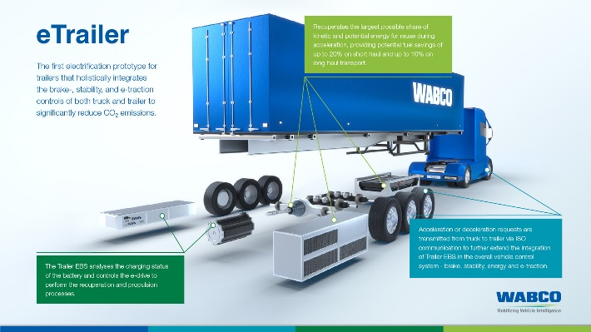
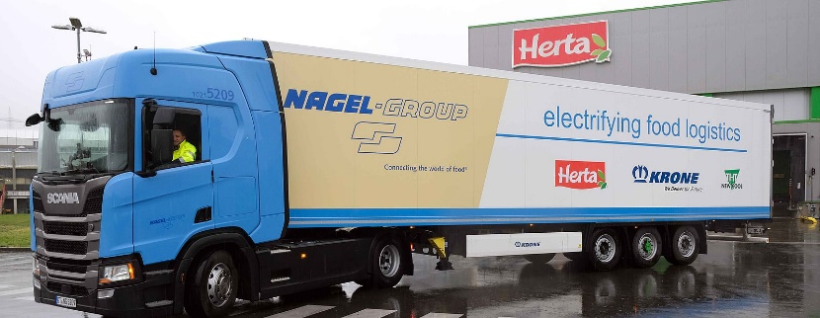
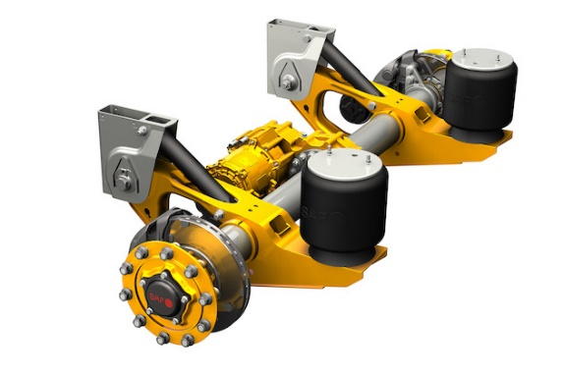
Advanced axles in trailers New technologies provided by suppliers and trailer industry
BOSCH
TrailerDynamics – Electric axle
ZF/WABCO – Driven trailer concept
Krone – Recuperation by trailer axles
Schmitz Cargobull – Electrified cooling unit with energy provided by trailer axles
SAF Holland – Electric axles

Slide 5
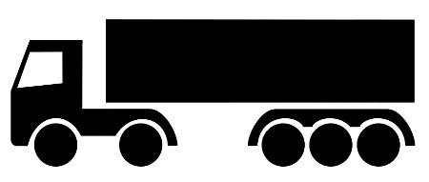
Advanced axles in trailers Reasons to propel trailers
Standard tractor/semi-trailer combination
Tractor/semi-trailer combination with driven trailer axles
Example
Example
Traction battery
Electric motor
m_{Tractor}
m_{Trailer}
m_{Tractor}
m_{Trailer}
- +
Rolling resistance Traction force
Air drag (tractor)
Grade resistance
- +
Rolling resistance Traction force
Air drag (tractor and trailer)
Grade resistance
Traction force is provided by tractor only and is transmitted to tractor axle(s)
Trailer does not support the tractor in driving conditions
Main traction force is provided by tractor and is transmitted to tractor axle(s) but in addition at least one trailer axle is driven independent from power source of tractor
Trailer power is less than tractor power
Electric trailer propulsion offers a wide range of applications (recuperation, acceleration, support start/stop manoeuvres …)

Slide 6
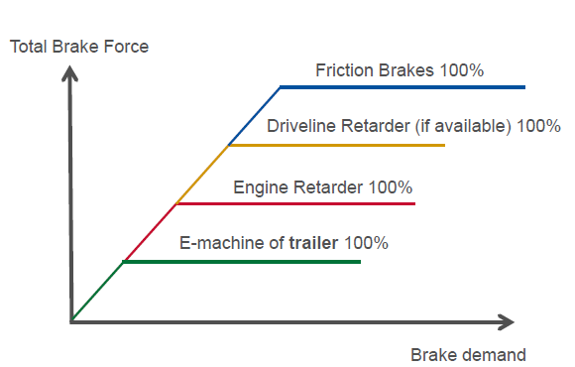
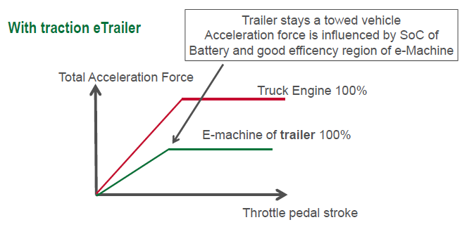
Advanced axles in trailers Applications for potential CO2 savings based on driven axles
Different use cases for advanced axles in trailers:
Support start/stop manoeuvres of tractor by driven axle(s) in trailers
Acceleration and Recuperation during driving
“Hybrid” propulsion concept for the vehicle combination
Separate energy support for auxiliary units by an electric axle (e.g. electric cooling units, heating devices …)
Independent energy support for the trailer during standstill/parking
“Vehicle to grid“ applications
Recuperation
Acceleration

Slide 7
Advanced axles in trailers Applications for potential CO2 savings based on driven axles
up to -16% CO₂ in short haul expected
Different use cases for advanced axles in trailers:
Support start/stop manoeuvres of tractor by driven axle(s) in trailers
Acceleration and Recuperation during driving
“Hybrid” propulsion concept for the vehicle combination
Separate energy support for auxiliary units by an electric axle (e.g. electric cooling units, heating devices …)
Independent energy support for the trailer during standstill/parking
“Vehicle to grid“ applications
Recuperation
Acceleration
up to -11% CO₂ in long/short haul expected

Slide 8
Advanced axles in trailers Premises
The trailer remains in the towed condition (except for the starting aid and except pushing forces that result from the dynamic conditions of the motor vehicle and trailer while driving)
Longitudinal dynamics of the motor vehicle influences the working mode of a driven trailer (e.g. for recuperation and interaction with retarder etc.) depending on the capabilities of the driven trailer
Motor vehicle and heavy trailers in a vehicle combination may communicate with each other (depending on the trailer category and driving modes)
Operating modes except for the starting aid are not subject to any speed restrictions, the speed range of the trailer propulsion can be identical to the speed range of the motor vehicle
The vehicle combination must remain separable, i.e. Motor vehicles and trailers each have their own drive components
Driven axles in trailers can have any type of propulsion (electrical, hydraulic ...) - specifications for this must be formulated in a technology-neutral manner

Slide 9
Advanced axles in trailers Today's bottleneck in the definition of trailers (RE.3/SR.1)
Paragraph 1.5:
“1.5. "Trailer" means any non-self propelled vehicle, which is designed and constructed to be towed by a power driven vehicle and includes semi-trailers.”
Paragraph 1.8:
“1.8. "Road tractor" means road motor vehicle designed, exclusively or primarily, to haul other road vehicles which are not power-driven (mainly semi–trailers).”
Paragraphs 2.4.5.1 to 2.4.5.3:
“2.4.5.1. "Semi–trailer": A towed vehicle, in which the axle(s) is (are) positioned behind the centre of gravity of the vehicle (when uniformly loaded), and which is equipped with a connecting device permitting horizontal and vertical forces to be transmitted to the towing vehicle. One or more of the axles may be driven by the towing vehicle.
“2.4.5.2. and 2.4.5.3. … similar to 2.4.5.1.
A trailer with a driven axle has a kind of propulsion independent from the motor vehicle and may self propelled but furthermore towed
A trailer with a driven axle is power-driven although not with the same power as the motor vehicle
A driven axle in a trailer (e.g. electric axles) operates independent from the towing vehicle as a separate device without force transmission from the tractors engine.

Slide 10
Advanced axles in trailers Next steps
Start the discussion in UNECE GRSG (Spring 2021) regarding the definitions in SR1 and RE3
Check for further amendments in other UN regulations (e.g. UN R13, UN R100 …)
CLCCR would appreciate the opinion of delegates in UNECE
What do you think about an amendment of definitions? Do we need sub-paragraphs? Are there examples in the past which may be used for a guidance in this case?
Who is interested in further discussions? Shall CLCCR prepare a proposal for the upcoming GRSG session in Autumn 2021?
Please, contact: Mr. Sascha Pfeifer* (sascha.pfeifer@vda.de) *on behalf of CLCCR

Slide 11
Founded in 1961, CLCCR is the International Association of the Body and trailer building industry. CLCCR advocates the various interests of trailer manufacturers, body builders and non-captive OEM Bus & Coach builders.
It functions as an international forum, through which its members discuss issues of common interest and develop mutual positions,
It offers a liaison between its members and the different international und European organizations,
It represents approved CLCCR positions to different international and European organizations,
It provides information services to its members and interested parties.
BluePoint Brussels | Bd A. Reyers Ln 80 | B-1030 Brussel / Bruxelles

Slide 12
Advanced axles in trailers Backup – Draft/Idea – Example for an amendment of definitions
Paragraph 1.5, amend to read:
“1.5. "Trailer" means any non-self propelled vehicle, which is primarily designed and constructed to be towed by a power driven vehicle and includes semi-trailers.”
Paragraph 1.8, amend to read:
“1.8. "Road tractor" means a road motor vehicle designed, exclusively or primarily, to haul other road vehicles which are not power-driven (mainly semi–trailers).”
Paragraphs 2.4.5.1 to 2.4.5.3, amend to read:
“2.4.5.1. "Semi–trailer": A towed towable vehicle, in which the axle(s) is (are) positioned behind the centre of gravity of the vehicle (when uniformly loaded), and which is equipped with a connecting device permitting horizontal and vertical forces to be transmitted to the a towing vehicle. One or more of the axles may be driven to support by the towing motor vehicle. A contribution to the propelling forces of the vehicle combination is permissible at all speeds. To ensure the stability of the vehicle combination, the propelling forces of the semi-trailer shall not push the towing vehicle at speeds above [15 km/h].
“2.4.5.2. and 2.4.5.3. … similar amendments as proposed in 2.4.5.1
DRAFT

