Slide 1
Transmitted by the expert of Switzerland
Transmitted by the Chairman of TF on RWS
Informal document GRSG-121-14
121st GRSG, April 12 – 16, 2021
Agenda item 16
Informal Document GRBP-73-12
73rd GRBP, January 26 - 29, 2021
Agenda item 6
Status report to GRBP #73
Task Force on Reverse Warning Sound issues

Slide 2
Meeting
Participants
12th meeting : October 1-2, 2020 Web meeting
13th meeting : October 19, 2020 Web meeting
14th meeting : October 28, 2020 Web meeting
15th meeting : November 5, 2020 Web meeting
16th meeting : December 7, 2020 Web meeting
17th meeting : January 13, 2021 Web meeting
Contracting parties : China, EC, Germany, India, Japan, Korea, Netherlands, UK
NGOs, etc : OICA, CLEPA, Reversing warning sound device manufactures (Guest)

Slide 3
Status of discussion
Schedule of document submission to GRBP
In status report to GRBP #72, I explained we will submit working document to GRBP #73.
Six meetings were held to achieve the goal, but we postponed our schedule because technical data collection did not proceed as expected due to COVID-19.
Our new goal is to submit working document to the next GRBP.
In this report, a latest draft and remaining issues will be explained.
Draft summarizes our discussions up to 16th meetings : TFRWS-17-02
https://wiki.unece.org/display/trans/TFRWS+-+17th+session,+WebEx+January+2021
A draft based on the results of the 17th meeting will be uploaded to the web site as soon as possible.

Slide 4
Status of discussion
TF group agreed
Composition of the draft
The draft consists of 2 parts.
I. Part I. Audible reverse warning device
II. Part II. Audible reverse warning signals of motor vehicles
Scope
1.1.1. PART I: Approval of audible reverse warning devices which are intended for fitting to motor vehicles of categories M2 (M > 3500 kg), N2, N3 and M3;
1.1.2. PART II: Approval of motor vehicles listed in 1.1.1. with regard to fitting of devices as specified under Part I automatically activated when reverse gear is selected and the propulsion system is on.

Slide 5
Status of discussion
TF group agreed
Definition : How to change sound level
2.1.1. “Non-self-adjusting audible reverse warning device” means a device which gives an audible reverse warning sound independent of ambient noise levels
2.1.2. “Self-adjusting audible reverse warning device” means a device which automatically adjusts its sound level, throughout a defined range, in order to maintain a sound level differential between the sound output of the device and the ambient noise measured by the device
2.1.3. “Stepwise self-adjusting audible reverse warning device” means a device which automatically adjusts to 1 of 3 fixed sound level modes (low, normal, high), depending on the ambient noise measured by the device

Slide 6
Status of discussion
Still under discussion
Definition : Sound level
To be more specific about when and where each sound level should be used, definition of each sound levels are defined as follows.
2.2. “Low Level” means the emitted sound level of the “Audible reverse warning device” which is sufficient for safety of vulnerable road users during quiet times and/or quiet areas.
2.3 “Normal Level” means the emitted sound level of the “Audible reverse warning device” which is sufficient for safety of vulnerable road users during normal traffic hours and areas not covered by 2.2. and 2.4.
2.4. “High Level” means the emitted sound level of the “Audible reverse warning device which is used when “Normal Level” is insufficient for safety owing to high ambient noise (e.g. construction area far from residential area).

Slide 7
Status of discussion
TF group agreed
Definition : Sound type
2.7. “Tonal Sound” means a sound which contains basically a single frequency, which is described as a basically pure sound commonly in the frequency range from 500 Hz to 4000 Hz
2.8. “Broadband Sound” means a sound which contains a large number of single frequency components, continuously distributed over a required frequency range covering at least 500 Hz to 4000 Hz (see §2.7)
2.9 “One-Third Octave Band Sound” means a sound which is defined as an acoustic signal with has its main energy and nearly constant power spectral density in 1 of 6 one-third octave frequency bands (Center frequency: 800, 1000, 1250, 1600, 2000, 2500 Hz or 3150 Hz).
Reverse warning sounds that do not fulfill above definition shall be excluded (i.e. Human voice message).

Slide 8
Status of discussion
TF group agreed
Test method : Part I (Non-self-adjusting)
Non-self-adjusting device is tested at 1m distance and 1.2m height.
Measurements in an anechoic chamber are preferred, but in view of the construction cost of an anechoic chamber, a semi-anechoic chamber or an open site is also allowed.

Slide 9
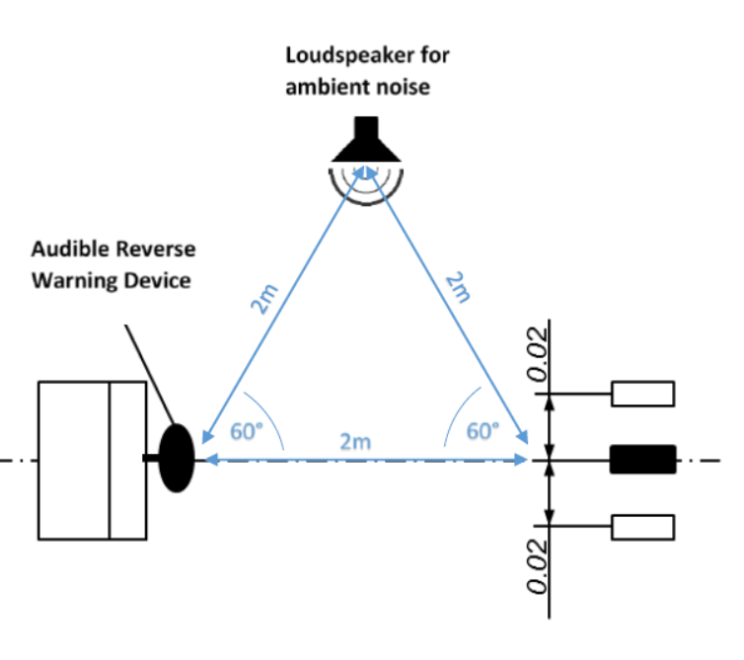
Status of discussion
Still under discussion
Pink noise is emitted from loudspeaker. The device is checked whether the warning sound SPL changes according to SPL of pink noise.
Although the test method has been finalized, SPL of pink noise will be determined according to the limit value of the test.
Test method : Part I (Self-adjusting & Step wise self-adjusting)
1m
1m
1m

Slide 10
Status of discussion
TF group agreed
Test method : Part II (Non-self-adjusting)
As a result of discussion based on measurement data, test method of part II is determined same as UN-R28.
In the test, SPL is measured at 7m distance from rear edge of a vehicle and find L_{MAX} between 0.5m to 1.5m height.

Slide 11
Status of discussion
Still under discussion
Test method : Part II (Self-adjusting & Step wise self-adjusting)
As well as Part I test, pink noise was emitted from loudspeaker. The device is checked for the warning sound SPL changes according to SPL of pink noise.
Verification tests of the test method will be conducted.

Slide 12
Status of discussion
Still under discussion
Limit value
The current limit values for Part II test are as follows. These values were decided based on technical data and the usage situation of each sound level.
If additional data is submitted, we will discuss whether it is necessary to change these limit values.
Limit value of Part I test will be decided from limit value of Part II test.
 | Tonal Sound, Broadband & One-Third Octave Band Sound
 | Min. Level | Max. Level
 | dB(A) | dB(A)
Low Level | [40] | [55]
Normal Level | [60] | [75]
High Level | [85] | [95]

Slide 13
Status of discussion
Still under discussion
Pause function
Pause function is defined as follows taking into the latest information about VRU-Proxi IWG.
A new regulation regarding reversing motion made by VRU-Proxi IWG is UN-R158. Our draft refer to it.
14.3. Pause function
The manufacturer may install a pause function to disable temporarily the acoustic reverse warning device when a vehicle of category M2 (M>3500 kg), N2, M3, or N3 is equipped with a non-audible safety system, [device(s) for reversing motion⁷], allowing the driver to check the hazard area behind the vehicle, including when towing vehicles, and it is ensured that such safety system(s) functions while reversing. Any other disabling function which does not satisfy the specifications below is prohibited.
[ ⁷The device(s) for reversing motion shall comply with UN Regulation No.158]

Slide 14
Next step
Major remaining issues
Test method for self-adjusting and step wise self-adjusting
Meeting
18th meeting : March 17, 2021 Web meeting
Additional meetings will be held to finalize the draft

Slide 15
Any information or comment is welcomed.
Please contact the followings.
Houzu, Hiroyuki (Chair) :
houzu@ntsel.go.jp
Klopotek, Manfred (Secretary) :
manfred.klopotek@scania.com

