Slide 1
IWG Safer Transport of Children in Buses and Coaches
Informal document GRSG-121-03
(121th GRSG, 12-16 April 2021 Agenda item 2(a))
Fifth meeting
28/01/2021
OICA

Slide 2
CRS installation in buses & coaches
Influence on interior arrangements of buses & coaches:
Seat dimensions and spacing
Access to the vehicle seats
Relevant vehicle classes
2-pts belt / 3-pts belt restraint availability
In-vehicle child seats (eg: Sit Safe)
Support leg assessment volume
France, Germany, Spain and UK accident data

Slide 3
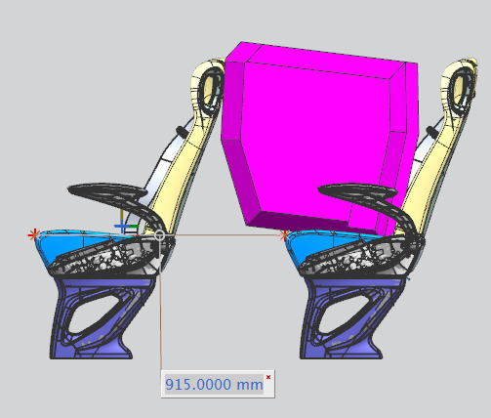
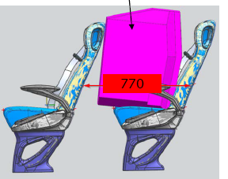
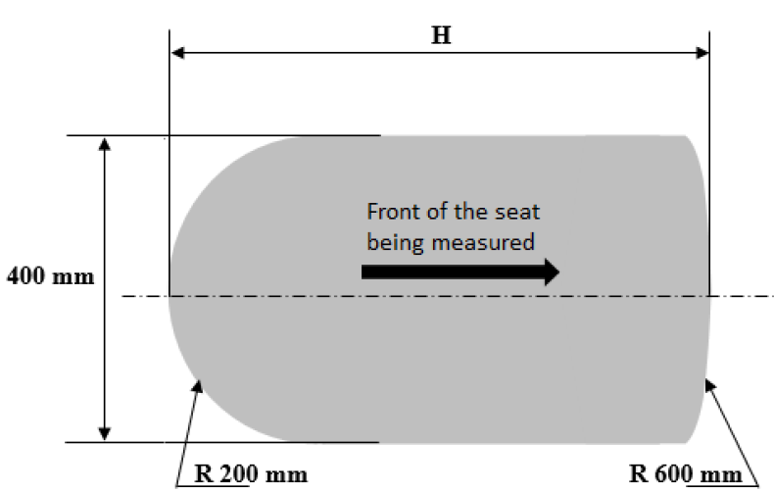
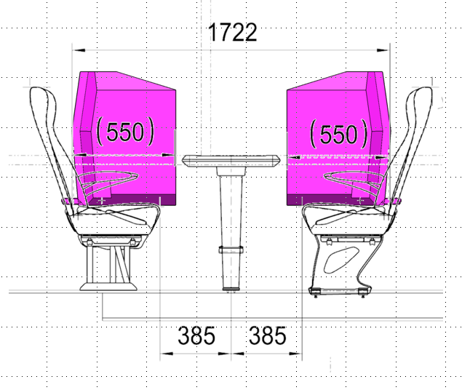
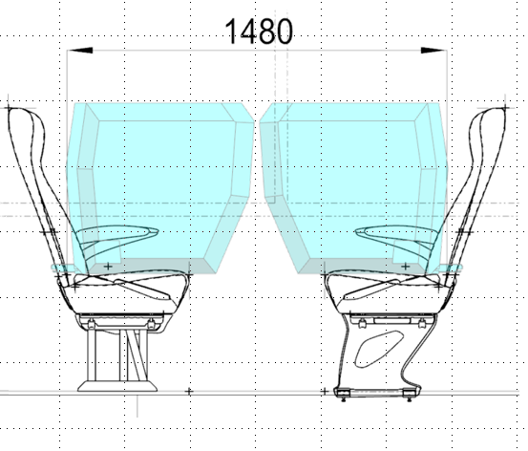
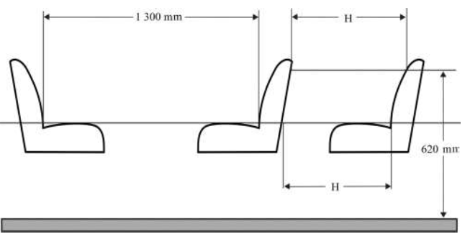
Influence on interior arrangements of buses 1) Seat dimensions and spacing
Using UN R 129-CRS would lead to larger seat spacing and a significant loss of seats in the vehicles
Front-facing ISO/F3 CLASS A
Rear-facing ISO/R2 CLASS D
Seat spacing
UN-R107 Annex 3 §7.7.8.4
 | H
Classes I, A and B | 650 mm
Classes II and III | 680 mm
915 mm
1300 mm

Slide 4
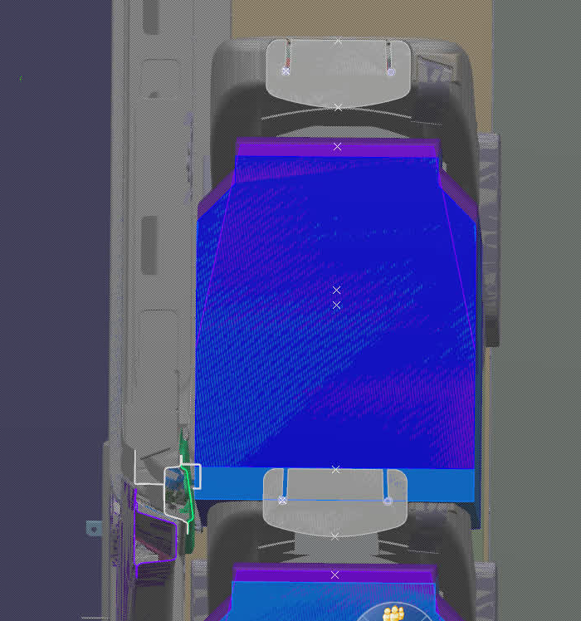
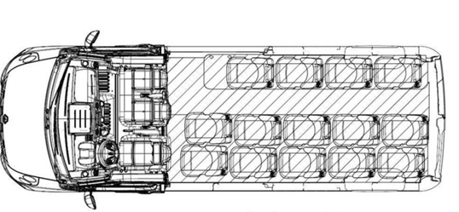
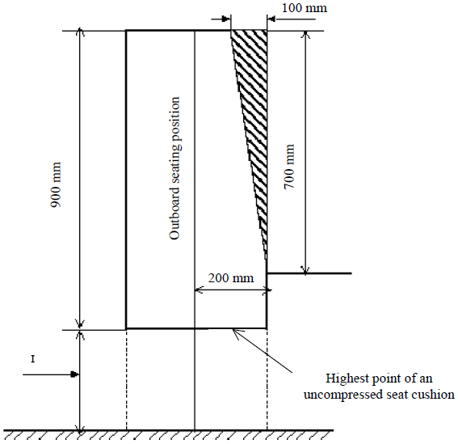
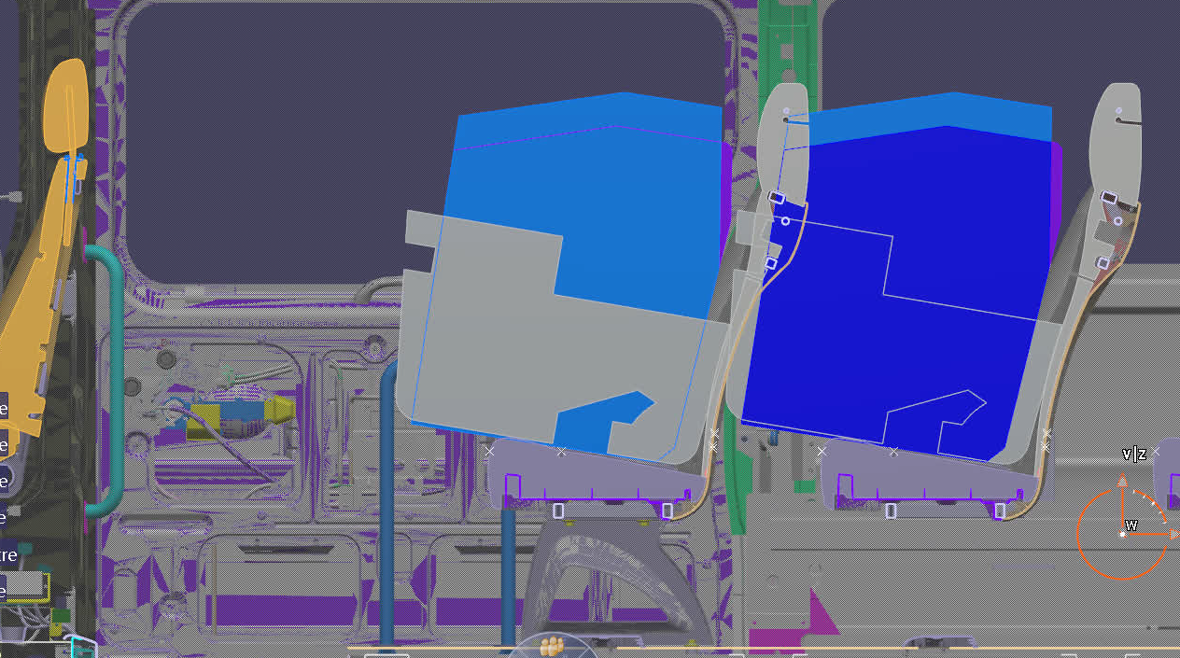
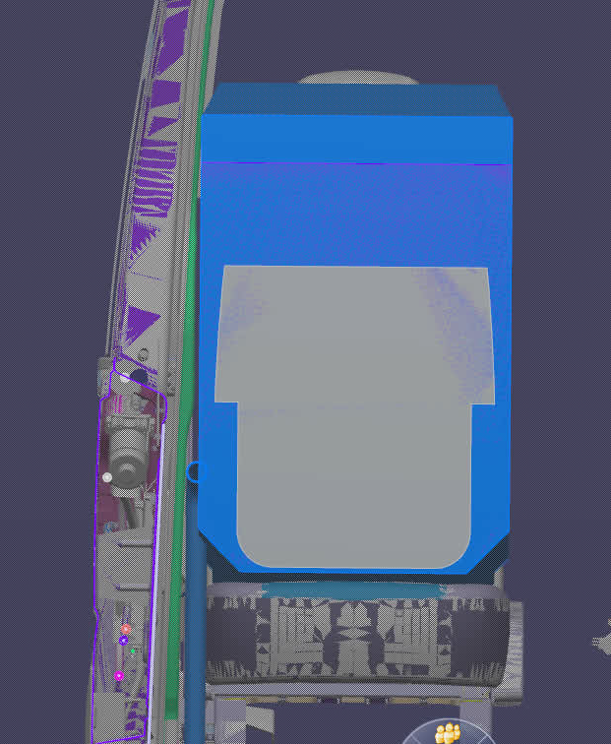
Influence on interior arrangements of buses 1) Seat dimensions and spacing
Permitted intrusions acc. to UN R 107 are in conflict with the dimensions of UN R 129-CRS!
Top view
6
Permitted intrusion above a seating position
UN-R107 Annex 3 §7.7.8.6.3.2
5
6
Cantrail
5
6
Front view
5
I (mm)
400 to 500 (for Classes A, B, I and II min 350 mm at wheel arches and engine compartment(s))
Handrail

Slide 5
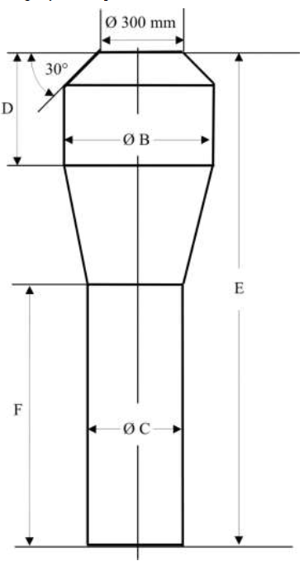
Influence on interior arrangements of buses 2) Access to the vehicle seats
UN R 107 Gangway dimensions do not permit to move the CRS to the individual passenger seats!
Gangway mannequin (Class B)
UN-R107 Annex 3 §7.7.8.6.3.2
Class | B (mm) | C (mm) | D (mm) | E (mm) | F (mm)
I | 550 | 450 | 500 | 1900 | 900
A and II | 550 | 350 | 500 | 1900 | 900
B | 450 | 300 | 300 | 1500 | 900
III | 450 | 300 | 500 | 1900 | 900
Class B mannequin
300 mm
Ø450 mm
ISO/F3 CLASS A
1500 mm
900 mm
Ø300 mm

Slide 6
Influence on interior arrangements of buses 3) Relevant vehicle classes
Seat belt fitting in Class II – vehicles follows national regulations of CPs – harmonisation needed?
 |  |  | UN-R16 Minmum requirements for safety belts
Number of passengers | Accomodation of passengers | Class | GVM ≤ 5t (M2) |  | GVM > 5t (M3)
 |  |  | GVM ≤ 3.5t | GVM > 3.5t
9 - 22 | Standing +seated | A | No * | No * | No *
 | All seated | B | 3-pt belt ** | 2-pt belt ** | 2-pt belt **
> 22 | Standing & seated (urban) | I | No * | No * | No *
 | Mostly seated (interurban) | II | No *** | No *** | No ***
 | All seated (coach) | III | 3-pt belt | 2-pt belt ** | 2-pt belt **
* When fitted, safety-belts must be in compliance with this regulation
** 8.1.7 – 3-pt belt must be installed unless:
1) Reference zone empty or
2) UN-R80 seat or
3) Parts fulfilling UN-R80 energy absorption test.
*** Contracting Parties applying this Regulation may demand the installation of safety belts on M2 and M3 vehicles belonging to Class II.

Slide 7
Influence on interior arrangements of buses 4) 2-pts belt / 3-pts belt availability
Most vehicles on the market are fitted with 2P-belts with energy absorbing zones!
 |  |  | UN-R16 Minmum requirements for safety belts
Number of passengers | Accomodation of passengers | Class | GVM ≤ 5t (M2) |  | GVM > 5t (M3)
 |  |  | GVM ≤ 3.5t | GVM > 3.5t
9 - 22 | Standing +seated | A | No * | No * | No *
 | All seated | B | 3-pt belt ** | 2-pt belt ** | 2-pt belt **
> 22 | Standing & seated (urban) | I | No * | No * | No *
 | Mostly seated (interurban) | II | No *** | No *** | No ***
 | All seated (coach) | III | 3-pt belt | 2-pt belt ** | 2-pt belt **
* When fitted, safety-belts must be in compliance with this regulation
** 8.1.7 – 3-pt belt must be installed unless:
1) Reference zone empty or
2) UN-R80 seat or
3) Parts fulfilling UN-R80 energy absorption test.
*** Contracting Parties applying this Regulation may demand the installation of safety belts on M2 and M3 vehicles belonging to Class II.

Slide 8
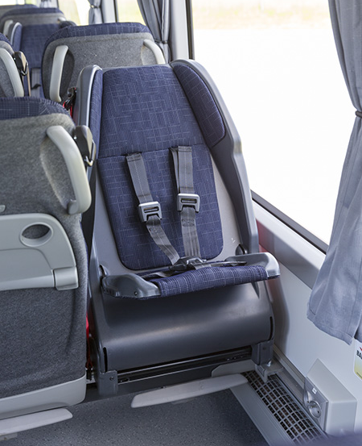
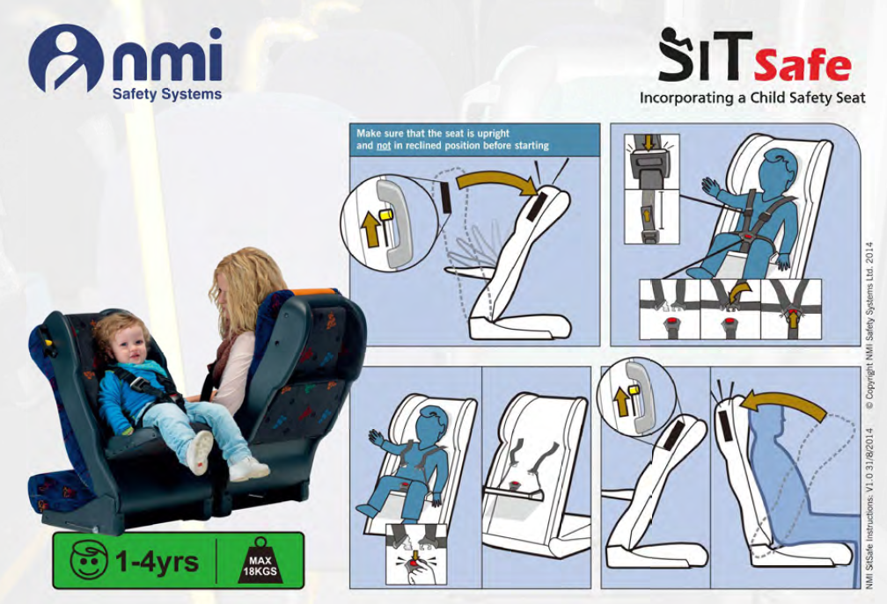
Influence on interior arrangements of buses 5) In-vehicle child seats
CRS-bus approval shall follow prescriptions on UN R 80 – basis, shall be technology neutral and not focused on existing R 129-CRS
Eg: SiTSafe as a solution for option in Nordic bus procurement requirements
« At least 2 child seats for 3 years of age (UN-R44) »

Slide 9
Influence on interior arrangements of buses 6) Support leg volume assessment
Support leg might lead to further increase of seat spacing and further loss of seats in the vehicle!
200 mm
200 mm
525
525
585
200
585
695
695
Side view
Front-facing ISO/F3 CLASS A

Slide 10
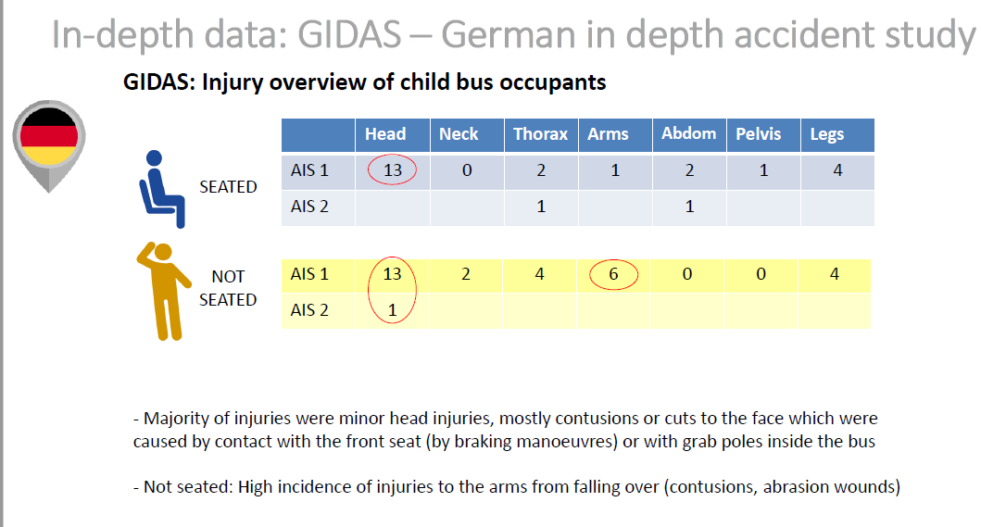
France, Germany, Spain and UK accident data
Most of injured children are above 9 years old
Most of them were not restrained.

Slide 11
SUMMARY
We identified some issues with significant influence on vehicle and its interior and seating layout :
CRS according to UN-R129 seem not to be compatible with Bus interior arrangements according to UN-R 107
France, Germany, Spain and UK accident data :
Main victim population: 9 years and older
Cause: unrestrained
We propose to seek guidance from GRSG
How to deal with vehicle requirements (UN-R107)
Number of designated CRS places in the vehicle needed?
ToR of the IWG to be amended accordingly

