Slide 1
Submitted by the experts from Japan | Informal document GRE-84-36 (84th GRE, 26 to 30 April 2021, agenda item 6 (a))
Japan’s concerns on ECE/TRANS/WP.29/GRE/2020/4/Rev.1
0. Delay in brake reaction time caused by road projections
1. Distracting glare to oncoming vehicles on wet road surfaces
2. Scope of symbol types
3. Prohibition of flashing or transforming symbols
4. Limitation of symbol colors
5. Limitation of projection range widths
6. Duration of symbol projection
7. Impact on oncoming vehicles and pedestrians

Slide 2
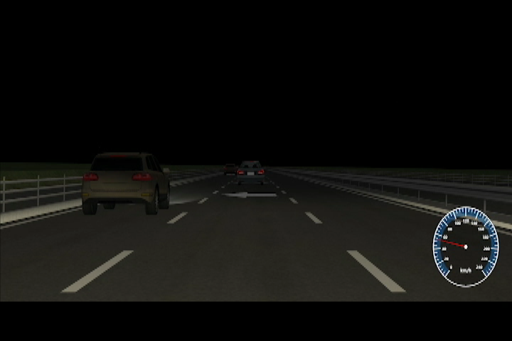
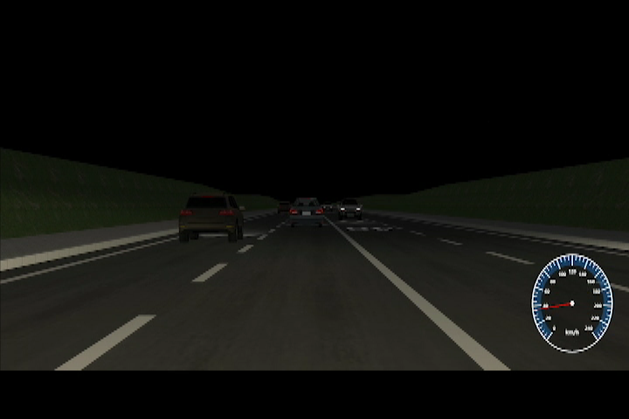
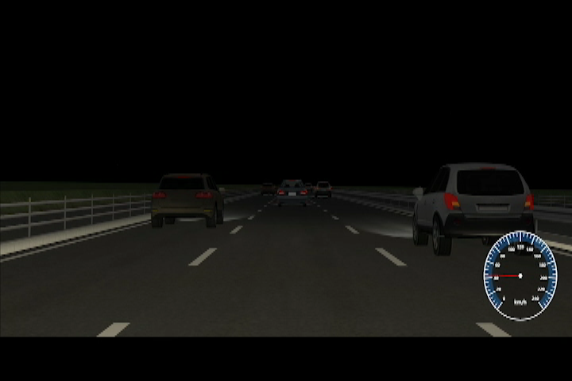
Experimental Method
Experimental conditions
- Vehicles with a road projection lamp : Host vehicle (with or without call-out*), oncoming vehicles, overtaking vehicles.
*Call-out (C/O) refers to the driver calling out the symbol type.
- Brightness of RP symbols : Bright (RGB gradation set to be equivalent to 140K cd lamp intensity), dark (a lamp intensity of 50K cd)
- Positions of RPs : 15 m, 25 m, 35 m ahead of the vehicle with the RP lamp
- Size of RP : Large (equivalent to a 2.5 m-wide symbol), Small (equivalent to a 1.2 m-wide symbol)
Experiment videos
Vehicles with a RP lamp:
(a) Host vehicle
(b) Oncoming vehicles
(c) Overtaking vehicles

Slide 3
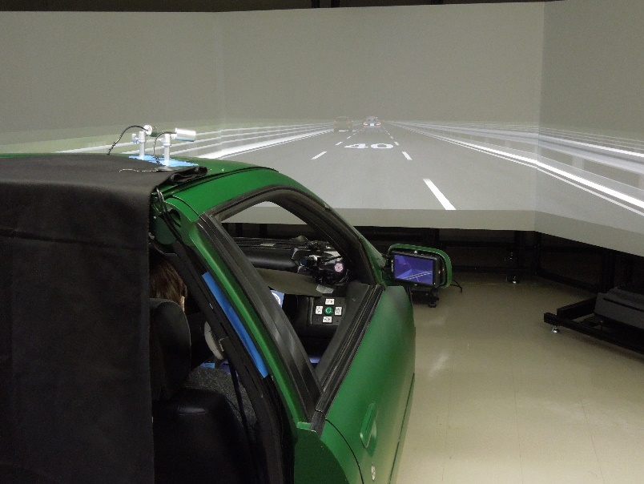
Experimental Method
An evaluation experiment was conducted on a driving simulator.
Evaluation subjects
- Changes in the driver's brake reaction time* in response to road projections under driving conditions
*The time measured between the time when the braking lights of the preceding vehicle lit up and the time when the driver stepped on the brake pedal
- Subjective evaluation (influence of RPs on other road users, etc.)
A scene of the simulator experiment

Slide 4
Conclusions
(1) The display of road projections caused a delay in the driver's brake reaction time (on average, 0.09 s with C/O and 0.05 s without C/O for a host vehicle, 0.04 s for an oncoming vehicle, and 0.05 s for an overtaking vehicle).
(2) RPs bothered most drivers in certain conditions if from oncoming vehicles, but not from overtaking vehicles.
(3) On wet road surfaces, the reflective luminance of RPs seen from the host vehicle significantly decreased, but increased when seen from oncoming vehicles.

Slide 5
Japan's Concerns
0. Delay in brake reaction time caused by road projections
1. Distracting glare to oncoming vehicles on wet road surfaces
2. Scope of symbol types
3. Prohibition of flashing or transforming symbols
4. Limitation of symbol colors
5. Limitation of projection range widths
6. Duration of symbol projection
7. Impact on oncoming vehicles and pedestrians
Concerns 2, 4, and 6 will be resolved in GRE/2020/4/Rev.1. Concern 0, too, has been resolved with the results of the dynamic tests presented above.
However, concerns 1, 3, 5 and 7 remain unresolved.
It is also necessary to discuss the question of listing not only symbols but also patterns (or of deleting patterns, keeping only symbols). It is also necessary to adjust the operating conditions, etc. of RP lamps to ensure that there are no conflicts with other GRs.

