Slide 1
Working Party on Working Party on Lighting and Light-Signalling General information and WP.29 highlights
Note by the secretariat
Informal document GRE-84-23
(84th GRE, 26-30 April 2021,
agenda item 1)
Next session
The next session is provisionally scheduled from 26 to 29 October 2021
The deadline for the submission of official working documents is 3 August 2021
For new pictures with notes, all text should be editable. No text as an embedded image!
Copyright/intellectual property issues: the submitter of any document (including presentation) is invited to confirm that publication of this document on the UNECE website and further use does not violate any copyright/intellectual property rights and that the submitter agrees to hold UNECE harmless of any copyright/intellectual property claims concerning this document.
Changes to the website
Our website has been migrated to a new platform. Access to meeting documents has changed
For 2021 meetings, use the "Meetings & Documents" entry menu on the left
For meetings before 2021, use the "Meeting Documents before 2021 (ARCHIVE)" menu
Wiki pages for IWGs and TFs have not changed:
https://wiki.unece.org/pages/viewpage.action?pageId=2523229
The link is below the GR name in the left menu
See the following slides

Slide 2
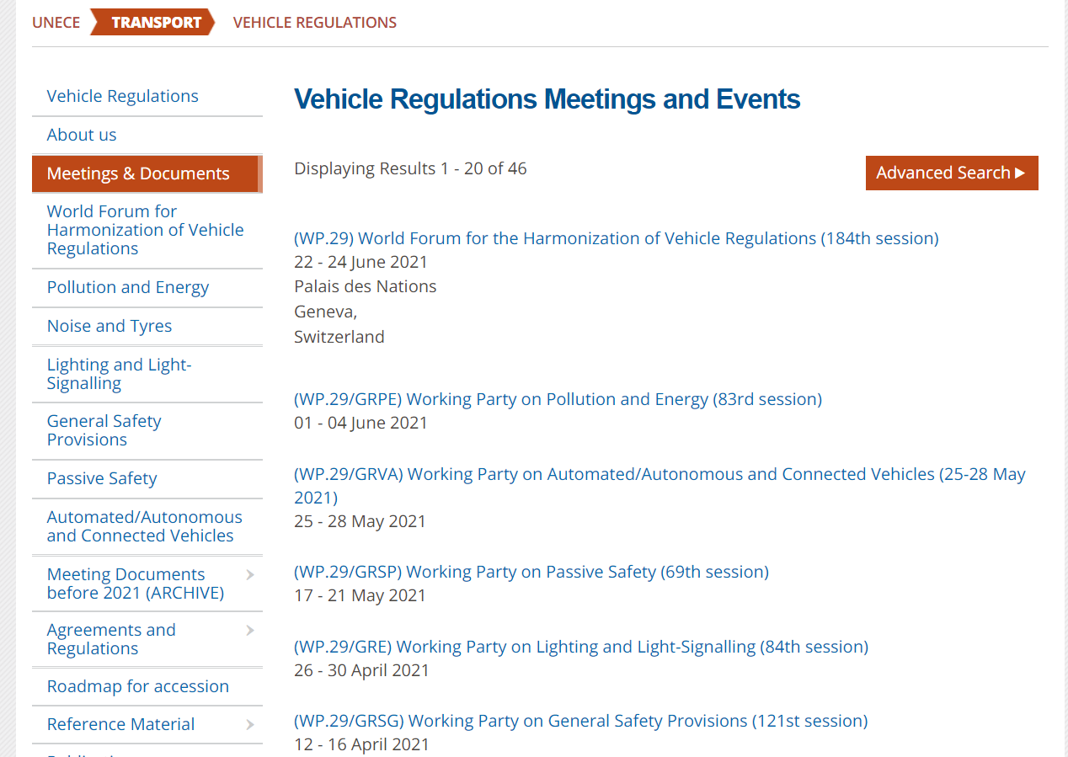
Website

Slide 3
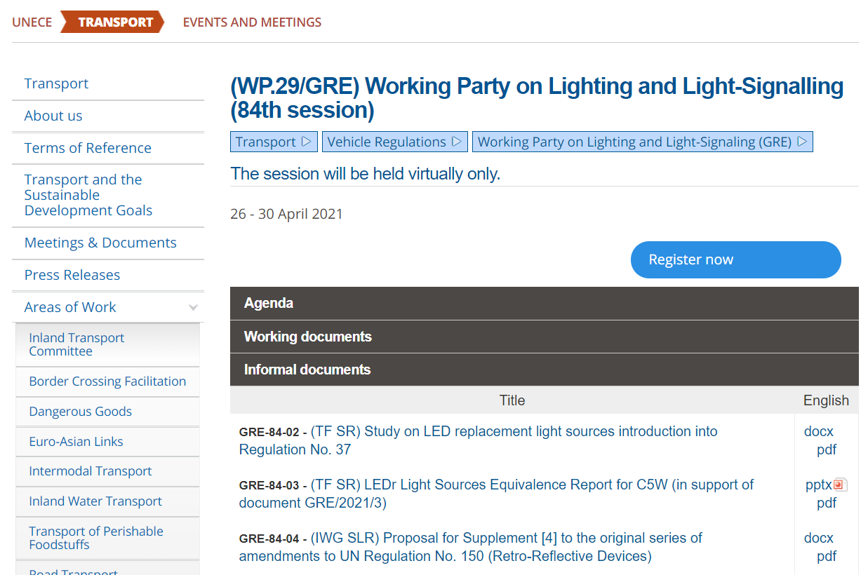
Website

Slide 4
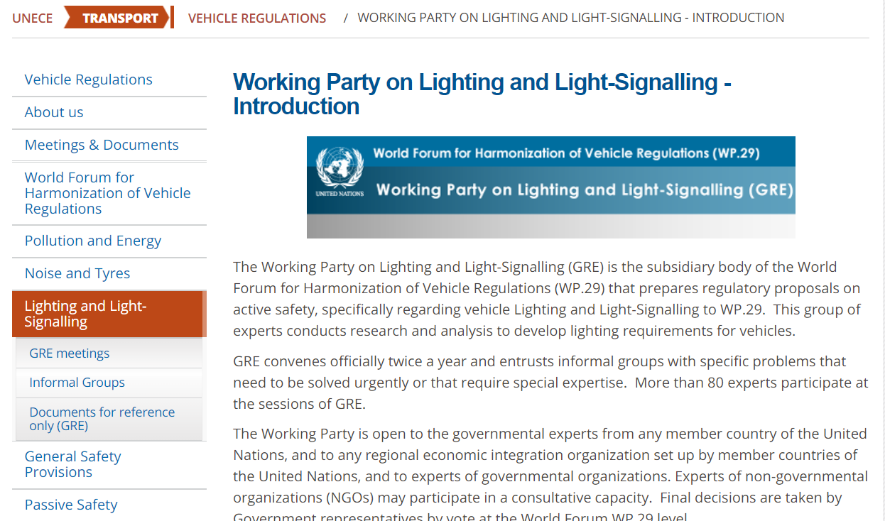
Website

Slide 5
Highlights of the recent session(s) of WP.29
November 2020
Opening statement of Dr. James Owens, NHTSA Deputy Administrator (WP.29-182-20)
Mr. Anikeev (Russian Federation) elected as Vice-Chair of WP.29
WP.29 endorsed a proposal by IWG IWVTA to amend provision V9 in the Guidelines on Transitional Provisions:
V.9. Contracting Parties applying this Regulation shall not refuse to grant type approvals according to any preceding series of amendments to this Regulation or extensions thereof.
“V.9. Contracting Parties applying this UN Regulation may grant type approvals according to any preceding series of amendments to this Regulation.
V.9bis. Contracting Parties applying this UN Regulation shall continue to grant extensions of existing approvals to any preceding series of amendments to this Regulation.”
See report in ECE/TRANS/WP.29/1155

Slide 6
Highlights of the recent session(s) of WP.29
March 2021
All GRE amendment proposals (21 documents) adopted
WP.29 agreed with a proposal of IWG DETA to grant Market Surveillance Authorities access to DETA under certain conditions
WP.29 invited IWGs on SLR and DETA to develop the proposal related to the use
of DETA in the context of Unique Identifier
WP.29 invited the secretariat to call for an informal meeting at AC.2 level to discuss financing of DETA
See report in ECE/TRANS/WP.29/1157

