Slide 1
Prof. dr Branko Glavonjić
Forest products statistics in Serbia:
existing system, innovations and
further perspectives

Slide 2
CONTENT
Forest products statistics for Serbia: short overview of the data collection and production phases
The main characteristics of the methodology: empirical survey data
System of distribution and use the data on forest products for Serbia
The main weaknesses and limitations of the existing system
Practical proposals for improving the existing system

Slide 3
Process of collecting, processing and production of data
Data collection and production phases
Collection from producers and statistical office
Data quality and logical check + creation of data basis
Data processing (conversion factors, summing, linking)
Final data

Slide 4
Strenghts of data collecting process for Serbia
Professional and trained staff
Trustable relationship with producers and traders, individual institutions
Production data is collected directly from producers
Trade data are collected directly from official statistics

Slide 5
Network and data sources?
Producers of wood-based panels
Producers of paper and paperboard
Producers of wooden furniture
Statistical office of the Republic of Serbia
Producers of sawnwood
Producers of roundwood from public forests
Producers of roundwood from private forests
Producers of wood fuels

Slide 6
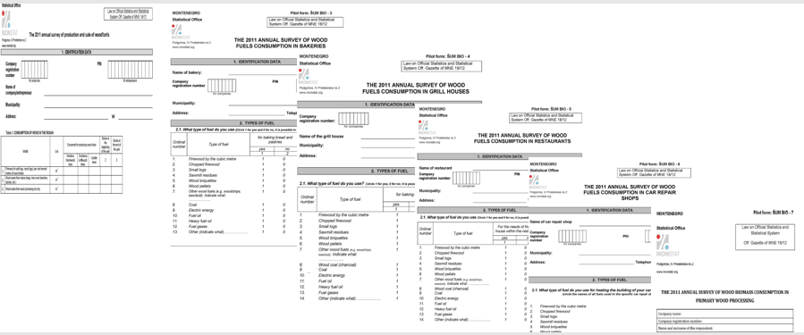
Innovations in data collecting process for Serbia
Methodology based on UNECE / FAO reporting principles
Innovations are carried out continuously, whenever some anomalies are noticed in the data collection process

Slide 7
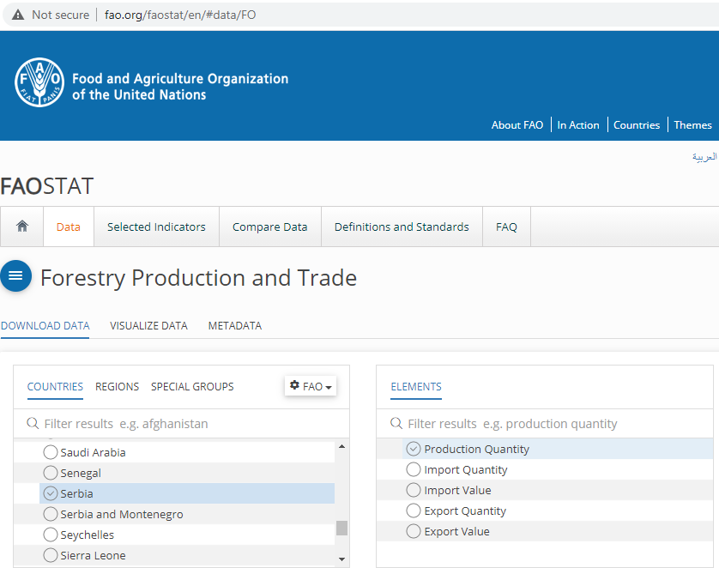
System of distribution and use of the data on forest products
The data are provided to UNECE through its questionnaires, and are publicly available in UNECE and FAO web databases.

Slide 8
System of distribution and use of data on forest products
FPAMR is the most visible publication for the forest products data dissemination

Slide 9
System of distribution and use of data on forest products
It is certain that the data is used by a huge number of different categories of users.
The main users of forest product statistics in Serbia
Staff from the Ministries and Agencies
Academy
Chambers and producer associations
Domestic producers and traders
International organizations
Domestic and international consultants
Journalists

Slide 10
The main weaknesses and limitations of the existing system for collecting, analyzing and disseminating data on forest products
Uncertainty in the financing of the data collection system. For more than ten years, the system is based on the support of international organizations (FAO, UNECE, UNDP) through various projects.
Weak coordination between the institutions charged for some segments of the forest-based sectors

Slide 11
Practical proposals for improving the existing system
Sustainable model for financing the data collection system
Continuation of supporting the projects aimed for further improvement of the data collecting system

Slide 12
Thank you for your attention !
Prof. dr Branko Glavonjić University Professor University of Belgrade
Faculty of Forestry Kneza Viseslava 1
11030 Belgrade Republic of Serbia tel.+381 11 30 53 863 fax.+381 11 3059 537 email: branko.glavonjic@sfb.bg.ac.rs
www.sfb.bg.ac.rs

