Slide 1
GRSG/120
GRSG-120-06
Data Elements
EDR
Which Trigger applies to Which Data Element?

Slide 2
Current Proposal
Current proposal to record all data elements in all triggers
Proposal raises concerns/questions
Misleading and confusing data, e.g. using delta-V accumulating in a rollover event
Benefit of additional data for reconstruction and analysis of an accident or specific type of event
Requires additional RAM memory for capturing the data
Requires additional non-volatile memory for storage, which will require more energy reserve
May drive system architecture design

Slide 3
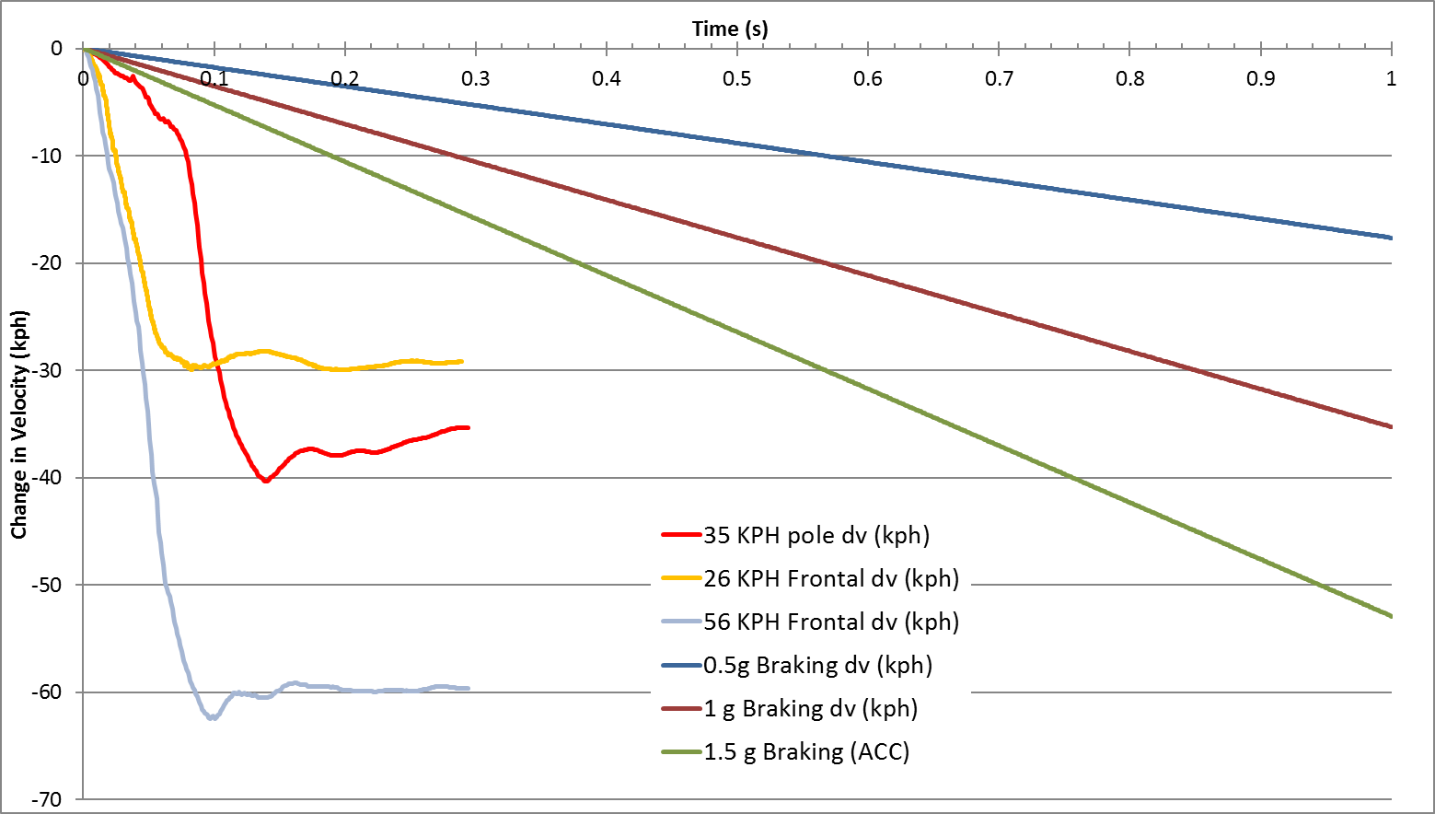
Rollover Event
Example: Using the longitudinal delta-V accumulating in a rollover event
The delta-V in longitudinal crashes typically peaks about 0.1 to 0.15 seconds after contact. The other plots are delta-V from various fixed braking deceleration levels.

Slide 4
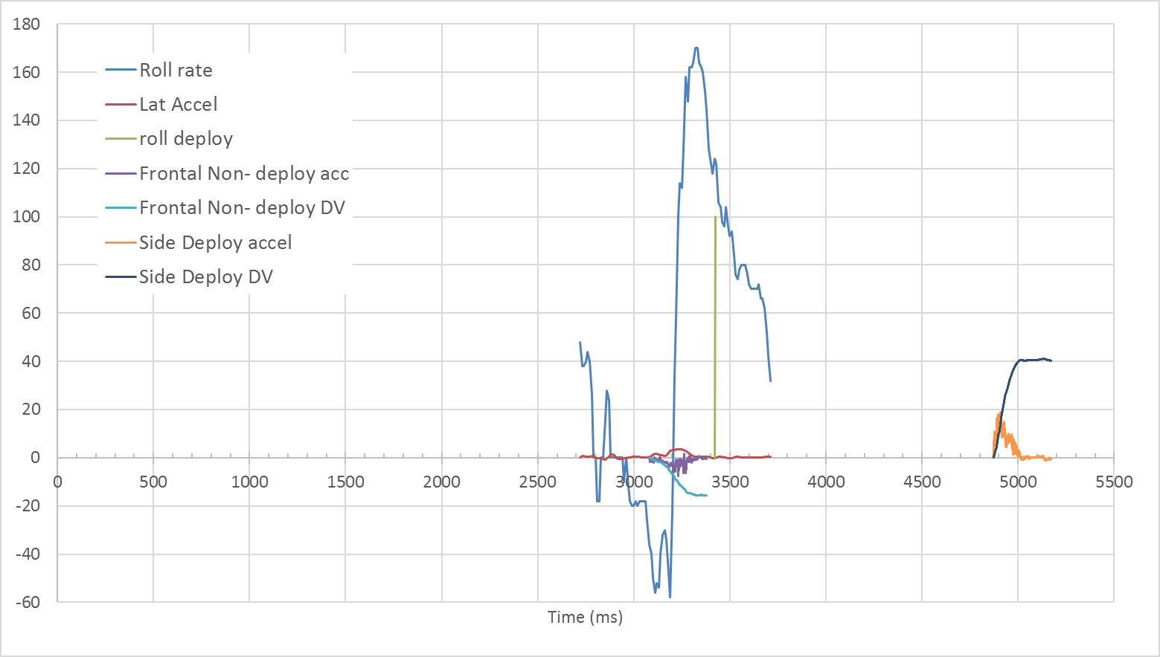
Event Duration of Vehicle Going Off Road
Requiring all parameters to be recorded in all event triggers means data cannot be stored to non-volatile memory until the roll ends (in this case 11.765 seconds). Events may not be recorded while waiting for this event to complete. However, with tailored EDR, the data is recorded as each event occurs

Slide 5
Recommendation
Proposal is to tailor the mandated EDR data elements per the trigger/event type
Benefits
Provides maximum flexibility (harmonization) for all parties implementing the EDR.
Helps minimize memory resources required to implement the EDR function
Provides the critical data needed for accident investigation and occupant injury analysis (based on 30+ years from experience in EDR design and analysis)
An EDR design tailored to record data based on the event type would record a planar event if the criteria to capture and store a planar event occurs before, during or after a rollover event. This would produce two separate EDR records. One for rollover and one for the planar.
The purpose of the EDR is to provide data to help improve motor vehicle safety. The focus should be on collecting the data parameters related to each event type (planar, rollover and VRU) which will provide useful data for analysis.

