Slide 1
Transmitted by the Co-Chairs of the IWG on EDR/DSSAD
Informal document GRSG-120-04 rev1 GRSG 120th Session, 11 January 2021
IWG on EDR/DSSAD
Status Report January 2020
Notes:
1

Slide 2
Background IWG on EDR/DSSAD
In accordance with the ‘Framework Document’ as adopted by WP.29-178, June 2019:
GRSG
GRVA
IWG on EDR/DSSAD
TASKS:
Define the scope and specific objectives of, and differences between, EDR (Event Data Recorder) and DSSAD (Data Storage System for Automated Driving)
Define EDR and DSSAD technical requirements
DELIVERABLES:
WP.29 Nov. 2019 Identification of differences between DSSAD and EDR
WP.29 Mar. 2020 Requirements for DSSAD for Automated Lane Keeping Systems
WP.29 Mar. 2020 Review of the existing national/regional actives & a proposed way forward for EDR/DSSAD
WP.29 Nov. 2020 → WP.29 Mar. 2021 Requirements for EDR

Slide 3
PREVIOUSLY – two-step approach & two deliverables
Step 1: for WP.29 November 2020 March 2021 basic requirements for EDR. (based on existing well-known standard)
Step 2: from WP.29 November 2020 March 2021 new, advanced requirements for EDR. (based on safety benefits, technological progress, etc. – to be identified)
Deliverables for Step 1:
- EDR Common Technical Requirements, appropriate for adoption in the 1958 and 1998 Agreements.
- UN Regulation on EDR, largely the same technical requirements in format of UN Regulation in accordance with the 1958 Agreement.

Slide 4
PREVIOUSLY – GRSG-118 decisions
GRSG-118 July 2020 – first proposals:
Outstanding issues on definitions, overwriting, testing, memory buffer and on data elements.
GRSG forwarded first proposals to WP.29/AC.1 Nov. 2020 session, subject to a final review at the GRSG-119 in October.
EDR Common Technical Requirements:
GRSG-118-13 = ECE/TRANS/WP.29/2020/100
UN Regulation:
GRSG-118-14 = ECE/TRANS/WP.29/2020/123

Slide 5
PREVIOUSLY – GRSG-119 decisions
GRSG-119 October 2020 – amended proposals:
Outstanding issues on data elements and on EDR non-volatile memory buffer accommodating [two/three] different events.
GRSG endorsed proposals. Decisions on final proposals at the GRSG-120th Session on 11 January 2021.
EDR Common Technical Requirements:
GRSG-119-02 rev1 amending ECE/TRANS/WP.29/2020/100
UN Regulation:
GRSG-119-03 rev 1 amending ECE/TRANS/WP.29/2020/123

Slide 6
IWG Activities – since GRSG-119
Activities during October-January:
three sessions of the IWG on EDR/DSSAD,
six sessions of Task-Force on data elements.
Participation by up to 60 people (representatives from many contracting parties to the 1958 and 1998 Agreements and experts from Industry and organizations for PTI, insurance, accident analysis, etc.).

Slide 7
TODAY – GRSG-120
GRSG-120 January 2021 – final proposals:
Most outstanding issues solved, some remaining.
EDR Common Technical Requirements:
GRSG-120-01 amending ECE/TRANS/WP.29/2020/100
UN Regulation, 00 Series:
GRSG-120-02 amending ECE/TRANS/WP.29/2020/123
UN Regulation, 01 Series:
GRSG-120-03 new document
GRSG-120-05 small latest amendments to GSG-120-01 and -02

Slide 8
EDR Requirements
Both GRSG-120-01 and GRSG-120-02:
Capturing, recording and locking of data,
Data elements and format,
Survivability testing.
Data retrieval is excluded.
Only GRSG-120-02 (UN Regulation format):
Type-Approval elements,
The EDR shall record the captured data in the vehicle,
Deactivation of the EDR shall not be possible,
Scope: without prejudice to national requirements on privacy, data protection and personal data processing.

Slide 9
EDR Requirements
Only GRSG-120-03 (UN Regulation, 01 Series):
Additional data elements and format,
EDR non-volatile memory buffer to accommodate the data related to at least two/three different events,
Transitional Provisions (Paragraph 11): Phasing in of new 01 Series requirements per [1 July 2024] new types, [1 July 2026] existing types.

Slide 10
Considerations for GRSG
1. The IWG did not reach consensus on the data elements:
Clipping flag;
CSF, ESF, ACSF, LDWS;
Emergency Call System status.
These are essential to some CP’s for EDR Step 1 whereas for other CP’s these shall be moved to EDR Step 2.
2. Shall data elements be related to the type of (VRU/rollover) event? (right column of data elements table in Annex)
3. Proposed lead time / Transitional Provisions?

Slide 11
Future work
From March 2021, the IWG on EDR/DSSAD suggests to continue its work on:
DSSAD (beyond ALKS),
EDR Step 2 (new and advanced future requirements).

Slide 12
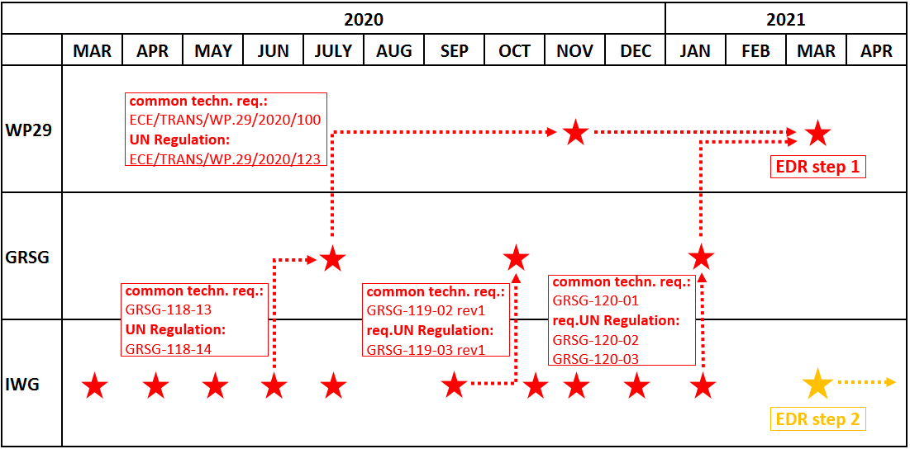
Schedule (for reference)

Slide 13
Thank you!

