Slide 1
Technical support for the impact assessment on Euro 5 step of L-category sound emissions level limits
Transmitted by the expert from EC
Informal document GRBP-73-26
(73rd GRBP, 26-29 January 2021,
agenda item 7)
73rd GRBP, 26-29/1/2021
By Applus IDIADA & ACASA, on behalf of the European Commission

Slide 2
Project Tasks
Task 1: Estimate of L-category fleet representativeness in sound emissions (IDIADA)
Task 2: Verification of sound level limits (IDIADA)
Task 3: Noise source ranking tests (IDIADA)
Task 4: Cost-benefit analysis (ACASA)
Task 5: Proposal of sound emission limit values and reporting (IDIADA)
Task 6: Project Management (IDIADA)

Slide 3
Task dependencies

Slide 4
Task 1: Estimate of L-categories fleet representativeness in sound emissions
Objectives
Sub-tasks
Determine a quantitative picture of the noise level emission of the current fleet.
The potential new technologies that can enable a noise emission improvement in current vehicles and in the mid and long term.
A high-level proposal of potential of new noise emission thresholds including a timeframe for implementation.
Task 1.1: Feedback gathering
Task 1.2: Literature review

Slide 5
Task 1: Estimate of L-categories fleet representativeness in sound emissions Task 1-1:Feed-back gathering: questionnaire topics (30 questions)
Effect of noise
Effectiveness of regulation
Tampering
Driver’s behavior
Evaluation of fleet
Noise sources
Technological limitations
Sound limits
Cost benefit
Time to market
In-use control

Slide 6
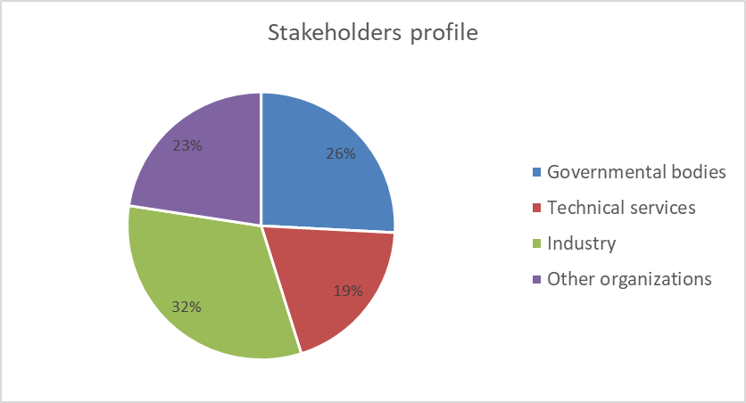
Task 1: Estimate of L-categories fleet representativeness in sound emissions Task 1-1. Feed-back gathering: Contacts
Industrial stakeholders
Technical services and type approval authorities
Department of transport, market surveillance and enforcement authorities
Countries, cities and citizens
Motorcycle and noise concerned associations
Environmental organisations and institutes
Contacts: 336 Replies: 33

Slide 7
Task 1: Estimate of L-categories fleet representativeness in sound emissions Task 1.2. Literature review: Topics
Vehicle life expectancy
Available technologies to reduce sound levels in L-category vehicles
Vehicle average mileage
EU sales of replacement exhausts
Registration per country and per vehicle category
EU countries with technical inspection of L-category vehicles
Urban noise levels
Extra urban noise levels
Average speed in EU cities
Number of EU cities with low-speed areas
Health issues related to noise
Environmental impact of road traffic noise
Average approval sound level values found in ETAES

Slide 8
Task 2: Verification of sound level limit
Objectives
Sub tasks
Verification of the sound levels of vehicles of different technologies available in the market ,by means of real tests performed according to the procedures defined in the current regulatory framework.
Comparison of the obtained results with the sound level limits estimated by means of the survey and literature analysis of task 1.
Task 2.1: Vehicle selection
Task 2.2: Vehicle testing

Slide 9
Task 2: Progress vehicle testing

Slide 10
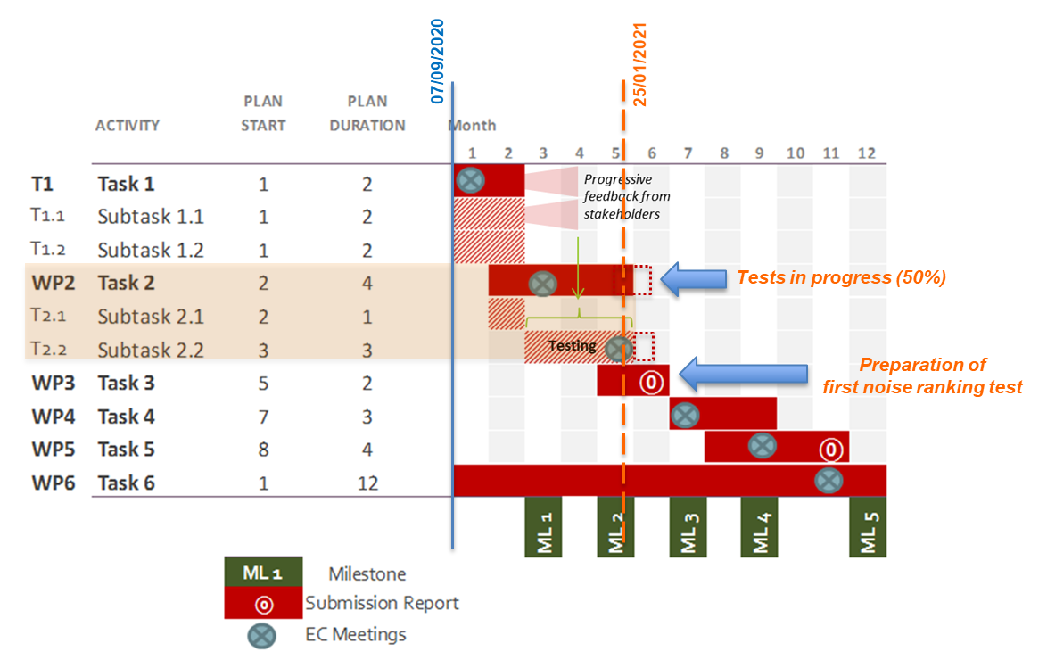
Gantt chart

Slide 11
Task 3: Noise source ranking tests Objective
To quantify the contribution of the different vehicle noise sources to the overall vehicle noise emissions, by determining tests requirements and by analysing the results of such tests.
Starting in week 4

