Slide 1
Transmitted by the expert from EC
Informal document GRBP-73-23
(73rd GRBP, 26-29 January 2021,
agenda item 7)
Study on sound level limits of M- and N-category vehicles
On behalf of the European Commission

Slide 2
Subject and aim of the study
To study the sound level limits of M- and N-category vehicles and investigate on such limits update
Background
M- and N-category vehicles constitute a big part of the European fleet; as a result, they contribute significantly to the overall sound emissions
Consequently, sound emission limits are legislated and need to represent the state of the art sound emission levels
There is legal obligation of the Commission for a detailed study on sound level limits by 1 July 2021 and submit, as appropriate, a legislative proposal – Regulation (EU) No 540/2014
Objectives
Investigate the current sound emission levels of M- and N-category vehicles
Propose possible new (improved) sound level limits for the next phases of the Regulation (EU) No 540/2014 in the coming years
Overall: protect the environment and human health and contribute in the reduction of the so-called ‘noise pollution’ and real-world traffic noise

Slide 3
Task overview and interaction
Completed
Completed
On-going
On-going
On-going

Slide 4
Time plan
 | Month
Task | 1 | 2 |  |  | 3 | 4 | 5 | 6 | 7 | 8 | 9 | 10 | 11 | 12 | 13 | 14 | 15 | 16 | 17 | 18 | 19
1. Estimate of sound level limits for all M- and N-category vehicles
2. Verification of vehicles’ sound level limits
3. Noise source ranking
4. Cost-benefit analysis
5. Validation tests
6. Proposal for limit values and reporting
^{Completed tasks}
^{Time elapsed}
^{Remaining time for each task}
The final report is expected by the end of June 2021

Slide 5
Estimate of sound level limits for all M- and N-category vehicles
Description
Feedback gathering procedure with questionnaire to stakeholders
Literature review to explore the current state-of-the-art sound emissions control technology and analysis of TA databases (KBA and RDW)
Main findings
Sound limits reduction seems feasible (by 1 or 2 dB) for all vehicle categories except for M3 vehicles with PN≤150 and N2 vehicles with PN≤250 kW (to be examined in the CBA)
Testing conditions: Better coverage of operation conditions is considered to be required for thorough sound emissions control
Technology: Potential reductions will require advancements in both vehicle and tyre technology
Additional measures: Regulation enforcement is a recurring item that goes beyond current regulation but is known to provide sound benefits

Slide 6
Vehicle testing (1/5)
Description
Vehicle testing includes CoP tests, ASEP and extended ASEP range testing
Current status
M1, M2, M3, N1, N2 and N3 vehicle testing for Task 2 has been concluded
43/47 of the planned measurements for Task 3 and Task 5 have been completed
Additional testing beyond the agreed test matrix (testing under an extended ASEP range), that will be beneficial for the study’s final outcome
Preliminary test results are shown for M1 (PMR>160) and for M1 sport vehicle (120<PMR<160) – R51.03 and Analysis of Tire Noise Share

Slide 7
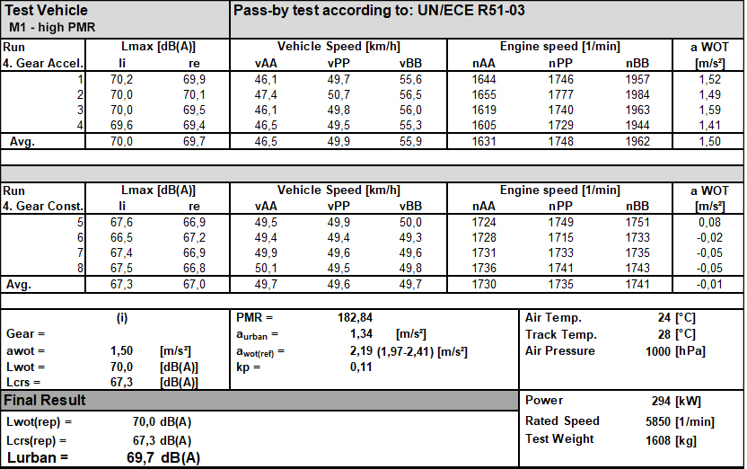
Vehicle testing (2/5)

Slide 8
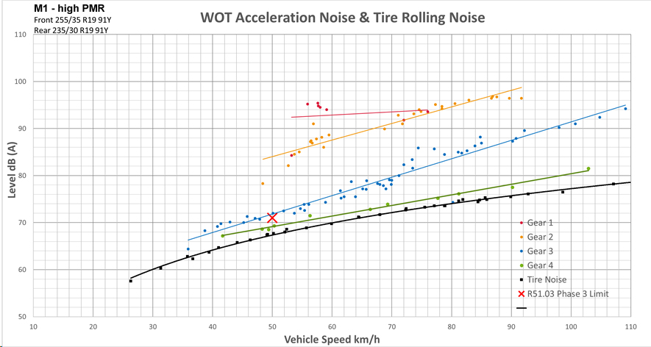
Vehicle testing (3/5)

Slide 9
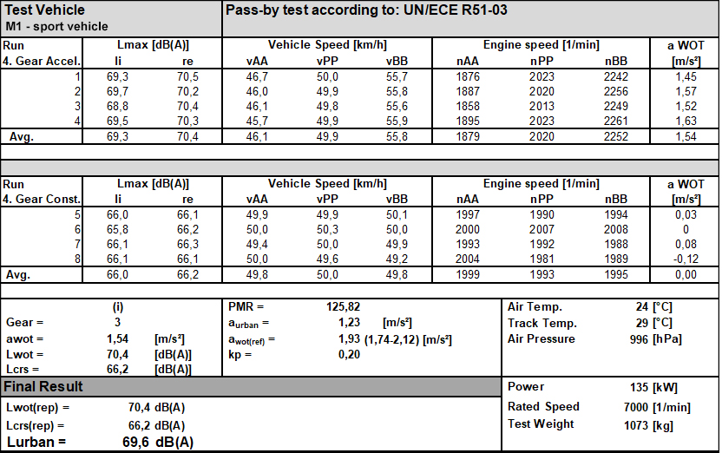
Vehicle testing (4/5)

Slide 10
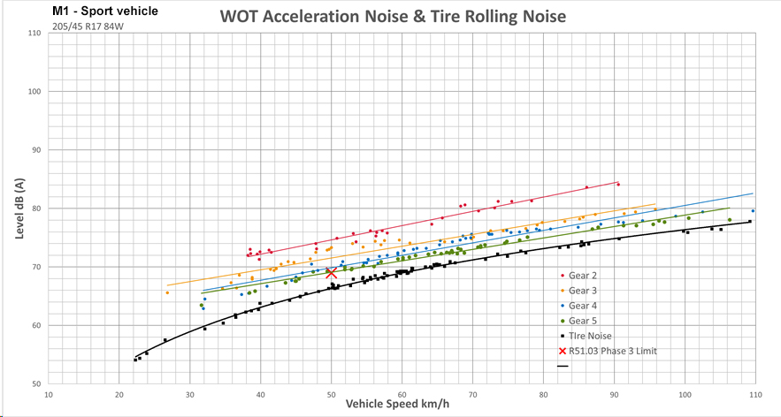
Vehicle testing (5/5)

Slide 11
Cost-benefit analysis (CBA) (1/2)
CBA Topics
- Environmental model and input data
- CBA procedure, costs and benefits
- Description and motivation of scenarios
- Input from consultation, type test databases and new test results
- Scenario analysis and CBA results

Slide 12
Cost-benefit analysis (CBA) (2/2)
Description
Several scenarios in order to assess the economic feasibility of potentially modified sound level limits
Current status
Proposed scenarios for CBA (2020-2045)
Scenario | Remark
0. Baseline | Vehicle and tyre limits as foreseen in Reg. (EU) 540/214 and 2016/1350 stage 2
A. Available limit space | Use available limit space in Lurban and LWOT for all vehicles
B. Targeted limit tightening | Available limit space + tighter limits for cars and lorries/trucks/buses
C. Same as B but with cap at 75 dB(A) | Encouraging electric lorries, trucks and buses
D. Add restriction on LWOT | Encouraging electric cars and reducing engine noise, lower urban noise
E. Expand ASEP range and tighter ASEP limits | Excluding noisier operation modes
F. Tighter tyre limits than stage 2 | Limiting rolling noise

Slide 13
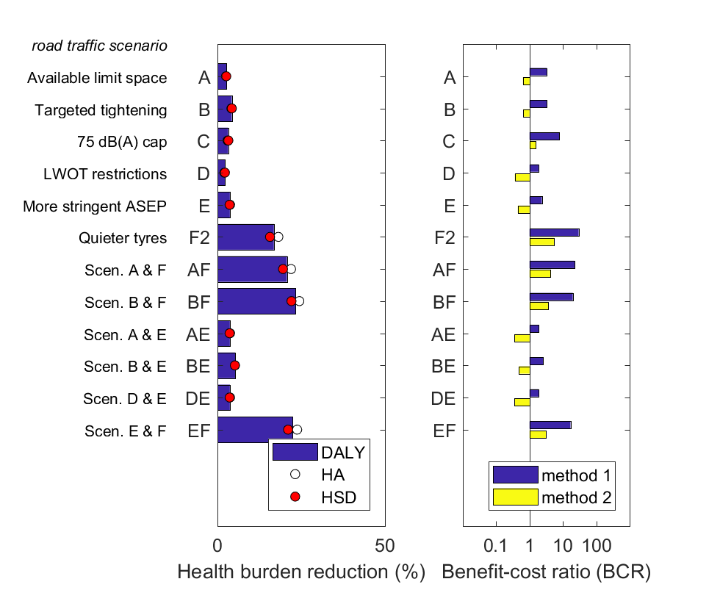
CBA preliminary results
2 methods for health benefits applied
Including 1% traffic growth
Most efficient measures for global health reduction:
Targeted limit tightening from phase 3
Stricter ASEP
2-stage tyre limits 2x 2 dB

