Slide 1
Tyre Industry preliminary Wet Grip on Worn tyre assessment on C2 and C3 tyres
Informal document GRBP-73-22
Agenda item 5 (d)
GRBP session 73, January 2021
European Tyre and Rim Technical Organisation

Slide 2
Outlines
Background
Hydroplaning phenomenon
Tyre Industry preliminary assessment on C2 and C3 tyres
Conclusions
European Tyre and Rim Technical Organisation 1

Slide 3
1. background
GRBP IWG WGWT was requested by EC to extend its scope to C2 and C3 tyres (Documents GRBP-72-02 and GRBP-73-02)
During the 72nd GRBP session, tyre industry preliminary considerations were provided to GRBP by the Informal Document GRBP-72-26-Rev.1
Aim of this document is to provide GRBP the technical evidence of Tyre Industry experience.
European Tyre and Rim Technical Organisation 2

Slide 4
1. background
ETRTO comments made during 72nd GRBP
C1: the initial purpose from France: C1 wet grip condition test in new state are not sufficient. Tyres have also to be tested in the worn state because wet grip (braking) tyre ranking in the worn state can be different than ranking in the new state, due in particular to the hydroplaning mechanism important in the worn state
C2 and C3: due to the higher ground pressure and lower speed in field conditions the mechanism is different than for C1, and C2 and C3 tyres are less or not subject to hydroplaning in the regulatory test (C2 and C3 wet grip test from 60 kph to 20 kph while for C1 it is from 80 kph to 20 kph). Due to less hydroplaning contribution in the wet grip test of worn C2 and C3 tyres, the wet grip performance loss according to the test conditions between new and worn state for C2 and C3 is much lower compared to C1.
Industry experience is that there is no significant difference in wet grip (braking) performance ranking between new and worn state for C2 and C3. Because of this, the testing of new tyres is sufficient to ensure the wet grip performance in worn state.
European Tyre and Rim Technical Organisation 3

Slide 5
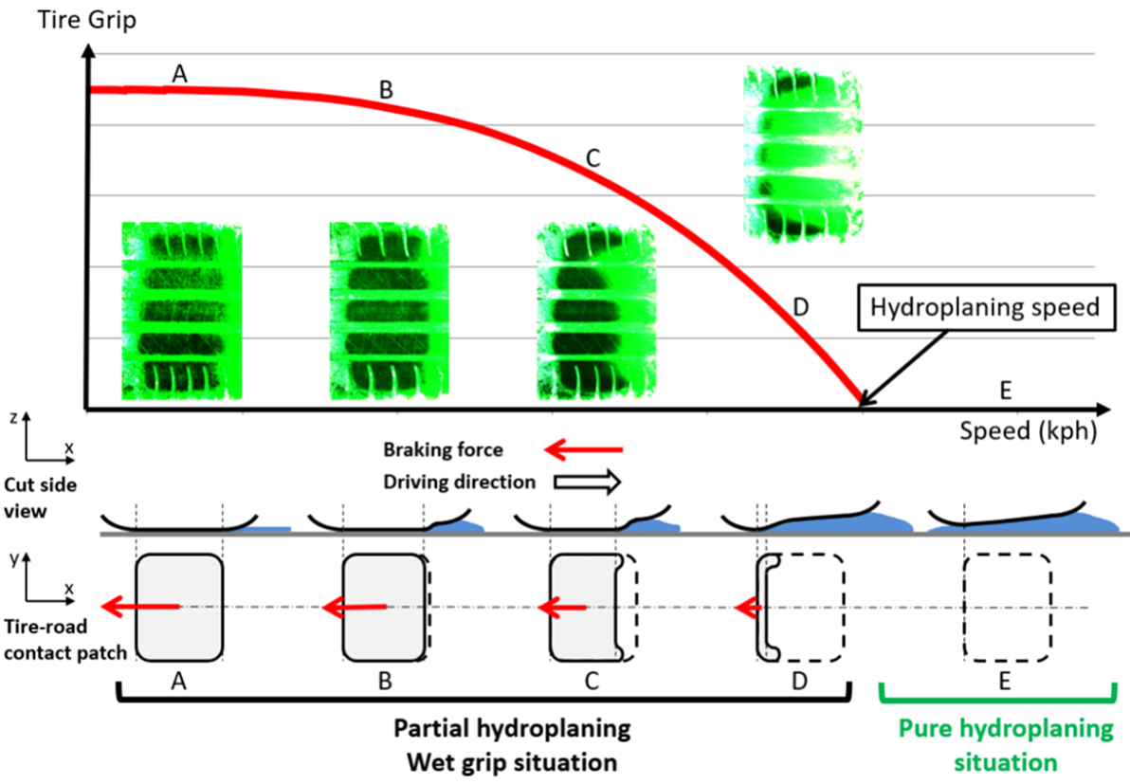
2. Hydroplaning phenomenon
European Tyre and Rim Technical Organisation 4

Slide 6
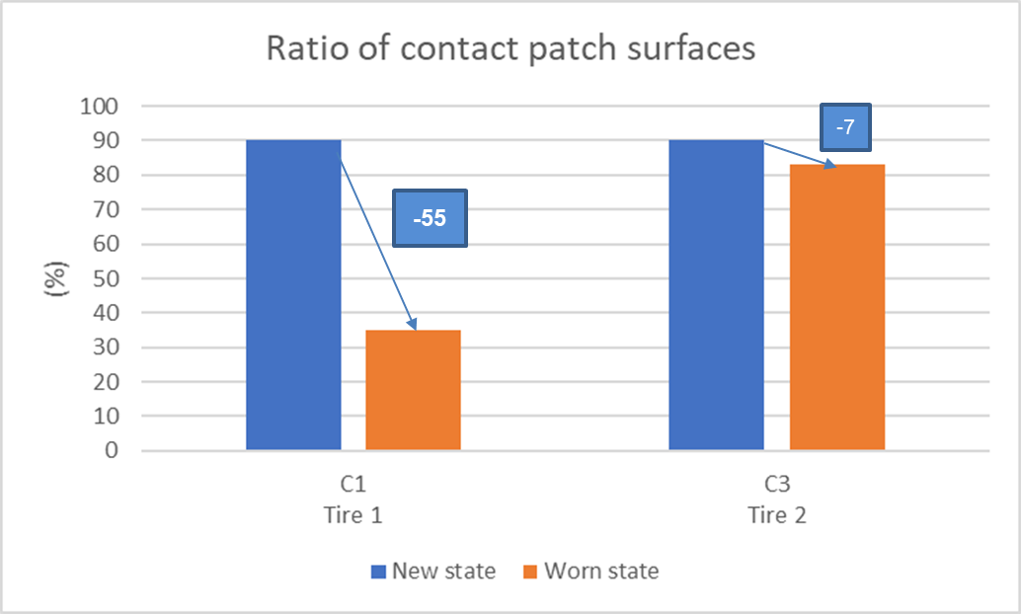
2. Hydroplaning phenomenon
C2 and C3 tyres: due to the higher ground pressure and lower speed in field conditions the mechanism is different than for C1, and C2 and C3 tyres are less or not subject to hydroplaning
(*)
(*) Contact patch surface at 90 km/h compared to contact patch surface at 30 km/h
European Tyre and Rim Technical Organisation 5

Slide 7
3. Tyre Industry preliminary assessment on C2 and C3 tyres
Tyre Industry assessed the possible scope extension of the IWG WGWT to C2 and C3 by generating preliminary data.
Comparison of average Wet Grip performance drop C1, C2 and C3
Comparison of New / Worn ranking assessment for C1, C2 and C3
European Tyre and Rim Technical Organisation 6

Slide 8
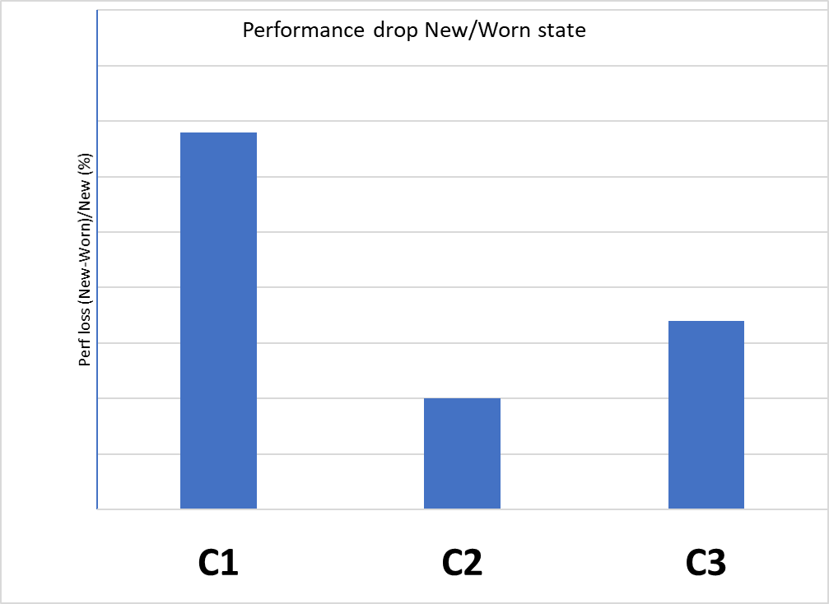
3. Tyre Industry preliminary assessment on C2 and C3 tyres
a. Comparison of average wet grip performance drop C1 (ref GRB-69-08), C2 and C3 (*)
40
30
20
10
0
The wet grip performance drop for C2 and C3 is significantly lower than C1
(*)C2 and C3: ETRTO data based on deceleration test method
European Tyre and Rim Technical Organisation 7

Slide 9
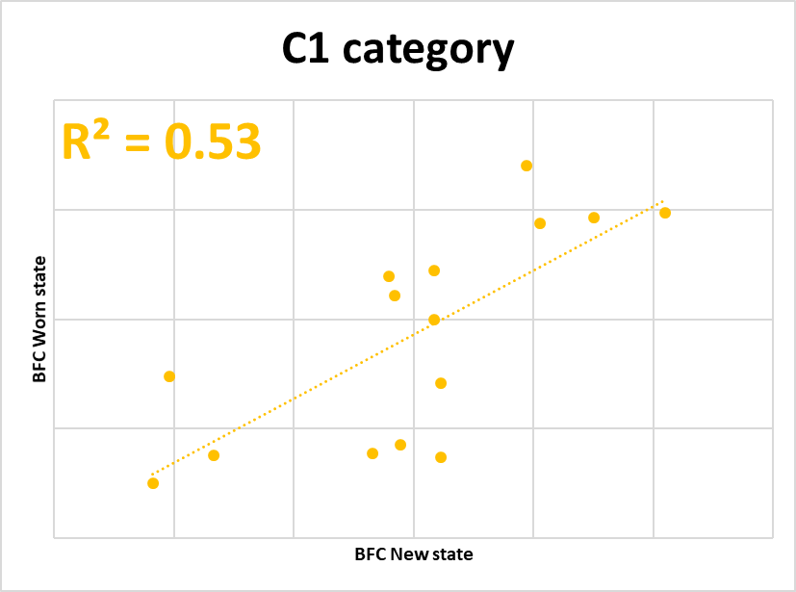
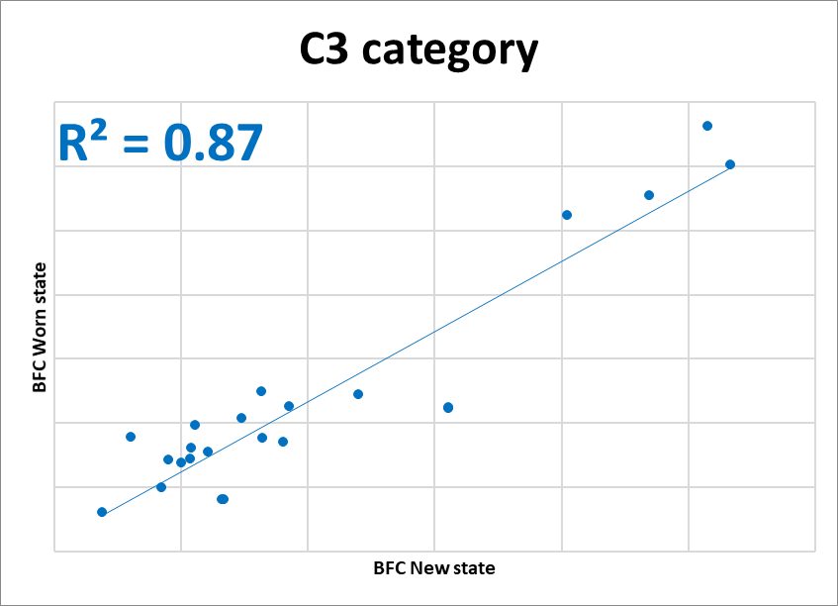
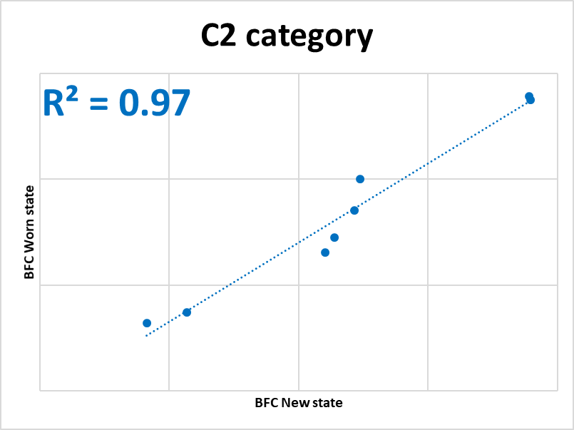
3. Tyre Industry preliminary assessment on C2 and C3 tyres
b. Comparison of New / Worn ranking assessment for C1 (GRB-69-08, C2 and C3 (*)
The correlation factor R² for C2 and C3 is significantly higher than C1 → strong wet grip performance correlation between new and worn stage
(*)C2 and C3: ETRTO data based on deceleration test method
European Tyre and Rim Technical Organisation 8

Slide 10
4. Conclusions
The Tyre Industry assumptions/experience, as mentioned in GRBP 72nd session were confirmed for C2 and C3 tyres in this study:
- The Wet Grip performance drop for C2 and C3 is significantly lower than for C1.
- No significant difference in Wet Grip performance ranking between New and Worn tyre for C2 and C3 tyres (as found for C1 tyres)
The Wet grip performance of new C2 and C3 tyres is representative for wet grip performance in worn state.
European Tyre and Rim Technical Organisation 9

