Slide 1
Submitted by the expert from France | Informal document GRB-73-20-Rev.1 (73rd GRBP, 26-29 January 2021, agenda item 5 (a))

Slide 2
NEW Radial structure Definition proposal in UN Reg. 30
GRBP - 73th session – JANUARY 2021
Informal document linked to informal document 72-24

Slide 3
Background
A tyre manufacturer applied to get an EC type-approval in respect of a type of tyre that incorporates a new architecture.
This new architecture has the functionalities of a Radial tyre (mechanical decoupling of the summit and the bead), but strictly speaking, does not meet the regulatory definition of a radial structure, insofar as the condition " are laid substantially at 90° " is not everywhere respected, especially under the summit of the tyre.
As this structural architecture opens new radial tyres performances possibilities, the followings actions have been done:
Based on R30 and R117 tests results, France granted as a first step provisional approvals to this tyre type for use in France only. As a second step, France has been authorized by EC to grand an EC type approval.
As Radial definition revision is necessary, France propose a working document to upgrade the “radial” definition of the UN-ECE regulations.

Slide 4
SUMMARY
Reminder : radial definition proposal
Macro risk analysis
Conclusions

Slide 5
Reminder: proposal (including EC amendment)
Paragraph 2.9.3., amend to read:
"2.9.3. "Radial" or "radial-ply" describes tyre structure in which the ply cords extend to the beads and are laid substantially at 90° to the centre line of the tread, the carcass being stabilized by an essentially inextensible circumferential belt in a zone including most of the side wall and [located] outside the bead and the essentially inextensible circumferential belt that stabilizes the carcass;"
Justification: It is proposed to clarify in the amended radial tyre definition the common points with the currently applicable definition, so that both state-of-the-art and potentially innovative features of a radial structure are included in this amended definition.

Slide 6
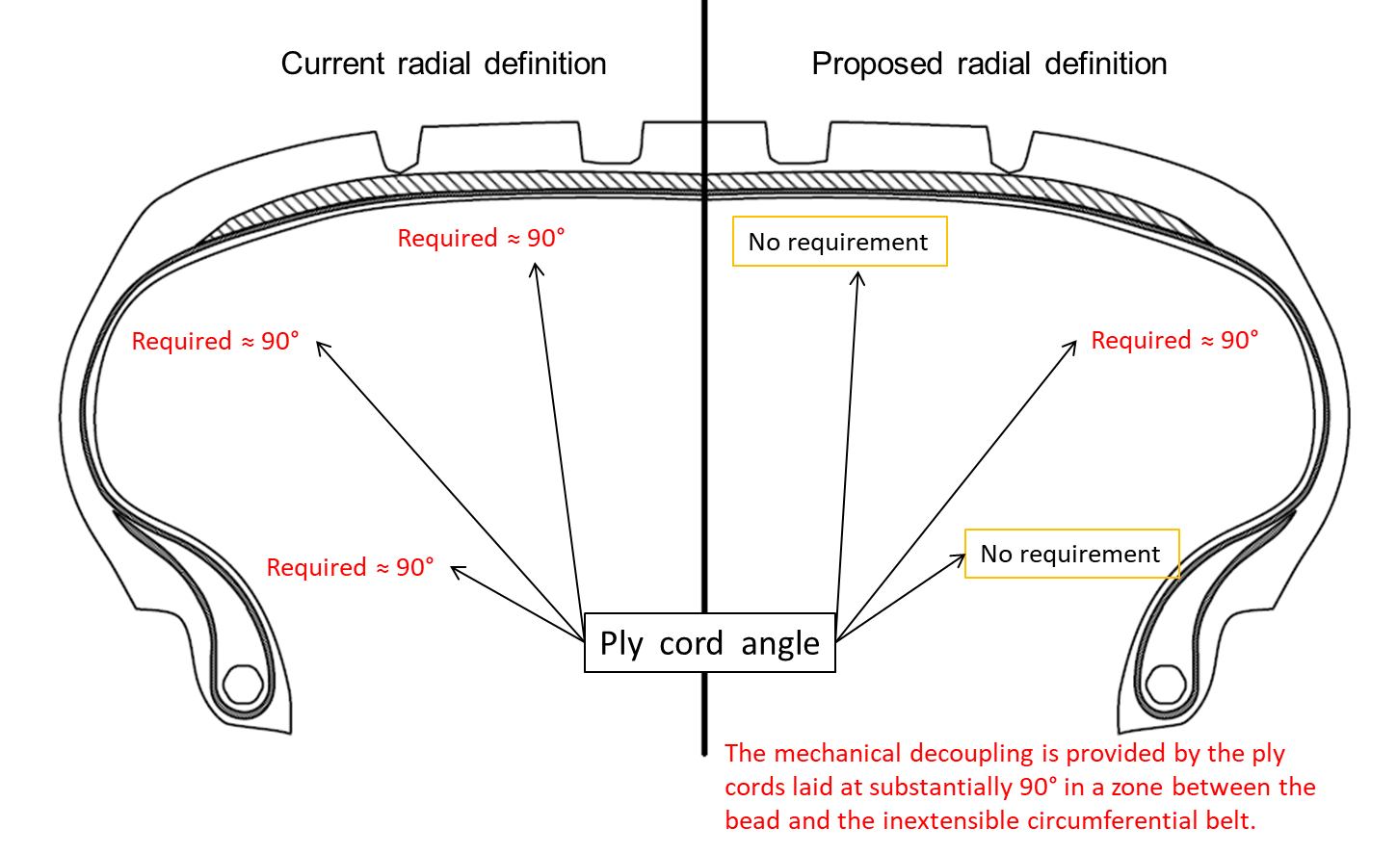
Reminder: summary of the proposal

Slide 7
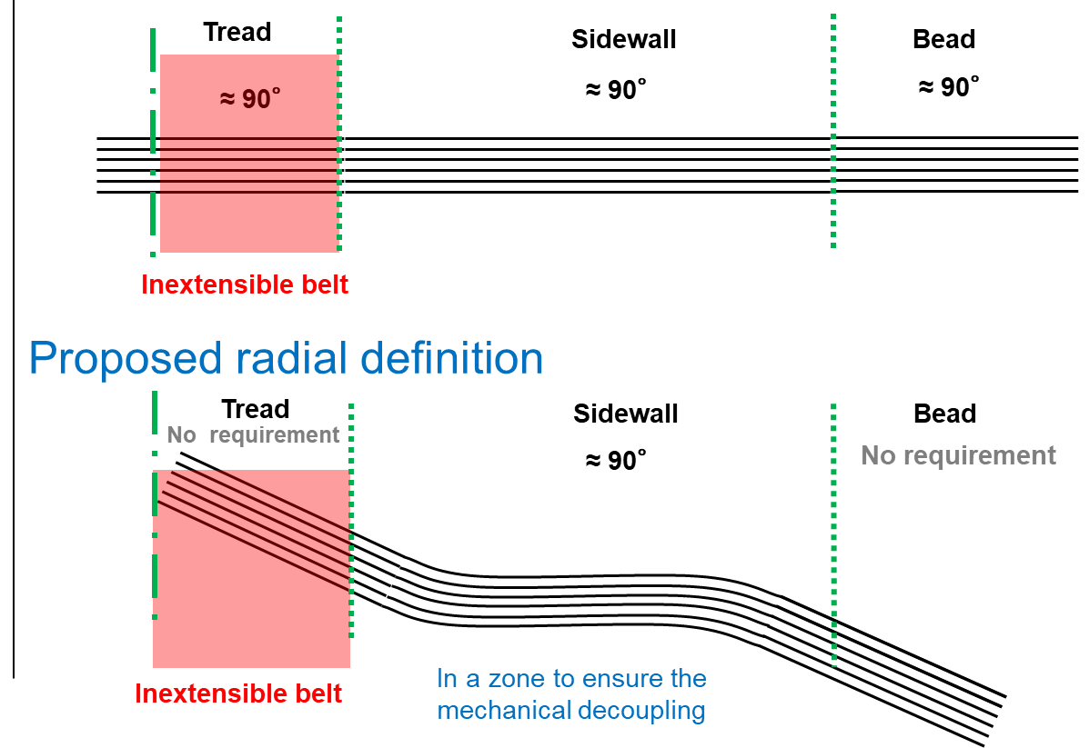
Current radial definition

Slide 8
Macro risk analysis
Formally, a risk analysis can only be carried out on a future solution that is precisely defined and characterized
Nevertheless, the following examples of possible use of both current and proposed radial definitions show that the proposed definition does not significantly increase a risk that exists already with the current definition
Typical questions:
1/ Can a bias tyre fall into the proposed radial definition ?
2/ Can the proposed definition allow « less radial » tyres than today ?
3/ Can the proposed definition increase the difference within a regulatory tyre
type (axle mixability) ?

Slide 9
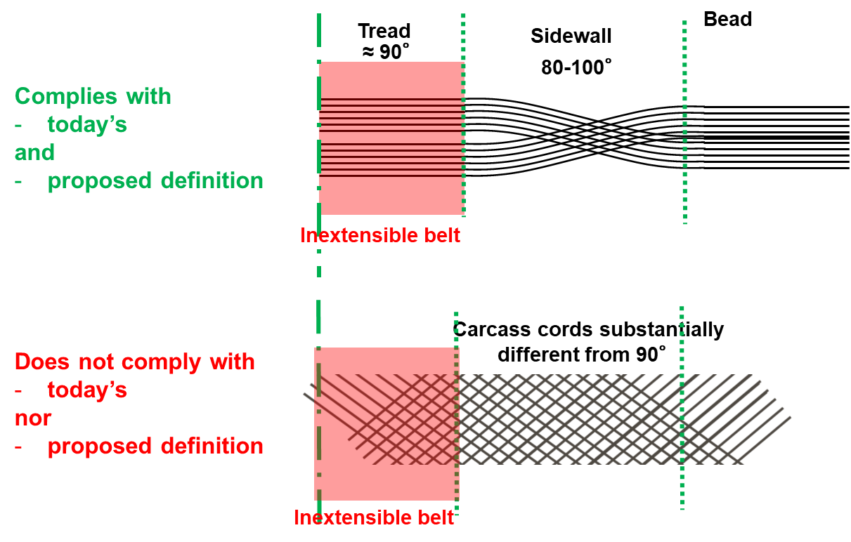
1) Can a bias tyre fall into the radial definition ? Same situation as today Def. Bias means « ply cords laid at alternate angles substantially less than 90°»
Radial maxi state of the Art
Bias tyre

Slide 10
2/ Can the proposed definition allow « less radial » tyres than today ? Current definition does not necessary guarantee a minimum mechanical decoupling between tread and bead zone. The proposed definition does not introduce additional risk on that point compared to today’s definition.
≈ 90°
≈ 90°
≈ 90°
Mechanical decoupling
Additionnal inextensible belt
Mechanical decoupling
Additionnal inextensible belt
Complies with
both definitions
Additionnal inextensible belt
Mechanical decoupling ?

Slide 11
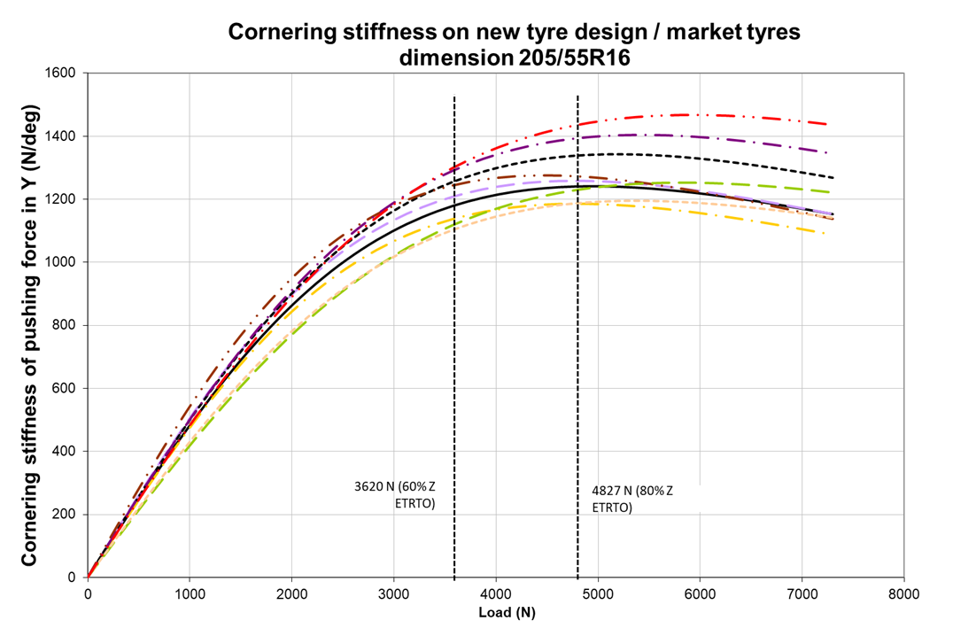
3/ Can the proposed definition increase the difference within a regulatory tyre type (axle mixability) ? There can be more differences between A and B (radial tires complying with today’s definition) than between A and C current vs. proposed definition).
Current definition
A
B
C
A
B ?
Proposed definition
C

Slide 12
3/ Can the proposed definition increase the difference within a regulatory tyre type (axle mixability) ? Both constructions comply with the radial definition (both current and proposed). Radial definition alone does not guarantee axle or even vehicle mixability (in the end, this will be managed and ensured by the tyre manufacturer)
Tread
Sidewall
Bead
+/- 50°
≈ 90°
0°
No shearing stiffness

Slide 13
CONCLUSIONS The current radial definition allows already a very wide range of technical solutions that can lead to very different tyre behaviors. The new definition allows potentially innovative features, nevertheless existing approved radial tyres still comply with the proposed amended radial definition (no additional requirements), and there is no change on the type definition in UN Regulation N° 30. Like today, each tyre manufacturer must manage its regulatory types and therefore the mixability on the same axle/vehicle, in agreement with the Type Approval Authority. The new proposed definition does not significantly increase this risk and does not allow bias tyres to be approved as radial tyres. This means that investigating the full range of possible solutions complying with the proposed definition would also have to be done for the current definition. In the end, the intrinsic risks are much more linked to the tyre design that to the radial structure definition itself. Within the current Radial definition, radial behavior is essentially ensured by the decoupling between the summit & the bead in the sidewall. The proposed definition will maintain the situation.

