Slide 1
ETRTO Tyre Performance Study
Informal document GRBP-73-11
Agenda item 5
GRBP 73rd session January 2021
European Tyre and Rim Technical Organisation

Slide 2
Outlines
Background
Aim of the study
Test program
Overview test results
Statistical analysis
Learnings
Overall conclusions

Slide 3
1. Background
Traffic noise mitigation programs
Revision of EU regulation on vehicle noise
Advice of Tyre Industry

Slide 4
2. Aim of the study
Trade-off study of C1 tyre performances (regulated and non-regulated)
Complete test program was performed by stand alone company: UTAC CERAM, France. This presentation is based on final UTAC CERAM report.
Objective of tyre testing evaluation
To illustrate the reciprocal interaction of tyre performance parameters;
To evaluate the influence of the rolling sound emission reduction of tyres regarding their essential parameters in order to provide the results to the CPs.
Tyre Industry Target
To provide the CPs the necessary information regarding the consequences of possible additional tightening of the limits, considering the overall balance between performances subject to legal requirements (Rolling Resistance, Wet Grip and Rolling Sound emission regulated by UN Regulations) and other performances not subject to legal requirements.

Slide 5
3. Test Program - Tested Tyres
  Size 205/55 R16, the most common size on European replacement market (15%), with load index of 91 or 94 and speed index of H, V or W.
  10 different sets of tyre references from different brands, covering different applications and a wide range of rolling sound emissions.
    6 sets of Normal tyres (summer)
    2 sets of Snow tyres for use in severe snow conditions (3PMSF)
    2 sets of plain tread tyres
      Plain tread tyres are used by the Tyre Industry during the development phase.
      A tread pattern can be hand carved in the plain tread for the development of a tread design. Therefore, a plain tread tyre is different from a slick tyre since a slick tyre is intended to be used as a tyre without tread pattern.
      Two plain tread tyres are used from different brands, having different construction and compound.

Slide 6
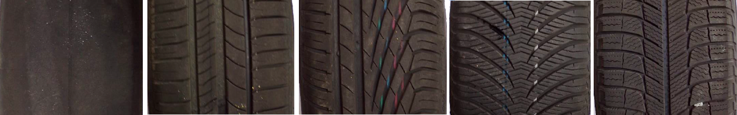
3. Test Program - Tested Tyres
  To give an impression on the variety of tyres as used in this study,
  a number of tread patterns are shown below.
  From plain tread, to several types of normal tyres towards Snow (3PMSF) tyres.
List | Tread type
A | Plain tread winter
B | Plain tread summer
C | Snow (3PMSF)
D | Normal
E | Normal
F | Normal
G | Normal
H | Normal
I | Snow (3PMSF)
J | Normal

Slide 7
3. Test Program - Test performed and used test methods
Rolling resistance UNECE R117
Bench test
RR index
Rolling sound UNECE R117 & R51.03
Vehicle test
sound emission level in different conditions
Wet grip UNECE R117
Trailer method test on wet surface
Wet Grip Index
Dry grip Similar to UNECE R117 (but on dry surface)
Trailer method test on dry surface
Dry grip performance
Dry handling Flat track Method proposed by ETRTO
Bench test
Cornering stiffness
Aquaplaning VDA E08 & VDA E05
Vehicle test
Aquaplane performance in straight line and cornering conditions

Slide 8
3. Test Program - Test conditions
Rolling resistance
- UNECE R117 procedure on test drum with the torque method
- Test Speed [km/h]: 80
- Load [kg]: 492
- Initial tyre pressure [kPa]: 210
- Room temperature [°C] 24<T<25
Rolling sound
- UNECE R117 procedure, 8 passes between 70-90 [km/h]
- UNECE R117 procedure, 4 passes between 45-55 [km/h]
- UNECE R51 procedure, 4 accelerations and 4 constant runs with ICE vehicle: VW Golf
Additionally L Urban is calculated according to UNECE R51
- UNECE R51 procedure, 3 accelerations and 2 constant runs with Electric vehicle: Nissan Leaf
Accelerations with the EV are spread between 1 and 2 [m/s²] and interpolated to 1.45 [m/s²] as a final value
Wet grip
- UNECE R117 procedure with a skid trailer
- Test speed [km/h]: 65
- Water depth [mm]: 0.9
- Load [kg]: 461

Slide 9
3. Test Program - Test conditions
Dry grip
- UNECE R117 procedure with a skid trailer
- Test speed [km/h]: 65
- Dry surface
- Load [kg]: 461
- Direct comparison with reference tyre, no corrections for temperature or track.
Dry handling Flat track
- Procedure proposed by ETRTO performed on a MTS Flat track test bench
- Test speed [km/h]: 80
- Test loads depending on the LI of the tyre
Aquaplaning
- VDA E08 procedure for longitudinal aquaplaning performance performed with a Peugeot 308
- VDA E05 procedure for lateral aquaplaning performance performed with a Peugeot 308

Slide 10
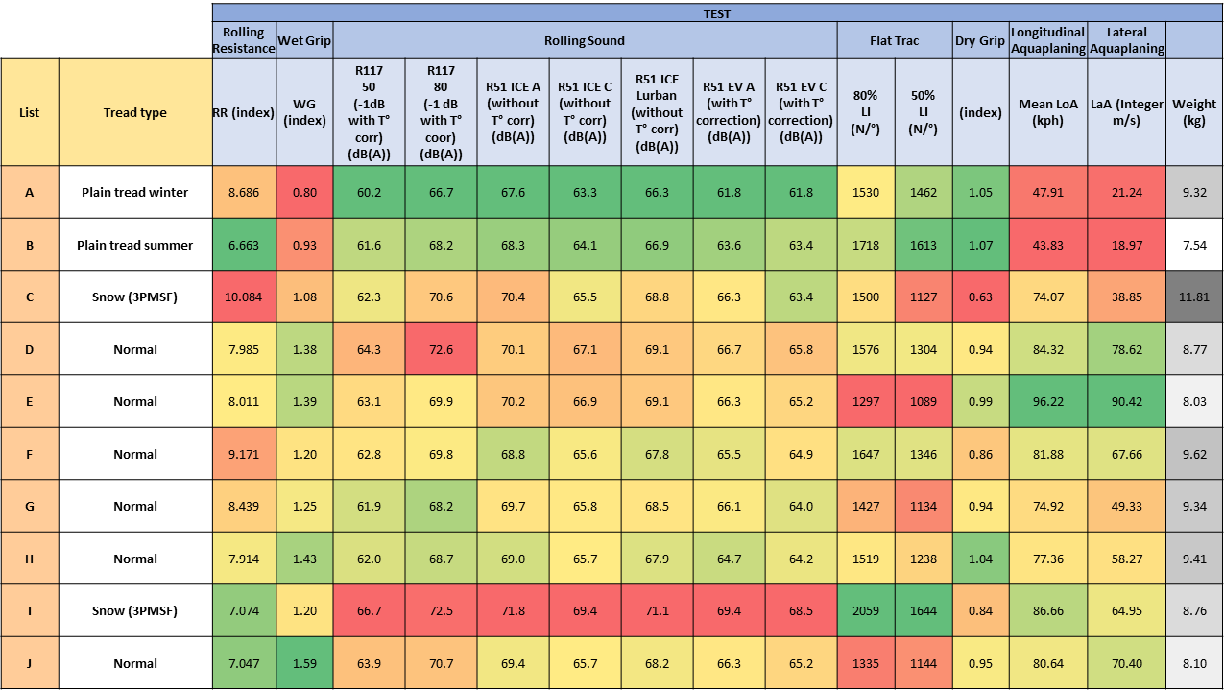
4. Overview Test Results
Result table

Slide 11
5. Statistical analysis
The goal of this study is to analyse the influence of the noise reduction of the tyres regarding their essential tyre performances. The statistical analysis is composed of three main stages:
Visualizing for several tyres all tests measurements by means of radar charts
Studying two by two correlations with scatter plots
Visualizing Rolling Sound Emission versus all of the other 7 tyre performances (Rolling Resistance, Wet Grip, Flat Trac 80%, Flat Trac 50%, Dry Grip, Longitudinal Aquaplaning and Lateral Aquaplaning).
  For the third stage as it is in high dimension, we use a dimension reduction (factorial) method (which is Principal Component Analysis) to select directions of maximum variability and summarize data minimizing the information loss.
  We will keep the first three principal components, and thus interpret the representations of noise versus each of these three components.

Slide 12
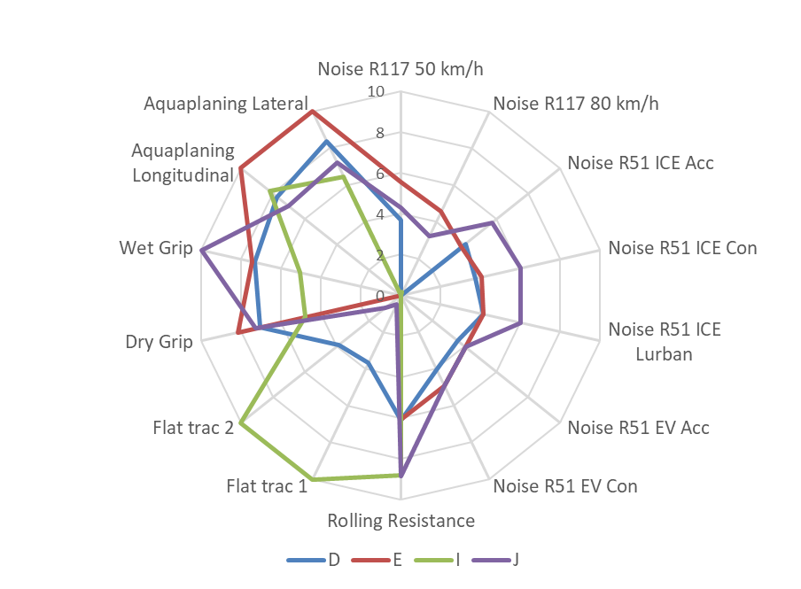
5. Statistical analysis – Radar charts
The 4 best tyres for Wet Safety
Rating:
0 is defined by:
the worst tyre of the sample
10 is defined by:
the best tyre of the sample
Best for Wet Safety ➔ Worse for Rolling Sound Emission

Slide 13
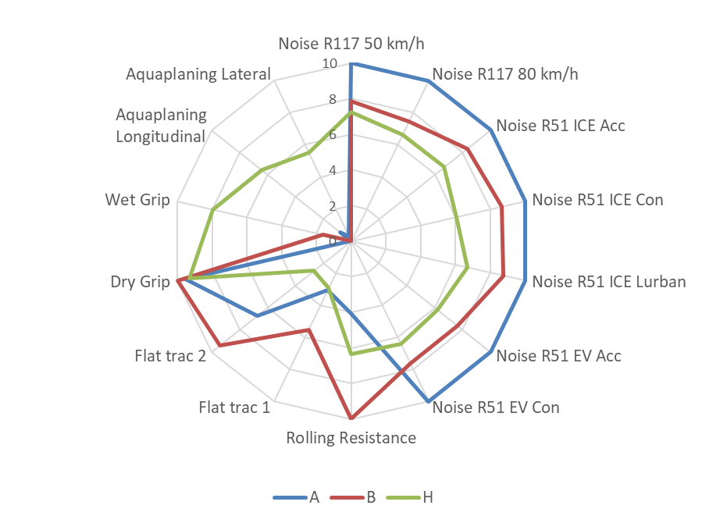
5. Statistical analysis – Radar charts
The 3 best tyres for Rolling Sound Emission
Rating:
0 is defined by:
the worst tyre of the sample
10 is defined by:
the best tyre of the sample
The lowest tyre rolling sound emission was achieved by plain tread tyres (not available on the market) by worsening the performances safety related (wet grip and hydroplaning resistance) at very poor level.
Best for Rolling Sound Emmission ➔ Worst for Aquaplaning

Slide 14
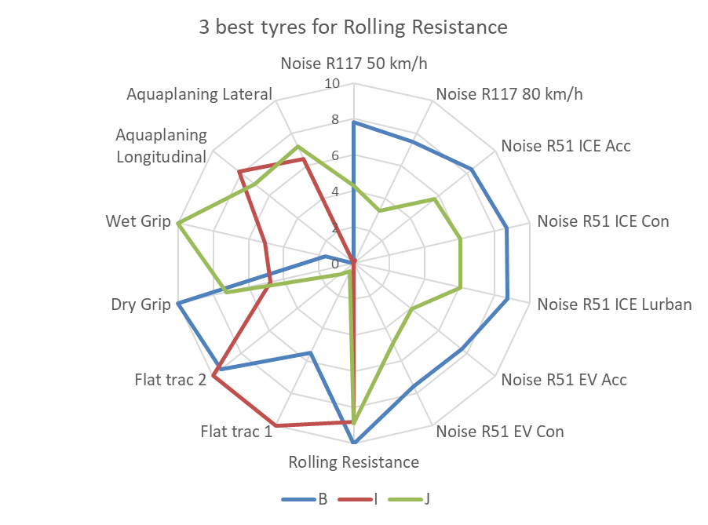
5. Statistical analysis – Radar charts
The 3 best tyres for Rolling Resistance
Rating:
0 is defined by:
the worst tyre of the sample
10 is defined by:
the best tyre of the sample
No clear visible correlation between
Rolling Resistance Coefficient and Rolling Sound Emission

Slide 15
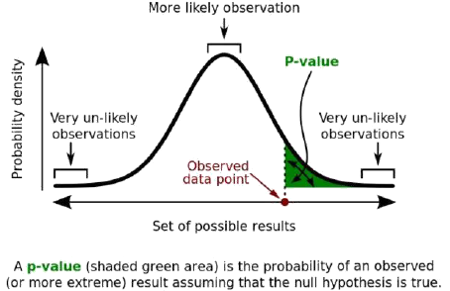
5. Statistical analysis – Scatter Plots
The P-value or probability value is, for a given statistical model, the probability that, when the null hypothesis is true, the statistical summary would be greater than or equal to the actual observed results.
In our case the hypothesis is “there is no correlation between characteristics”.
In other words, if p-value is low then our hypothesis is false and we can conclude that there is a correlation. The admitted threshold value is 5%.

Slide 16
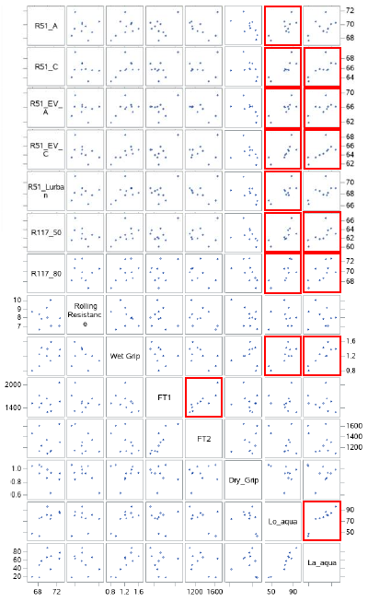
5. Statistical analysis – Scatter Plots
In the chart of scatterplots, red boxes show strong probability of correlation (P-value < 5%).
Due to the large amount of data it is difficult to analyse the data.
However, this tool allows us to show direct relationship between the parameters.

Slide 17
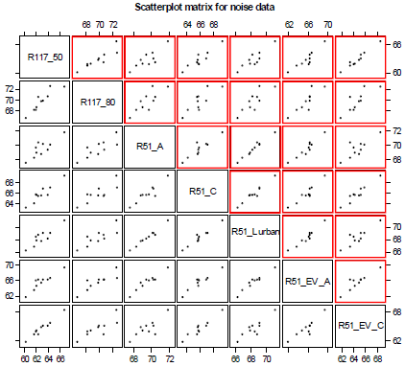
5. Statistical analysis – Scatter plots
Rolling Sound – Scatter plots
To simplify the comparison, it was checked if all the rolling sound performances can be presented using only 1 performance.
Comparison between each rolling sound test with P-value <1%.
Red boxes show strong probability of correlation.

Slide 18
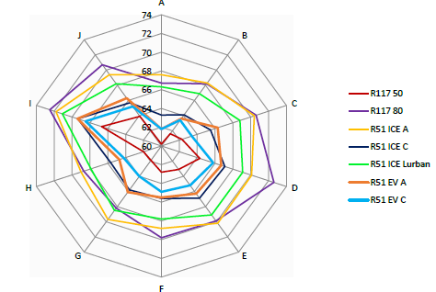
5. Statistical analysis
Rolling Sound – Radar chart
Even though the correlations are shown, there are some important remarks to make:
At first glance, the majority of the tests
seems to follow the same trend.
However, it can be seen that
there are ranking inversions
between the tyres.
the offset between the the tyres
is by far not constant.
It looks that the correlation analysis shows that the acoustic characteristics concerning R51.03 (Vehicle measurement) and R117.02 (Tyre measurement) at different velocities are correlated and can be represented by only one in this study. However, it is to be noted that this correlation is a linear statistical correlation and not determinist rule and we observe some rank inversion in this sample.

Slide 19
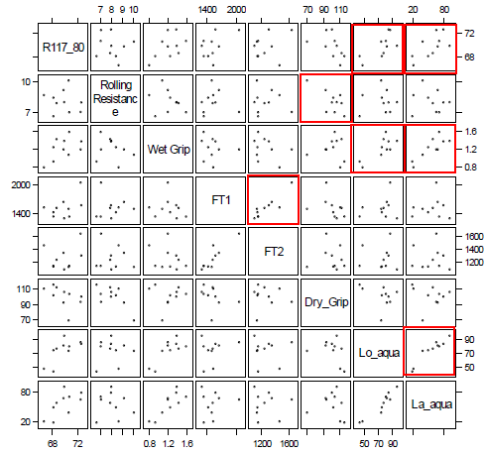
5. Statistical analysis – Scatter plots
Same data as before however now using the R117 at 80 km/h rolling sound emission result as a substitute for the rolling sound emission test methods.
Red boxes show very probability of correlation (P-value <5%)
See next slide for visualisation of the items marked in blue as an example:
R117_80 and Lo_aqua / La_aqua

Slide 20
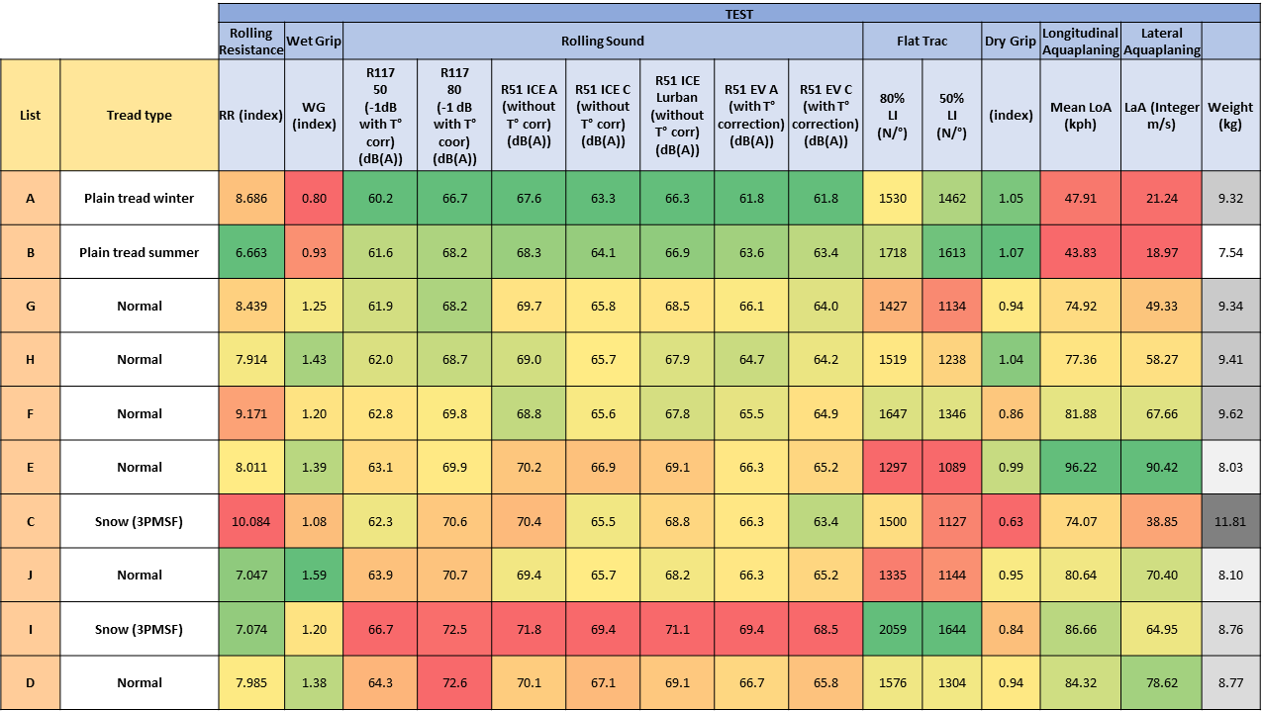
5. Statistical analysis
Scatter Plot
Strong probability of opposite correlation (P-value < 5%) between R117 80 km/h
and both Aquaplaning longitudinal and lateral. Data is sorted (low to high) on
R117 80 km/h.

Slide 21
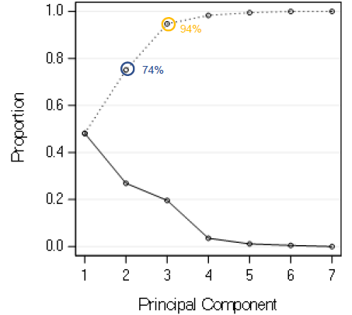
5. Statistical analysis – Principal Component Analysis
Principal Component Analysis (PCA)
Multidimensional analysis
Reduce the 7 studied characteristics, being:
Rolling Resistance
Wet grip
Flat trac 80%
Flat trac 50%
Dry Grip
Longitudinal Aquaplaning
Lateral Aquaplaning
to a total of 3 variables.
Cumulative inertia of the first 3 axis
is 94%.
First 3 axis represent 94% cumulative inertia
First 2 axis represent 74% cumulative inertia
47%
First axis represents 47% inertia

Slide 22
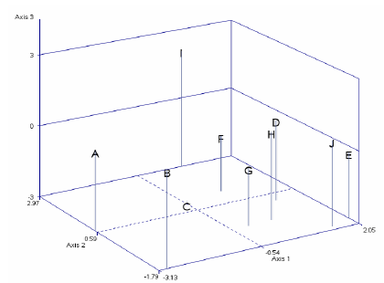
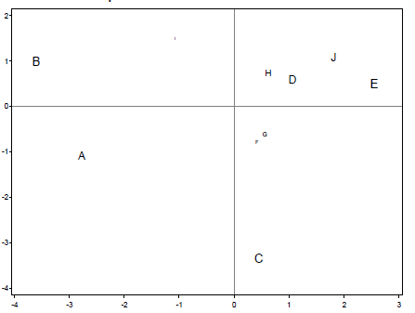
5. Statistical analysis – Principal Component Analysis
From 3 axis to 2 dimensional representation:
The bigger the letters, the more the axis is driven by the tyre in comparison to the other tyres for this 10 tyres sample.
The smaller the letters, the less the axis is driven by this tyre in comparison to the other tyres for this 10 tyres sample.

Slide 23
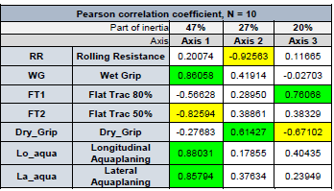
5. Statistical analysis – Principal Component Analysis
Axis 1 mainly represents Wet Grip, Longitudinal Aquaplaning, Lateral Aquaplaning but also by Flat Trac 50%.
This axis should be understood as the most representative for Wet Safety performances, but is also driven by opposite performance on Flat Trac 50%
Axis 2 mainly represents Rolling Resistance and Dry Grip
This axis should be understood as most representative for CO₂ emissions and a portion of Dry Grip.
Axis 3 mainly represents Flat Trac 80% and Dry Grip

Slide 24
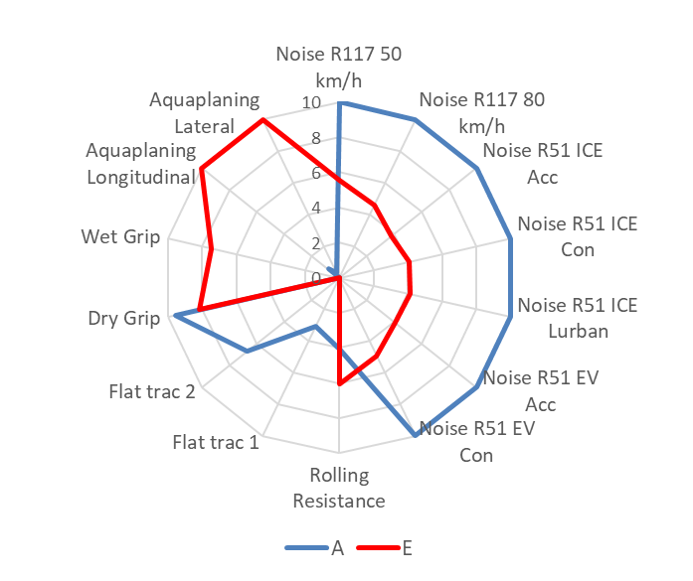
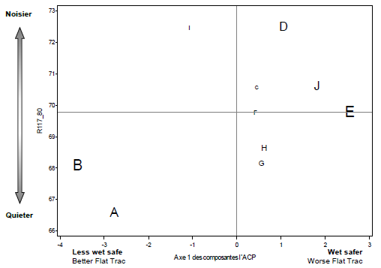
5. Statistical analysis – Principal Component Analysis
Axis 1
Axis 1 mainly represents Wet Safety performances.
The statistic concerning our sample of 10 tyres shows a conflict between Rolling Sound and Safety on Wet Surfaces.
Focus on tyre A and E
Axis 1

Slide 25
6. Learnings
This study offers test results which allow to assess influence of performance parameters to each other and particularly Rolling Sound Emission versus other parameters
A correlation analysis shows that the five acoustic characteristics concerning R51.03 (Vehicle measurement) and R117.02 (Tyre measurement) at different velocities are correlated and can be represented by only one in this study. However, it is to be noted that this correlation is a linear statistical correlation and not determinist rule and we observe some rank inversion in this sample.
The lowest tyre road Rolling Sound Emission was achieved by plain tread tyres (not available on the market) by worsening the performances safety related (wet grip and hydroplaning resistance) at very poor level.
Plain tread tyres represent an asymptote for Rolling Sound Emission but are forbidden for road use because they cannot guarantee the minimum safety requirements.
Overall conclusions drafted here are based on one size, representative of the market. However, it may be not directly transposed on some other sizes (very narrow or extremely low aspect ratio tyres).

Slide 26
7. Overall conclusions
This study shows that Rolling Sound performance is in trade-off with Wet Safety performances at least on the study sample. These performances are in opposition, good rolling sound performances implies less good wet safety performances.
The study shows that some existing tyres are already close to rolling sound emission physical limits and further reduction of to rolling sound emissions will irremediably impact other tyre performances.

Slide 27
Thank you

Slide 28
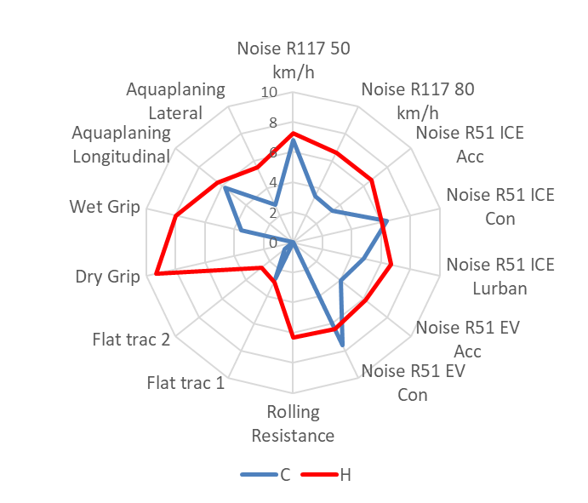
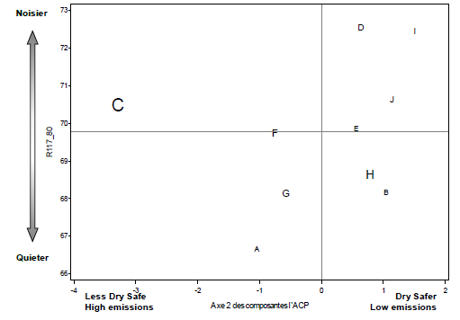
5. Statistical analysis – Principal Component Analysis
Axis 2
Axis 2 is mainly directed by Rolling resistance and the Dry Grip test.
Simple conclusion cannot be drawn on this axis.
Focus on tyre C and H
Axis 2

Slide 29
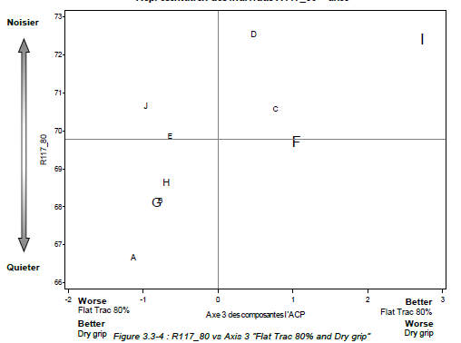
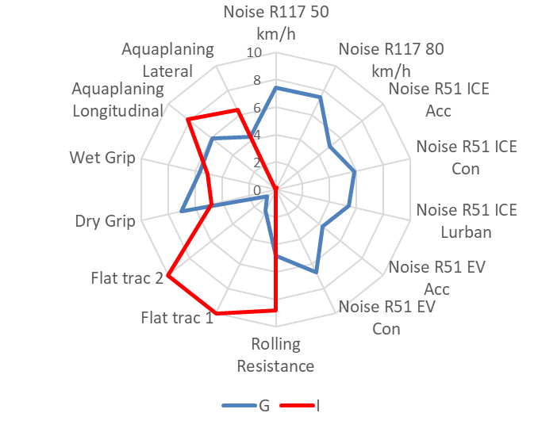
5. Statistical analysis – Principal Component Analysis
Axis 3
Axis 3 mainly directed by Flat Trac 80% and the Dry Grip test.
Simple conclusion cannot be drawn on this axis.
Focus on tyre G and I
Axis 3

Slide 30
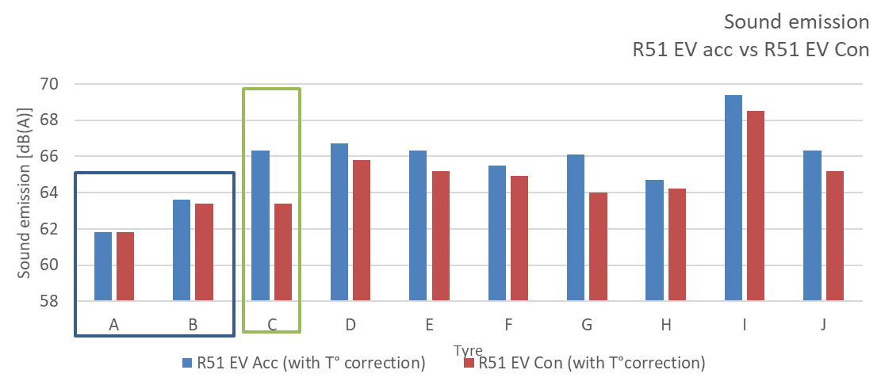
Annex
Rolling sound emission R51 accelerated versus R51 constant speed
Example 1: Change in ranking under acceleration (3PMSF vs Normal)
C noisier than F in R51 EV a
F Noisier than C in R51 EV c
Slick tyres show no significant change under acceleration
Example 2: Change in ranking under acceleration (2 normal tyres)
G noisier than F in R51 EV a
F noisier than G in R51 EV c

Slide 31

Annex
Rolling sound emission R51 accelerated versus R51 constant speed
Rolling sound emission build up of the two parts of the test:
R51 Constant speed R51 Accelerated
Since the rolling sound emission from constant speed is part of both tests, as it represents:
the total sound emission level for the constant speed test
the basic sound emission level for the accelerated test
→ it is evident that a low P-value showing a high level of probability for correlation can be found.
However, that does not state that there is a deterministic rule.
+
Sound emission from
Constant speed
Sound emission from
Constant speed
Sound emission from
Acceleration

Slide 32
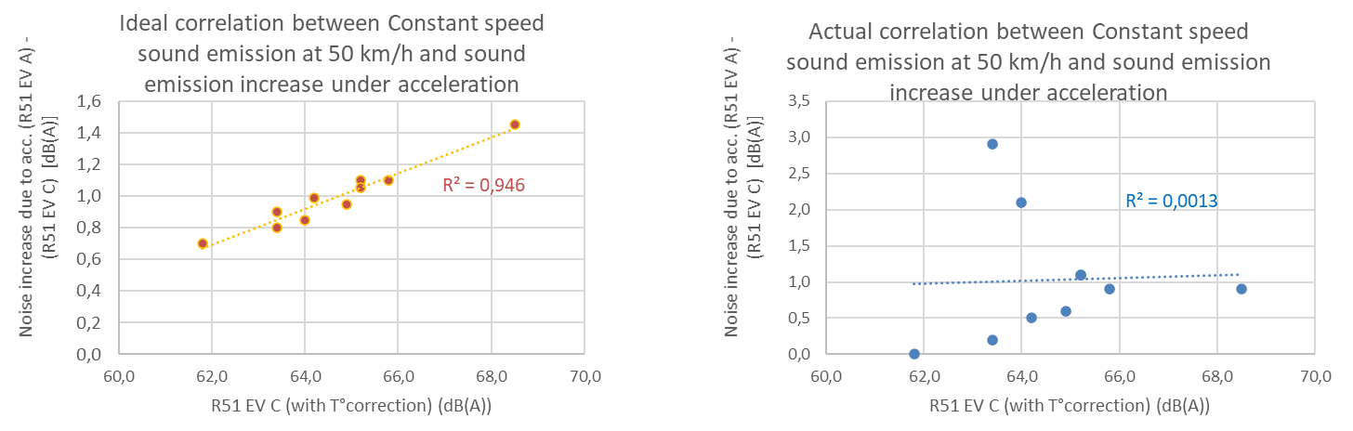
Annex
Rolling sound emission R51 accelerated versus R51 constant speed
Imaginary ideal situation Actual situation
Ideally, one would find a clear correlation trend between the difference of R51 constant and R51 Accelerated, as shown in the left graph (made from imaginary data as an example).
However, actual data from this study shows, that there is no simple correlation between the difference of R51 constant and R51 accelerated.

Slide 33
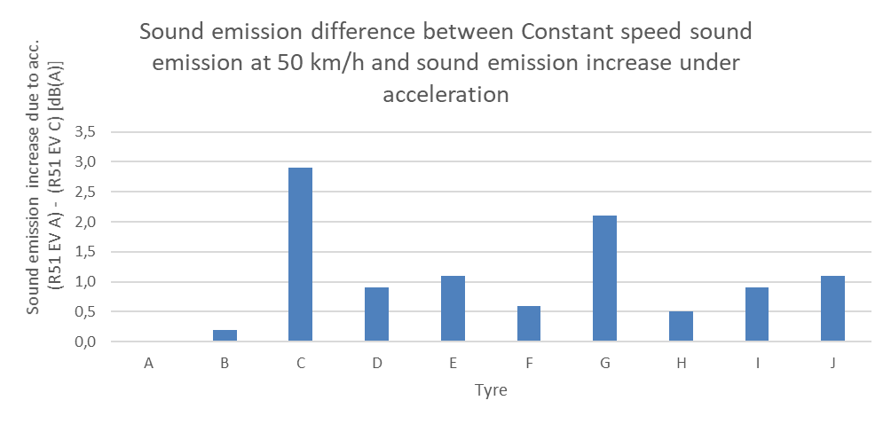
Annex
Rolling sound emission R51 accelerated versus R51 constant speed
The graph below also shows the actual data per tyre
As can be seen in this study:
For plain tread tyres ‘A’ and ‘B’ there is almost no impact due to acceleration → no tread blocks
For a 3PMSF tyre the impact is up to 2.9 dB(A)
For Normal tyres the impact is varying between 0.6 and 2.1 dB(A)

