Slide 1
Working Party on Noise (GRB) General information and WP.29 highlights
Note by the secretariat
Informal document GRBP-73-10
(73rd GRBP, 26-29 January 2021,
agenda items 1 and 10)
Next session
The next session is provisionally scheduled from 15 to 17 September 2021
The deadline for the submission of official working documents is 28 June 2021
For new pictures with notes, all text should be editable. No text as an embedded image!
Changes to the website
Our website has been migrated to a new platform. The access to meeting documents has changed
For 2021 meetings, use the "Meetings & Documents" entry menu on the left
For meetings before 2021, use the "Meeting Documents before 2021 (ARCHIVE)" menu
Wiki pages for IWGs and TFs have not changed:
https://wiki.unece.org/pages/viewpage.action?pageId=917781
The link is below the GR name in the left menu
See the following slides

Slide 2
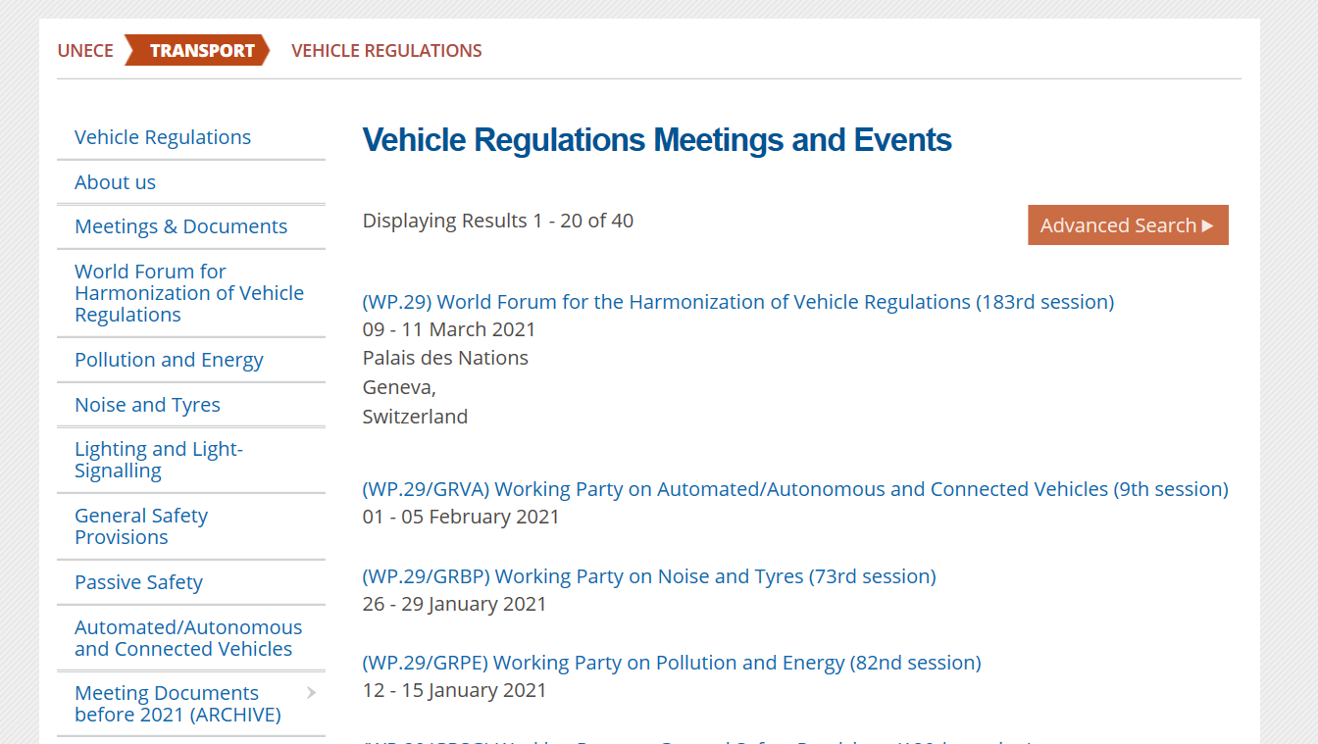
Website

Slide 3
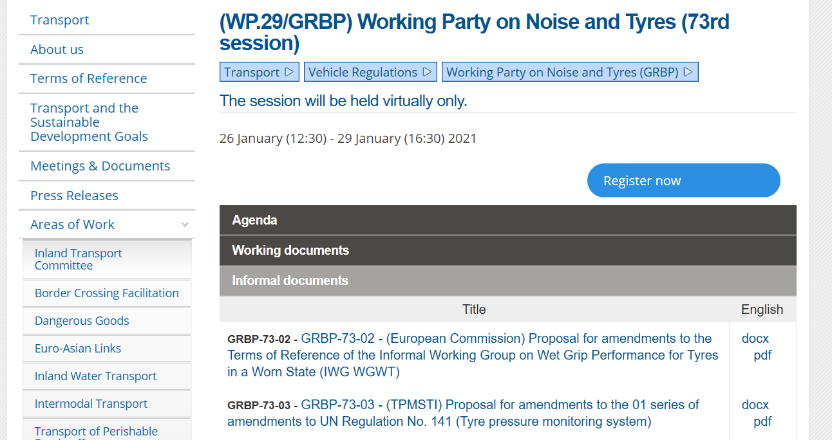
Website

Slide 4
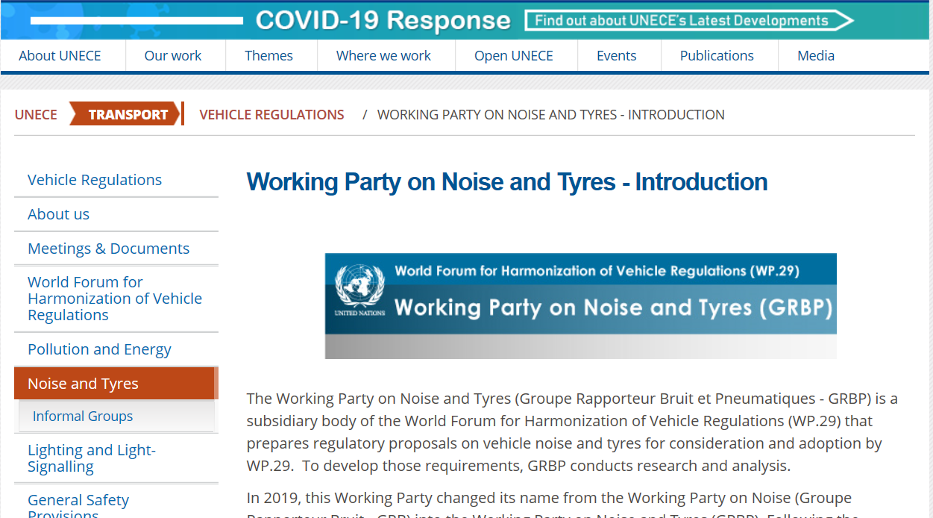
Website

Slide 5
Highlights of the recent session(s) of WP.29
November 2020
Opening statement of Dr. James Owens, NHTSA Deputy Administrator (WP.29-182-20)
Mr. Anikeev (Russian Federation) elected as Vice-Chair of WP.29
WP.29 endorsed a proposal by IWG IWVTA to amend provision V9 in the Guidelines on Transitional Provisions:
V.9. Contracting Parties applying this Regulation shall not refuse to grant type approvals according to any preceding series of amendments to this Regulation or extensions thereof.
V.9. Contracting Parties applying this UN Regulation may grant type approvals according to any preceding series of amendments to this Regulation.
V.9bis. Contracting Parties applying this UN Regulation shall continue to grant extensions of existing approvals to any preceding series of amendments to this Regulation.”
See report in ECE/TRANS/WP.29/1155

