Slide 1
Organisation Internationale de Métrologie Légale
International Organization of Legal Metrology
Very quick introduction to the OIML
Ian Dunmill
Assistant Director
Bureau International de Métrologie Légale

Slide 2
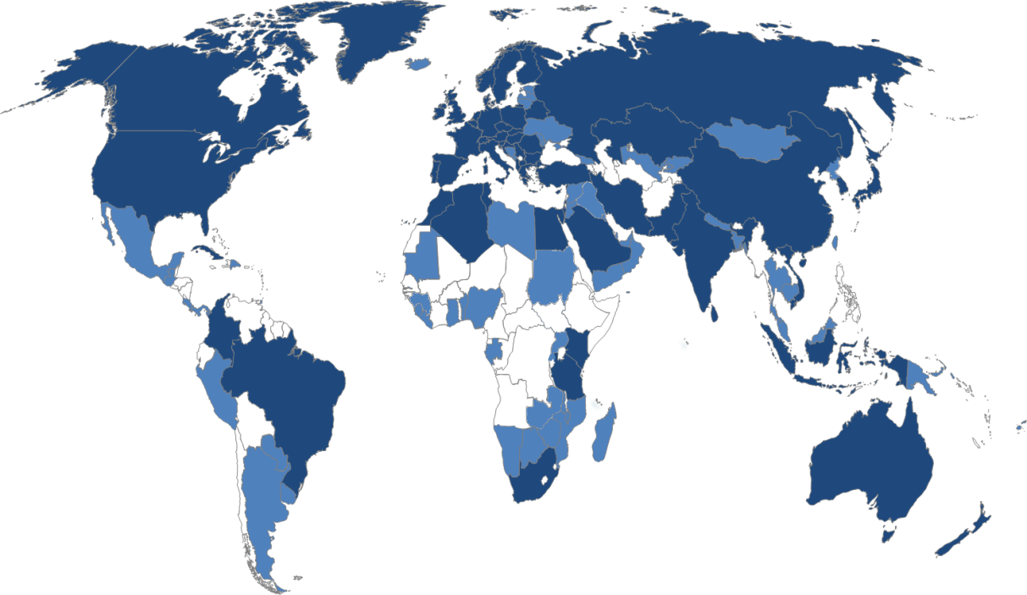
What is the OIML?
The OIML is an intergovernmental treaty organization
Current membership:
  61 Member States
  62 Corresponding Members
Headquarters in Paris
Technical work undertaken by volunteer members

Slide 3
Definition of legal metrology
“Legal metrology is the practice and the process of applying regulatory structure and enforcement to metrology. It comprises all activities for which legal requirements are prescribed on measurement, units of measurement, measuring instruments and methods of measurement, these activities being performed by or on behalf of governmental authorities, in order to ensure an appropriate level of credibility of measurement results in the national regulatory environment….”
(OIML D 1: 2012 “Considerations for a law on metrology”)

Slide 4
Why do we need legal metrology?
Measurements may fall within the scope of legal metrology when:
  those affected have conflicting interests
  these parties do not have the competence or the possibility to evaluate the reliability of the measurement results
  legal evidence is needed of measurement reliability
  health & safety require reliability of measurement

Slide 5
What does the OIML do?
Publishes “International Recommendations” on measuring instruments
  model technical regulations
  considered as relevant international standards by the WTO TBT Committee
  technical requirements, tests, report
  developed by volunteer experts from OIML Member States
Operates OIML Certificate System and Mutual Acceptance Arrangement (MAA)

Slide 6

Who does the OIML work with?
“Sister organisation” is BIPM
  Also based in Paris
  Establishes and disseminated the SI
  Works on scientific and industrial metrology
WTO
DCMAS Network on developing and emerging economies

Slide 7
Thank you
ian.dunmill@oiml.org
www.oiml.org

