Slide 1
Graphs Showing Forecasts made for 69th Timber Committee meeting (supplement)
UNECE/FAO Forestry and Timber Section

Slide 2
Chips, particles and residues - Europe

Slide 3
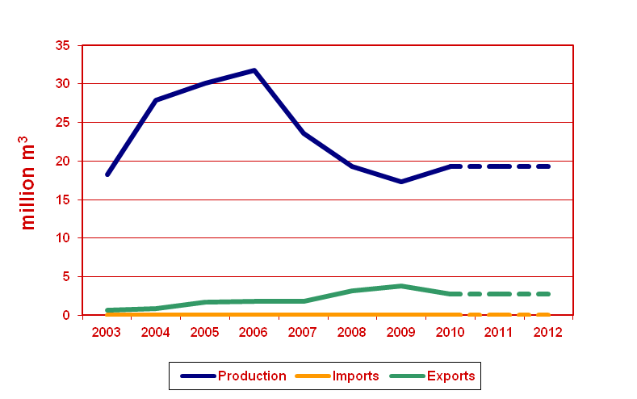
Chips, particles and residues - CIS

Slide 4
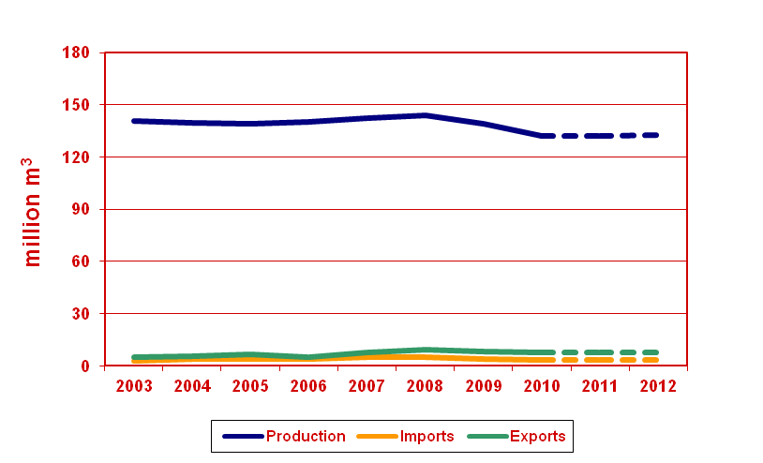
Chips, particles and residues – North America

Slide 5
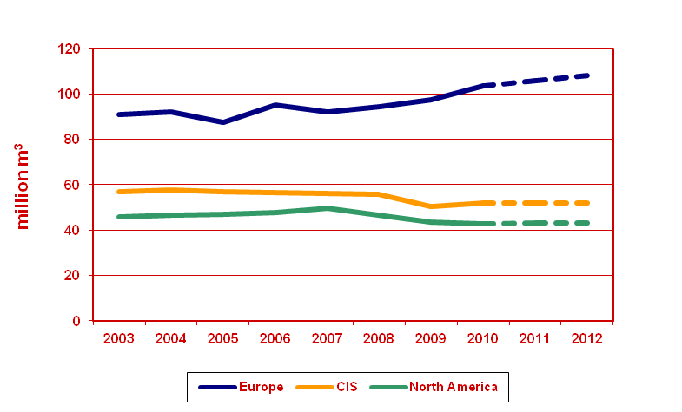
Wood Fuel Removals

Slide 6
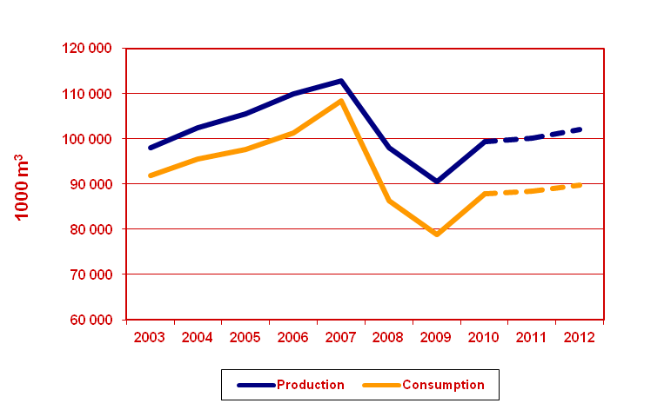
Sawn Softwood – Europe (I)

Slide 7
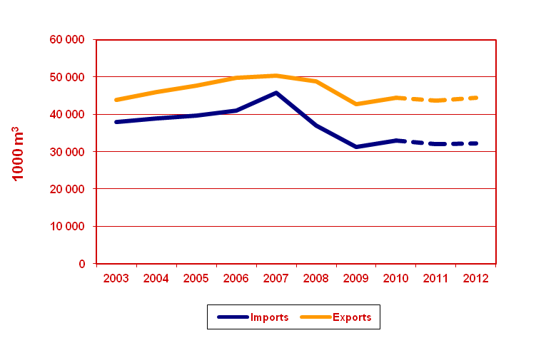
Sawn Softwood – Europe (II)

Slide 8
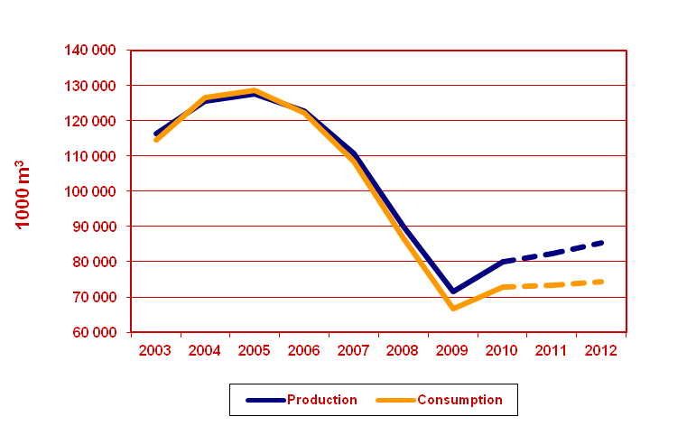
Sawn Softwood – North America (I)

Slide 9
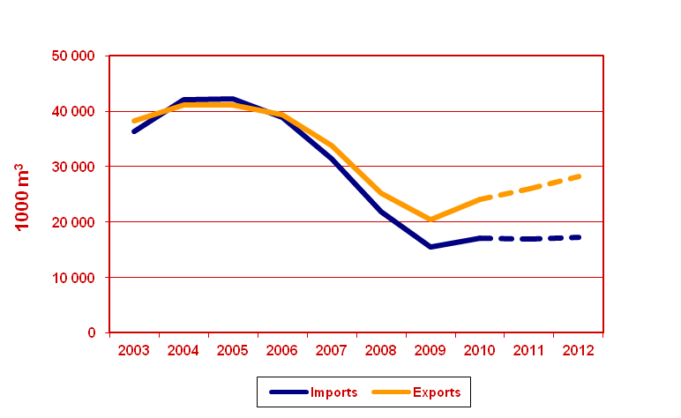
Sawn Softwood – North America (II)

Slide 10
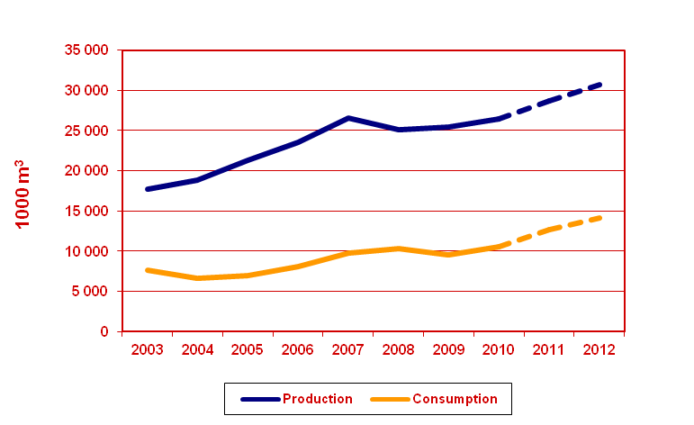
Sawn Softwood – Russian Federation (I)
Production is estimated by UNECE based on a calculation of consumption

Slide 11
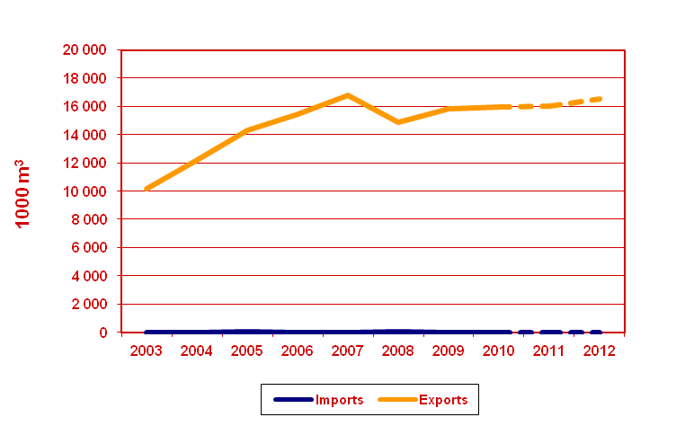
Sawn Softwood – Russian Federation (II)

Slide 12
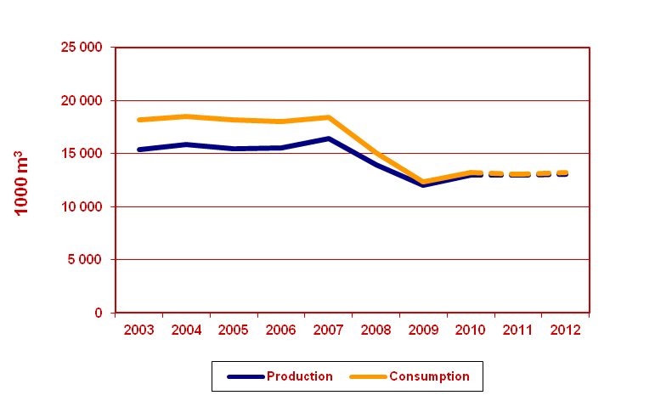
Sawn Hardwood – Europe (I)

Slide 13
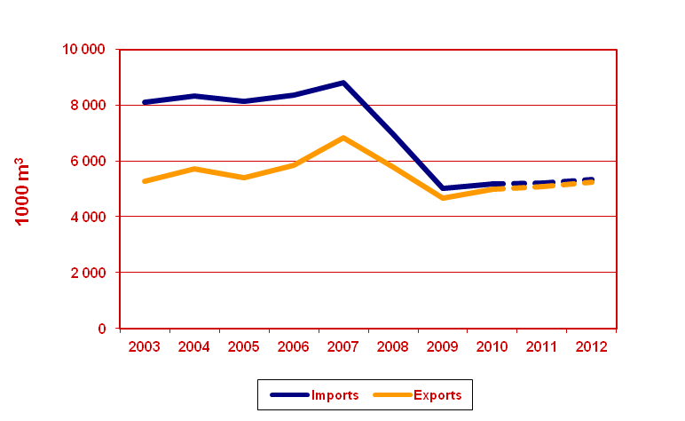
Sawn Hardwood – Europe (II)

Slide 14
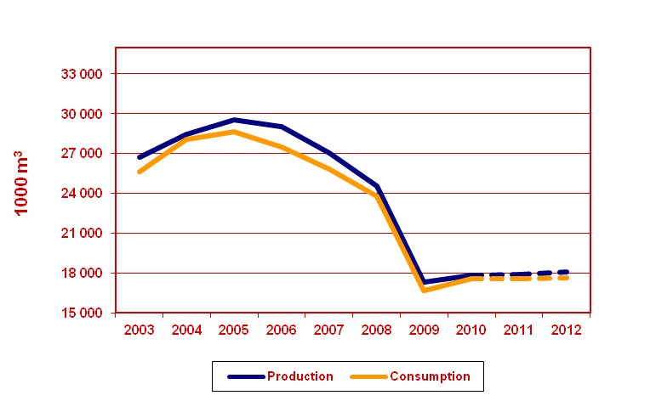
Sawn Hardwood – North America (I)

Slide 15
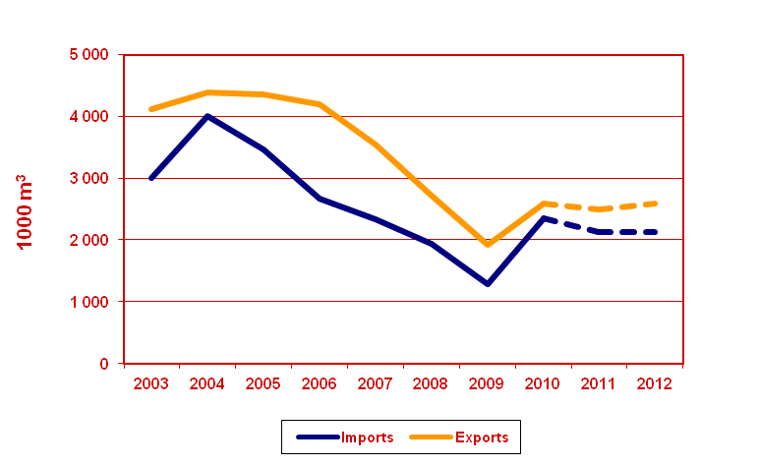
Sawn Hardwood – North America (II)

Slide 16
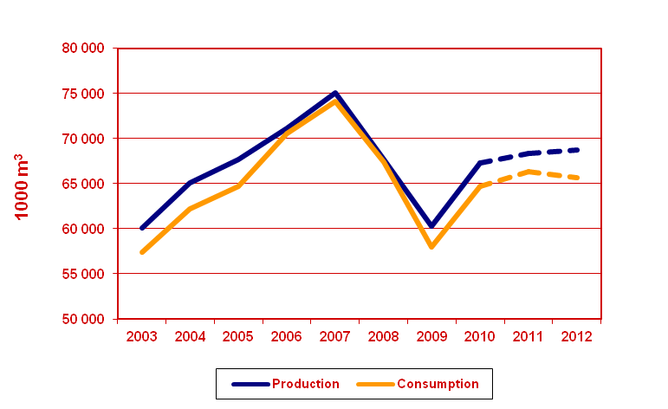
Wood-based Panels – Europe

Slide 17
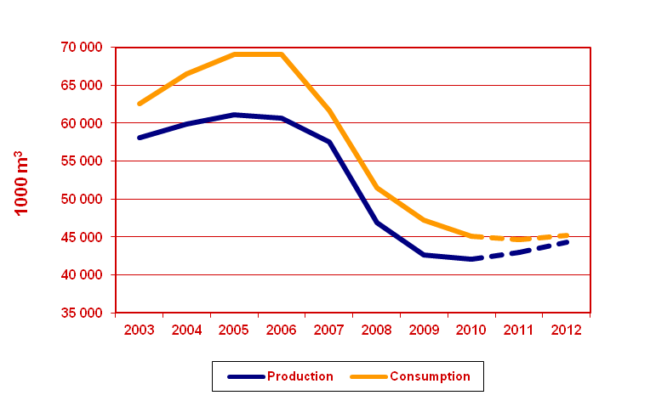
Wood-based Panels – North America

Slide 18
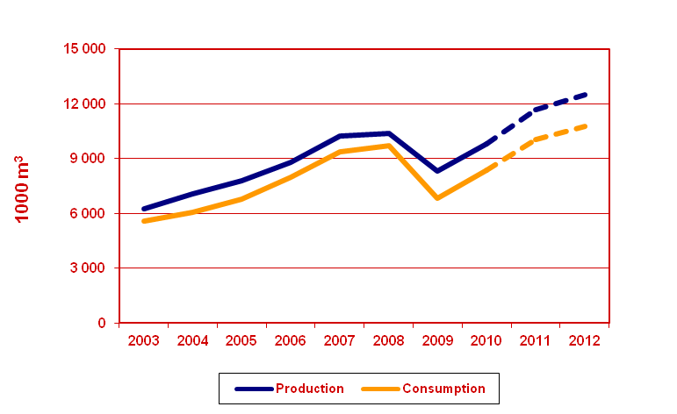
Wood-based Panels – Russian Federation

Slide 19
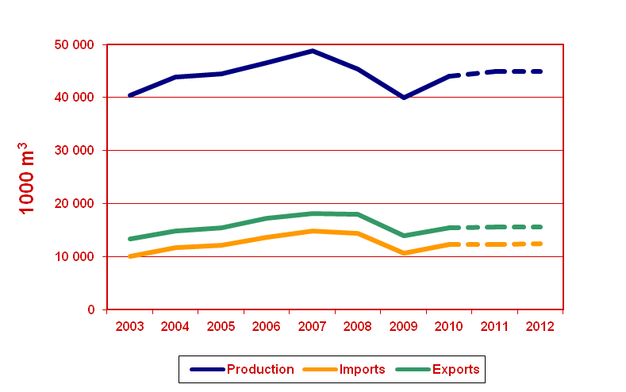
Particle Board – Europe

Slide 20
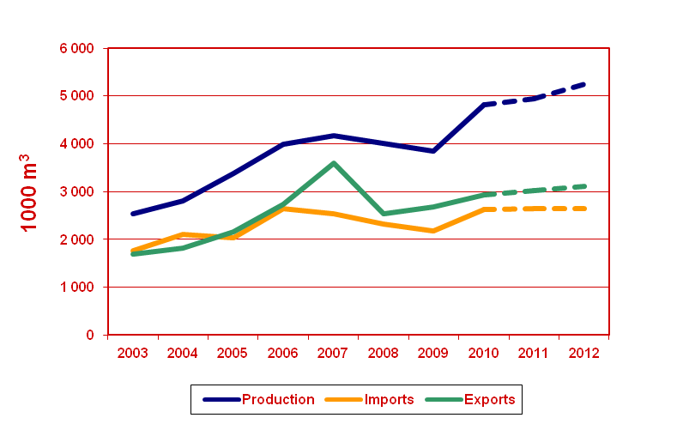
OSB - Europe

Slide 21
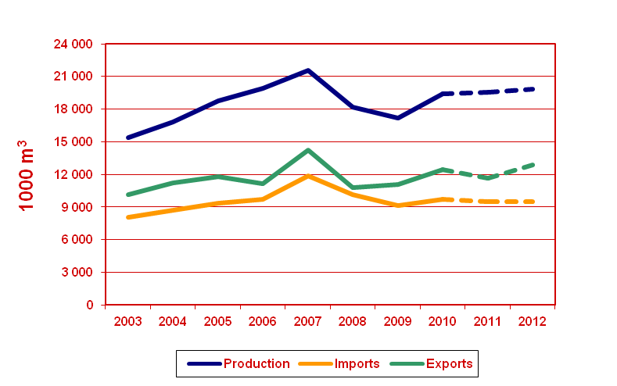
Fibreboard - Europe

Slide 22
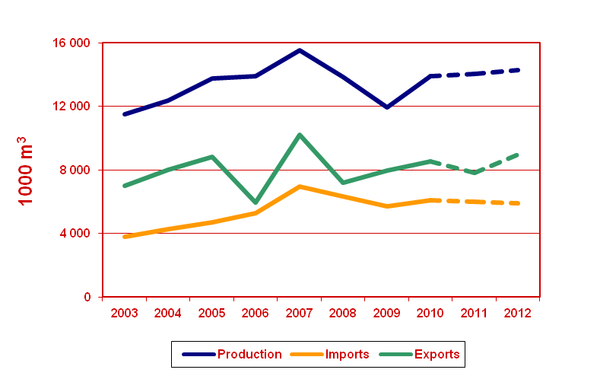
MDF - Europe

Slide 23
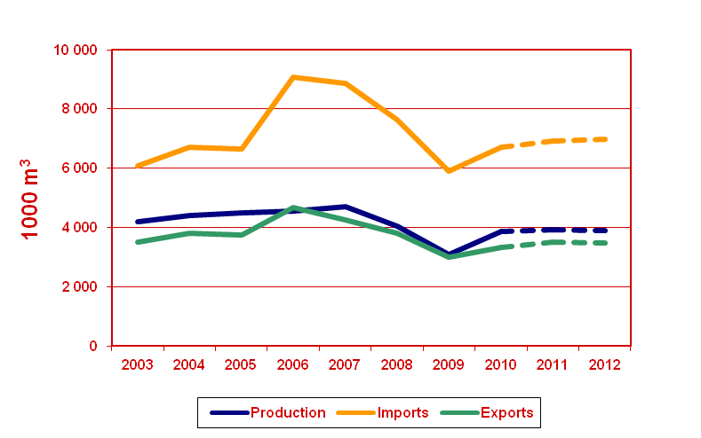
Plywood - Europe

Slide 24
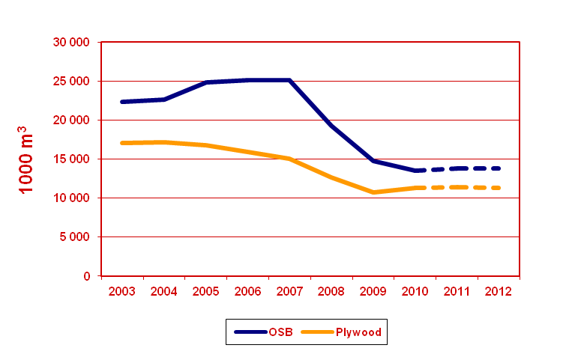
Structural Panel Production – North America

Slide 25
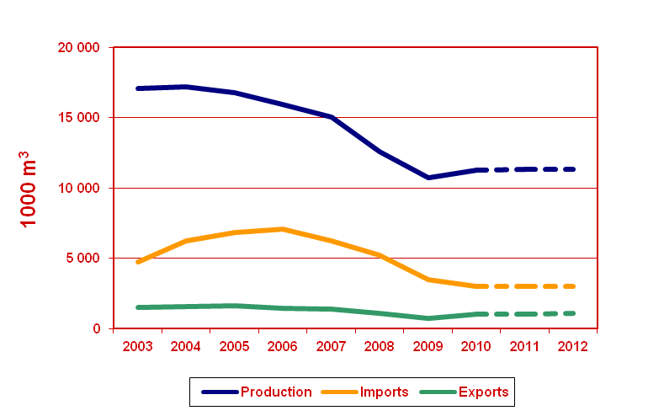
Plywood – North America

Slide 26
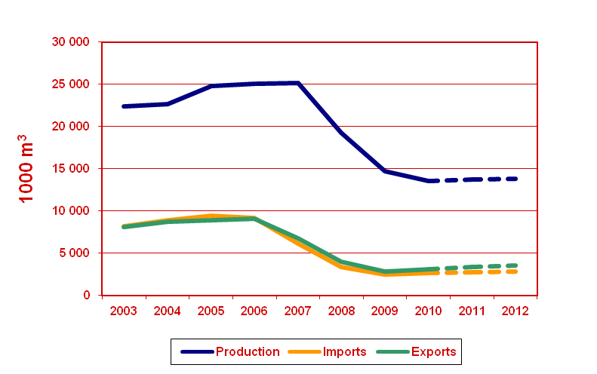
OSB – North America

Slide 27
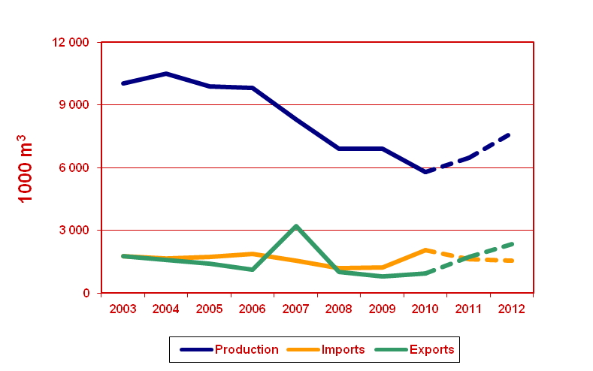
Particle Board (excluding OSB) – North America

Slide 28
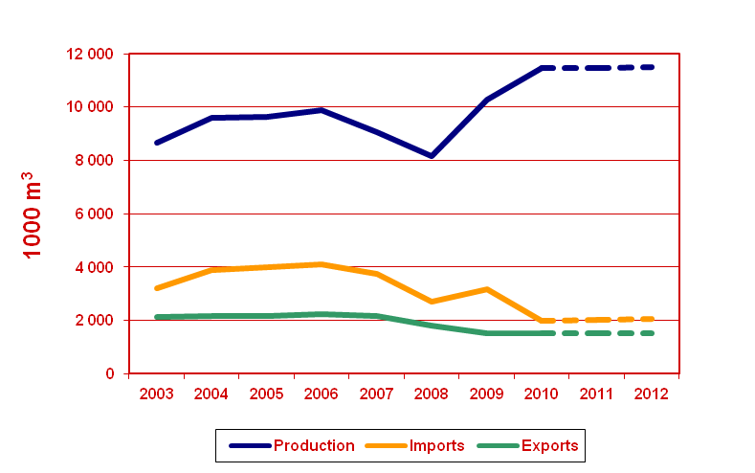
Fibreboard – North America

Slide 29
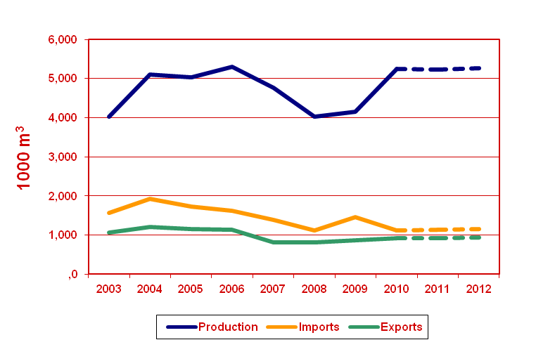
MDF – North America

Slide 30
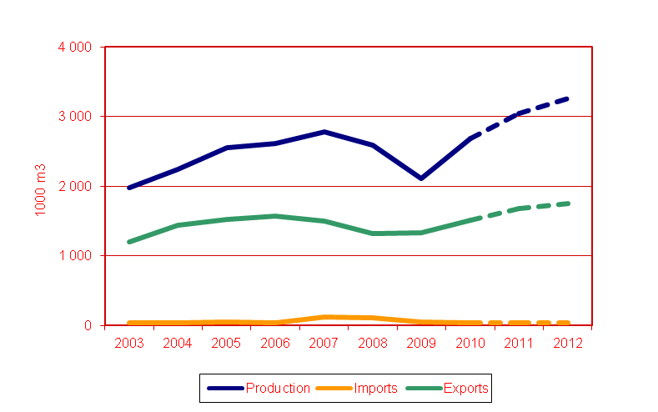
Plywood – Russian Federation

Slide 31
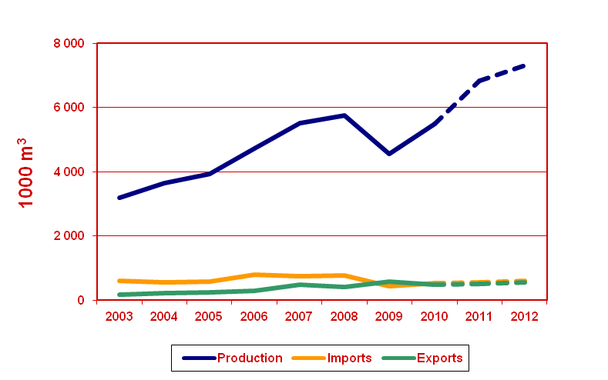
Plywood – Russian Federation

Slide 32
Particleboard – Russian Federation

Slide 33
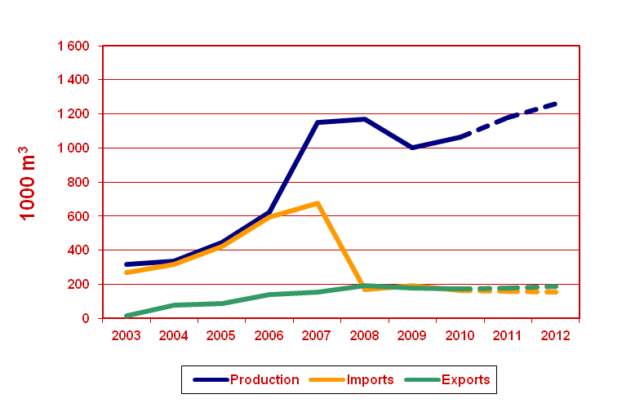
MDF – Russian Federation

Slide 34
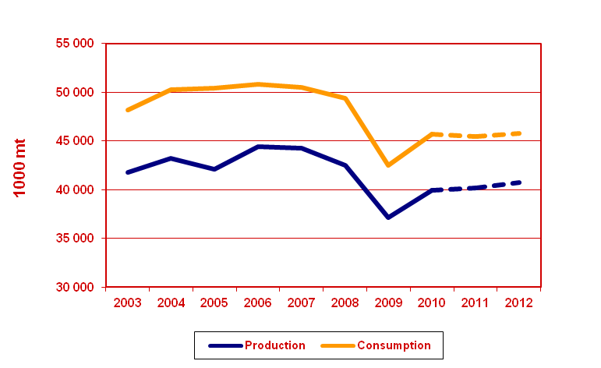
Wood Pulp – Europe (I)

Slide 35
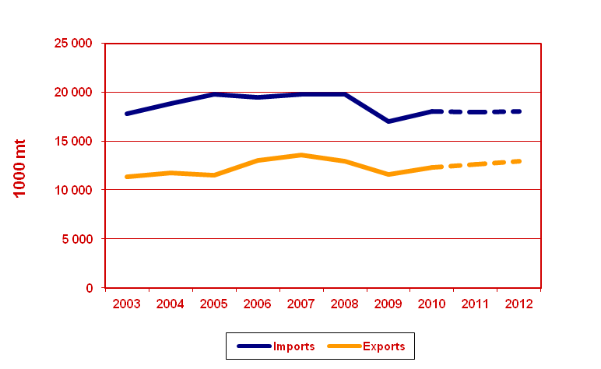
Wood Pulp – Europe (II)

Slide 36
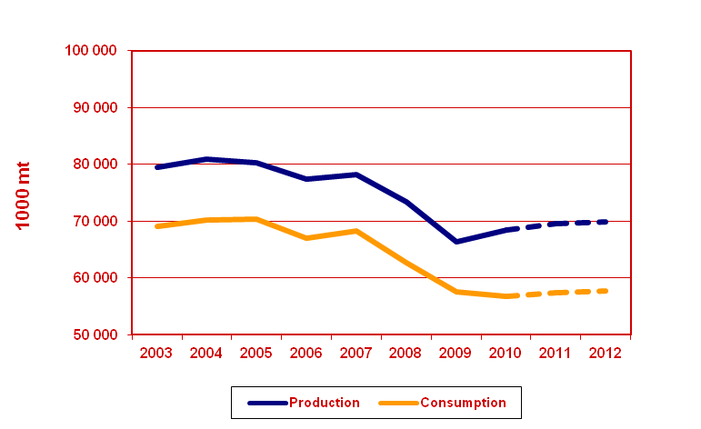
Wood Pulp – North America (I)

Slide 37
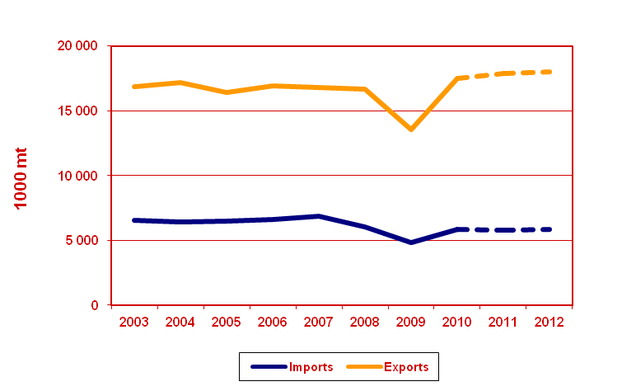
Wood Pulp – North America (II)

Slide 38
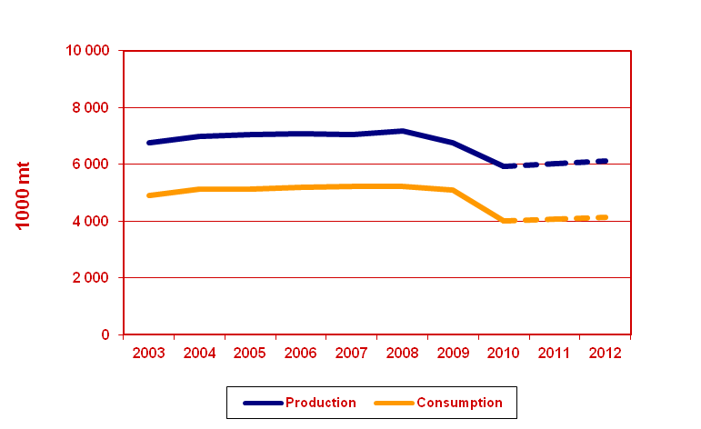
Wood Pulp – Russian Federation (I)

Slide 39
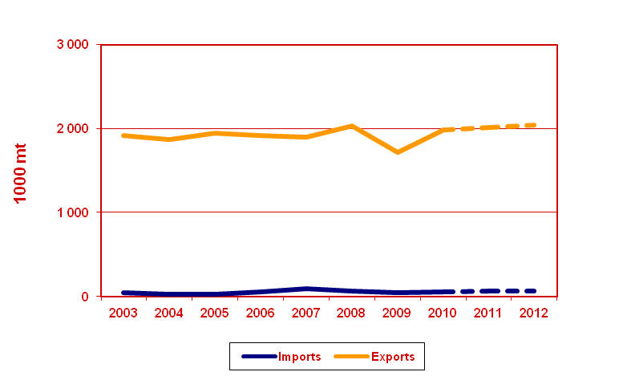
Wood Pulp – Russian Federation (II)

Slide 40
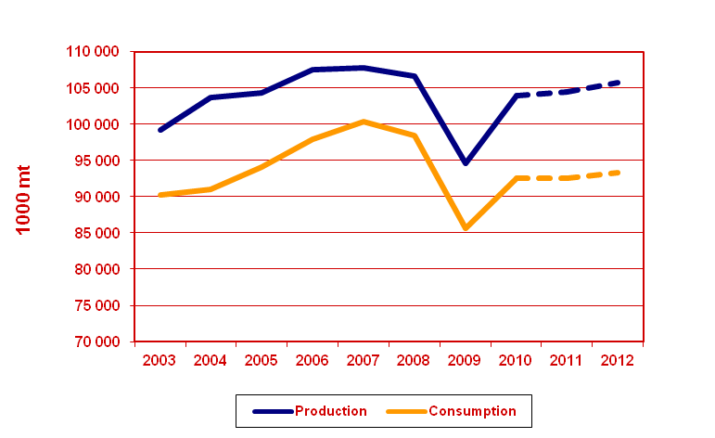
Paper and Board – Europe (I)

Slide 41
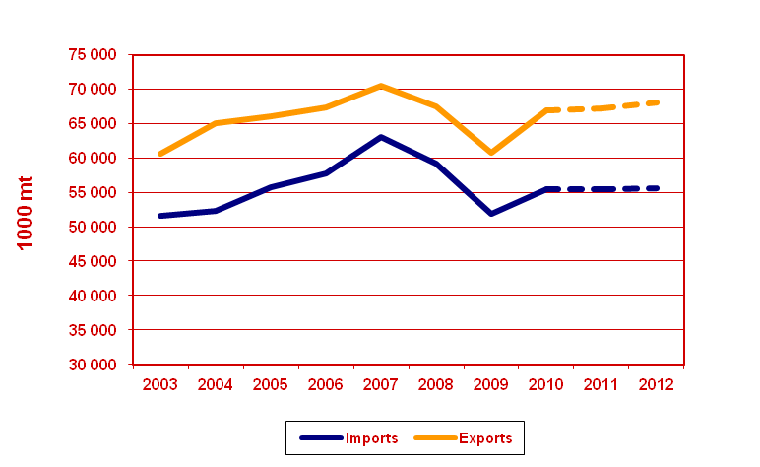
Paper and Board – Europe (II)

Slide 42
Paper and Board – North America (I)

Slide 43
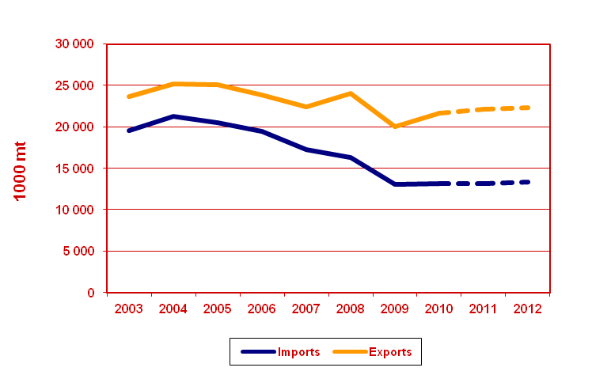
Paper and Board – North America (II)

Slide 44
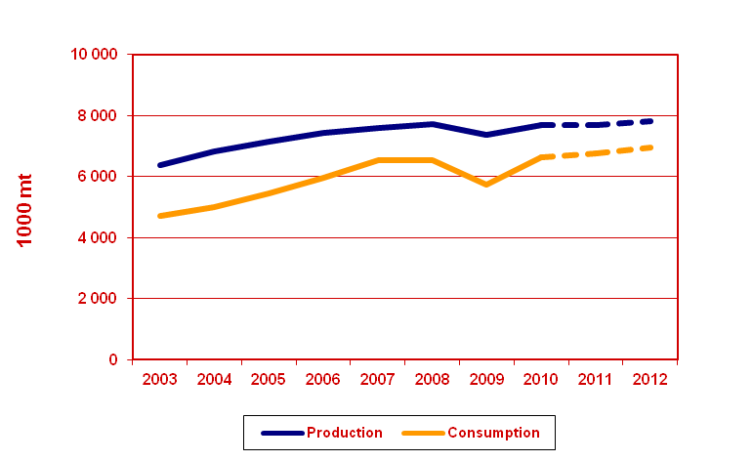
Paper and Board – Russian Federation (I)

Slide 45
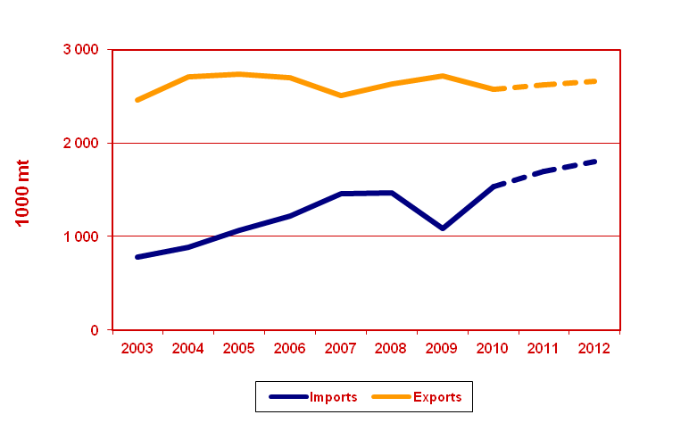
Wood Pulp – Russian Federation (II)

Slide 46
For additional information please contact Alex McCusker stats.timber@unece.org

