Slide 1
Embracing the changes required for a successful collaboration
OECD Statistical Information System
Collaboration Community experience
MSIS2011 Meeting – EuroStat, Luxembourg
By Jonathan Challener, OECD

Slide 2


Embracing the changes required for a successful collaboration
“LETS COLLABORATE!”
Notes:
Someone shouts “Lets collaborate!” and we all agreed it’s a good thing

Slide 3
Embracing the changes required for a successful collaboration
But what does it take to collaborate,
and can the benefits be realised?
OECD’s Statistical Information System Collaboration Community (SIS-CC) is now working together to answer these questions.

Slide 4
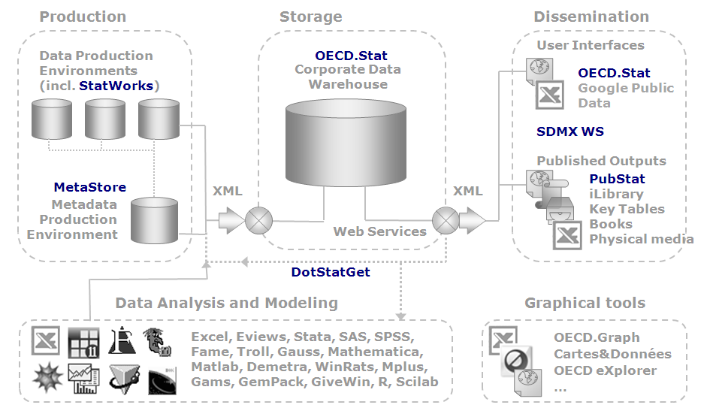
What is SIS?

Slide 5
Who are the SIS-CC members?
Organisation | Module(s) | MOU Signed
Australian Bureau of Statistics (ABS) | .Stat MetaStore (e) | May 2010
European Commission (EC) (Business Unit - DG-SANCO) | .Stat | March 2011
International Monetary Fund (IMF) | .Stat MetaStore | June 2007
Italian National Institute of Statistics (ISTAT) | .Stat MetaStore (e) StatWorks (e) | July 2010
Statistics New Zealand (SNZ) | .Stat | May 2009
Note: (e) indicates that the modules are currently being evaluated for use and no MOU for the module has been signed. MetaStore is included in the MOU if one is in place for either .Stat or StatWorks.

Slide 6

Identifying a common need
System 3
Database A
Database B
Before
Today
Database C
System 2
System 1

Slide 7
Setting the expectations
There are four key values that form the basis of how the SIS-CC will work together:
Partnership
Commitment
Transparency
Fostering common standards

Slide 8
Setting the expectations
start simple to build confidence and gradually increase complexity of assigned tasks
avoid too many early restrictions,
set-up some ground rules and increasingly build on these as we progress,
communicate openly and provide constructive feedback,
don‘t struggle, ask for help or questions of others.
Remember this is collaboration so ask others if you are unsure; don’t struggle on until it becomes a real issue.

Slide 9
Setting the expectations
agreed method to deliver common need,
having the right skills,
have matching technology and be working on the same platforms as the core developments,
dedicate resources to the assigned tasks,
follow agreed development standards,
commit to the agreed timelines.

Slide 10
Development scenarios
Developing core components
Add new features to core components
Work in OECD team on agreed tasks
Develop isolated plug-in
Add method to existing WS
Develop new tool using existing WS

Slide 11
Implementing the supporting framework
Members and culture
Tools and technology
Governance and process

Slide 12
Implementing the supporting framework
The following represent the five key documents that form the working relationship between member organisations:
MOU
Bilateral agreement between 'x' and OECD
Governance framework
100% OECD with community validation
OECD workplan
100% OECD shared with community
100% community consensus
Intellectual property
100% OECD but made available for use by community
Community workplan

Slide 13
Implementing the supporting framework
The Governance structure can be divided into three levels:
  Strategic
  Management
  Operational/Technical
Strategic level
Endorses annual community workplan
Signs MOU
Guarantees organisation commitment including resources
Escalation point for resolving issues
Signs off governance model

Slide 14
Collaboration activities
Support
Build
Promotion
Coordination
Four main activity streams
Coordination is central providing the coherence
Each activity has a number of inputs that contribute to outputs

Slide 15
Breakdown of community contributions across activities
Funding source
Future
Financial contributions from members
Community coordination by OECD
Community support by OECD
In-kind contributions
from members
Community workplan
Potential developments
OECD workplan
New developments
OECD owns
the intellectual
property
In-kind contributions
from OECD
OECD initial investment
In SIS Modules
.Stat
Metastore
Statworks
Note: The scales used do not reflect
actual financial figures
Past

Slide 16
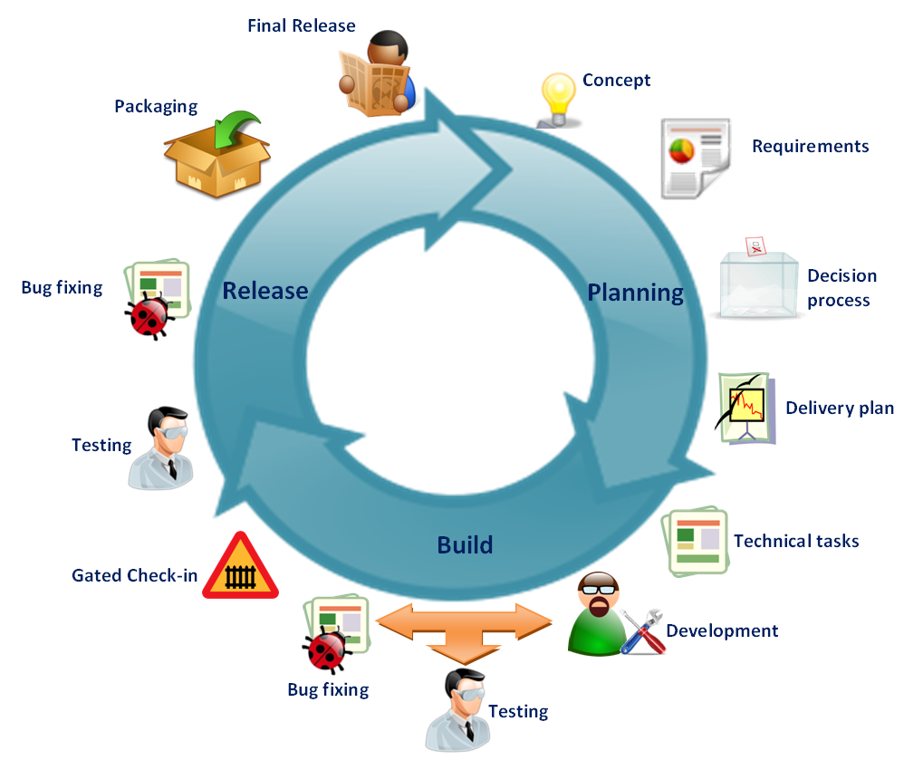
The Application Lifecycle Management
Agile with scrum methodology,
4 week sprints,
3 major releases per annum,
Code peer review last week of every sprint,
UAT during final sprint prior to release.

Slide 17
Applying the standards
The quality standards will gradually be increased over time:
Step 1: (June 2011):
    Force that check-ins are associated to work item (TFS Task, bug, etc…)
    Verify that the code checked-in compiles
Step 2: (October 2011):
    Systematic Unit Tests implementation (linked to every single task)
    GUI Tests: Key Scenario
    Tests have to pass before checked-in code can be accepted
    Enable some basic Code Analysis rules (Security, etc...)
Step 3: (1st Quarter 2012):
    More Code Analysis rules will be enabled
    Code Coverage will be enabled (minimum coverage has to be defined)

Slide 18
Applying the standards
must be configurable (on/off),
support localisation,
created in a way to enable users to be autonomous,
no direct database access,
builds must be linked to work item 'task‘,
tasks must be linked to work item ‘scenario’,
bugs must be linked to work item ‘Task’,
Bug fixes found in submitted code to be resolved by original member organisation,
automate testing where possible ,
release branch once created is never changed.

Slide 19
Realising the benefits
The benefits outweigh the short term trade-offs
Individual deadlines
Niche requirements
Reduce costs
Greater resources
Accelerate outputs
More agile
Benefits
Trade-offs

Slide 20
Major challenges and changes
Organisational culture change,
redesign of existing processes for collaboration team,
more freedom for individuals to work outside usual processes,
implement collaboration behaviours from the bottom-up,
seek senior management champion,
ensure own organisation joins the collaboration journey,
break down the barriers to innovation and technology.

Slide 21
Next steps for SIS-CC
June 2011:
  validate SIS Collaboration Community framework,
  validate and finalise community delivery plan,
  community members confirm resource commitment.
July 2011:
  initiate development phase.
September 2011:
  first rotation into OECD core development team.
End of 2011:
  review and update to collaboration framework.
Early 2012:
  SIS collaboration workshop:

Slide 22
Statistical Information System Collaboration Community Workshop
21-23 March 2011
Main outcomes

Slide 23
Workshop objective
First time community members all met together,
set the path for a new phase of active, multilateral collaboration towards a common goal,
shared experiences, knowledge and best practices.
Theme:
  Laying the foundations for a strong collaboration community
Objectives:
  Build a community spirit of sharing and working together for a common goal.
  Facilitate the sharing of ideas and knowledge to increase the use and awareness of OECD common statistical information systems.
  Confirm and initiate collaboration framework.

Slide 24
Programme
Main workshop held over 2 days,
total of 51 people attended representing 15 different organisations,
following topics were covered:
  presentations on use cases, working implementations and benefits gained from the systems,
  vision for SIS strategies and user requirements,
  focus on SDMX, an area where SIS have always been at the forefront of standards implementation,
  community governance and feedback on collaboration experiences among community members.
3rd and 4th days were open to Community members only and covered specific topics in more detail.

Slide 25
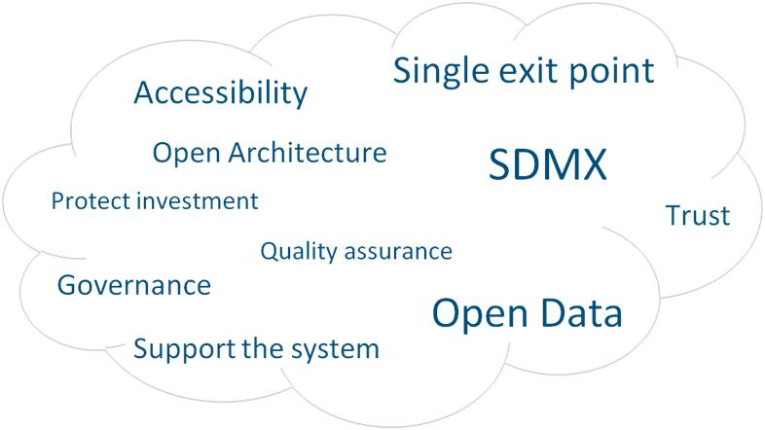
Key topic cloud
Notes:
Key points cloud based on topics of high interest and discussion points during the workshop

Slide 26
Main Outcomes for Interested Organisations
Helped them increase their awareness and knowledge of OECD’s SIS and the Collaboration Community,
benefited from the experience of partner organisations on their SIS implementations and business cases,
new relationships were created through the sharing of ideas and knowledge.
Following the workshop, a number of organisations showed interest in evaluating the Statistical Information Systems or joining the community.

Slide 27
Main outcomes for member organisations
Exchanged precious experience, technical expertise and business views,
confirmed and refined the proposed collaboration framework and governance model.
agreed on the requirements to form the community workplan for 2011,
strengthened relationships and sense of belonging among community members.

Slide 28
Through the sharing of vision and the laying of the
foundations for future collaborative work, the path was
set for the community to bring substantial value and
benefits to community members in 2011 and beyond.

Slide 29
Further information
Questions?
Email: jonathan.challener@oecd.org
or
dotstatcollaborationsupport@oecd.org

