Slide 1
MSIS 2011 – Statistics Sweden
Tentative anatomy of a new generation of IT-architecture to support GSBPM-processes

Slide 2
Modularization
→ Process?
Increased use of IT required bigger systems
Business area dimension: Survey
Survey 1
Survey 2
Survey 3
Survey n
Applications
[
]
IT-system
Technology dimension
10 Do(something)
20 Do(somethingElse)
GOTO 10
Storage

Slide 3
Process oriented plus services
Business area dimension: Process
Process 1
Process 2
Process 3
Process n
Applications
Technology dimension
Storage
Introduce a new layer: Services

Slide 4
State and Automation
Business area dimension: Process
Business area dimension: Process
Process 1
Process 1
Process 2 (Automated)
Process 2
Process 3
Process 3
Process n (Automated)
Process n
Applications & Services
Applications
Technology dimension
Technology dimension
Services
Service layer
Service layer / workflow engine
Service layer
Workflow
Service layer / workflow engine
Storage
Storage

Slide 5
User experience
Business area dimension: Process
Process 1
Process 2
Process 3
Process n
Process dashboard
Dashboard
Applications & Services
Technology dimension
Workflow
Service layer / workflow engine
Service layer / workflow engine
Storage

Slide 6
International collaboration
Business area dimension: Process
Process 1
Process 2
Process 3
Process n
Process dashboard
Dashboard
Dashboard
International
Collaboration
Applications & Services
Technology dimension
Workflow
Service layer / workflow engine
Service layer / workflow engine
Storage

Slide 7
Input and output
The information requirements in a process oriented software module reflects the information requirements for the process it supports
[
]
[
]
Process oriented
Software module
Processed information/data
Information/data to be processed

Slide 8
Additional information needs
[
]
Parameters for controlling the process execution
[
]
[
]
Process oriented
Software module
Processed information/data
Information/data to be processed
[
]
[
]
Information resources to support process execution
Additional information about how the process was executed

Slide 9
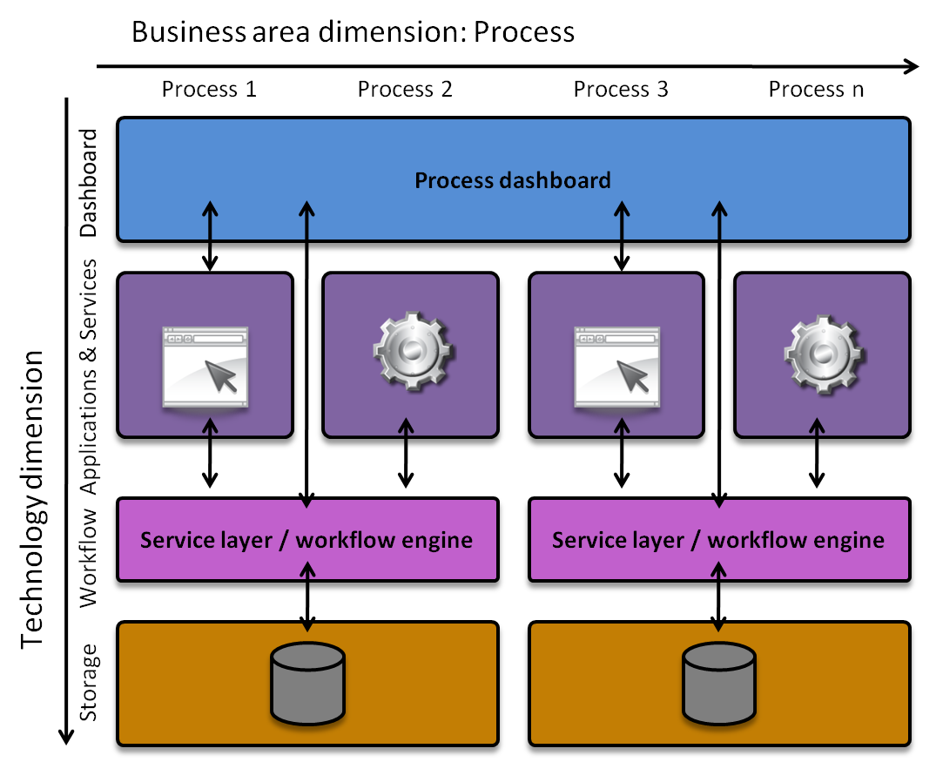
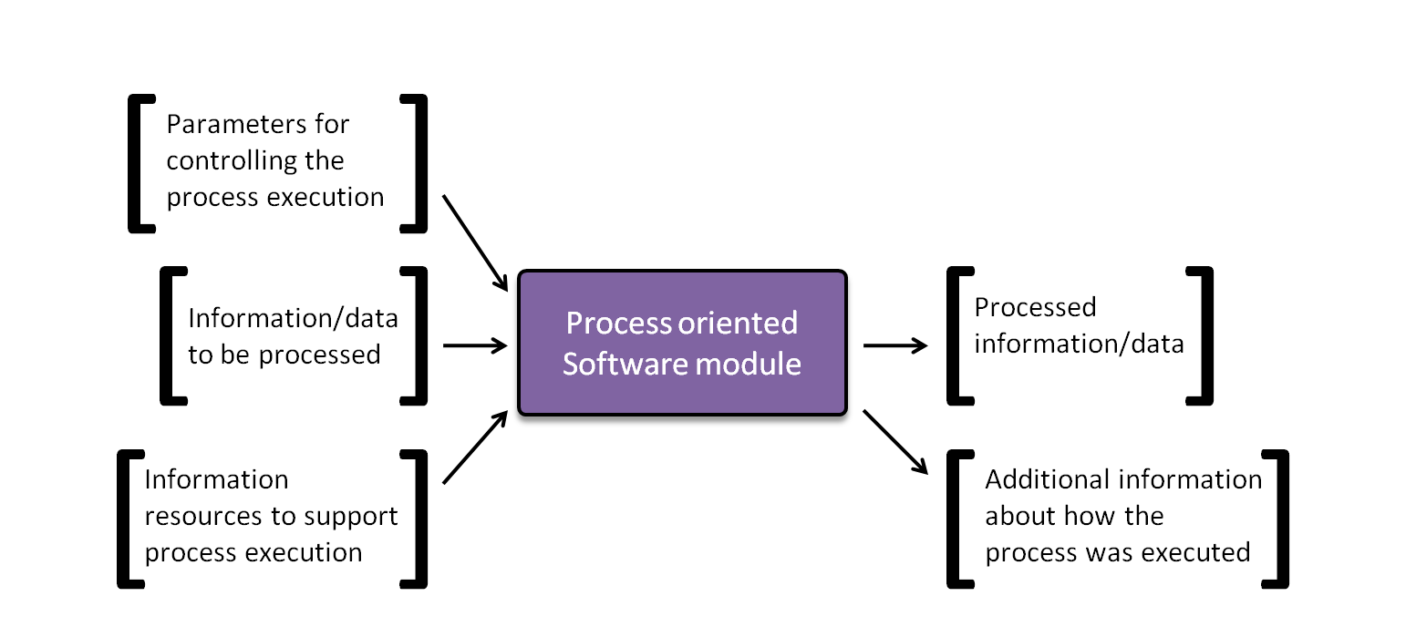
Conclusions
Prepare the internal
architecture
Model the information need for each process oriented software module

Slide 10
Thank you for your attention

