Slide 1
Christchurch Earthquake Recovery
The Story about People Who Never Give Up
May 2011

Slide 2
Content
Background
BCP/DR
September
February
March
April
May

Slide 3
Statistics NZ in 2010
More than 1000 staff
3 locations: Wellington, Auckland and Christchurch + Census building in Christchurch
Very stove-piped legacy IT environment
Building move project in Auckland
2011 is a Census year (8 March)
Statistics 2020 programme in planning phase with anticipated launch in 2011

Slide 4
BCP/DR
Some planning after pandemic experience
No comprehensive organisation-wide plan
Staged approach to increase IT resilience (generators, secondary location for data)
End of August - generator installed in Christchurch.
No battle plan ever survives contact with the enemy?

Slide 5
September
At 4.35 am on Saturday 4th September Canterbury was rocked by 7.1 Earthquake!
No casualties, but very hard times for people
Christchurch IT services: safe shut-down on 6th September; restored on 7th September.
Main building partly damaged (3rd floor not in use until Christmas!), Census building OK.
Extremely good response of ChCh staff despite 2,300 aftershocks recorded in the 7 weeks!

Slide 6
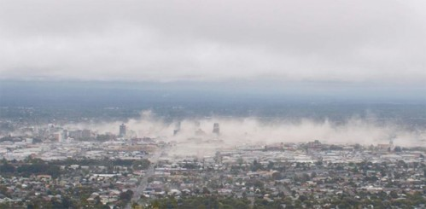
12:51 pm on Tuesday, 22 February

Slide 7
Earthquake Response Agenda
People – nobody from organisation injured
Buildings – main building damaged and unsafe but Census building seems relatively OK
Outputs – Census and key outputs impacted
Services – ChCh data centre not even accessible
Communication – difficult to find channels to communicate to staff in Christchurch

Slide 8
Census 2011 Cancelled
25 February: the national census planned for 8 March 2011 would not take place due to the disruption and displacement of people in the Canterbury region, and also the damage sustained by Statistics New Zealand's buildings in Christchurch, which was scheduled to process much of the census.

Slide 9
IT Challenges
We have a building – but we don’t have a WAN
We need to recover ChCh IT services
We need to recover data
We need a full remote access solution for key staff to work on outputs
We need more storage
We need a channels to communicate to staff
Notes:
WAN will be at least 6 - 8 weeks away as civil defence takes control of all major services. This is because emergency services requests are rightly being prioritised.

Slide 10
March
Remote Access infrastructure established (using Census equipment)
Secure “cloud” web site for ChCh staff
Work underway to prepare Census building
Some staff working in Auckland & Wellington
All looks good for April
Census building changed from green to yellow!!!

Slide 11
April
We can’t rely that we will have a premises able to house server and storage equipment
All ChCh desktops will have to be virtualised
Remote Access now even more important
Census netbooks used as a remote clients
Now we need even more storage
Temporary building found
Notes:
Desktops will need to be virtualised as SNZ has no guarantee that any new premises will be able to house server and storage equipment in server environment. This approach makes us very mobile and puts limitation only on connectivity.

Slide 12
May
4th May – the temporary building is open, but with capacity of 105 - less than half of what would be required (additional 38 sits in Census District office opened the following week)
All desktops virtualised and thin client PCs deployed
Work on remote collaboration options (VC)

Slide 13
Lessons Learned
Always think first about people!
Staff in all 3 locations have done absolutely fantastic job!
Don’t assume that you can’t loose data so make sure you understand which data is important!
BCP/DR planning is important.
Communication, communication, communication!

Slide 14
Strategic Impact
Remote Access has initiated new thinking about flexible working arrangements.
Lack of certainty about the building has kicked off desktop virtualisation.
Prioritised Output work has confirmed the need for standardisation and removal of legacy silos.
Urgent need for fast infrastructure deployment will influence our Cloud strategy.

Slide 15
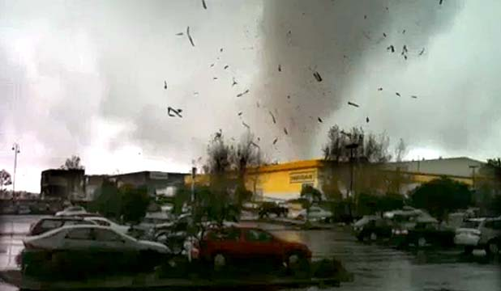
Disaster can happen anytime – anywhere and can be global or local

