Slide 1
Differential Privacy
A Primer for the Perplexed
Cynthia Dwork, Frank McSherry,
Adam Smith, Kobbi Nissim

Slide 2
Differential Privacy

Slide 3
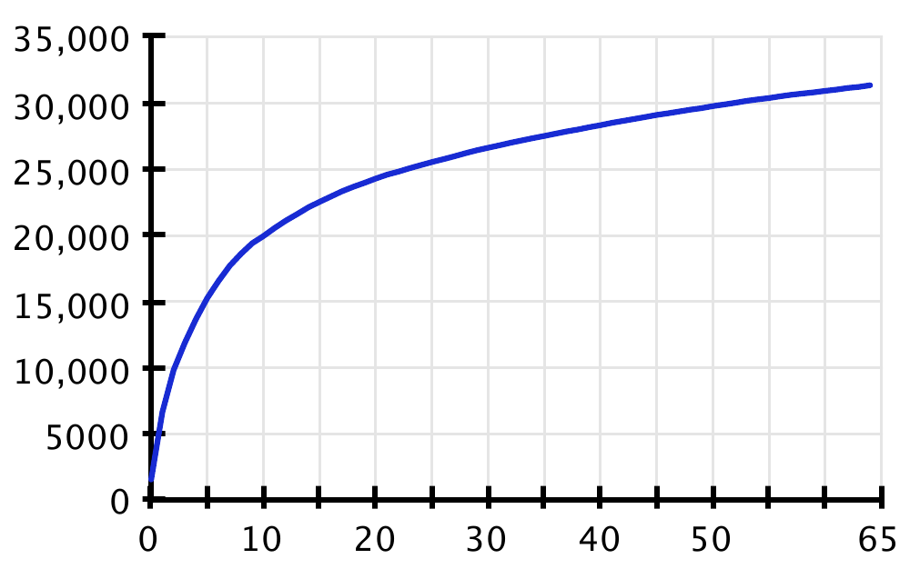
Differential Privacy is a criterion. It is not a specific algorithm.
Many randomized algorithms provide eps-DP.
The discovery that one works poorly for your problem is only that. Others may work better.
On the other hand, using just noisy counts we can produce
a cumulative density function:

Slide 4
Differential Privacy can’t “make” privacy.
Imagine that a DP analysis teaches us that smokers are at risk for cancer, and also you smoke in public.
DP has not violated your privacy. All conclusions about you could be reached without your secrets.
DP masks the nature of one’s participation in surveys,
and prevents the mishandling of individuals’ records.
It does not manufacture privacy where none exists.

Slide 5
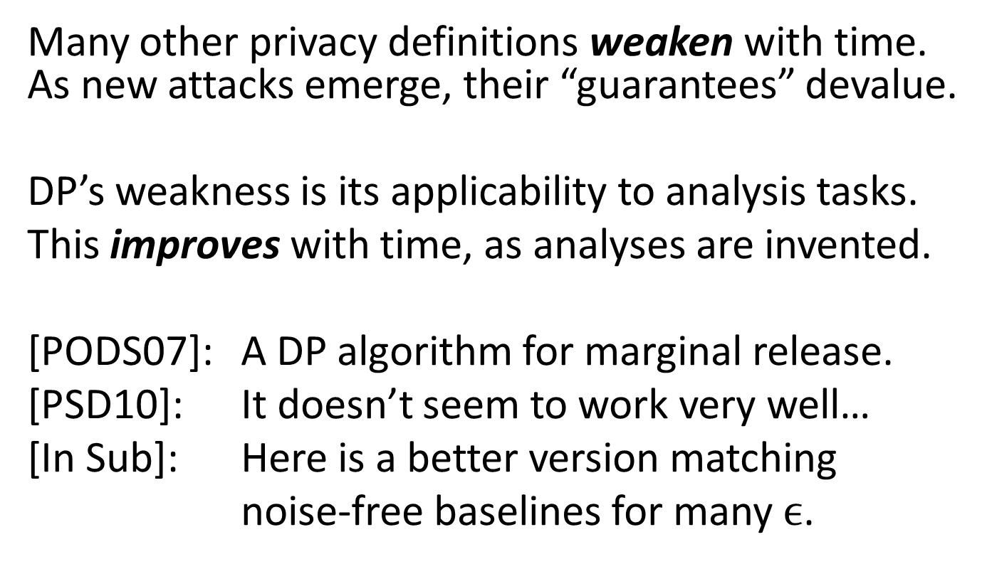
Differential Privacy is good research.

