Slide 1
The Future of Government
a.k.a.: “gov 2.0”
Bringing Census Data
Into the 21st Century

Slide 2
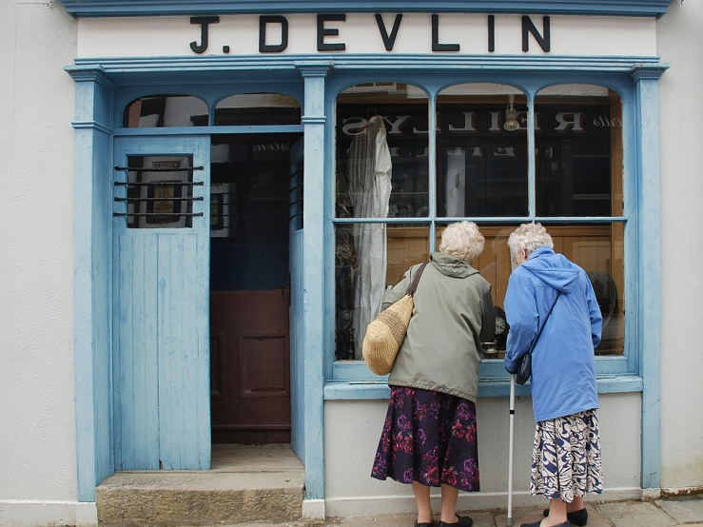
The Old Way of Doing Things
Organized like a
vertically integrated
three-part supply chain:
Warehouse
Retail Store
Road Between

Slide 3
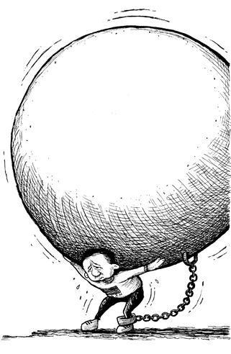
Break Free from the Chain
.com
.org
Unlike the traditional model - where the government is forced to shoulder the ‘retail’ burden - APIs turn citizens into potential franchisees.
.net
Data
.gov

Slide 4
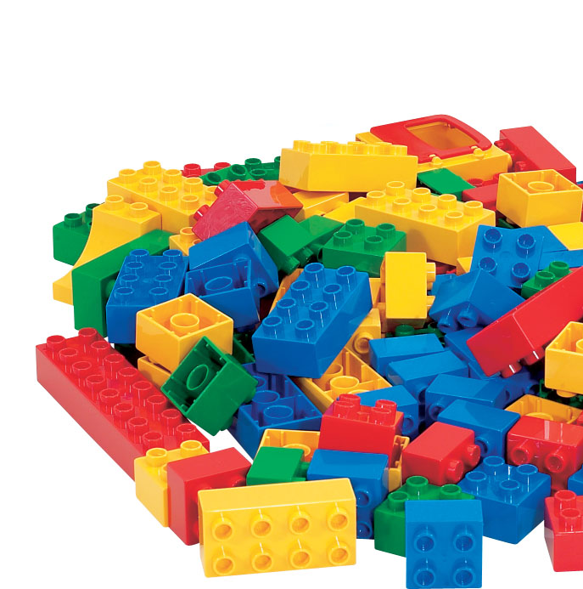
Provision Your Data as Building Blocks
Decoupling data from presentation allows:
Outsourcing of innovation via third-party adoption
Portability to almost any type of application on any device
Reduction in redundant efforts within the bureau

Slide 5
Doing More with Less
Allow your customers a greater variety of specialty applications created internally while enabling 3rd-party developers to produce their own custom-purposed applications all at a lower cost.

Slide 6
Digital Government Strategic Alignment
Information-Centric
Customer-Centric
Security and Privacy

Slide 7
“Government agencies must enable the public, entrepreneurs and our own government programs to better leverage the rich wealth of federal data (and help) serve to unlock the power of government data, spur innovation, and thereby improve the quality of services for the American people.”

Slide 8
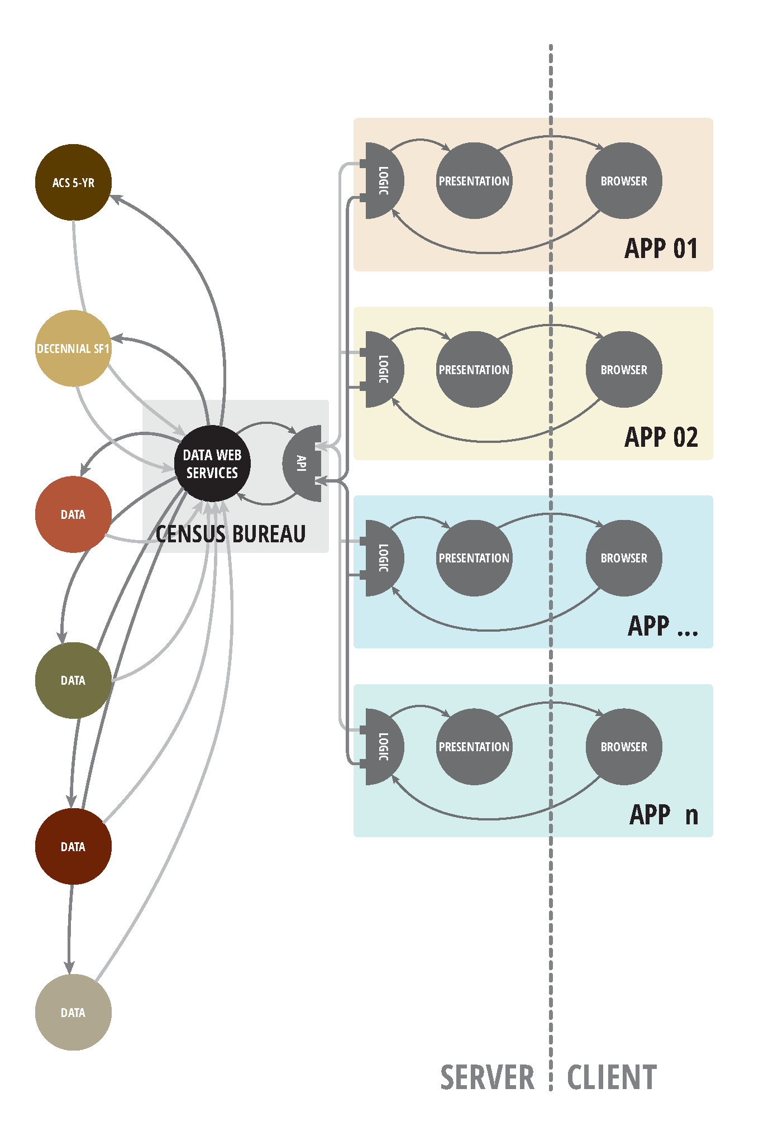
The Census’ Data Web API
The Data Web connects a network of cross-governmental agency databases and is provisioned by the Data Web API
Initially available data-sets:
American Community Survey
Decennial SF1

Slide 9
Reactions from Developers @Y-Combinator
J Campbell
Wow, this is good government… this is one giant leap in the right direction.
Taylor Buley
When you sign up for an API key you get the message "Happy querying!" Quite the model of transparency.
Jordan Coeyman
This opens my mind up to a whole new slew of ideas using their information so easily..
Source: http://news.ycombinator.com/item?id=4076253

Slide 10
The Power of the “Mash-up”
By combining resources through multiple APIs, developers can ‘mash’ together applications quickly and easily to create synergetic hybrids

Slide 11
Census Bureau Examples

Slide 12
Mobile App: “Dwellr”
Mashup of APIs from:
American Community Survey 5-year (Census)
Weather (NOAA)
Location (FCC)

Slide 13
Mobile / Tablet App: “America’s Economy”
Mashup of: CIDR (Census); Labor (BLS); Econ (BEA)

Slide 14
Third-parties Examples
(metadata enabled partnerships)

Slide 15
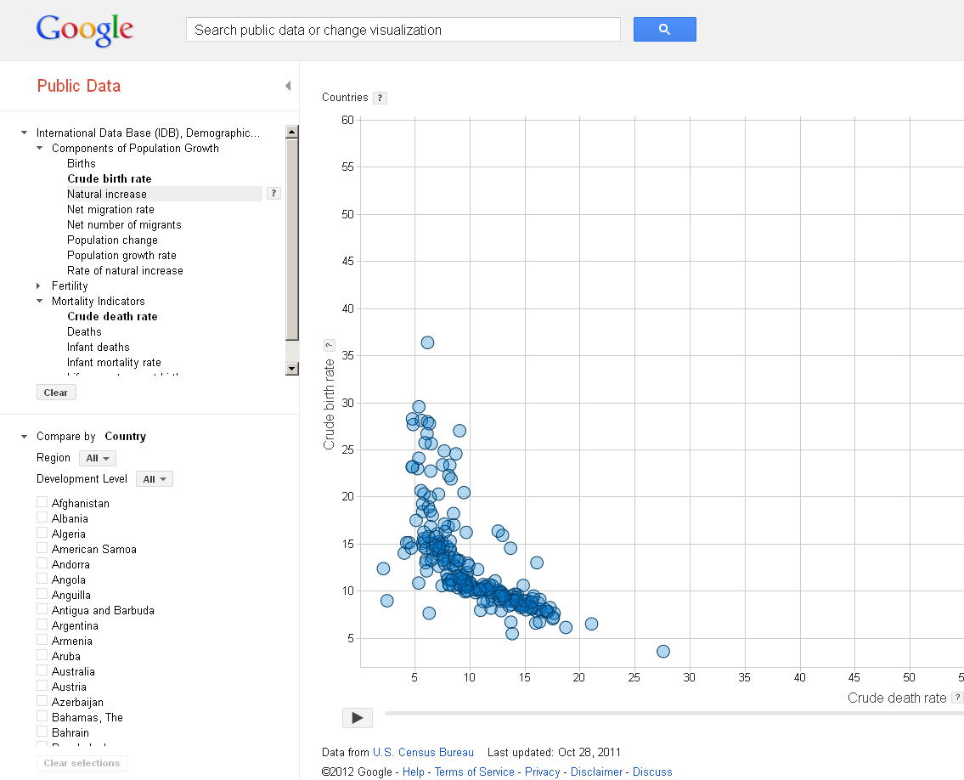
Google Public Data Explorer (Web App)

Slide 16
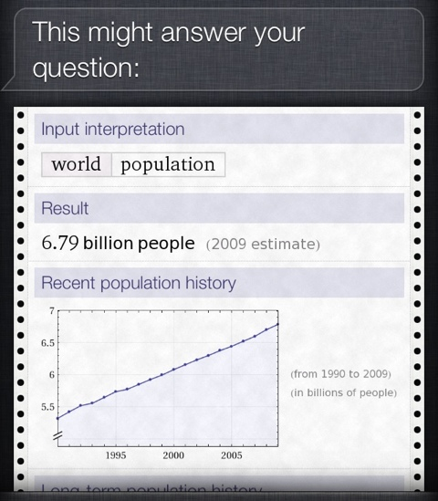
Siri / Wolfram Alpha
Siri (iPhone / Apple) powered by Wolfram Alpha powered by Census Data

