Slide 1
2011 Population and Housing Census communications campaign and measuring its effectiveness
Aira Veelmaa
Head of Information and Marketing Service
Statistics Estonia

Slide 2
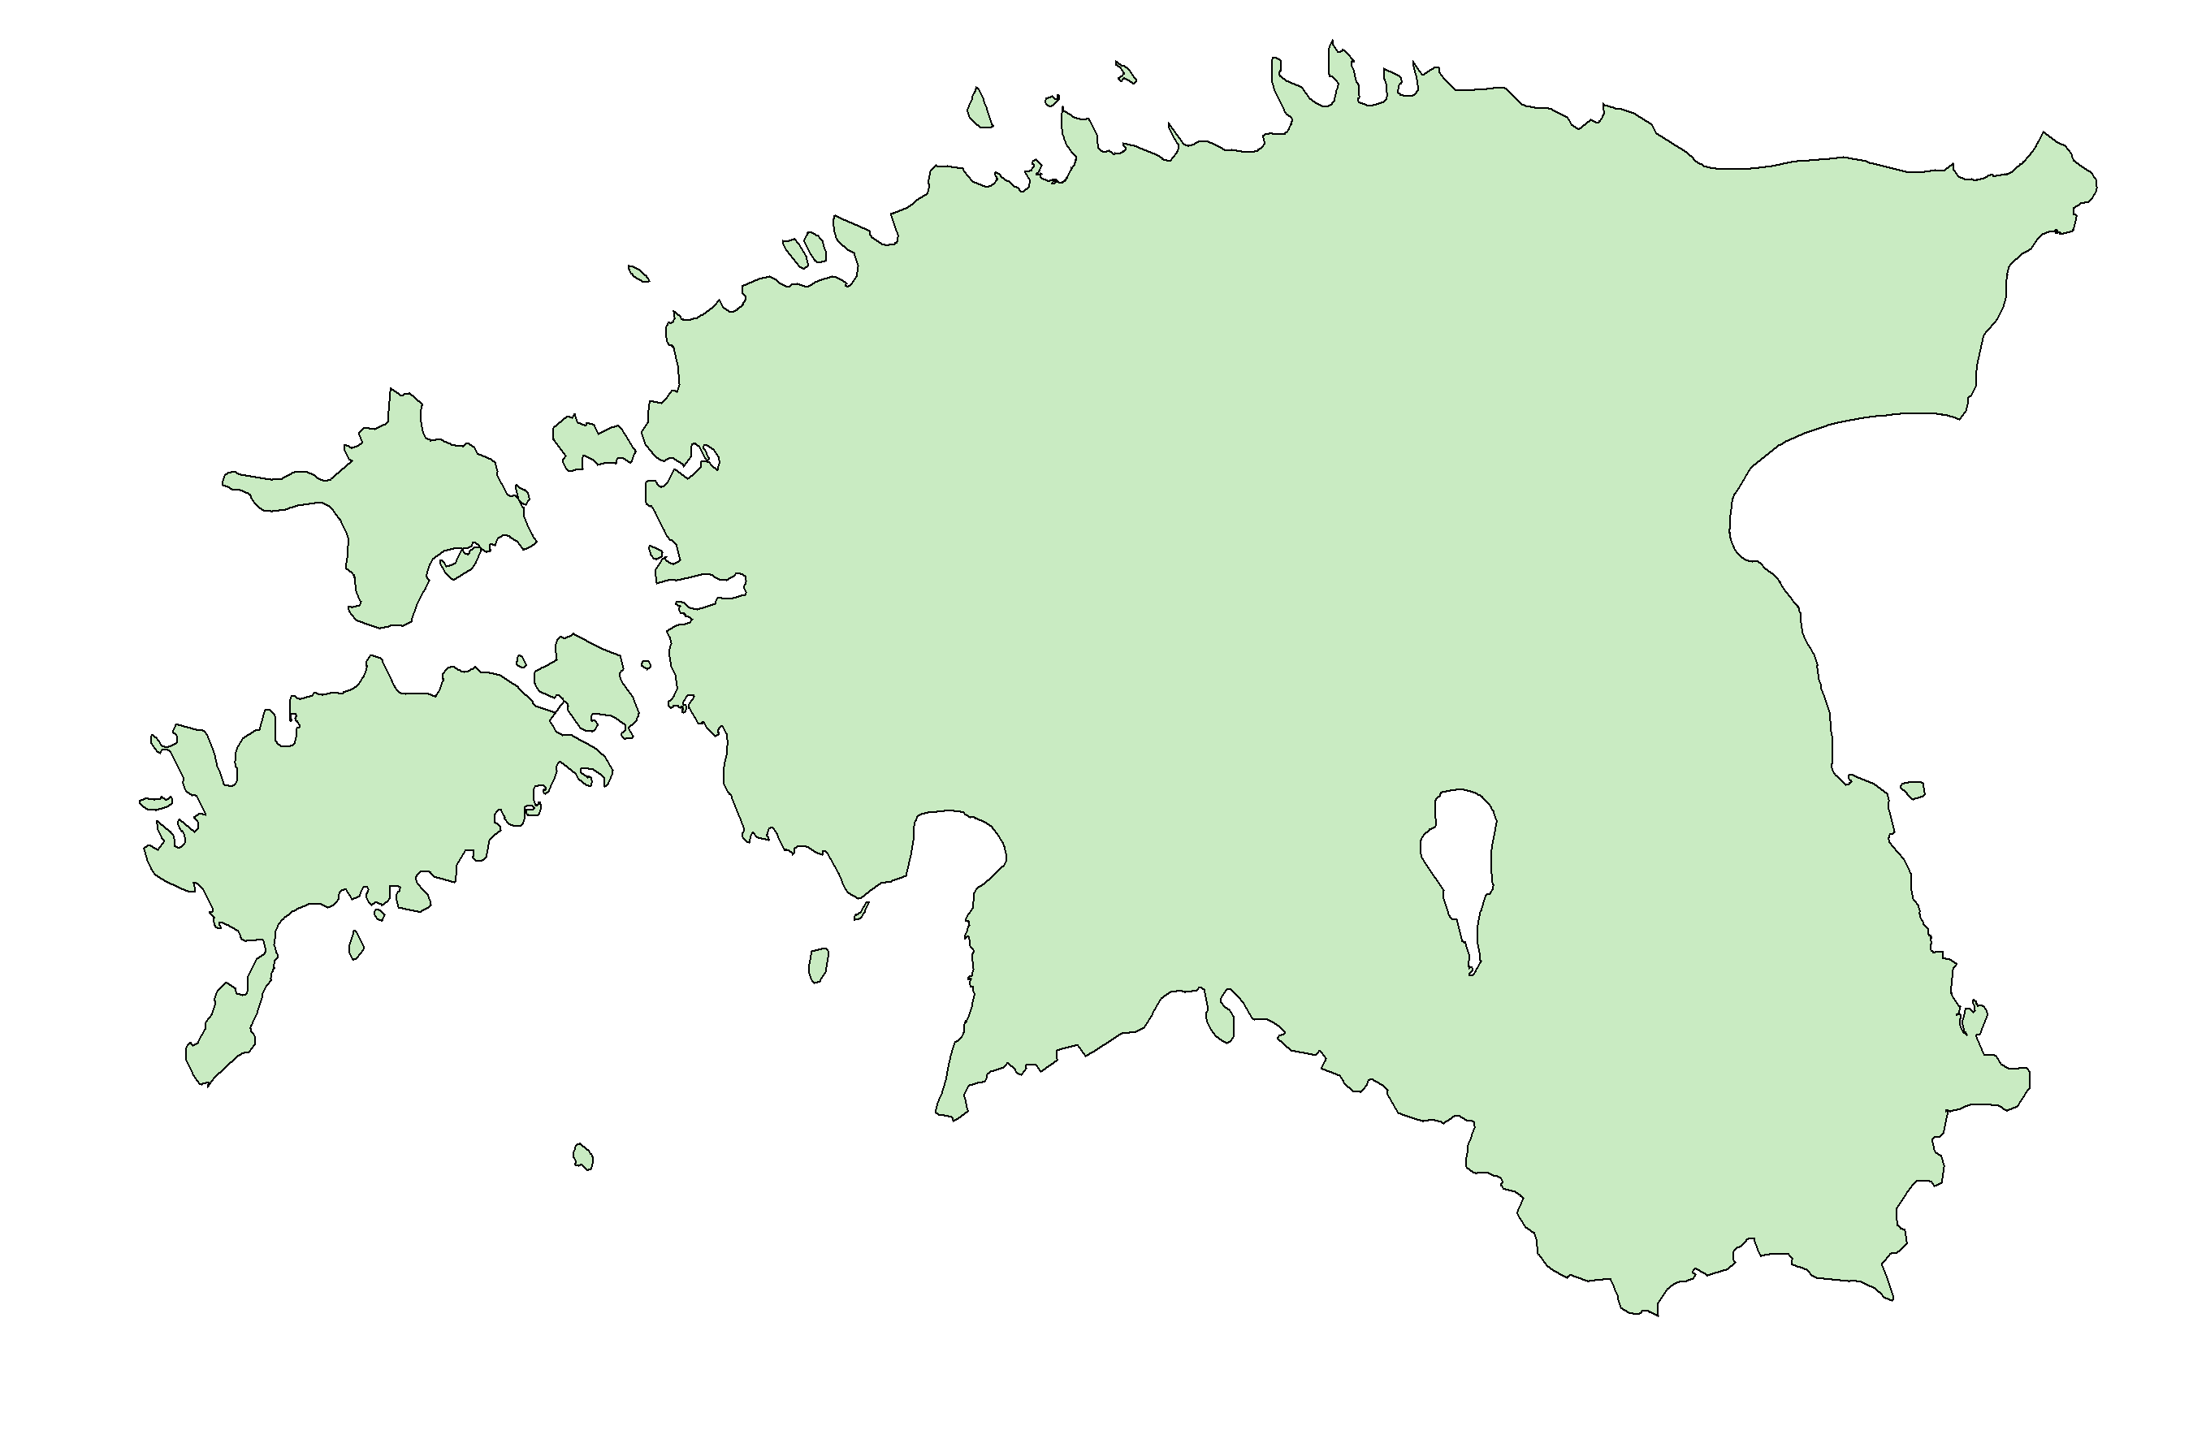
2011 Population and Housing Census in Estonia
From 31 December 2011 to 31 March 2012
Two stages:
E-census from 31 December 2011 to 1 February 2012
Interview census from 20 February to 31 March 2012

Slide 3
Goals of the communications campaign
To introduce the purpose of the census.
To explain the importance of this nationwide survey.
To stress the necessity to submit the correct data.
To introduce the different options for participating in the census and give instructions how to fill in the census form and how to recognise the interviewer.
To guarantee a high participation rate and
encourage people to complete the census form online
in order to achieve a high e-census participation rate.

Slide 4
Main challenges
Complicated census process with different stages of data collection.
Risks related to the endurance of the IT-system.
Long period of data collection.

Slide 5

Census communications campaign
Informational campaign (December 2011)
E-census campaign (January 2012)
Interview census campaign (February/March 2012)
“Everyone counts!”

Slide 6
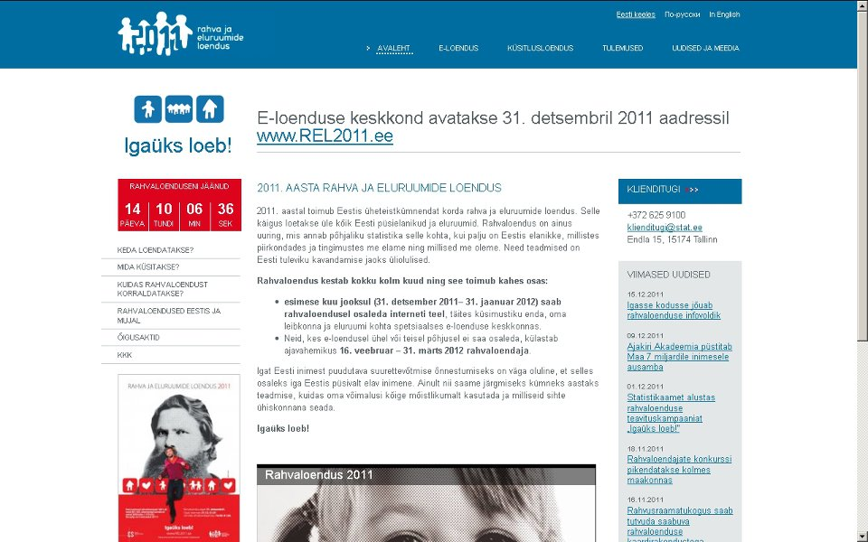
Census website

Slide 7


Informational campaign (I)

Slide 8


Slide 9
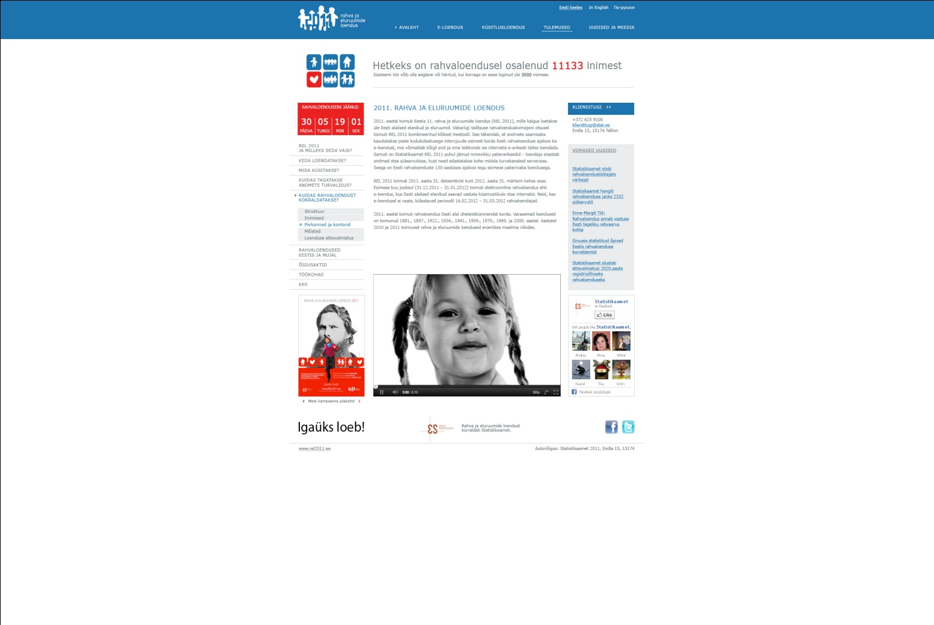
E-census campaign

Slide 10


Interview census campaign

Slide 11
Measuring the effectiveness of communication activities (1)
One goal of the communications campaign was to reach
at least 90% of the population by the beginning of the
census.
What to measure?
people’s awareness of the census
willingness to participate in the e-census
learn about the attitudes towards the census and Statistics Estonia

Slide 12
Measuring the effectiveness of communication activities (2)
How to measure?
Media and social media monitoring
Statistics on website visits
Survey of population’s awareness of the census

Slide 13
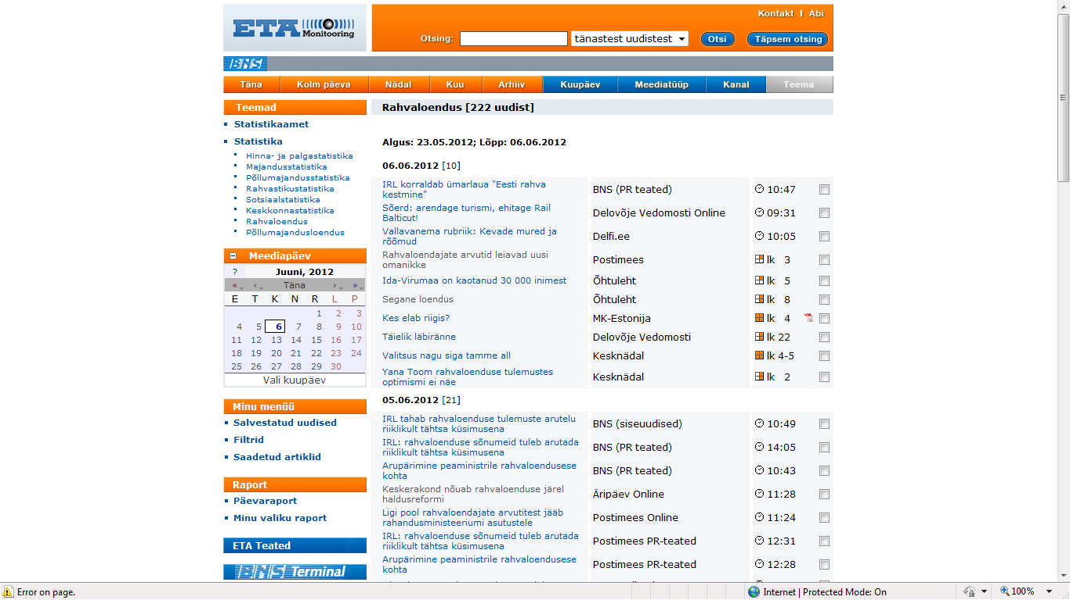
Media monitoring

Slide 14
Number of media mentions

Slide 15
Number of website visits and questionnaires completed during the e-census

Slide 16
Survey of population’s awareness of the census
Conducted monthly from August 2011 to February 2012
Target group: 500 persons aged 15–74
Method: telephone interview
The questionnaire included 12 questions + background information (region, sex, age, educational attainment, income, ethnicity and Internet use)
The questions about the census were prepared by our communication team. The data collection and processing was outsourced to a market research agency.

Slide 17
What was asked in the survey?
Awareness of the census
(when is it conducted, how is it organised, when is the census moment, what are the options for participating in the census, self-estimation of awareness of the census)
Attitudes towards the census and Statistics Estonia
(whether the census is considered necessary, what information is regarded as the most important outcome of the census, whether Statistics Estonia is trusted as the census organiser)
Preferred way to participate in the census
(e-census vs. interviewer’s visit)
Need for information about the census

Slide 18
Main results of the survey

Slide 19
Conclusions
The results of the survey gave valuable information for planning the communication activities.
Based on the results of the survey, some changes were made in the main communication messages.
  It probably helped to avoid serious problems with overload of the census IT-system.
    66% of the population participated in the e-census.

Slide 20
THANK YOU!

